Slide 1
第 21 堂：定題
Lesson 21: Topic Setting
聖公會呂明才中學
S.K.H. Lui Ming Choi Secondary School
創科班 Little Makers Class｜S1 Unit 5：關愛 Project
第 21 堂：定題
Lesson 21: Topic Setting
✎ 4–5 人一組 ‧ 每組共用一部裝置 ‧ 正能量——用創科關愛弱勢社群
Groups of 4-5 · one shared device per group · Positive Energy – Caring for the Underprivileged through Innovation and Technology

Slide 2
物資表 Materials List
定題工作紙（A4） × 每人一張
關愛對象資料卡（A4 彩印，過膠） × 每組一套（4 張）
白板筆／馬克筆 × 每組一套
磁貼／藍丁膠 × 每組數粒

Slide 3
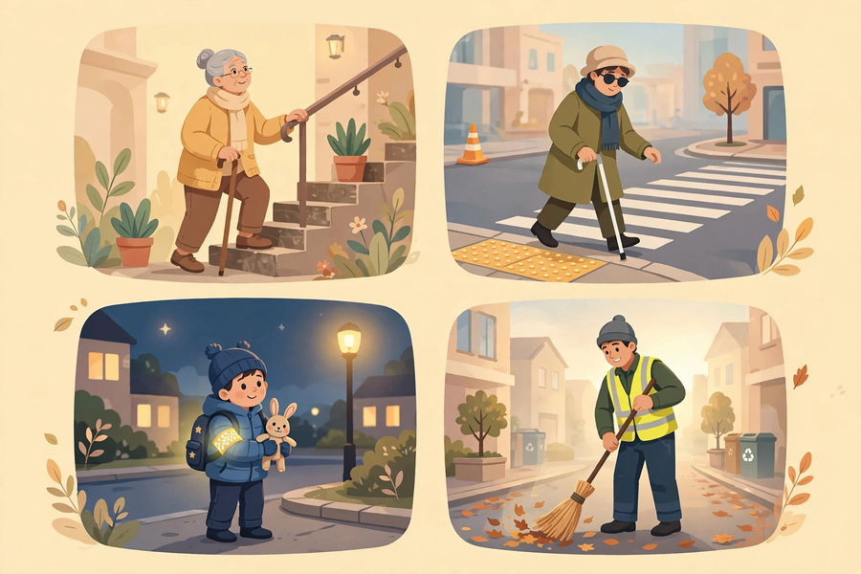

Slide 4
學習目標 Learning Objectives
Lesson 21
• 學生能列出四類關愛對象，並各舉一個其日常面對的困難。
Students can list the four caring target groups and give one daily difficulty faced by each.
• 學生能以「如何能……？」句式，寫出一個具體、可觀察的問題定義。
Students can write a specific, observable problem definition in the form of a ‘How might we…?’ question.
• 學生能向全班解釋選擇該關愛對象的原因（至少一點理由）。
Students can explain to the class why they chose their target group (with at least one reason).

Slide 5
課程內容（1） Lesson Content (1)
Lesson 21
• 【甲、什麼是「關愛創科」】
A. What is ‘caring innovation’?
• 關愛創科，就是運用創意和科技，回應弱勢社群在真實生活中面對的困難，把「關心」變成具體的行動和作品。
Caring innovation means using creativity and technology to respond to real difficulties faced by underprivileged groups — turning ‘care’ into concrete actions and products.
• 本單元是全年主題「正能量——用創科關愛弱勢社群」的高峰。這五堂課，我們會經歷完整的專題過程：定題 → 設計 → 動手做 → 成果展。
This unit is the culmination of our year theme, ‘Positive Energy – Caring for the Underprivileged through Innovation and Technology’. Over these five lessons we will complete a full project cycle: topic setting → design → making → showcase.
• 【乙、四類關愛對象】
B. The four caring target groups
• 長者（elderly people）：體力下降、視力和聽力減弱、行動較慢；有些獨居，提重物和上下樓梯較吃力。
Elderly people: declining strength, weaker eyesight and hearing, slower movement; some live alone and find carrying heavy things or using stairs difficult.
• 視障人士（visually impaired people）：看不見或視力很弱，主要依靠聽覺和觸覺；外出時需要引路或導盲設施協助。
Visually impaired people: blind or with very weak vision; they rely mainly on hearing and touch, and need guidance or tactile facilities when going out.
• 小朋友（young children）：年紀小、力氣小，對危險的警覺性較低，在街上容易被途人或司機忽視。
Young children: small and not strong, less aware of danger, and easily overlooked by passers-by or drivers on the street.
• 清潔工（cleaners）：多在清晨或深夜工作，長時間彎腰和站立；工作時光線不足，容易被途人或車輛忽視，有一定危險。
Cleaners: often work in the early morning or late at night, bending and standing for long hours in dim light; they are easily overlooked by passers-by and vehicles, which can be dangerous.

Slide 6
課程內容（2） Lesson Content (2)
Lesson 21
• 【丙、「需要」不是「想要」】
C. A ‘need’ is not a ‘want’
• 需要（need）：對方真實面對的困難。例如：「清潔工在昏暗的街道上工作，容易發生危險。」
A need is a real difficulty the other person faces, e.g. ‘Cleaners working on dimly lit streets are at risk of danger.’
• 想要（want）：我們自己想做的東西。例如：「我想做一個很酷的機械人。」想要不一定對應對方的真實困難。
A want is something we ourselves would like to make, e.g. ‘I want to build a cool robot.’ A want does not necessarily match the other person’s real difficulty.
• 定題時，先找「需要」，再想「可以做什麼」；不要倒轉。先想做什麼產品，才硬套一個對象，是本課要避免的錯誤。
When setting the topic, find the need first, then think about what to make — not the other way round. Deciding on a product first and forcing it onto a target group is the mistake to avoid in this lesson.
• 【丁、「如何能……？」問題定義】
D. The ‘How might we…?’ problem definition
• 把需要寫成一句問句：「如何能……？」（英文：How might we…?），這就是本組專題的問題定義，也是未來四堂的設計方向。
Write the need as a question: ‘How might we…?’ This becomes your group’s problem definition and the design direction for the next four lessons.
• 好的問題定義有三個特點：對象明確（幫助誰）、情境具體（在什麼情況下）、可觀察（做到了看得見、驗證得到）。
A good problem definition has three features: a clear target (who), a concrete situation (when/where), and observability (success can be seen and tested).
• 不要空泛：「幫助所有長者」太大、太空，什麼都做不了。要聚焦：「如何能幫助膝蓋不好的長者更安全地上下樓梯？」
Avoid vague topics: ‘help all elderly people’ is too big and empty — nothing concrete can be done. Focus instead: ‘How might we help elderly people with weak knees use stairs more safely?’

Slide 7
例子 Examples
Lesson 21
• 例 1：例一（課堂示例）：關愛對象——清潔工；真實需要——清晨在街上工作時光線不足，容易被途人忽視而發生危險；問題定義——「如何能讓清晨工作的清潔工更容易被途人看見？」
Example 1: Example 1 (class example): Target group – cleaners; real need – working on streets in dim light in the early morning, easily overlooked by passers-by and at risk of danger; problem definition – ‘How might we make cleaners working in the early morning more visible to passers-by?’
• 例 2：例二：關愛對象——長者；真實需要——膝蓋退化，上下樓梯時容易失去平衡；問題定義——「如何能幫助膝蓋不好的長者更安全地上下樓梯？」
Example 2: Example 2: Target group – elderly people; real need – degenerating knees, easily losing balance on stairs; problem definition – ‘How might we help elderly people with weak knees use stairs more safely?’
• 例 3：例三（壞例子 → 好例子）：✘ 空泛：「如何能幫助視障人士？」（對象雖明確，但情境不明：幫助什麼？） ✔ 具體：「如何能幫助視障人士在過馬路時更清楚分辨來車的方向？」
Example 3: Example 3 (vague → specific): ✘ Vague: ‘How might we help visually impaired people?’ (the target is clear, but the situation is not: help with what?) ✔ Specific: ‘How might we help visually impaired people tell the direction of oncoming traffic more clearly when crossing the road?’

Slide 8
課堂小練習 Class Practice
Lesson 21
• 以下哪一項是「真實需要」，哪一項是「想要」？(a) 視障人士過馬路時難以判斷來車方向，容易發生危險；(b) 我想做一個會飛的機械人。
Which of the following is a ‘real need’ and which is a ‘want’? (a) Visually impaired people find it hard to judge the direction of oncoming traffic when crossing the road, which is dangerous; (b) I want to build a flying robot.
• 「如何能讓小朋友在晚上更容易被司機看見？」這個問題定義的「對象」是誰？「情境」是什麼？
In the problem definition ‘How might we make young children more visible to drivers at night?’, who is the ‘target’ and what is the ‘situation’?
• 判斷以下問題定義是否夠具體，並說明原因：「如何能幫助清潔工？」
Judge whether the following problem definition is specific enough, and explain why: ‘How might we help cleaners?’
✎ 與鄰座討論後作答，稍後全班核對
Discuss with your neighbour, then check with the class

Slide 9
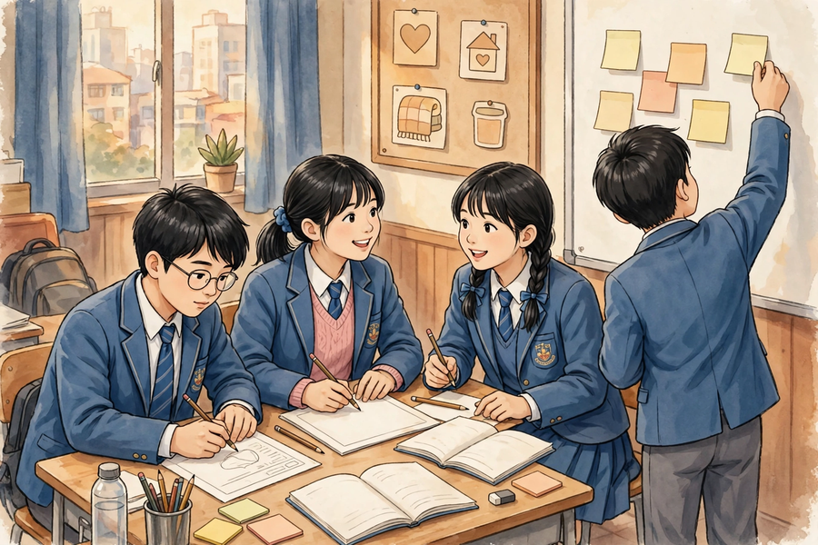
思考題 Thinking Questions
Lesson 21
• 如果全班每一組都選同一類關愛對象，可能會出現什麼問題？你會怎樣說服組員考慮其他對象？
If every group in the class chose the same caring target group, what problems might arise? How would you persuade your groupmates to consider other groups?
• 我們怎樣才能肯定一個「需要」是真實的，而不是我們想像出來的？
How can we be sure that a ‘need’ is real, rather than something we imagined?
✎ 先獨立思考，再與小組分享
Think alone first, then share with your group

Slide 10
分組活動 Group Activity
Lesson 21
• 步驟 1：小組討論，從四類關愛對象中選定一類，並參閱資料卡，找出該對象的一個真實需要。
Step 1: Discuss in your group, choose one of the four caring target groups, and use the information cards to identify one real need of that group.
• 步驟 2：在定題工作紙上寫下：(1) 我們的關愛對象；(2) 一個真實需要；(3) 「如何能……？」問題定義；(4) 選擇原因。
Step 2: On the topic-setting worksheet, write down: (1) our caring target; (2) one real need; (3) the ‘How might we…?’ problem definition; (4) the reason for your choice.
• 步驟 3：每位組員都要發言；推選一位代表，準備用一分鐘向全班分享本組的定題。
Step 3: Every member must speak during the discussion; choose one representative to share your group’s topic with the class in one minute.
• 步驟 4：完成後，與相鄰組別交換工作紙，互相檢查對方的問題定義是否夠具體（對象明確、情境具體、可觀察）。
Step 4: When finished, exchange worksheets with a neighbouring group and check whether each other’s problem definition is specific enough (clear target, concrete situation, observable).

Slide 11
總結 Summary
Lesson 21
• 關愛創科：用創意和科技，回應弱勢社群的真實需要，把關心變成行動。
Caring innovation: use creativity and technology to respond to the real needs of underprivileged groups — turning care into action.
• 四類關愛對象：長者、視障人士、小朋友、清潔工；每類都有其日常面對的困難。
The four caring target groups: elderly people, visually impaired people, young children, and cleaners — each faces daily difficulties.
• 先找「需要」（對方的真實困難），不要先想「想要」（自己想做的東西）。
Find the ‘need’ (the other person’s real difficulty) first; do not start from a ‘want’ (something you feel like making).
• 用「如何能……？」寫出對象明確、情境具體、可觀察的問題定義，並能說出選擇原因。
Write a problem definition as ‘How might we…?’ with a clear target, a concrete situation and observability — and be able to explain your reason for choosing it.

Slide 12
小測驗 Mini Quiz
Lesson 21
• 1. 「如何能……？」這個句式的主要作用是什麼？
What is the main purpose of the ‘How might we…?’ question form?
• A. 讚美關愛對象 B. 把真實需要寫成具體、可觀察的問題 C. 列出製作所需的材料 D. 計算專題的總成本
• 2. 以下哪一項是「需要」，而不是「想要」？
Which of the following is a ‘need’ rather than a ‘want’?
• A. 我想做一個很酷的機械臂 B. 長者提重物上樓梯時手腕疼痛 C. 我想用很多顏色的卡紙 D. 我想贏得最佳創意獎
• 3. 一個好的問題定義不應該是怎樣的？
Which of the following should a good problem definition NOT be?
• A. 對象明確 B. 情境具體 C. 愈空泛愈好，方便自由發揮 D. 可以觀察是否做到
• 4. 請寫出本單元四類關愛對象的名稱。
Write down the names of the four caring target groups in this unit.
• 5. 請為「視障人士」寫一個「如何能……？」的問題定義。（須對象明確、情境具體）
Write a ‘How might we…?’ problem definition for ‘visually impaired people’. (The target must be clear and the situation concrete.)
✎ 獨立完成，檢視本課學習成果
Complete independently

Slide 13
家課 Homework
Lesson 21
• 選擇題＋問答題（見家課工作紙）
MC + short questions (see homework sheet)
• 延伸任務：訪問一位家人、鄰居或親友，了解他／她在日常生活中遇到的一個不便或困難，用三至五句記錄下來，下一堂帶回課室分享。訪問時要有禮貌，並先徵得對方同意。
Extension task: Interview a family member, neighbour or relative about one inconvenience or difficulty in their daily life. Record it in three to five sentences and bring it to the next lesson for sharing. Be polite and ask for permission first.

