Slide 1
第 22 堂：設計
Lesson 22: Design and Planning
聖公會呂明才中學
S.K.H. Lui Ming Choi Secondary School
創科班 Little Makers Class｜S1 Unit 5：關愛 Project
第 22 堂：設計
Lesson 22: Design and Planning
✎ 4–5 人一組 ‧ 每組共用一部裝置 ‧ 正能量——用創科關愛弱勢社群
Groups of 4-5 · one shared device per group · Positive Energy – Caring for the Underprivileged through Innovation and Technology

Slide 2
物資表 Materials List
方格紙（A3） × 每組兩張
鉛筆、擦膠、間尺 × 每組一套
顏色筆／馬克筆 × 每組一套
製作計劃表＋分工表（A4） × 每組各一張

Slide 3
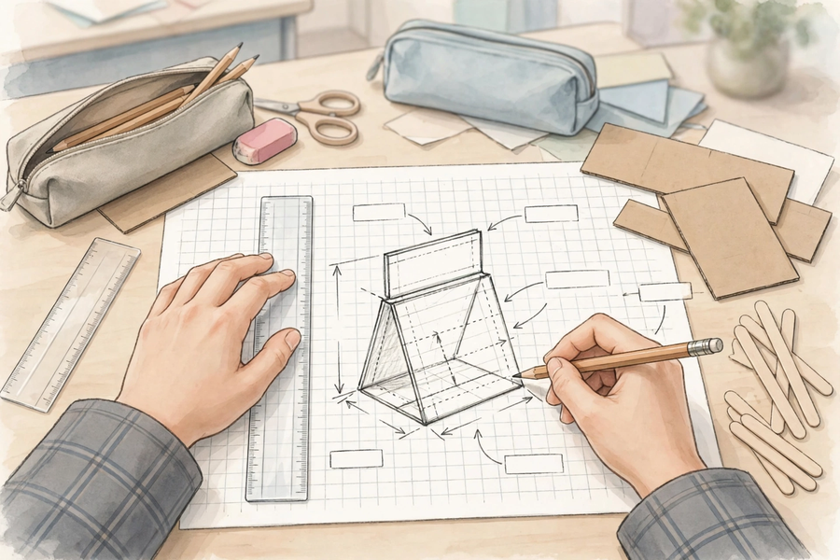

Slide 4
學習目標 Learning Objectives
Lesson 22
• 學生能繪製一份設計圖，並標註主要尺寸與使用材料。
Students can draw a design sketch with main dimensions and materials labelled.
• 學生能寫出按先後次序排列的製作步驟（至少五步）。
Students can write production steps in sequential order (at least five steps).
• 學生能完成分工表，清楚列明每位組員負責實物部分或 AI 生成部分的具體工作。
Students can complete a task-allocation table clearly stating each member’s responsibility in the physical part or the AI-generated part.

Slide 5
課程內容（1） Lesson Content (1)
Lesson 22
• 【甲、設計圖三要素】
A. The three elements of a design sketch
• 一份合格的設計圖必須具備三要素：(1) 外形——作品大概長什麼樣子（正面圖／側面圖）；(2) 尺寸標註——主要部分的長、闊、高，用數字寫清楚；(3) 材料標註——每個部分用什麼材料做。
A satisfactory design sketch must have three elements: (1) shape – what the work roughly looks like (front/side view); (2) dimension labels – the length, width and height of the main parts, written as numbers; (3) material labels – what material each part is made of.
• 設計圖不必美觀，但必須清晰易懂、切實可行。別人看著你的圖，要知道「做什麼、做多大、用什麼做」。
A sketch need not be beautiful, but must be readable and buildable. Anyone reading it should know ‘what to make, how big, and with what’.
• 常見錯誤：把設計圖畫成藝術畫，忽略尺寸；或所選材料根本買不到、做不到（例如要求金屬焊接）。
Common mistakes: drawing an artistic picture without dimensions, or choosing materials that are unavailable or unworkable (e.g. requiring metal welding).
• 【乙、方格紙與尺寸】
B. Grid paper and dimensions
• 在方格紙上繪圖時，先定好比例，例如一格代表 5 cm；先數格數，再換算成實際尺寸，才標在圖上。
When drawing on grid paper, fix a scale first, e.g. one square = 5 cm; count the squares, convert to real dimensions, then label them on the sketch.
• 標尺寸時要寫單位（cm），並標在對應的邊旁邊，不要只寫在角落。
Write the unit (cm) with each dimension, and place the label next to the corresponding edge – not just in a corner.
• 課堂上教師會用軟尺示範量度；小組在繪圖前，先用間尺量一量手邊的材料，心中有數才下筆。
The teacher will demonstrate measuring with a tape measure; before drawing, measure the materials at hand with a ruler so the dimensions are realistic.
• 【丙、製作計劃】
C. The production plan
• 製作計劃表有四欄：步驟（按先後次序）、負責人、所需材料、預計完成日期。
The production plan has four columns: step (in sequential order), person in charge, materials needed, and target completion date.
• 步驟至少五步，而且次序要合理：一般是「準備材料 → 製作部件 → 組合 → 測試 → 改良」。
There should be at least five steps in a sensible order, usually: ‘prepare materials → make components → assemble → test → improve’.
• 寫步驟時用動詞開頭，例如「裁剪卡紙」「黏合支架」「測試穩固度」，讓人一看就知道要做什麼。
Start each step with a verb, e.g. ‘cut the cardboard’, ‘glue the stand’, ‘test stability’, so anyone can see what to do.

Slide 6
課程內容（2） Lesson Content (2)
Lesson 22
• 【丁、分工：實物部分與 AI 生成部分】
D. Task allocation: physical part vs AI-generated part
• 本專題分兩類工作：(1) 實物部分——動手製作的原型（卡紙、雪條棍等）；(2) AI 生成部分——用 AI 工具生成的海報、故事、音樂或介紹。
This project has two kinds of work: (1) the physical part – the hands-on prototype (cardboard, ice-cream sticks, etc.); (2) the AI-generated part – a poster, story, music piece or introduction made with AI tools.
• 分工表須具體到人、到任務：寫出每位組員的姓名、負責部分（實物／AI 生成）、具體任務。兩部分都要有人負責，不能遺漏。
The task-allocation table must name each member, their part (physical / AI-generated) and their specific task. Both parts must be covered – neither may be left out.
• 分工宜按組員長處：手巧的同學多做實物，文書能力強的可負責 AI 生成的文字內容；但每個人都要參與，不能「事不關己」。
Allocate by strengths: handy members do more of the physical making, strong writers handle the AI-generated text – but everyone must take part; no one is a bystander.
• 【戊、成本估算與可行性檢查】
E. Cost estimation and feasibility check
• 材料清單列出品名和數量，再估算總成本；盡量選用易得、便宜、安全的材料（卡紙、雪條棍、膠紙）。
List each material with its quantity, then estimate the total cost; prefer materials that are easy to get, cheap and safe (cardboard, ice-cream sticks, tape).
• 動手前用三條問題檢查可行性：材料買得到嗎？我們做得到嗎？時間夠嗎？有一題答「不」，就要改設計。
Before making, run the three-question feasibility check: Can we get the materials? Can we actually build it? Is there enough time? If any answer is ‘no’, revise the design.
• 記住：簡單而做得到的設計，勝過複雜而做不出的設計。
Remember: a simple design that can actually be built beats a complicated one that cannot.

Slide 7
例子 Examples
Lesson 22
• 例 1：例一（課堂示例：為清潔工設計的反光提示牌）：設計圖標註——牌身 20 cm × 15 cm（卡紙＋反光貼紙）、支架 30 cm（雪條棍）；製作步驟——1. 裁剪卡紙 2. 貼上反光貼紙 3. 裝嵌支架 4. 測試能否穩固豎立 5. 改良；分工——兩人負責實物、兩人負責 AI 生成介紹海報。
Example 1: Example 1 (class example: a reflective warning sign for cleaners): sketch labels – 20 cm × 15 cm board (cardboard + reflective stickers), 30 cm stand (ice-cream sticks); steps – 1. cut the cardboard 2. stick on reflective stickers 3. assemble the stand 4. test whether it stands steadily 5. improve; allocation – two members on the physical part, two on the AI-generated introduction poster.
• 例 2：例二（成本估算）：卡紙 HK$1.5 × 2 張＝HK$3；反光貼紙 HK$6 × 1 張＝HK$6；雪條棍約 HK$2；膠紙共用約 HK$2；總成本約 HK$13。
Example 2: Example 2 (cost estimation): cardboard HK$1.5 × 2 = HK$3; reflective stickers HK$6 × 1 = HK$6; ice-cream sticks about HK$2; shared tape about HK$2; total about HK$13.
• 例 3：例三（壞例子 → 好例子）：✘ 只有漂亮圖畫，沒有尺寸和材料標註——別人無法按圖製作。✘ 設計要求「金屬焊接」——中一生做不到、學校也沒有設備。✔ 改用卡紙＋雪條棍＋低溫膠槍，全部做得到。
Example 3: Example 3 (bad → good): ✘ A pretty picture with no dimensions or material labels – nobody can build from it. ✘ A design requiring ‘metal welding’ – impossible for S1 students and unavailable at school. ✔ Use cardboard + ice-cream sticks + a low-temperature glue gun instead – all achievable.

Slide 8
課堂小練習 Class Practice
Lesson 22
• 一份合格的設計圖必須具備哪三要素？
What are the three required elements of a satisfactory design sketch?
• 以下哪個製作步驟次序正確？(a) 測試 → 裁紙 → 貼上；(b) 裁紙 → 組合 → 測試 → 改良。
Which production sequence is correct? (a) test → cut paper → stick on; (b) cut paper → assemble → test → improve.
• 小明負責「實物部分」，小美負責「AI 生成部分」。請各舉一個他們具體可以做的工作。
Ming is in charge of the ‘physical part’ and Mei of the ‘AI-generated part’. Give one specific task each of them could do.
✎ 與鄰座討論後作答，稍後全班核對
Discuss with your neighbour, then check with the class

Slide 9
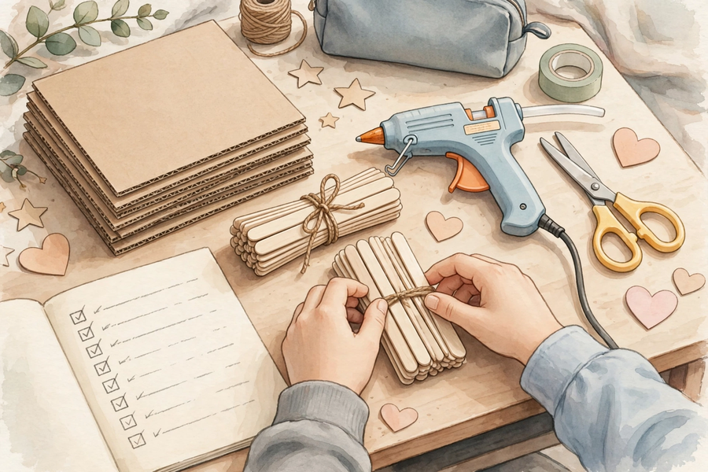
思考題 Thinking Questions
Lesson 22
• 為什麼設計圖「清晰、可行」比「美觀」更重要？
Why is it more important for a design sketch to be ‘clear and buildable’ than ‘beautiful’?
• 如果設計圖需要的材料買不到或太貴，小組可以怎樣應變？
If a material in the design sketch is unavailable or too expensive, how can the group adapt?
✎ 先獨立思考，再與小組分享
Think alone first, then share with your group

Slide 10
分組活動 Group Activity
Lesson 22
• 步驟 1：按分工在方格紙上繪製設計圖，必須包含三要素：外形、尺寸標註（寫上單位 cm）、材料標註。
Step 1: Draw the design sketch on grid paper as allocated; it must include all three elements: shape, dimension labels (with the unit cm), and material labels.
• 步驟 2：填寫「製作計劃表」：至少五個步驟，按先後次序排列，寫明負責人、所需材料、預計完成日期。
Step 2: Complete the ‘production plan’: at least five steps in sequential order, with the person in charge, materials needed, and target completion date.
• 步驟 3：填寫「分工表」：每位組員的姓名、負責部分（實物／AI 生成）、具體任務；兩部分都要有人負責。
Step 3: Complete the ‘task-allocation table’: each member’s name, part (physical / AI-generated) and specific task; both parts must be covered.
• 步驟 4：與相鄰組別交換設計圖，用兩句話寫下一個優點和一個建議；然後取回設計圖，教師會收回作下一堂製作之用。
Step 4: Exchange sketches with a neighbouring group; write one strength and one suggestion in two sentences. The teacher will collect the sketches for the next lesson’s making session.

Slide 11
總結 Summary
Lesson 22
• 設計圖三要素：外形、尺寸標註、材料標註；清晰可行比美觀重要。
The three elements of a design sketch: shape, dimension labels, material labels – clear and buildable matters more than beautiful.
• 製作計劃：步驟按先後次序（至少五步），寫明負責人、材料、完成日期。
Production plan: steps in sequential order (at least five), with person in charge, materials and target dates.
• 分工具體到人、到任務；實物部分與 AI 生成部分（海報／故事／音樂／介紹）都要有人負責。
Allocate tasks to named people with specific jobs; both the physical part and the AI-generated part (poster / story / music / introduction) must be covered.
• 估算成本，選用易得、便宜、安全的材料；用三條問題檢查可行性。
Estimate the cost, choose materials that are easy to get, cheap and safe, and run the three-question feasibility check.

Slide 12
小測驗 Mini Quiz
Lesson 22
• 1. 設計圖三要素不包括以下哪一項？
Which of the following is NOT one of the three elements of a design sketch?
• A. 外形 B. 尺寸標註 C. 材料標註 D. 上色是否美觀
• 2. 製作步驟應該怎樣排列？
How should production steps be arranged?
• A. 按先後次序排列 B. 隨意排列 C. 先做最難的 D. 愈少步驟愈好
• 3. 估算成本時，需要列出什麼？
When estimating costs, what must be listed?
• A. 每種材料的品名和數量 B. 只寫一個總數 C. 不用理會，隨便寫 D. 只寫最貴的一項
• 4. 請寫出「AI 生成部分」可以做的四種作品。
Write down the four kinds of work the ‘AI-generated part’ can be.
• 5. 你的小組想做一個 30 cm 高的支架，方格紙每格代表 5 cm，應該畫多少格高？
Your group wants a 30 cm tall stand. If each grid square represents 5 cm, how many squares tall should you draw it?
✎ 獨立完成，檢視本課學習成果
Complete independently

Slide 13
家課 Homework
Lesson 22
• 選擇題＋問答題（見家課工作紙）
MC + short questions (see homework sheet)
• 延伸任務：按分工表完成設計圖的修訂，並列出實物部分所需的材料清單（品名、數量），估算總成本，下一堂帶回課室作製作參考。
Extension task: Revise the design sketch according to the task allocation; list the materials needed for the physical part (item name, quantity) and estimate the total cost. Bring it to the next lesson as a reference for making.

