Slide 1
第 23 堂：動手做（一）：實物原型
Lesson 23: Making the Physical Prototype I
聖公會呂明才中學
S.K.H. Lui Ming Choi Secondary School
創科班 Little Makers Class｜S1 Unit 5：關愛 Project
第 23 堂：動手做（一）：實物原型
Lesson 23: Making the Physical Prototype I
✎ 4–5 人一組 ‧ 每組共用一部裝置 ‧ 正能量——用創科關愛弱勢社群
Groups of 4-5 · one shared device per group · Positive Energy – Caring for the Underprivileged through Innovation and Technology

Slide 2
物資表 Materials List
卡紙（A3，多色） × 每組 4–5 張
雪條棍 × 每組約 30 枝
低溫膠槍＋膠條 × 每組一部（共用）
剪刀 × 每組兩把
美工刀＋切割墊 × 每組一套（教師監管下使用）
膠紙、雙面膠紙 × 每組各一卷
反光貼紙 × 每組一張（A4）
製作日誌（A4） × 每人一張

Slide 3
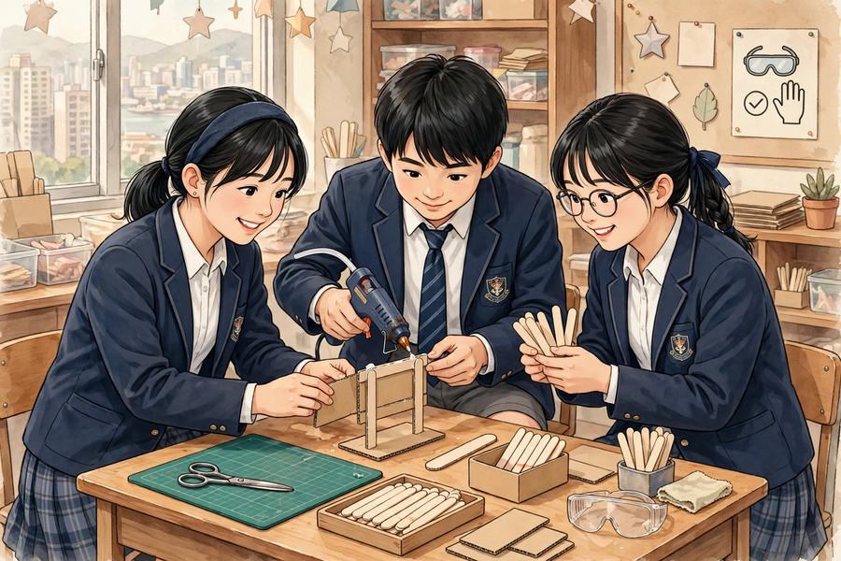

Slide 4
學習目標 Learning Objectives
Lesson 23
• 學生能按設計圖完成實物原型的至少一半製作進度。
Students can complete at least half of the physical prototype according to the design sketch.
• 學生能在製作日誌中記錄至少一個製作問題及所採用的解決方法。
Students can record at least one making problem and the solution adopted in the making log.
• 學生能正確示範安全使用剪刀、美工刀（或申請教師協助）及低溫膠槍的基本守則。
Students can demonstrate the basic safety rules for scissors, craft knives (or seeking teacher assistance), and low-temperature glue guns.

Slide 5
課程內容（1） Lesson Content (1)
Lesson 23
• 【甲、什麼是「原型」】
A. What is a ‘prototype’?
• 原型（prototype）是產品的初步模型，用來試驗意念是否可行。它不必一次成功——原型就是用來試錯的。
A prototype is a preliminary model of a product, used to test whether the idea works. It need not succeed on the first attempt – prototypes are for trial and error.
• 記錄下「哪裡失敗、怎樣改良」，和成功本身同樣有價值；製作日誌的分數正正來自這些記錄。
Recording ‘what failed and how it was improved’ is as valuable as success itself; the making-log marks come precisely from these records.
• 【乙、安全守則】
B. Safety rules
• 剪刀：傳遞時握住尖端、把手向外遞給同學；用後放回原處，不可拋擲或嬉戲。
Scissors: when passing them, hold the pointed end and offer the handles outward; put them back afterwards; never throw or play with them.
• 美工刀：只准在切割墊上、刀片向外裁切；用後即收回刀片；如不確定，申請教師協助，不要勉強。
Craft knives: use only on a cutting mat with the blade facing outward; retract the blade immediately after use; if unsure, ask the teacher for help instead of forcing it.
• 低溫膠槍：只准使用低溫型；切勿觸碰出膠口；用後即關電源；如被燙到，立即舉手通知教師，用清水沖洗。
Low-temperature glue guns: use the low-temperature type only; never touch the nozzle; switch off immediately after use; if burnt, raise your hand at once, inform the teacher and rinse with clean water.
• 受傷即時處理三步：舉手通知教師 → 用清水沖洗 → 由教師決定是否需要進一步處理。
Three steps for injuries: raise your hand and inform the teacher → rinse with clean water → let the teacher decide whether further treatment is needed.
• 【丙、製作技巧】
C. Making techniques
• 結構穩固：直立的部件容易搖晃，可改用三角形支架結構，或在底部加闊卡紙座增加穩定。
Stable structures: upright parts wobble easily – switch to a triangular stand structure or widen the cardboard base for stability.
• 量度準確：下刀／下膠前先用間尺量度並做記號；尺寸出錯多數是「目測」造成的。
Measure accurately: measure and mark with a ruler before cutting or gluing; most dimension errors come from ‘eyeballing’.
• 先做核心部件：如果時間緊迫，先完成能展示主要功能的核心部分，裝飾細節留待最後。
Core components first: when time is tight, finish the core parts that show the main function first; leave decorative details for last.

Slide 6
課程內容（2） Lesson Content (2)
Lesson 23
• 【丁、製作日誌】
D. The making log
• 製作日誌有五欄：(1) 今日完成的製作部分；(2) 遇到的問題；(3) 嘗試過的解決方法；(4) 測試結果；(5) 下次要改良的地方。
The making log has five columns: (1) part completed today; (2) problem encountered; (3) solutions tried; (4) test result; (5) what to improve next time.
• 寫日誌要具體：寫「支架黏合後搖晃」，不要只寫「失敗了」；寫「改為三角形支架後不再搖晃」，不要只寫「改好了」。
Be specific in the log: write ‘the stand wobbled after gluing’, not just ‘failed’; write ‘it stopped wobbling after switching to a triangular stand’, not just ‘fixed’.
• 【戊、解難策略】
E. Problem-solving strategies
• 卡住了，可以試：改用另一種材料、簡化結構、向同伴求助、請教師指導。不要呆等，也不要代做別人的部分。
When stuck, try: switching to another material, simplifying the structure, asking a classmate, or asking the teacher. Do not wait idly, and do not do someone else’s part for them.
• 進度落後時，縮小範圍（先完成核心部件），不要追趕全部細節；半完成的核心部件，勝過什麼都差一點的半成品。
When behind schedule, narrow the scope (finish the core components first) instead of chasing every detail; a half-finished core beats an almost-finished nothing.
• 教師巡視時會問：「這裡卡住了，可以怎樣改設計就做得到？」——引導改良，而不是代做。
When circulating, the teacher will ask: ‘It’s stuck here – how could the design be changed to make it work?’ – guiding improvement, not doing it for you.

Slide 7
例子 Examples
Lesson 23
• 例 1：例一（製作日誌示例）：今日完成的製作部分——反光提示牌的牌身與支架黏合；遇到的問題——支架用雪條棍黏合後容易搖晃；嘗試過的解決方法——改為三角形支架結構，並在底部加闊卡紙座；測試結果——輕推後不再搖晃，能穩固豎立；下次要改良的地方——支架與牌身的接合位再加固。
Example 1: Example 1 (sample making-log entry): Part completed today – glued the sign board to the stand of the reflective warning sign; problem – the ice-cream-stick stand wobbled after gluing; solutions tried – changed to a triangular stand structure with a widened cardboard base; test result – no more wobbling when pushed gently, stands steadily; to improve next time – reinforce the joint between the stand and the board.
• 例 2：例二（測試示例）：把反光牌放在枱上，輕推一下，看它會不會倒下；把牌身拿到較暗的角落，看反光貼紙是否仍然顯眼。測試要針對「問題定義」——我們的問題是「讓清潔工更容易被看見」，所以「顯眼」就是測試重點。
Example 2: Example 2 (sample test): place the sign on the desk and push it gently to see if it topples; take the board to a dim corner to check the reflective stickers still stand out. Tests must target the problem definition – ours is ‘making cleaners more visible’, so ‘visibility’ is the test focus.

Slide 8
課堂小練習 Class Practice
Lesson 23
• 以下哪種做法違反安全守則？
Which of the following breaks the safety rules?
• 製作日誌有哪五欄？
What are the five columns of the making log?
• 原型第一次測試失敗了，小組應該怎樣做？
The prototype failed its first test. What should the group do?
✎ 與鄰座討論後作答，稍後全班核對
Discuss with your neighbour, then check with the class

Slide 9
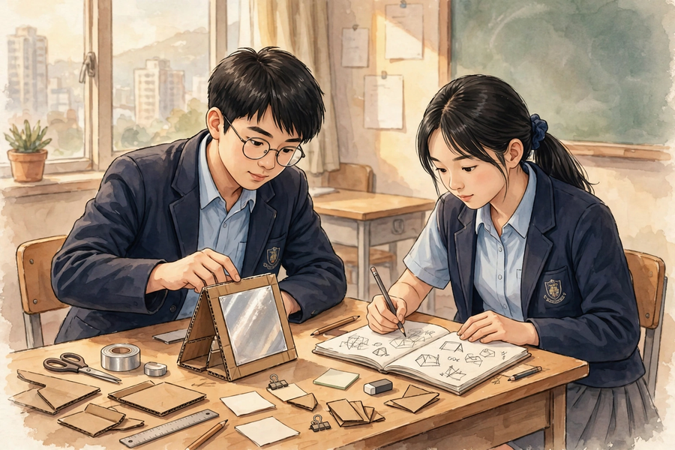
思考題 Thinking Questions
Lesson 23
• 為什麼說「原型就是用來試錯的」？記錄失敗和改良為什麼同樣有分？
Why do we say ‘prototypes are for trial and error’? Why do recorded failures and improvements earn marks too?
• 製作時間只剩 15 分鐘，但原型只完成一半，小組應該怎樣取捨？
Only 15 minutes of making time remain, but the prototype is only half done. How should the group prioritise?
✎ 先獨立思考，再與小組分享
Think alone first, then share with your group

Slide 10
分組活動 Group Activity
Lesson 23
• 步驟 1：聆聽安全講解，並能覆述三項安全守則（剪刀、美工刀、低溫膠槍）；領取本組材料。
Step 1: Listen to the safety briefing and repeat the three safety rules (scissors, craft knives, low-temperature glue guns); collect your group’s materials.
• 步驟 2：按設計圖與分工製作實物原型（約 35 分鐘）；遇到困難先試解難策略，再請教師指導。
Step 2: Build the physical prototype from the design sketch and task allocation (about 35 minutes); try the problem-solving strategies first when stuck, then ask the teacher.
• 步驟 3：初步測試原型（例如反光牌能否穩固豎立、尺寸是否合用），在製作日誌寫下五欄內容。
Step 3: Carry out a preliminary test of the prototype (e.g. whether the sign stands steadily, whether dimensions are suitable) and complete the five columns of the making log.
• 步驟 4：收拾工具、清理枱面，把半成品妥善存放；聆聽教師總結常見製作問題。
Step 4: Tidy the tools, clean the table and store the work-in-progress safely; listen to the teacher’s summary of common making problems.

Slide 11
總結 Summary
Lesson 23
• 原型是用來試錯的初步模型；記錄問題與改良，和成功同樣有價值。
A prototype is a preliminary model for trial and error; recording problems and improvements is as valuable as success.
• 安全第一：剪刀、美工刀、低溫膠槍各有守則；受傷即舉手通知教師、清水沖洗。
Safety first: scissors, craft knives and glue guns each have their rules; if injured, raise your hand, inform the teacher and rinse with clean water.
• 製作日誌五欄：完成部分、遇到的問題、解決方法、測試結果、下次改良；要寫得具體。
The making log’s five columns – part completed, problem, solution, test result, next improvement – must be written specifically.
• 卡住時：改用材料、簡化結構、向同伴或教師求助；進度落後時縮小範圍，先完成核心部件。
When stuck: change materials, simplify the structure, or ask classmates/the teacher; when behind, narrow the scope and finish the core first.

Slide 12
小測驗 Mini Quiz
Lesson 23
• 1. 使用美工刀時，正確的做法是？
What is the correct way to use a craft knife?
• A. 在手上直接裁切 B. 只在切割墊上、刀片向外裁切，用後即收回刀片 C. 刀片向內，方便施力 D. 用完放在枱邊，下次方便拿
• 2. 被低溫膠槍燙到，第一時間應該怎樣做？
If burnt by a low-temperature glue gun, what should you do first?
• A. 舉手通知教師，用清水沖洗 B. 用口吹一吹繼續做 C. 自己塗藥膏 D. 忍著不說
• 3. 以下哪一項不是製作日誌的欄目？
Which of the following is NOT a column of the making log?
• A. 今日完成的製作部分 B. 遇到的問題 C. 嘗試過的解決方法 D. 組員的午餐吃了什麼
• 4. 原型測試失敗後，小組在日誌寫下「失敗了」三個字。這樣寫有什麼不足？應怎樣寫？
After a failed test, a group wrote only ‘failed’ in the log. What is lacking, and how should it be written?
• 5. 小組進度落後，只剩很少時間。請寫出一個合理的取捨決定，並說明原因。
A group is behind schedule with little time left. Write down one sensible prioritising decision and explain why.
✎ 獨立完成，檢視本課學習成果
Complete independently

Slide 13
家課 Homework
Lesson 23
• 選擇題＋問答題（見家課工作紙）
MC + short questions (see homework sheet)
• 延伸任務：完成實物原型尚未完成的部分（在家只做安全的手工部分，如剪貼、繪畫；不可使用美工刀與膠槍），並在製作日誌補寫「下次要改良的地方」，下一堂帶回課室。
Extension task: finish any incomplete parts of the physical prototype at home (only safe handwork such as cutting-and-sticking with scissors and drawing – do not use craft knives or glue guns), and complete the ‘what to improve next time’ column of the making log. Bring it to the next lesson.

