Slide 1
第 24 堂：動手做（二）：AI 生成與整合
Lesson 24: AI Generation and Integration
聖公會呂明才中學
S.K.H. Lui Ming Choi Secondary School
創科班 Little Makers Class｜S1 Unit 5：關愛 Project
第 24 堂：動手做（二）：AI 生成與整合
Lesson 24: AI Generation and Integration
✎ 4–5 人一組 ‧ 每組共用一部裝置 ‧ 正能量——用創科關愛弱勢社群
Groups of 4-5 · one shared device per group · Positive Energy – Caring for the Underprivileged through Innovation and Technology

Slide 2
物資表 Materials List
共用裝置（平板電腦或手提電腦，已連接校園 Wi-Fi） × 每組一部
AI 使用工作紙＋輪流操作時間表＋整合測試表（A4） × 每組各一張
打印紙（A4） × 每組 2–3 張（列印 AI 海報／故事用）
展示板／大卡紙 × 每組一塊

Slide 3
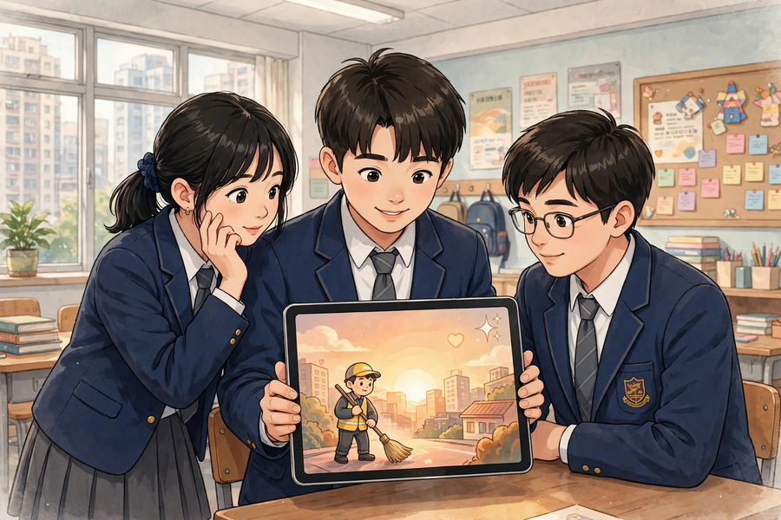

Slide 4
學習目標 Learning Objectives
Lesson 24
• 學生能運用 AI 工具，為本組關愛專題生成一件配合主題的作品（海報、故事、音樂或介紹）。
Students can use AI tools to generate one theme-appropriate work (poster, story, music piece, or introduction) for their caring project.
• 學生能在作品上註明「本作品部分內容由 AI 生成」，並說出一項使用 AI 時的道德考慮。
Students can label the work ‘partly generated by AI’ and state one ethical consideration when using AI.
• 學生能把 AI 生成部分與實物原型整合展示，並按測試結果作出至少一項改良。
Students can integrate the AI-generated part with the physical prototype for presentation, and make at least one improvement based on testing.

Slide 5
課程內容（1） Lesson Content (1)
Lesson 24
• 【甲、AI 生成部分是什麼】
A. What is the ‘AI-generated part’?
• 本專題有兩部分：實物原型（上一堂做的）和 AI 生成部分（本堂做的）。AI 生成部分是配合關愛主題的數碼作品：海報、故事、音樂或介紹，四選一。
This project has two parts: the physical prototype (made last lesson) and the AI-generated part (made this lesson). The AI-generated part is a digital work matching the caring theme: a poster, story, music piece or introduction – choose one.
• 例子：為反光提示牌專題生成一張關愛海報，放在展示板上；或生成一段 100 字的介紹，在成果展時配合講解。
Examples: generate a caring poster for the reflective-sign project to mount on the display board; or generate a 100-word introduction to support the showcase presentation.
• 課堂會用 Google Teachable Machine（https://teachablemachine.withgoogle.com/）或 AI 繪圖／文字工具示範；每組一部裝置，輪流操作。
The class will demonstrate with Google Teachable Machine (https://teachablemachine.withgoogle.com/) or AI drawing/text tools; each group shares one device and takes turns.
• 【乙、寫好提示詞】
B. Writing good prompts
• 提示詞（prompt）就是你給 AI 的指示。提示詞愈具體，生成結果愈合用。
A prompt is the instruction you give the AI. The more specific the prompt, the more usable the result.
• 好提示詞有四個要領：對象是誰、情境是什麼、想要什麼風格、有什麼具體要求。
A good prompt covers four points: who it is for, what the situation is, what style is wanted, and any specific requirements.
• 比較：✘「畫一張海報」（太空泛） ✔「為清晨工作的清潔工設計一張暖色調、文字簡短的關愛海報」（對象、情境、風格、要求俱備）。
Compare: ✘ ‘Draw a poster’ (too vague) ✔ ‘Design a warm-toned caring poster with short text for cleaners working in the early morning’ (audience, situation, style and requirements all covered).
• 提示詞可以用中文寫；試過不理想就修改再試，多試幾次是正常過程。
Prompts can be written in Chinese; if the result is poor, revise and try again – trying several times is normal.
• 【丙、版本比較與篩選】
C. Comparing versions and selecting
• AI 生成一次不算完成。要生成至少三個版本，比較後選出最配合主題的一個，並寫出選擇原因。
One AI generation does not finish the job. Generate at least three versions, compare them, select the one that best matches the theme, and write down why.
• 「篩選與改良」才是人的價值所在：AI 負責生成，人負責判斷、選擇和改良——照單全收不是好方法。
Selecting and refining is where human value lies: AI generates, humans judge, select and refine – accepting everything uncritically is not good practice.
• 比較時看三點：是否配合關愛主題、內容是否恰當、放在實物旁邊是否協調。
When comparing, check three points: does it match the caring theme, is the content appropriate, and does it sit well alongside the physical prototype.

Slide 6
課程內容（2） Lesson Content (2)
Lesson 24
• 【丁、使用 AI 的三項道德守則】
D. Three ethical rules for using AI
• 第一，註明出處：在作品上註明「本作品部分內容由 AI 生成」，這是誠信要求，不是扣分項目。
First, give credit: label the work ‘partly generated by AI’. This is a matter of honesty, not a penalty.
• 第二，核實內容：檢查 AI 生成的內容是否真確、恰當；有錯誤或不恰當的地方要修改或棄用。
Second, verify the content: check whether the AI output is accurate and appropriate; correct or discard anything wrong or unsuitable.
• 第三，不冒充：不可以把 AI 作品說成是自己親手繪畫或創作的。
Third, do not pass off: never claim AI-generated work as your own hand-drawn or hand-created work.
• 【戊、輪流操作與角色分工】
E. Rotation and role allocation
• 學校裝置有限，每組一部裝置（平板電腦或手提電腦），按「輪流操作時間表」每人操作約 6 分鐘。
Devices are limited: each group shares one device (tablet or laptop) and follows a rotation timetable of about 6 minutes per person.
• 四個角色：操作員（輸入提示詞）、提示詞記錄員（記下用過的提示詞）、作品篩選員（比較各版本、選出最佳）、整合測試員（構思 AI 作品與實物如何結合）。
Four roles: operator (enters prompts), prompt recorder (notes the prompts used), work selector (compares versions and picks the best), integration tester (plans how to combine the AI work with the physical prototype).
• 未能輪到操作的組員不要閒置：同步進行實物原型的最後修飾，或撰寫成果展講稿。
Members waiting for their turn must not sit idle: refine the physical prototype or draft the showcase presentation script.
• 【己、整合測試表】
F. The integration test form
• 整合測試表有三欄：(1) AI 作品與實物的結合方式；(2) 測試發現的問題；(3) 作出的改良。
The integration test form has three columns: (1) how the AI work combines with the physical prototype; (2) problem found in testing; (3) improvement made.
• 結合方式例子：把 AI 生成的海報貼於展示板、把 AI 生成的介紹故事印出配合講解、把 AI 生成的音樂在展示時播放。
Example combinations: mount the AI-generated poster on the display board, print the AI-generated introductory story to support the talk, or play the AI-generated music during the presentation.
• 互相測試展示效果：請別組同學看看，問他們「看得明白嗎？有什麼建議？」，然後至少作出一項改良並記錄。
Test the presentation effect on each other: ask another group ‘Is it clear? Any suggestions?’, then make at least one improvement and record it.

Slide 7
例子 Examples
Lesson 24
• 例 1：例一（提示詞比較）：✘ 壞提示詞：「畫一張海報」——結果太空泛，不知為誰而畫。✔ 好提示詞：「為清晨工作的清潔工設計一張暖色調、文字簡短的關愛海報」——對象、情境、風格、要求俱備，效果好得多。
Example 1: Example 1 (prompt comparison): ✘ Bad prompt: ‘Draw a poster’ – the result is too vague, with no clear audience. ✔ Good prompt: ‘Design a warm-toned caring poster with short text for cleaners working in the early morning’ – audience, situation, style and requirements all covered, far better results.
• 例 2：例二（AI 使用工作紙示例）：使用的 AI 工具——AI 繪圖工具；試過的提示詞——(1)「畫一張海報」(2)「為清晨工作的清潔工設計關愛海報」(3)「為清晨工作的清潔工設計一張暖色調、文字簡短的關愛海報」；三個版本比較——版本一太空泛、版本二色調太冷、版本三最配合主題；選定版本及原因——版本三，因為暖色調能傳遞關愛，文字簡短易讀；道德檢查——☑ 已註明 AI 生成 ☑ 內容已核實恰當。
Example 2: Example 2 (sample AI-usage worksheet): AI tool used – AI drawing tool; prompts tried – (1) ‘Draw a poster’ (2) ‘Design a caring poster for cleaners working in the early morning’ (3) ‘Design a warm-toned caring poster with short text for cleaners working in the early morning’; comparison – version 1 too vague, version 2 tones too cold, version 3 matches the theme best; chosen version and reason – version 3, because warm tones convey care and short text is easy to read; ethics check – ☑ AI labelling done ☑ content verified as appropriate.
• 例 3：例三（整合測試示例）：結合方式——把 AI 生成的海報貼在展示板左邊，實物反光牌放在右邊；測試發現的問題——海報文字太多，觀眾要看很久；作出的改良——把海報文字縮減到三句，並把標題字體放大。
Example 3: Example 3 (sample integration test): combination – the AI-generated poster mounted on the left of the display board, the physical reflective sign on the right; problem found in testing – the poster had too much text and took the audience too long to read; improvement made – cut the poster text to three sentences and enlarged the title font.

Slide 8
課堂小練習 Class Practice
Lesson 24
• 以下哪個提示詞比較有效？為什麼？A「寫個故事」B「為視障人士寫一個 100 字、語氣溫暖的短故事，講述導盲設施如何幫助他們安全過馬路」
Which prompt is more effective, and why? A ‘Write a story’ B ‘Write a 100-word warm-toned short story for visually impaired people about how tactile guide facilities help them cross roads safely’
• 請說出使用 AI 的三項道德守則。
State the three ethical rules for using AI.
• 輪流操作時，「提示詞記錄員」負責什麼？「整合測試員」負責什麼？
During rotation, what does the ‘prompt recorder’ do? What does the ‘integration tester’ do?
✎ 與鄰座討論後作答，稍後全班核對
Discuss with your neighbour, then check with the class

Slide 9
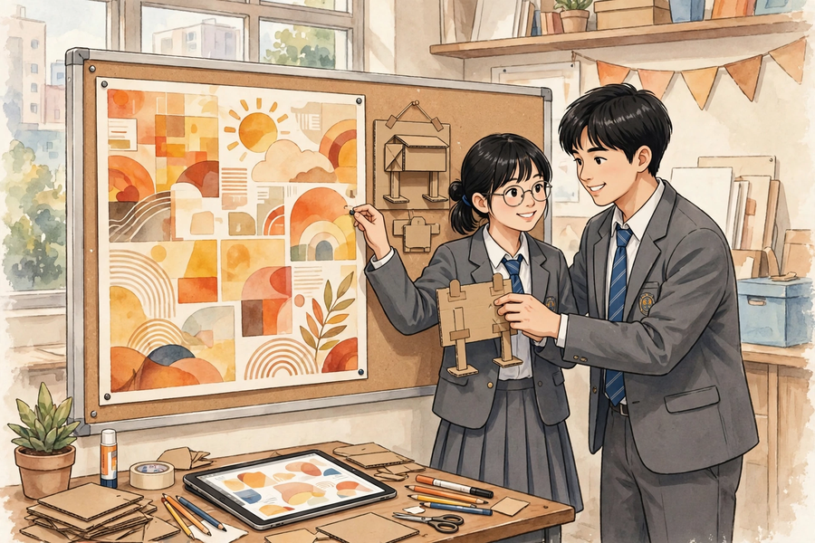
思考題 Thinking Questions
Lesson 24
• 為什麼 AI 生成一次不算完成？比較多個版本有什麼好處？
Why does one AI generation not finish the job? What are the benefits of comparing multiple versions?
• 有同學不想註明「AI 生成」，覺得會被扣分。你會怎樣勸他？
A classmate does not want to label the work as ‘AI-generated’, fearing marks will be deducted. How would you persuade them?
✎ 先獨立思考，再與小組分享
Think alone first, then share with your group

Slide 10
分組活動 Group Activity
Lesson 24
• 步驟 1：聆聽教師示範：用一部裝置即場為示例專題生成海報初稿，並記下三項道德守則。
Step 1: Watch the teacher’s demonstration: generating a first-draft poster for the sample project on one device; note the three ethical rules.
• 步驟 2：按「輪流操作時間表」輪流使用裝置（每人約 6 分鐘），擔任分配到的角色；未能輪到的組員同步修飾實物原型或撰寫講稿。
Step 2: Take turns on the device per the rotation timetable (about 6 minutes each) in your assigned role; members waiting refine the physical prototype or draft the presentation script.
• 步驟 3：填寫「AI 使用工作紙」：使用的 AI 工具、試過的提示詞、三個版本比較、選定版本及原因、道德檢查。
Step 3: Complete the ‘AI usage worksheet’: AI tool used, prompts tried, comparison of three versions, chosen version and reason, ethics check.
• 步驟 4：填寫「整合測試表」：把 AI 作品與實物原型結合展示，請別組試看，記錄至少一項改良；把選定版本列印或儲存好。
Step 4: Complete the ‘integration test form’: combine the AI work with the physical prototype, invite another group to try it out, and record at least one improvement; print or save the chosen version.

Slide 11
總結 Summary
Lesson 24
• AI 生成部分四選一：海報、故事、音樂、介紹；必須配合關愛主題。
The AI-generated part is one of four: poster, story, music piece, or introduction – and it must match the caring theme.
• 好提示詞四要領：對象是誰、情境是什麼、想要什麼風格、有什麼具體要求；多試幾次是正常過程。
Four essentials of a good prompt: who it is for, the situation, the style wanted, and specific requirements; trying several times is normal.
• 生成至少三個版本，比較後選出最配合主題的一個並寫出原因；照單全收不是好方法。
Generate at least three versions, compare them, and select the best-matching one with reasons; accepting everything uncritically is poor practice.
• 三項道德守則：註明 AI 生成、核實內容真確恰當、不冒充為親手作品。
Three ethical rules: label AI-generated content, verify accuracy and appropriateness, and never pass it off as hand-created.
• 每組一部裝置輪流操作（每人約 6 分鐘），四個角色分工；等待時修飾實物或寫講稿，不要閒置。
Each group shares one device in rotation (about 6 minutes each) with four roles; while waiting, refine the physical work or draft the script – no idling.
• 用整合測試表記錄結合方式、測試發現的問題和至少一項改良。
Use the integration test form to record the combination method, problems found in testing, and at least one improvement.

Slide 12
小測驗 Mini Quiz
Lesson 24
• 1. 以下哪個是好提示詞？
Which of the following is a good prompt?
• A. 畫一張海報 B. 唱首歌 C. 為清晨工作的清潔工設計一張暖色調、文字簡短的關愛海報 D. 幫我做功課
• 2. 為什麼要在作品上註明「本作品部分內容由 AI 生成」？
Why label the work ‘partly generated by AI’?
• A. 因為這是誠信要求 B. 因為會加分 C. 因為老師喜歡看 D. 因為 AI 要求
• 3. 輪流操作時，未能輪到使用裝置的組員應該怎樣做？
During rotation, what should members waiting for the device do?
• A. 閒坐等待 B. 修飾實物原型或撰寫展示講稿 C. 玩手機 D. 離開課室
• 4. 請寫出輪流操作的四個角色及其職責。
Write down the four rotation roles and their duties.
• 5. 小組只生成了一個版本就決定採用。請指出這樣做的兩個問題。
A group generated only one version and adopted it. Point out two problems with this.
✎ 獨立完成，檢視本課學習成果
Complete independently

Slide 13
家課 Homework
Lesson 24
• 選擇題＋問答題（見家課工作紙）
MC + short questions (see homework sheet)
• 延伸任務：完成 AI 生成作品的最後篩選，把選定版本列印或儲存好；每位組員寫一段約 50 字的使用心得：「我用 AI 做＿＿＿＿，我學會了＿＿＿＿，我覺得使用 AI 時要注意＿＿＿＿。」下一堂帶回課室。
Extension task: finalise the selection of the AI-generated work and print or save the chosen version. Each member writes a reflection of about 50 words: ‘I used AI to ______. I learnt ______. I think when using AI one should ______.’ Bring it to the next lesson.

