Slide 1
第 25 堂：成果展
Lesson 25: Showcase and Celebration
聖公會呂明才中學
S.K.H. Lui Ming Choi Secondary School
創科班 Little Makers Class｜S1 Unit 5：關愛 Project
第 25 堂：成果展
Lesson 25: Showcase and Celebration
✎ 4–5 人一組 ‧ 每組共用一部裝置 ‧ 正能量——用創科關愛弱勢社群
Groups of 4-5 · one shared device per group · Positive Energy – Caring for the Underprivileged through Innovation and Technology

Slide 2
物資表 Materials List
互評表（A4） × 每人一張
反思紙（A5） × 每人一張
展示提示卡 × 每組一張
獎狀 × 每組一張
小獎品（貼紙／文具） × 每組一份
計時器（投影用） × 一個

Slide 3
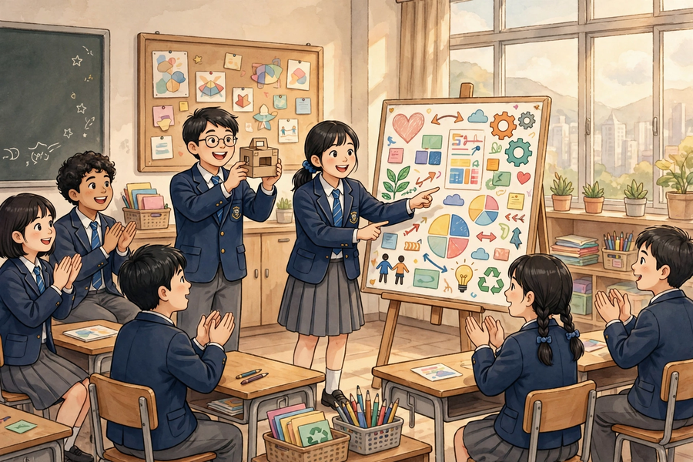

Slide 4
學習目標 Learning Objectives
Lesson 25
• 學生能在三分鐘內向全班介紹本組作品（包括關愛對象、真實需要、實物設計、AI 生成部分）。
Students can introduce their group’s work to the whole class within three minutes (covering the caring target, real need, physical design, and AI-generated part).
• 學生能按互評表為至少三組作品評分，並為每組寫出至少一項具體讚賞。
Students can score at least three groups’ works using the peer-evaluation form and write at least one specific compliment for each.
• 學生能說出本單元中自己學到的一項與「正能量」相關的體會。
Students can state one takeaway from the unit related to ‘positive energy’.

Slide 5
課程內容（1） Lesson Content (1)
Lesson 25
• 【甲、展示四要素】
A. The four elements of the presentation
• 三分鐘展示必須包括四要素：(1) 關愛對象是誰；(2) 真實需要是什麼；(3) 實物設計是怎樣的；(4) AI 生成部分是什麼。缺一不可。
The three-minute presentation must cover four elements: (1) who the caring target is; (2) what the real need is; (3) what the physical design is like; (4) what the AI-generated part is. None may be missing.
• 展示規則：每組 3 分鐘展示＋1 分鐘問答；教師會用計時器嚴格計時，超時會被叫停。
Presentation rules: 3 minutes per group + 1 minute Q&A; the teacher keeps strict time with a timer – overtime will be stopped.
• 【乙、「1＋1＋1」三分鐘結構】
B. The ‘1+1+1’ three-minute structure
• 第 1 分鐘：講關愛對象與真實需要——「我們關心的是誰？他們有什麼困難？」
Minute 1: the caring target and real need – ‘Who do we care about? What difficulty do they face?’
• 第 2 分鐘：講實物設計——展示原型，「我們的設計是怎樣的？怎樣回應這個需要？」
Minute 2: the physical design – show the prototype: ‘What is our design like? How does it address the need?’
• 第 3 分鐘：講 AI 生成部分與分工——「AI 幫我們生成了什麼？組員各自負責了什麼？」
Minute 3: the AI-generated part and task allocation – ‘What did AI generate for us? What did each member do?’
• 每組會獲發一張展示提示卡；上台前小組先分配好每人講哪一分鐘。
Each group receives a presentation prompt card; allocate who speaks in which minute before going on stage.
• 【丙、互評表】
C. The peer-evaluation form
• 每位學生為其他組別評分（不評自己組別），每項 1–5 分；評分只作參考，最終獎項由教師綜合決定。
Each student scores other groups (not their own), 1–5 per criterion; scores are advisory and final awards are decided by the teacher overall.
• 互評五項：(1) 關愛對象與需要是否明確；(2) 實物原型是否配合需要、製作認真；(3) AI 生成部分是否配合主題；(4) 介紹是否清晰、有條理；(5) 整體創意。
The five criteria: (1) Is the caring target and need clear? (2) Does the physical prototype address the need, and is it carefully made? (3) Does the AI-generated part match the theme? (4) Is the presentation clear and well organised? (5) Overall creativity.
• 評分要看作品準則，不可只給朋友高分；這是誠實和公平的表現。
Score against the criteria – do not give high marks only to friends; this is a matter of honesty and fairness.

Slide 6
課程內容（2） Lesson Content (2)
Lesson 25
• 【丁、具體讚賞】
D. Specific compliments
• 每評一組，須寫出一句具體讚賞。具體讚賞＝指出作品的某個特點＋它好在哪裡。
For each group scored, write one specific compliment. A specific compliment = name a feature of the work + say what is good about it.
• 比較：✘ 空泛：「很好」「很漂亮」「不錯」——沒有指出好在哪裡。✔ 具體：「他們的反光牌支架用了三角形結構，很穩固」「海報用了暖色調和簡短文字，很配合清晨清潔工的主題」。
Compare: ✘ Vague: ‘very good’, ‘very pretty’, ‘not bad’ – none says what is good. ✔ Specific: ‘Their sign stand uses a triangular structure, which is very stable’; ‘The poster uses warm tones and short text, which suits the early-morning cleaners’ theme’.
• 欣賞別人的長處、說出具體原因，是本課要學的「正能量」態度。
Appreciating others’ strengths and stating specific reasons is the ‘positive energy’ attitude this lesson teaches.
• 【戊、獎項與正能量分享】
E. Awards and positive-energy sharing
• 獎項類別：最具關愛精神獎、最佳創意獎、最佳 AI 應用獎、最佳演說獎，以及最佳進步獎（肯定起點較低但付出努力的小組）。
Award categories: Most Caring Spirit, Most Creative, Best AI Application, Best Presentation, plus Most Improved (recognising groups that started lower but worked hard).
• 得獎組別分享一句得獎感受；最後全班每人用一句話分享本單元的正能量體會，例如「原來科技可以令清潔工更安全」。
Winning groups share one acceptance sentence; finally, every student shares one positive-energy takeaway in one sentence, e.g. ‘Technology can actually make cleaners safer’.
• 獎項人人有機會；即使沒有得獎，認真完成五堂專題的每一位同學都值得肯定。
Awards are open to all; even without winning, every student who completed the five-lesson project seriously deserves recognition.

Slide 7
例子 Examples
Lesson 25
• 例 1：例一（展示講稿開場示例）：「大家好，我們是第 3 組。我們關心的對象是清晨工作的清潔工。他們在光線不足的街道上工作，容易被途人忽視，有一定危險。我們的問題是：如何能讓清晨工作的清潔工更容易被途人看見？」——30 秒內講完對象、需要、問題定義。
Example 1: Example 1 (sample presentation opening): ‘Hello everyone, we are Group 3. Our caring target is cleaners working in the early morning. They work on poorly lit streets and are easily overlooked by passers-by, which is dangerous. Our question is: How might we make cleaners working in the early morning more visible to passers-by?’ – target, need and problem definition covered in 30 seconds.
• 例 2：例二（互評表填寫示例）：第 2 組——關愛對象與需要是否明確：4 分；實物原型是否配合需要、製作認真：5 分；AI 生成部分是否配合主題：4 分；介紹是否清晰、有條理：4 分；整體創意：5 分。具體讚賞：「他們的反光牌支架用了三角形結構，很穩固，而且海報的標題字很大，遠處也看得見。」
Example 2: Example 2 (sample peer-evaluation entry): Group 2 – Is the caring target and need clear: 4; Does the physical prototype address the need / carefully made: 5; Does the AI-generated part match the theme: 4; Is the presentation clear and well organised: 4; Overall creativity: 5. Specific compliment: ‘Their sign stand uses a triangular structure and is very stable, and the poster title is so large it can be read from far away.’

Slide 8
課堂小練習 Class Practice
Lesson 25
• 以下哪一句是「具體讚賞」？
Which of the following is a ‘specific compliment’?
• 三分鐘展示的「1＋1＋1」結構是怎樣的？
What is the ‘1+1+1’ structure of the three-minute presentation?
• 互評時可以評自己組別嗎？為什麼？
May you score your own group in peer evaluation? Why?
✎ 與鄰座討論後作答，稍後全班核對
Discuss with your neighbour, then check with the class

Slide 9

思考題 Thinking Questions
Lesson 25
• 互評分數只作參考、最終獎項由教師綜合決定，你認為這樣公平嗎？為什麼？
Peer scores are only advisory and the teacher decides the final awards overall. Do you think this is fair? Why?
• 如果你是台下觀眾，怎樣做才是有禮貌、有幫助的觀眾？
As an audience member, how can you be a polite and helpful audience?
✎ 先獨立思考，再與小組分享
Think alone first, then share with your group

Slide 10
分組活動 Group Activity
Lesson 25
• 步驟 1：按抽籤次序上台展示（3 分鐘＋1 分鐘問答）：用「1＋1＋1」結構介紹關愛對象、真實需要、實物設計、AI 生成部分與分工。
Step 1: Present on stage in drawn order (3 minutes + 1 minute Q&A): introduce the caring target, real need, physical design, AI-generated part and task allocation using the ‘1+1+1’ structure.
• 步驟 2：台下即時完成互評表：為至少三組評分（不評自己組別，每項 1–5 分），並為每組寫出一句具體讚賞。
Step 2: Complete the peer-evaluation form in real time: score at least three groups (not your own, 1–5 per criterion) and write one specific compliment for each.
• 步驟 3：在反思紙上寫下：「我最欣賞的一組是＿＿＿＿，原因是＿＿＿＿。」
Step 3: On the reflection slip, write: ‘The group I admire most is ______, because ______.’
• 步驟 4：參與頒獎與正能量分享：每人用一句話分享本單元的正能量體會。
Step 4: Join the awards and positive-energy sharing: each person shares one positive-energy takeaway from the unit in one sentence.

Slide 11
總結 Summary
Lesson 25
• 展示四要素：關愛對象、真實需要、實物設計、AI 生成部分；用「1＋1＋1」結構在三分鐘內講完。
The four presentation elements – caring target, real need, physical design, AI-generated part – delivered in three minutes with the ‘1+1+1’ structure.
• 互評五項（每項 1–5 分），不評自己組別；評分看準則、不只給朋友高分；分數只作參考。
Five peer-evaluation criteria (1–5 each); do not score your own group; score against the criteria, not friendships; scores are advisory.
• 每評一組寫一句具體讚賞：指出作品特點＋好在哪裡；空泛的「很好」不算數。
Write one specific compliment per group: name a feature + say what is good about it; vague ‘very good’ does not count.
• 五堂專題歷程：定題 → 設計 → 動手做（一）→ 動手做（二）→ 成果展；正能量不只是一句標語，而是課堂中真實發生的互相肯定。
The five-lesson journey: topic setting → design → making I → making II → showcase; positive energy is not just a slogan but real mutual appreciation happening in class.

Slide 12
小測驗 Mini Quiz
Lesson 25
• 1. 三分鐘展示必須包括以下哪四要素？
Which four elements must the three-minute presentation include?
• A. 關愛對象、真實需要、實物設計、AI 生成部分 B. 組員名單、日期、地點、天氣 C. 成本、利潤、廣告、銷量 D. 老師姓名、課室編號、堂數、功課
• 2. 「1＋1＋1」結構中，第 2 分鐘講什麼？
In the ‘1+1+1’ structure, what is covered in minute 2?
• A. 關愛對象與真實需要 B. 實物設計 C. AI 生成部分與分工 D. 得獎感受
• 3. 互評時，以下哪種做法正確？
Which of the following is correct practice in peer evaluation?
• A. 只給朋友高分 B. 按作品準則評分，不評自己組別，並寫出具體讚賞 C. 全部給 1 分 D. 不寫評語
• 4. 請寫出互評表的五項評分項目。
Write down the five criteria of the peer-evaluation form.
• 5. 請把以下空泛評語改寫成具體讚賞：「他們的作品很好。」
Rewrite the following vague remark into a specific compliment: ‘Their work is very good.’
✎ 獨立完成，檢視本課學習成果
Complete independently

Slide 13
家課 Homework
Lesson 25
• 選擇題＋問答題（見家課工作紙）
MC + short questions (see homework sheet)
• 延伸任務：寫一篇約 100 字的反思，主題為「我的關愛行動」，內容包括：(1) 本組的關愛對象是誰；(2) 我在專題中負責了什麼；(3) 我學到最重要的一件事。下一星期交回教師批改。
Extension task: write a reflection of about 100 words titled ‘My Caring Action’, covering: (1) who our group’s caring target is; (2) what I was responsible for in the project; (3) the most important thing I learnt. Submit to the teacher next week for marking.

