Slide 1
聖公會呂明才中學 S.K.H. Lui Ming Choi Secondary School
創科班 Little Makers Class
第 22 堂 Lesson 22
進階設計：迭代改良
Advanced Design: Iteration
學生筆記 Student Notes

Slide 2
物資表 Materials List
A3 設計圖紙 A3 drawing paper × 每組 3 張 3 sheets per group
鉛筆、擦膠、直尺 Pencils, erasers, rulers × 每組 1 套 1 set per group
顏色筆 Colour pens × 每組 1 盒（共用） 1 box per group (shared)
製作計劃表及對照表（影印） Production plan and mapping tables (photocopied) × 每組 2 份 2 copies per group

Slide 3
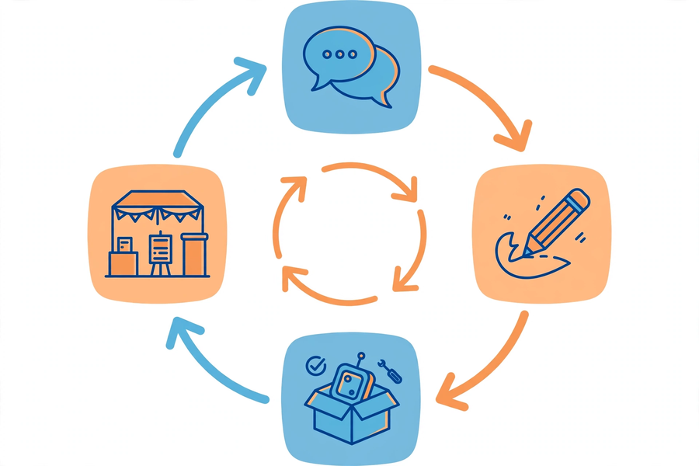

Slide 4
課堂目標
Lesson Objectives
▸ 指出至少兩處修改，並說明依據的用家回饋
Name ≥2 revisions, citing the user feedback behind each
▸ 繪出修改後設計圖：視圖＋尺寸＋物料
Draw the revised design: views + dimensions + materials
▸ 列出工序表：至少四步＋分工
List a procedure table: ≥4 steps + task allocation

Slide 5
迭代設計
Iterative Design
▸ 循環：收集回饋 → 修改設計 → 再測試
Cycle: gather feedback → revise → test again
▸ 真實產品很少一次成功
Real products rarely succeed first time
▸ 本單元：L21 收集 → L22 修改 → L23–24 製作測試 → L25 展示
Our unit: L21 gather → L22 revise → L23–24 build & test → L25 showcase

Slide 6
先做哪項回饋？
Which Feedback First?
▸ 用「影響 × 迫切」矩陣排序
Rank with the impact × urgency matrix
▸ 優先：高影響＋高迫切（例：按鈕太小致誤觸）
First: high impact + urgent (e.g. buttons causing mis-presses)
▸ 可不做：影響小＋不迫切（例：包裝花紋）
Skip: low impact + not urgent (e.g. packaging pattern)
▸ 不採納的也要記錄理由
Record reasons for anything not adopted

Slide 7
「回饋 → 改動」對照表
Feedback → Change Table
▸ 欄一：用家原話（加引號）
Col 1: user’s words (in quotes)
▸ 欄二：具體改動（連數字：尺寸、數量）
Col 2: concrete change (with numbers)
▸ 欄三：預期效果
Col 3: expected effect
▸ 例：「按鈕太小」→ 直徑 1cm 加大至 3cm
E.g. “buttons too small” → diameter 1 cm → 3 cm

Slide 8
設計圖規範
Drawing Standards
▸ 正視圖或側視圖，用直尺繪畫
Front or side view, drawn with a ruler
▸ 尺寸全部標註，單位：厘米
All dimensions marked, in cm
▸ 每部分註明物料
Label the material of each part
▸ 改動處以紅筆圈出並編號，對應對照表
Circle changes in red, numbered to match the table

Slide 9
製作計劃四要素
Four Elements of a Plan
▸ 工序：至少四步，按先後排列
Procedures: ≥4 steps in order
▸ 物料：每步列出物料及數量
Materials: list per step with quantities
▸ 負責人：每步寫明組員姓名
Person in charge: name per step
▸ 預計時間：總和不超過 120 分鐘
Estimated time: total within 120 minutes

Slide 10
常見陷阱
Common Pitfall
▸ ✘ 為改而改：沒有回饋依據的改動
✘ Change for change’s sake: no feedback behind it
▸ ✘ 加功能代替解痛點（例：嫌掣細卻加發聲）
✘ Adding features instead of fixing pain (e.g. sound for small buttons)
▸ ✔ 首要原則：回應用家最迫切的需要
✔ First principle: answer the user’s most pressing need

Slide 11
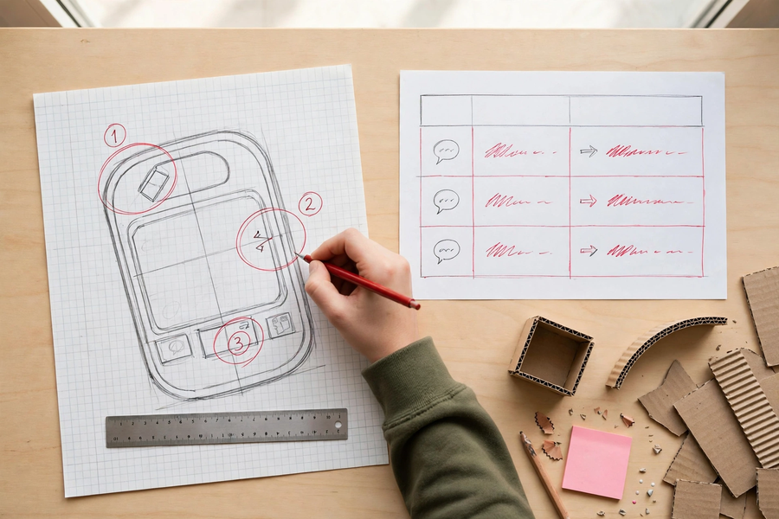
分組任務
Group Tasks
▸ 1. 用矩陣排優先次序，填好對照表（≥2 項）
1. Rank with the matrix; complete the table (≥2 items)
▸ 2. 重繪設計圖：尺寸＋物料＋紅筆圈改動
2. Redraw: dimensions + materials + red-circled changes
▸ 3. 一分鐘簡介綵排：改了什麼？依據哪句原話？
3. Rehearse 1-min briefing: what changed? based on which quote?

Slide 12
總結
Summary
▸ 每處修改都要有回饋依據
Every change needs feedback behind it
▸ 矩陣排優次；不採納的記下理由
Matrix for priority; note reasons for rejections
▸ 設計圖：視圖＋尺寸＋物料＋紅筆編號
Drawing: views + dimensions + materials + red numbers
▸ 家課：完成設計圖、製作計劃表及第 23 堂物料清單
Homework: finish drawing, plan and the L23 materials list

