Slide 1
聖公會呂明才中學 S.K.H. Lui Ming Choi Secondary School
創科班 Little Makers Class
第 23 堂 Lesson 23
動手做（一）：實物原型
Hands-on Making I: Physical Prototype
學生筆記 Student Notes

Slide 2
物資表 Materials List
瓦楞紙板 Corrugated cardboard × 每組 4 塊 4 boards per group
熱熔膠槍及膠棒 Hot glue gun and glue sticks × 每組 1 把槍（學校借用）＋ 5 枝棒 1 gun per group (borrowed from school) + 5 sticks
剪刀 Scissors × 每組 2 把 2 per group
美工刀 Craft knife × 每組 1 把 1 per group
雙面膠紙 Double-sided tape × 每組 1 卷 1 roll per group
雪條棒 Ice-cream sticks × 每組 1 包 1 pack per group
彩紙及裝飾物料 Coloured paper and decorations × 每組 1 份 1 set per group

Slide 3
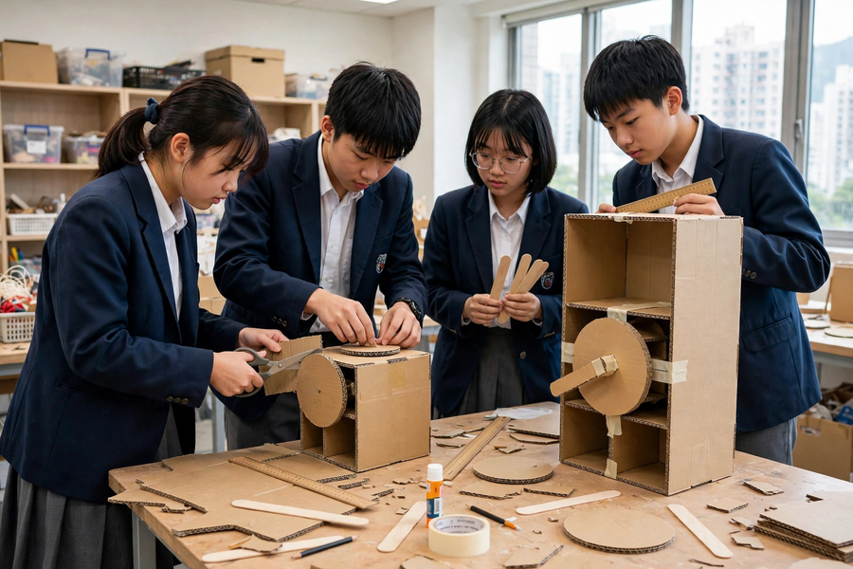

Slide 4
課堂目標
Lesson Objectives
▸ 按工序表完成原型主要結構（≥70%）
Main structure ≥70% complete per the procedure table
▸ 遇問題能提出方案並動手嘗試
Propose and try solutions when problems arise
▸ 正確、安全使用手工工具
Use hand tools correctly and safely

Slide 5
製作五步
Five Making Steps
▸ 1. 量度並標記（摺邊預留 0.5cm）
1. Measure & mark (0.5 cm fold allowance)
▸ 2. 切割（直尺壓邊，慢慢切）
2. Cut (ruler on edge, cut slowly)
▸ 3. 黏合組裝（先試裝，後上膠）
3. Glue & assemble (dry-fit first)
▸ 4. 加固結構（三角支撐／加厚底座）
4. Reinforce (triangular supports / thicker base)
▸ 5. 對照設計圖驗收
5. Verify against the drawing

Slide 6
物料特性
Material Properties
▸ 瓦楞紙板：順紋易彎、橫紋硬挺；承重用橫紋
Cardboard: bends along flutes, stiff across; load-bearing across
▸ 雪條棒：硬身，適合做支架、轉軸
Sticks: rigid, good for frames and axles
▸ 熱熔膠：約一分鐘定型；宜少不宜多
Hot glue: sets in ~1 min; sparingly, not more
▸ 未乾前用膠紙暫時固定
Tape parts temporarily before glue sets

Slide 7
解難四步
Four Problem-Solving Steps
▸ 1. 發現：具體說出問題（例：轉盤裝上後擰不動）
1. Identify: state it precisely
▸ 2. 分析：提出可能成因
2. Analyse: suggest possible causes
▸ 3. 試行：每次只改一個變量
3. Try: change one variable at a time
▸ 4. 檢驗：記錄結果，有效保留、無效重來
4. Verify: record; keep what works

Slide 8
工具安全
Tool Safety
▸ 美工刀：指定組員＋切割墊＋用後即交還教師
Craft knife: designated user + mat + return immediately
▸ 熱熔膠槍：槍頭高溫不觸碰；放回支架冷卻
Glue gun: never touch nozzle; rest on stand to cool
▸ 剪刀：刀鋒向外，不指向他人
Scissors: blades outward, never at others
▸ 受傷：立即通知教師
If injured: inform the teacher at once

Slide 9
常見問題對策
Common Problems & Fixes
▸ 黏合不牢 → 熱熔膠＋壓實＋膠紙輔助定位
Weak joints → hot glue + press + tape assist
▸ 切割毛邊 → 直尺壓邊慢慢切
Rough edges → ruler on edge, cut slowly
▸ 結構不穩 → 三角支撐／加厚底座
Wobbly → triangular supports / thicker base
▸ 膠水溢出 → 減量、分兩次上、趁未乾抹走
Overflow → less glue, two goes, wipe early

Slide 10
進度檢查
Progress Check
▸ 對照工序表：完成了幾步？
Against the table: how many steps done?
▸ 主要結構完成度達七成嗎？
Is the main structure 70% complete?
▸ 把未完成部分寫進第 24 堂計劃
Write unfinished parts into the Lesson 24 plan

Slide 11
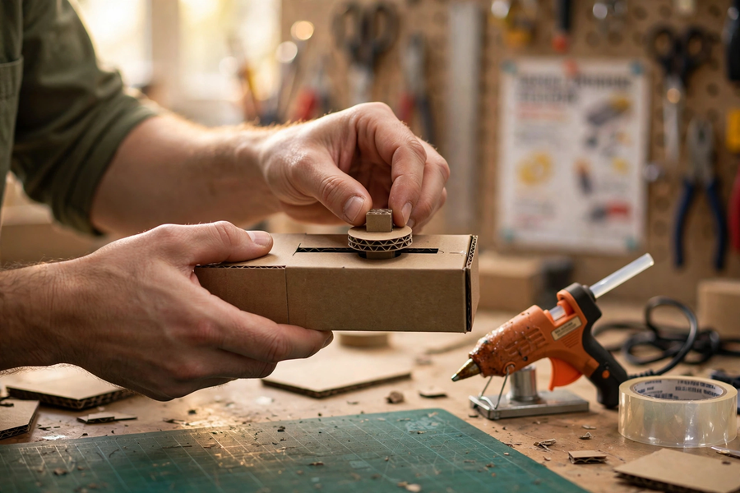
分組任務
Group Tasks
▸ 確認分工，領取工具物料
Confirm roles; collect tools and materials
▸ 按工序表分工製作
Build per the procedure table
▸ 用解難四步處理問題，填寫記錄表
Solve problems with the 4 steps; log them
▸ 收拾：交還美工刀，清潔工作枱
Tidy up: return craft knives; clean benches

Slide 12
總結
Summary
▸ 五步：量度 → 切割 → 黏合 → 加固 → 驗收
Measure → cut → glue → reinforce → verify
▸ 先試裝，後上膠水
Dry-fit before gluing
▸ 安全鐵律：刀、槍、剪刀各有規矩
Safety rules for knife, glue gun and scissors
▸ 家課：記錄一個製作問題及解決方法（文字＋相片）
Homework: log one making problem + fix (words + photos)

