Slide 1
Lesson 8
進階電路：串聯並聯
Series and Parallel Circuits
S2 Little Makers Class - Unit 2: Advanced Hands-on STEAM

Slide 2
物資表 Materials List
AA 電池及電池盒 AA batteries with holders × 2 套
小燈泡及燈座 Small bulbs with holders × 3 個
電線（連鱷魚夾） Wires with crocodile clips × 6 條
開關掣 Switches × 2 個
工作紙 Worksheet × 每人 1 張

Slide 3
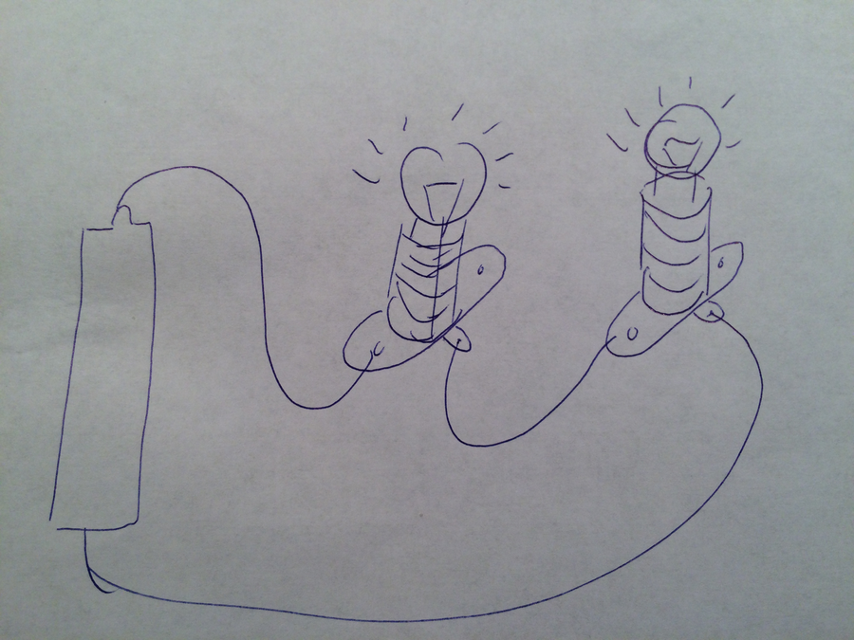

Slide 4
課堂目標
Lesson Objectives
• 正確連接串聯及並聯電路 Connect series and parallel circuits correctly
• 說出兩者在電流路徑、光暗、開關控制的分別 State differences in paths, brightness, switch control
• 解釋為何並聯適合家居及課室照明 Explain why parallel suits homes and classrooms
• 設計課室節能小夜燈 Design a classroom energy-saving night light

Slide 5
串聯 Series
Series Connection
• 所有元件首尾相接 —— 電流只有一條路 Components end to end — one single path
• 電池電壓由各燈泡攤分：燈泡愈多，每個愈暗 Voltage shared: more bulbs → each dimmer
• 開關控制整個電路；一燈損壞，全滅 Switch controls all; one fails → all out

Slide 6
並聯 Parallel
Parallel Connection
• 每個燈泡各自接電池兩極 —— 多條分支 Each bulb across the battery — multiple branches
• 每個燈泡都得全電壓：光暗不受燈泡數量影響 Full voltage each: brightness unaffected by number
• 分支開關只控制該分支；一燈損壞，其餘照亮 Branch switch: that branch only; one fails → rest stay lit

Slide 7
比較表
Comparison Table
• 電流路徑：串聯一條；並聯多條分支 Paths: series one; parallel many
• 光暗：串聯多燈變暗；並聯不變 Brightness: series dims; parallel unchanged
• 開關：串聯控全部；並聯分支控分支 Switch: series all; parallel branch-only
• 損壞：串聯全滅；並聯其餘照亮 Failure: series all out; parallel rest lit

Slide 8
為何家居用並聯？
Why Do Homes Use Parallel?
• 一件電器損壞，不會令全屋斷電 One failed appliance does not black out the house
• 每件電器都取得全電壓，運作正常 Every appliance gets full voltage
• 可獨立開關各電器 Independent switching

Slide 9
實驗一：串聯
Experiment 1: Series
• 連接兩個燈泡串聯，觀察光暗 Connect two bulbs in series; observe brightness
• 擰走一個燈泡，記錄現象 Remove one bulb; record what happens
• 繪畫電路圖 Draw the circuit diagram
• 用同一組電池作比較！ Use the SAME batteries for comparison!

Slide 10
實驗二：並聯
Experiment 2: Parallel
• 改接為並聯，比較燈泡光暗 Rewire in parallel; compare brightness
• 測試開關在不同位置的控制範圍 Test switch positions and control range
• 擰走一個燈泡，記錄現象 Remove one bulb; record

Slide 11
設計任務：節能小夜燈
Design Task: Energy-saving Night Light
• 選用接法、燈泡數量、開關位置 Choose connection type, bulb number, switch positions
• 繪畫電路圖 Draw the circuit diagram
• 寫出省電之處：如分區獨立開關 State energy-saving features, e.g. zonal switches

Slide 12
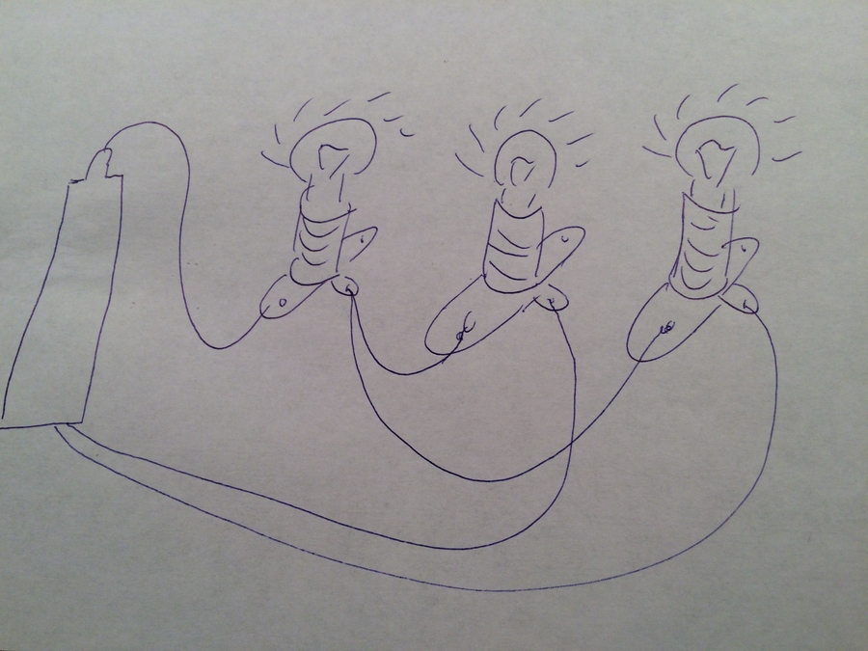

Slide 13
安全須知
Safety Notes
• 只用低壓電池；嚴禁短路 Low-voltage batteries only; NO short circuits
• 先畫電路圖，後接線 Diagram before wiring
• 燈泡發熱，小心觸摸；異常發熱即斷開 Bulbs get hot; disconnect if abnormally hot

Slide 14
總結
Summary
• 串聯：單一路徑、分壓、一壞全滅 Series: one path, shared voltage, one fails → all out
• 並聯：多分支、全電壓、獨立運作 Parallel: branches, full voltage, independent
• 節約能源，由設計做起 Energy saving starts with design
• 關愛反思：長者夜燈應用哪種接法？ Caring reflection: which connection for an elderly person's night light?

