Slide 1
Lesson 9
太陽能小車
Solar Car
S2 Little Makers Class - Unit 2: Advanced Hands-on STEAM

Slide 2
物資表 Materials List
太陽能小車套件（太陽能板＋摩打＋車架） Solar car kit (panel + motor + chassis) × 1 套
計時器（教師提供，全班共用） Timers (provided by teacher, shared) × 每班 2–3 個
鉛筆芯粉／潤滑用具（共用，可選） Pencil lead powder for lubrication (shared, optional) × 共用
工作紙 Worksheet × 每人 1 張

Slide 3
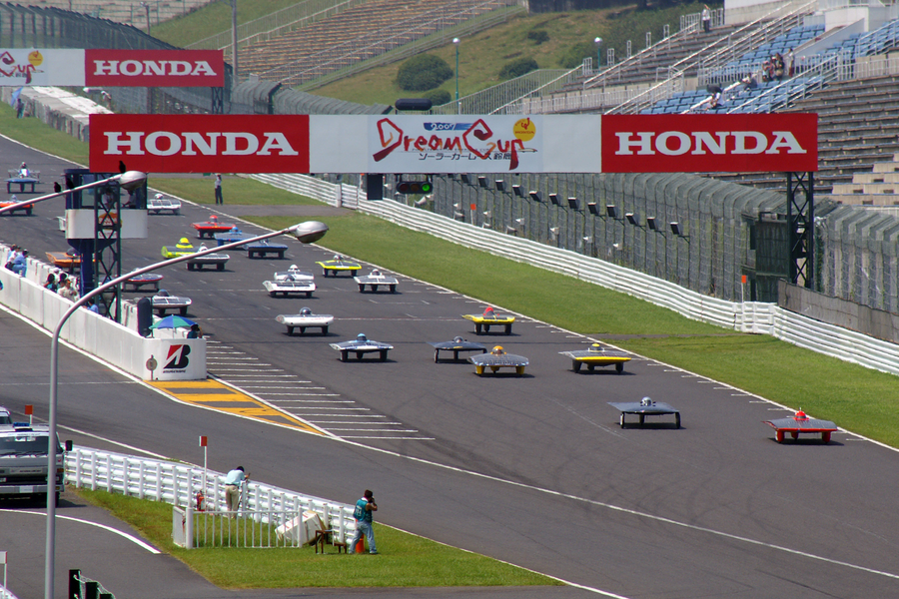

Slide 4
課堂目標
Lesson Objectives
• 說出能量轉換過程：光能 → 電能 → 動能 Describe the energy conversion chain
• 組裝可正常行走的太陽能小車 Assemble a working solar car
• 調校最少一項並記錄前後表現 Tune at least one aspect with before/after records
• 說出兩個再生能源的好處 State two benefits of renewable energy

Slide 5
能量轉換鏈
The Energy Conversion Chain
• 光能 Light energy →（太陽能板 solar panel）→ 電能 Electrical energy
• 電能 Electrical energy →（摩打 motor）→ 動能 Kinetic energy
• 整條鏈：光能 → 電能 → 動能 Full chain: light → electrical → kinetic

Slide 6
光照與發電
Light and Power Generation
• 光線愈強，電流愈大，車愈快 Stronger light → more current → faster car
• 正對陽光：入射角接近垂直，效能最高 Face the sun: near-perpendicular incidence = max output
• 陰天仍可緩慢行走，只是慢得多 Cloudy days: still crawls, but much slower

Slide 7
影響速度的三因素
Three Factors Affecting Speed
• 太陽能板角度：正對陽光 Panel angle: face the sun
• 車身重量：愈輕，摩打負擔愈小 Body weight: lighter = less motor load
• 車軸摩擦：愈順滑愈快；鉛筆芯粉潤滑 Axle friction: smoother is faster; lubricate

Slide 8
再生能源：好處
Renewable Energy: Benefits
• 清潔：使用時不排放廢氣 Clean: no emissions in use
• 可再生：陽光取之不盡 Renewable: inexhaustible sunlight
• 運作成本低：陽光免費 Low running cost: sunlight is free

Slide 9
再生能源：限制
Renewable Energy: Limitations
• 受天氣影響：陰天、夜晚大減 Weather-dependent
• 能量密度較低：需較大面積收集 Lower energy density: large area needed
• 初期設備成本較高 Higher initial cost

Slide 10
調校與記錄
Tuning and Recording
• 每次只改一項：角度／重量／摩擦 Change ONE thing at a time
• 記錄：調校項目、調校前成績、調校後成績 Record: item, before, after
• 比較數據，判斷調校是否有效 Compare data to judge effectiveness

Slide 11
比賽規則
Race Rules
• 戶外直線競速 Outdoor straight-line sprint
• 每組兩次，取最佳成績 Two runs per group; best counts
• 跑道平坦，起終點線清晰 Flat track, clear start/finish lines

Slide 12
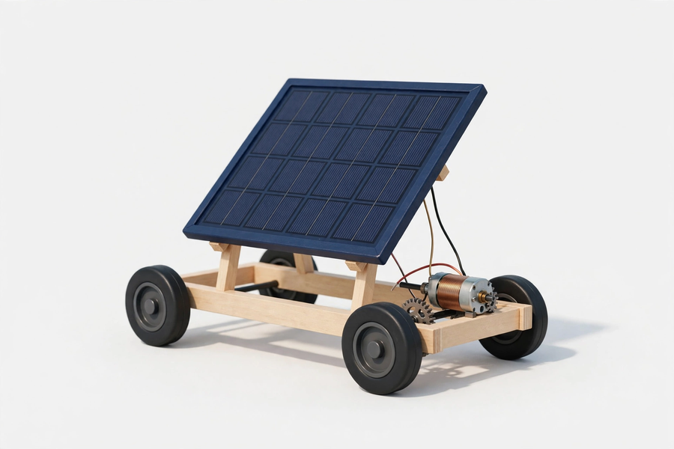

Slide 13
安全須知
Safety Notes
• 太陽能板輕放，防壓裂；用後抹乾淨 Handle panel gently; wipe after use
• 鉛筆芯粉避免吸入 Avoid inhaling graphite powder
• 戶外遵守教師指示，不離開指定範圍 Stay in the designated area outdoors

Slide 14
總結與反思
Summary and Reflection
• 光能 → 電能 → 動能；調校三方向 Light → electrical → kinetic; three tuning directions
• 數據比較是工程探究的方法 Data comparison is the engineering method
• 關愛反思：再生能源如何幫助偏遠社群獲得電力？ Caring reflection: how can renewables bring power to remote communities?

