Slide 1
DGIST
Project
Kernel Programming
Instructor:
Prof. Sungjin Lee (sungjin.lee@dgist.ac.kr)
Jinhyung Koo (jhk5361@dgist.ac.kr)
Youngdon Jung (yeavov@dgist.ac.kr)

Slide 2
DGIST
Index
Objective
Data Compression
Data Deduplication
Benchmark
Submission & Evaluation

Slide 3
DGIST
Objective
Implement a block device that can store more user data than the block device capacity
Use data compression or data deduplication to store user data in smaller amounts
User Program
Write
Read
1MB data
1MB data
Write
Read
Compression
Or
Deduplication
Decompression
Block device
Write
Read
1MB*r% data stored

Slide 4
DGIST
Objective
When compressing data, there is a trade-off between performance and data compression rate
00001111
01101101
Low performance
High compression rate
High performance
Low compression rate

Slide 5
DGIST
Data Compression
When saving data to a device, save it with a compression technique
The compression algorithm should be able to store more data than the device capacity when storing the data
Compression techniques can be implemented directly, or you can use compression techniques in the kernel
Compression techniques in the kernel are: gzip, lz4, lzo, xz, etc…
You can see the compression algorithm implemented in the files.
/lib/inflate.c, /crypto/deflate.c
/include/linux/lz4.h
/inlcude/linux/lzo.h
/include/linux/xz.h
/include/linux/zlib.h

Slide 6
DGIST
Data Compression – LZ4
/include/linux/lz4.h

Slide 7
DGIST
Data Compression – LZ4
Compression
int LZ4_compress_default (const char *source, char *dest, int inputSize, int maxOutputSize, void *wrkmem)
source: source address of the original data
dest: output buffer address of the compressed data
inputSize: size of the input data
maxOutputSize: full or patial size of buffer ‘dest’
wrkmem: address of the working memory

Slide 8
DGIST
Data Compression – LZ4
Decompression
int LZ4_decompress_safe (const char *source, char *dest, int compressedSize, int maxDecompressedSize)
source: source address of the original data
dest: output buffer address of the compressed data
compressedSize: precise full size of the compressed block
maxDecompressedSize: size of buffer ‘dest’
You can alse see codes that use various compress/decompress functions in fs/pstore/platform.c

Slide 9
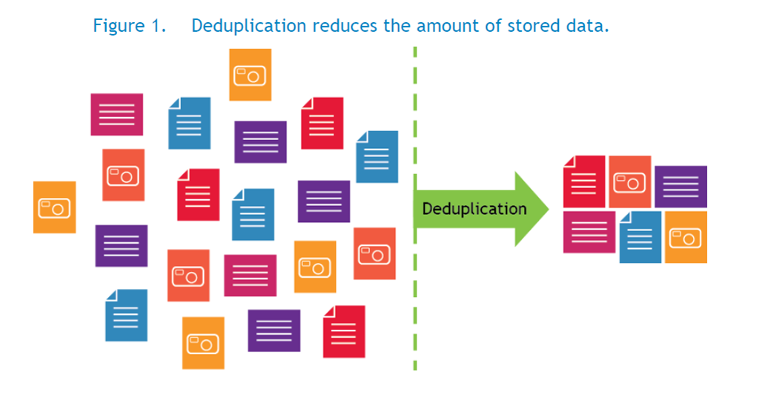
DGIST
Data Deduplication

Slide 10




DGIST
Data Deduplication
1. Splits one large piece of data into chunks
2. Generate a hash per chunk to compare each chunk
Ex) 4KB Data, Chunk 512 byte, 8 Chunks
Hash : SHA-1 or SHA-256 or etc…
0000
0101
0000
0110
0110
0000
0101
1010

Slide 11
DGIST
Data Deduplication
3. Checks the result of the hash and records the information of the hash value and chunk
0000
0101
0000
0110
0110
0000
0101
1010
Hash | Chunk Number
0000 | 1,3,6
0101 | 2,7
0110 | 4,5
1010 | 8

Slide 12
DGIST
Data Deduplication
4. Delete duplicate data
5. It then stores the data and the mapping information together.
0000
0101
0110
1010
Hash | Chunk Number
0000 | 1,3,6
0101 | 2,7
0110 | 4,5
1010 | 8

Slide 13
DGIST
Data Deduplication
Original file size : 4KB
50% reduce file size
Hash | Chunk Number
0000 | 1,3,6
0101 | 2,7
0110 | 4,5
1010 | 8
Deduplication file size : 2KB
0000
0101
0110
1010

Slide 14
DGIST
Data Deduplication
When the read request comes, use the logical block number(LBA) to check the hash table
LBA : 15
Return
Read
Check the table
0110
Hash | Chunk Number
0000 | 1,3,6
0101 | 2,7
0110 | 4,5
1010 | 8

Slide 15
DGIST
Data Deduplication
The higher the number of chunks, the slower the device will be because the hash must be done multiple times
However, if there are many chunks, the amount of data that is the same hash value increases, so the storage capacity decreases
0000
0101
0000
0110
0110
0000
0101
1010
Speed ↑
0000
0101
0110
1010
Capacity ↓
VS
Speed ↓
00
01
10
Capacity ↑
00
00
01
01
00
00
01
10
01
10
00
00
01
01
10
10

Slide 16
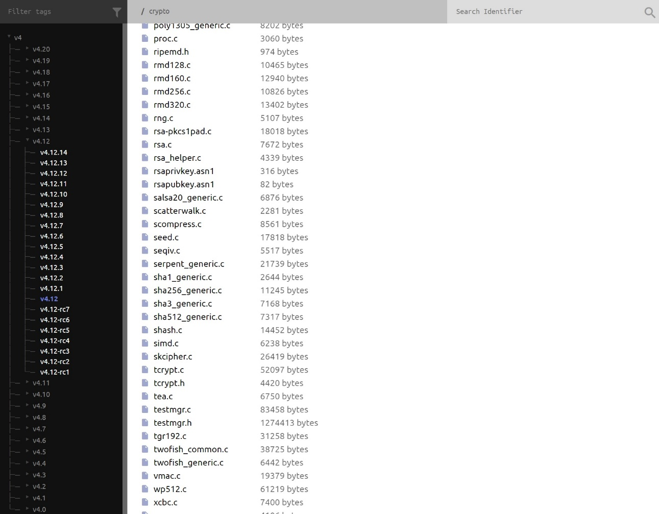
DGIST
Data Deduplication
5. Various encryption hashing techniques(SHA-256, etc…) are implemented in the kernel
You can check the files by entering that path
/crypto

Slide 17
DGIST
Data Deduplication – MD5
/crypto/md5.c
int md5_init (struct shash_desc *desc)
desc: source address of shash_desc to use md5
int md5_update (struct shash_desc *desc, const u8 *data, unsigned int len)
desc: source address of shash_desc to use md5
data: source address of the original data
len: size of the input data
int md5_final (struct shash_desc *desc, const u8 *out)
desc: source address of shash_desc to use md5
out: output buffer address of the hash data

Slide 18
DGIST
Preparation
Step1: Check your kernel version
$uname –a
Step2: The capacity of the block device should be 512 MB
$lsblk
The capacity available to the user is greater than 512 MB

Slide 19
DGIST
Benchmark
You can use the provided file as a benchmark
bench1.c , bench2.c, sample1, sample2, Makefile
The device path for the benchmark program is /dev/sbulla
The make command creates the bench1 and bench2
You can use the bench 1 executable and the bench 2 executable to run the project
$ ./bench1
$ ./bench2

Slide 20
DGIST
Print your device information
You should implement user program to print device information
You should output the actual data capacity and the amount of compressed and stored data
The current compression rate should be displayed
You should print out how many I / O have occurred
It keeps the device information inside the device, and the user program only outputs the contents using the ioctl
Ex)
User Capacity : 540MB
Stored Capacity : 512MB
I/O Count : Read – 10000, Wrtie – 10000

Slide 21
DGIST
Submission
Please submit a report about the results of implementation
There must be a compile method and a working method
The report should include the result of the user program and the runtime of the comparison between the normal block device and the compressed block device
The report should be 2colum, total 3 pages
The project's score will be measured in terms of compression ratios and runtime
Submit all your files, (source code, report, and so on) in the single compressed file, “your_student_number.zip”
ex) 201800000.zip
The deadline is until December 15th 24:00
Submission after deadline
1 day : 80%
2 days : 50%
3 days : 30%

