Slide 1
WB_PLViz
File created on: 2/3/2021 4:13:20 PM

Slide 2
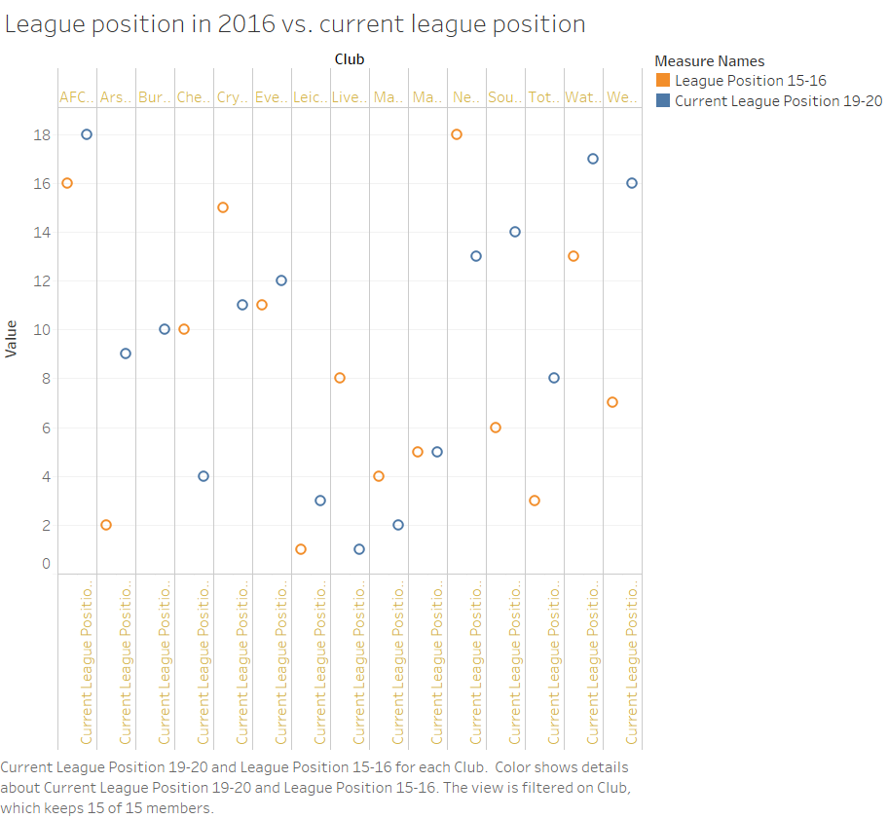

Slide 3


Slide 4
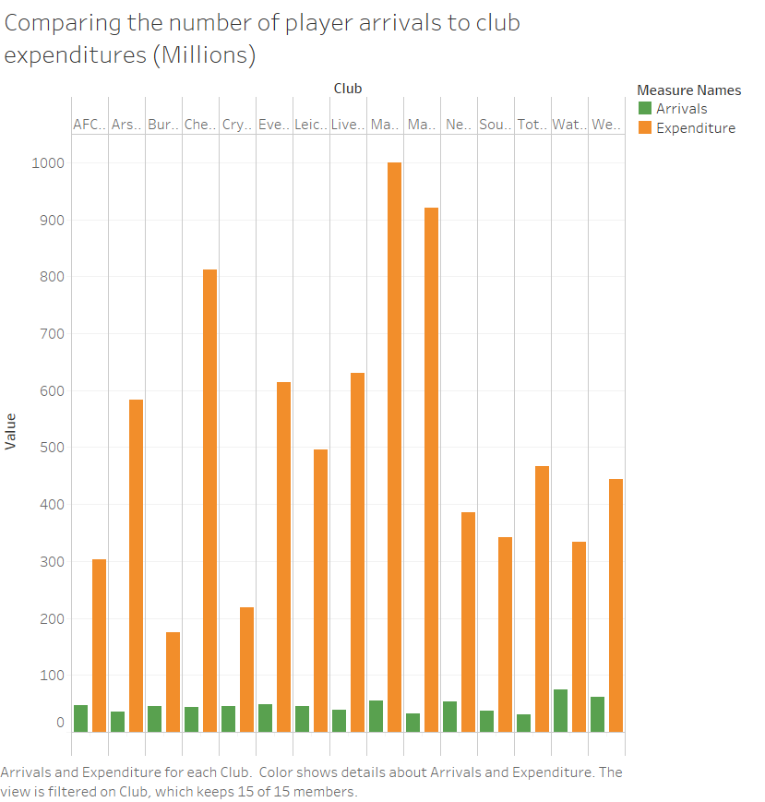

Slide 5
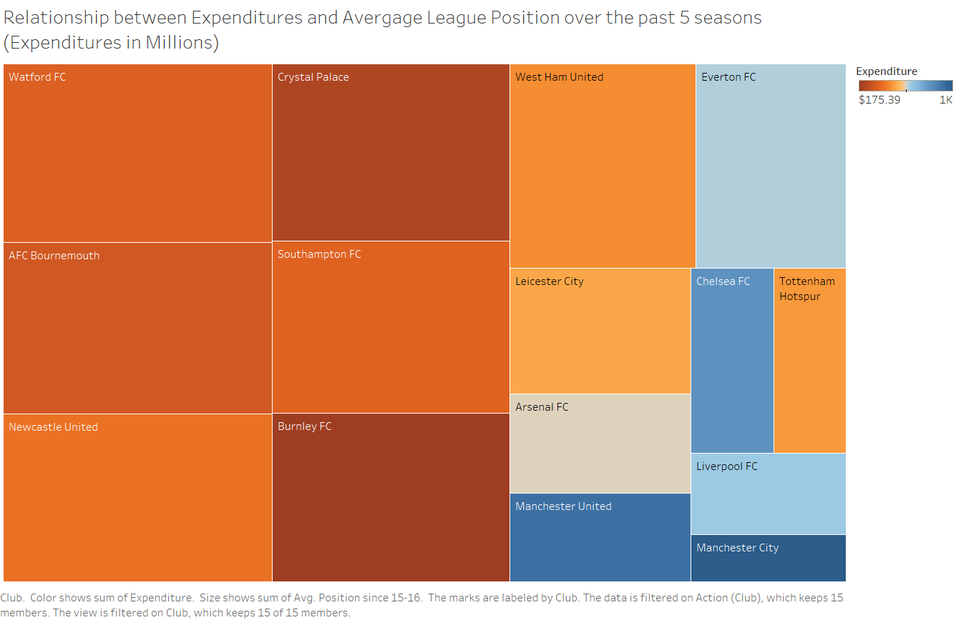

Slide 6
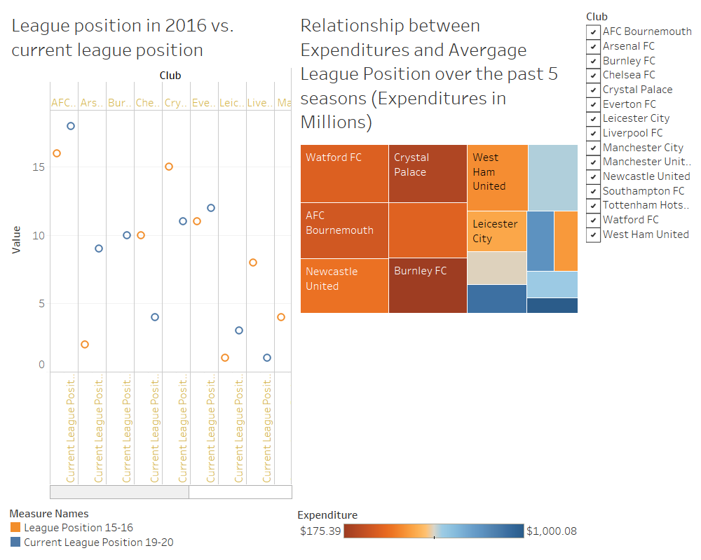

Slide 7
