Slide 1
General Assembly Data Science
December 20, 2016
John Hensley

Slide 2
Predicting wind power offer prices in MISO
Wind energy is a zero-variable cost electricity generation source. As such, wind projects should bid into competitive electricity markets at $0. Nonetheless, wind power offer prices in the MISO footprint have trended to negative territory since September 2014.
I investigate the correlation between wind offer prices and different generation technologies, offer prices, and available generation.

Slide 3
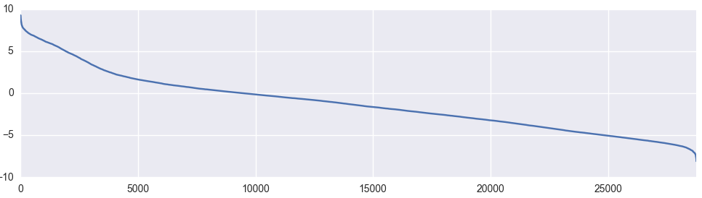
Wind offering negative price majority of time
Average Wind Offer Price
Cumulative Hours

Slide 4
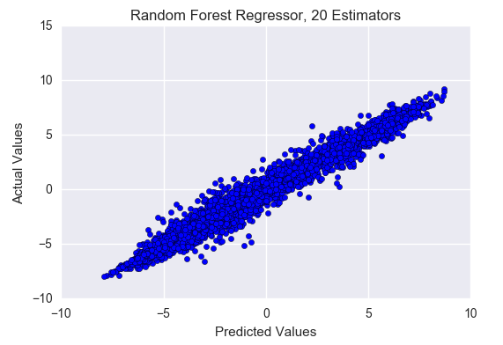
Expected and Unexpected Results
Nuclear generation is an important features when predicting wind offer prices
Price of natural gas strongly correlated with wind offer prices
Wind availability suppresses offer prices
Diesel plant offer prices correlated with higher wind offer prices

