Slide 1
DSP UG2
Lecture 1 Computer Architecture / Digital System
By Yonghao Wang

Slide 2
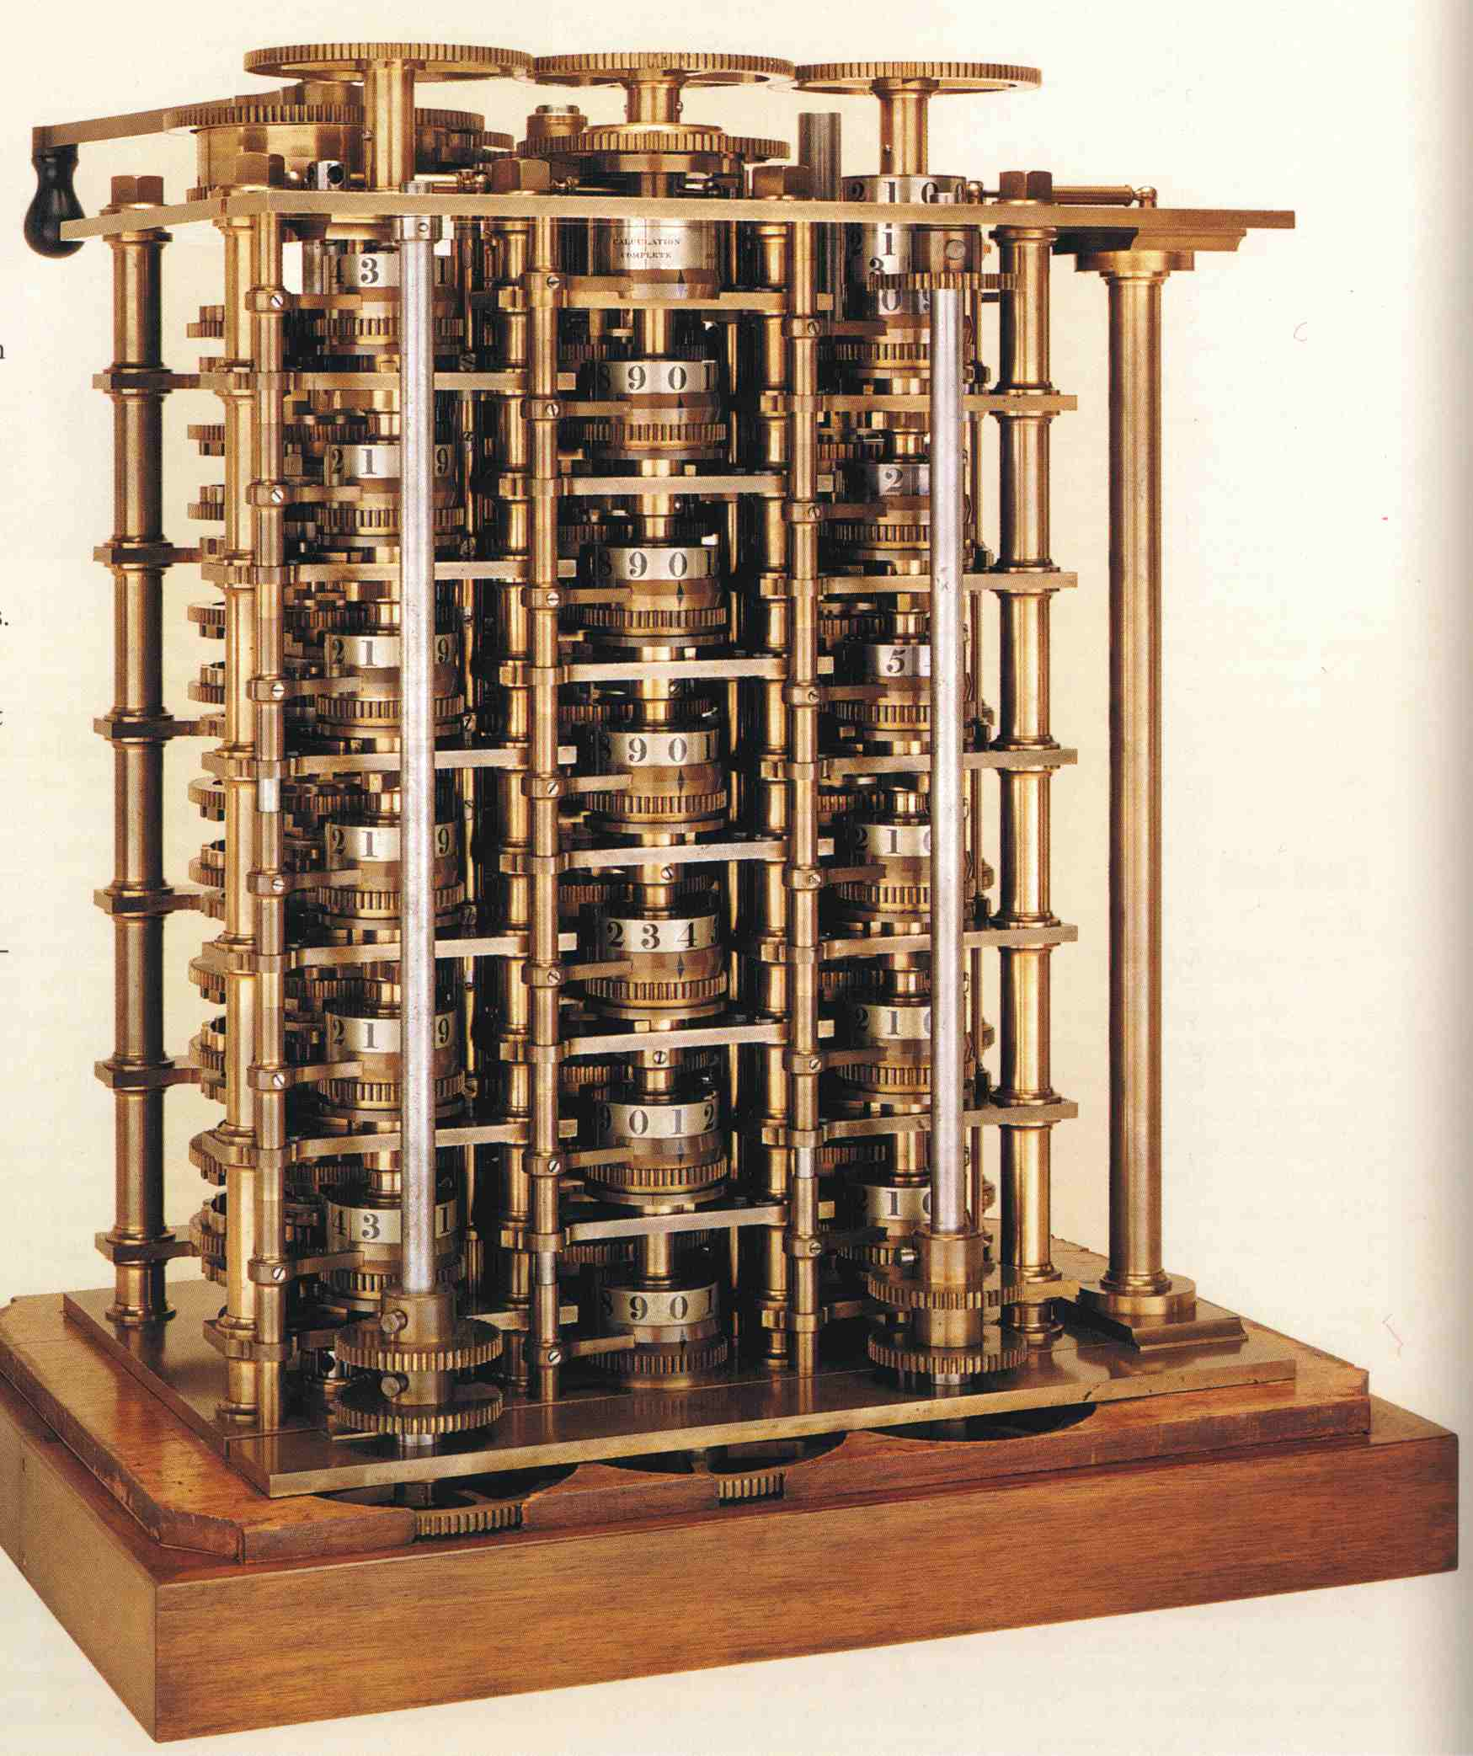
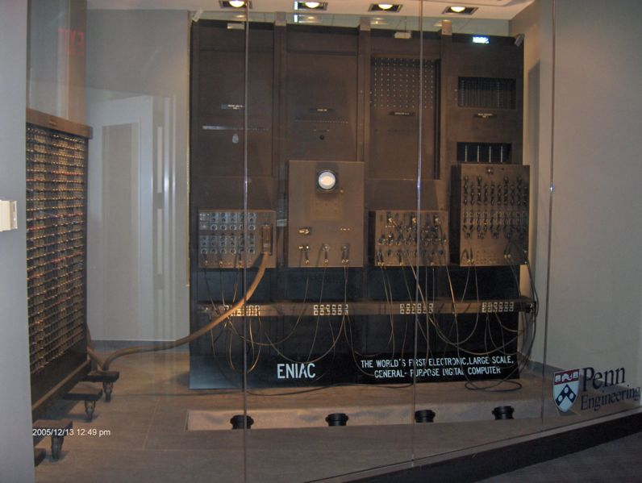
History of Computer
From Machine aided computing to ENIAC
by Y.Wang
Notes:
从图灵机到冯诺依曼架构！2016
http://www.computersciencelab.com/ComputerHistory/HistoryPt2.htm
People have tried machine aided computing since very earlier time. By 1822 the English mathematician Charles Babbage was proposing a steam driven calculating machine the size of a room, which he called the Difference Engine. Which has not been finished since it is extremely difficult.
The title of forefather of today's all-electronic digital computers is usually awarded to ENIAC, which stood for Electronic Numerical Integrator and Calculator. ENIAC filled a 20 by 40 foot room, weighed 30 tons, and used more than 18,000 vacuum tubes.

Slide 3
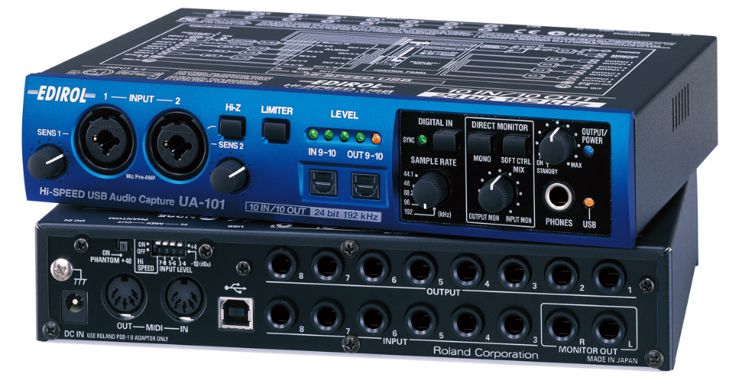
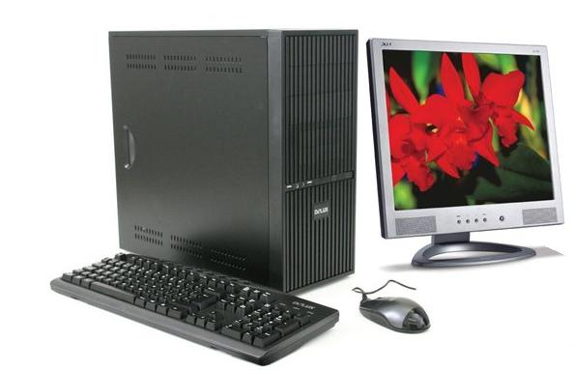
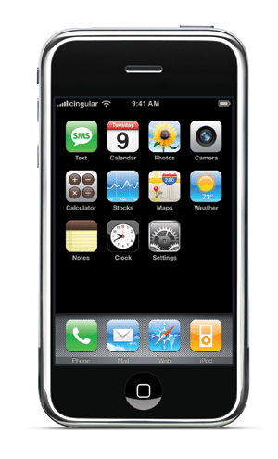
Microprocessor based Computers
Modern Computer is a general term which may refer to PC, iPhone, or Roland UA-101
by Y.Wang 2008
Notes:
In academic, we study and research computer architecture. So the computer has more generic meaning in context of this module than what people’s common perception in mind. For example, you may think Pc, iPhone, and Roland UA-101 (pro-audio interface) are three totally different products, but for me they are all computers and have some similar structure.
Samsung manufactured ARM based chipset for iphone.

Slide 4
Three main components of computer
Central Processing Unit (CPU)
  Intel/PowerPc, ARM based, Blackfin
  System on Chip (SoC), DSP
Memory
  On-chip cache
  Primary memory (DRAM, ROM, Flash)
I/O Interfaces
  Keyboard port, USB, PCI, Display port etc.
  interface to Secondary Storage (SATA PCIe)
    Hard drive, CD-ROM, etc
by Y.Wang 2008

Slide 5
Software
Software is vital for computer to function.
Function specific software: Embedded system or home electronics.
General purpose software: Operating systems.
User interfaces (Graphic user interface -GUI)
Application programming interfaces (API)
by Y.Wang 2008
Notes:
Windows, Mac OSX, Android, (Linux)

Slide 6
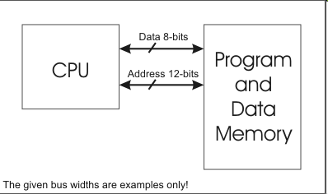
John Von Neumann Architecture
John Von Neumann Architecture
Stored-Program technique
Data and instruction are stored in same memory
Most modern PC still use this architecture
by Y.Wang 2008
Notes:
Modern computer architecture:
John Von Neumann
CPU has two parts control unit and arithmetic logic unit

Slide 7
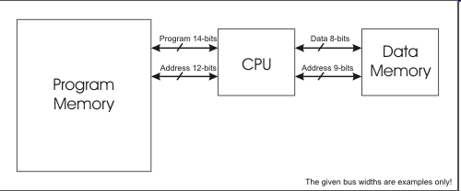
Harvard architecture
Harvard architecture
Data and Instruction in separate memory
High speed pipe line but more complex IC
Used in modern DSP system
Embedded microprocessor and Microcontroller
by Y.Wang 2008

Slide 8
Common Von Neumann machines
Personal computer (PC): people normally refer to Intel x86 CPU based or compatible machines.
Apple/Mac OSX: was based on IBM PPC series architecture. Now based on Intel x86-64 Arch.
Many other commercial servers and workstations.
by Y.Wang 2008

Slide 9
Common Harvard machines
Most embedded system hardware.
ARM architecture based CPUs
Analog Devices: SHARC, Blackfin etc
Texas Instruments: OMAP, TI C5000 etc.
Product Examples: Various Smart phones, iPhone, various Yamaha, Roland devices.
by Y.Wang 2008

Slide 10
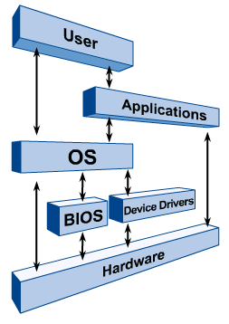
Operating System
An OS is special software to manage hardware and software resources.
It provides interface to upper level applications.
Normally it consists of kernel, device driver, I/O, Networking, GUI etc
OS runs on different Hardware
by Y.Wang 2008

Slide 11
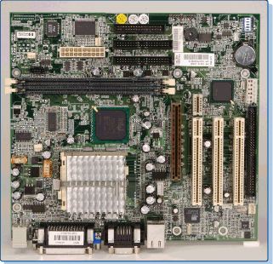
PC and OSes
Today PC refers to IBM Personal Computer compatible machines.
Based on x86 and x86-compatible CPU
Similar structure since first IBM 8088 (8-bit microprocessor) based PC
Different OSes can run on PC. DOS/Windows, Linux, MacOSX (?)
by Y.Wang 2008

Slide 12
Microsoft Windows OS
Microsoft has two major types of OS routes
  Dos based OSes: DOS -> Windows 3x -> Windows 95/98/Me (focus on backwards compatible, home user, for example 16bits app compatible)
  NT based OSes: Windows NT -> Windows 2K -> Windows XP -> Windows 2003 (focus on stability, business user, pure 32-bit OS)
  Windows Vista based on NT kernel but with reengineered GUI components.
by Y.Wang 2008

Slide 13
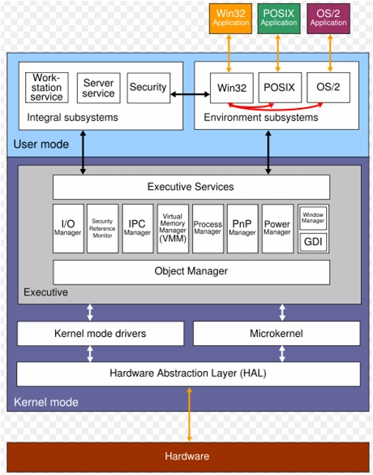
Windows NT/2K/XP
by Y.Wang 2008
Notes:
The Graphics Device Interface (GDI) is part of kernel

Slide 14
Mac OS X
Mac OS X is the successor to the original Mac OS but in total different technology.
First Mac OS X is Server 1.0 (1999), First Desktop Mac OS X 10.0 (2001).
Kernel Darwin based on FreeBSD (UNIX) and supposes to be open source.
Proprietary Graphic User Interface (GUI) Aqua.
by Y.Wang 2008

Slide 15
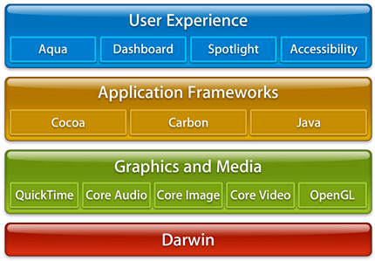
Mac OS X Architecture
by Y.Wang 2008
Notes:
Key thing is kernel Darwin which comes from Unix with stability, portability and expandability of UNIX characteristics.
Java is built in in Application framework makes it running faster than windows pc.

Slide 16
Mac OS X facts
Since 2001 Darwin kernel has been supporting x86 arch.
Built-in Unix (BSD style) applications such as tar, ssh, etc.
Open source based development toolset XCode GCC GDB.
Open Darwin project has been ceased on July 2006 after Apple officially announced Intel transition.
by Y.Wang 2008

Slide 17
GNU/Linux
Kernel developed by Finnish student Linus Torvalds in 1991 at beginning.
Most system applications come from GNU project.
Open source development mode, people contribute code worldwide via Internet.
Many distributions, Redhat, Debian, Ubuntu etc.
by Y.Wang 2008

Slide 18
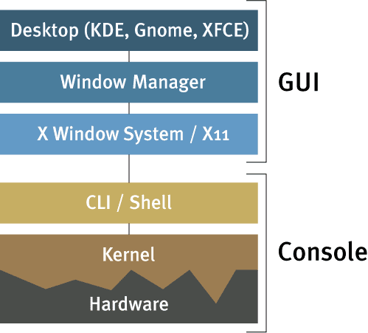
Linux OS Architecture
Independent development of each part.
Current Kernel 2.6.22 (Networking Stack in kernel)
Shell: BASH, CSH
Graphic Libs: XORG, Xfree86
Desktop: KDE, Gnome, XFCE
by Y.Wang 2008

Slide 19
GNU/Linux Features
Very flexible, fully customisable from kernel to applications
Support most 32-bit CPUs, ARM (ipod), Intel x86, PowerPC, MIPS (psp).
Security and stability (Debian server)
Many different distributions.
Has bad reputation of hackers toy.
Easy to use nowadays.
by Y.Wang 2008

Slide 20
Platform agnostic (cross-platform)
Application/software can run on different OSes.
Example as Audacity, Matlab.
Web-based application.
How to write cross-platform software?
  Minimise the efforts of creating platform dependent code.
  Using standard libraries.
  Consider web based.
by Y.Wang 2008

Slide 21
The End
Questions?
by Y.Wang 2008

