Slide 1

CyberSigma

Slide 2

katahiromz
(ARMYANT)

Slide 3
×
katahiromz
CyberSigma
(ARMYANT)

Slide 4
Hello, Wonders API
It's a show time!

Slide 5
Wonders API (Won32)
Windows API Got Open!

Slide 6
Wonders API (Won32)
Created by katahiromz (ARMYANT)
Windows API (Win32 API) Became Open
100% Open Technology
Almost all type information available

Slide 7
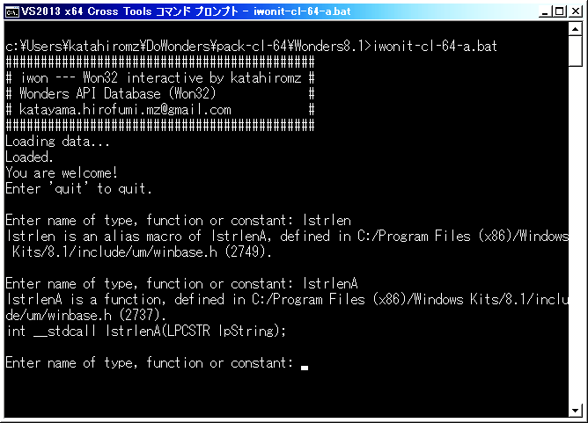

Slide 8
Wonders API (Won32)
The previous slide is “iwonit” interactive program screen shot.
Almost all type information is available.
Types
Enums
Functions
Structs
Unions
Constants
DLL linkage
Macros

Slide 9
Future of Wonders API
Wonders API is going to provide full accessibility to Windows API on many programming languages.

Slide 10
Future of Wonders API
Anyone cannot stop evolution of Wonders API.

Slide 11
Let's Go For Won32
Earn By it
* Windows, Win32 and Microsoft are registered trademarks of Microsoft Corporation.

Slide 12
Special Thanks for...
Google
2ch.net
@jonigata
Microsoft

