Slide 1
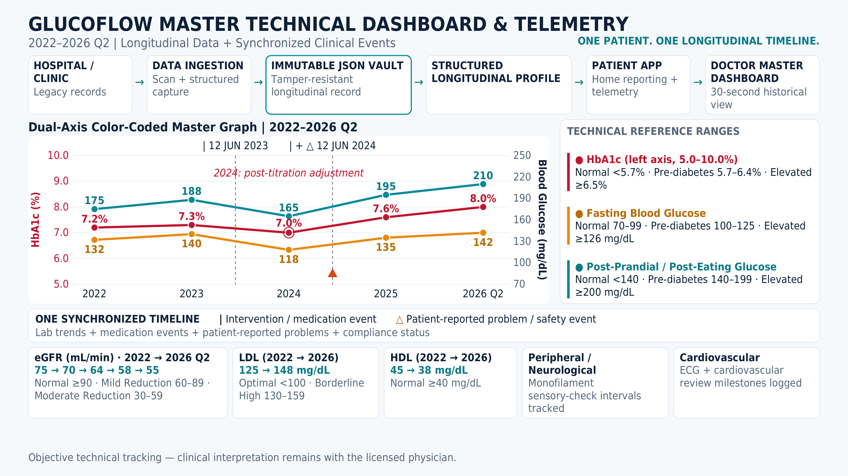
Source page image · non-editable

Slide 2
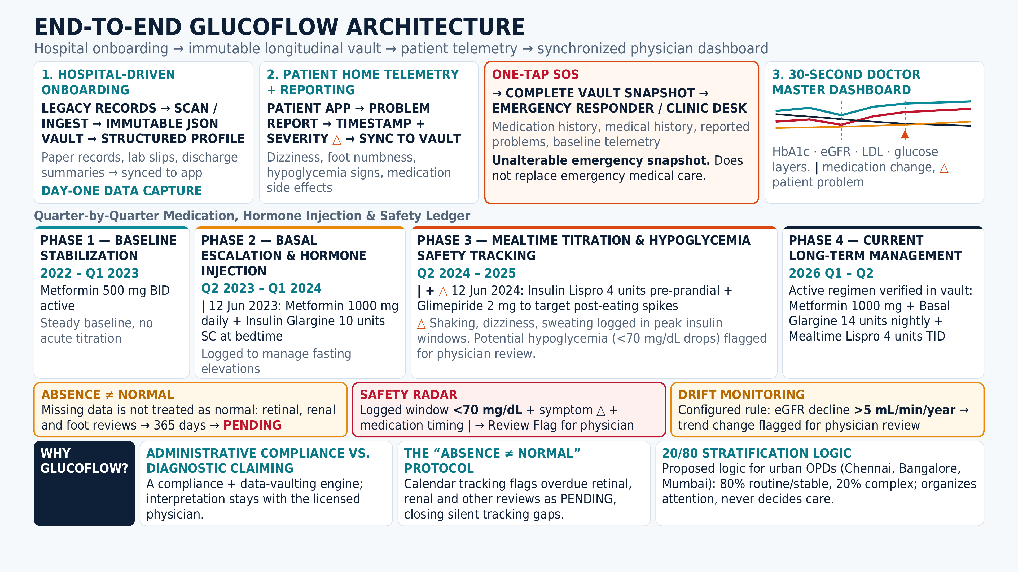
Source page image · non-editable

