Slide 1
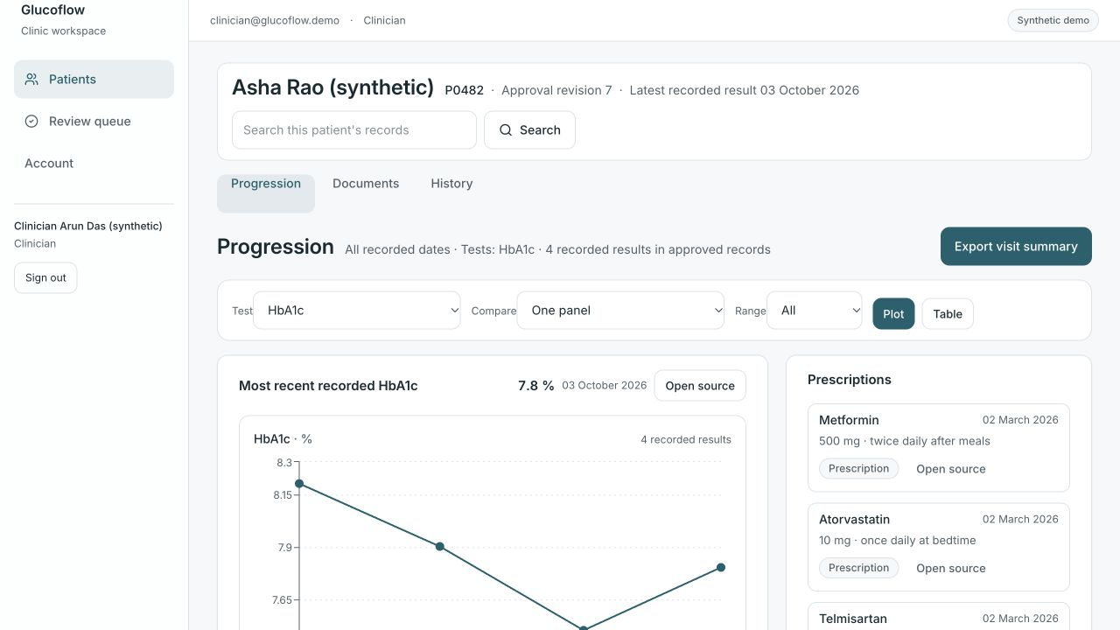
Glucoflow
A patient’s follow-up history, ready for the doctor to review.
Lab trends, prescriptions and patient reports together, with access to the original records.
glucoflow.vercel.app
Notes:
Screenshot of the deployed progression view. Synthetic patient data. Clinical interpretation remains with the physician.

Slide 2
Problem statement
Reports are scattered
History takes work
Follow-up is hard to track
Lab slips and prescriptions arrive from different visits. Finding the right result, date and source takes repeated searching.
To compare visits, the doctor must piece together test results, medication changes and patient-reported problems.
Staff must check which screening dates are recorded and which follow-ups are still pending.
Preparing the history competes with time spent listening to the patient.
Notes:
Pain points from the supplied PDFs and user workflow discussions. OPD and review timings are not measured. An absent record is not proof a test was not done.

Slide 3
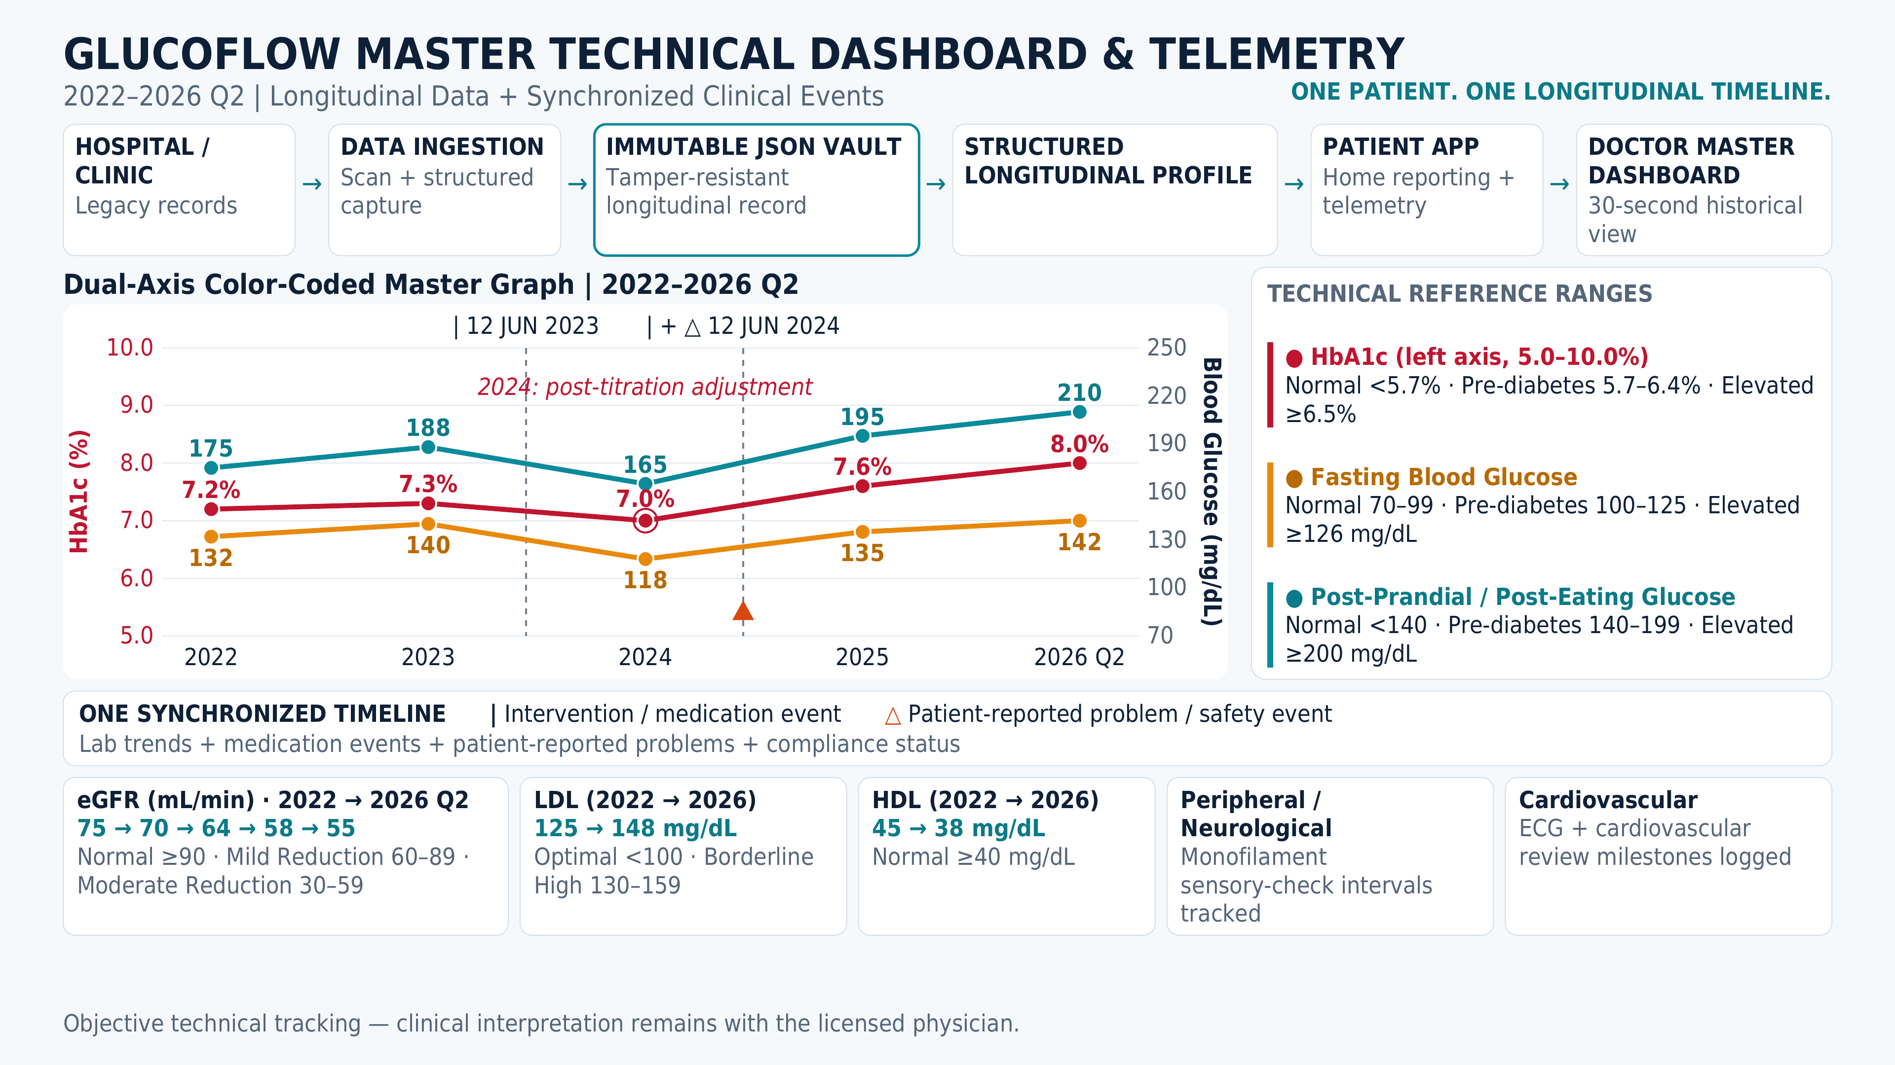
Source page image · non-editable
Notes:
Entire supplied PDF page reproduced unchanged at the user’s request. Source: /Users/wysh/Downloads/GlucoFlow_Master_Dashboard_and_Architecture (1).pdf. Graphs, text and diagrams are preserved as a source page image. Claims and thresholds are those of the supplied source; this reproduction does not establish clinical validation, measured review time, emergency dispatch or immutable infrastructure.

Slide 4
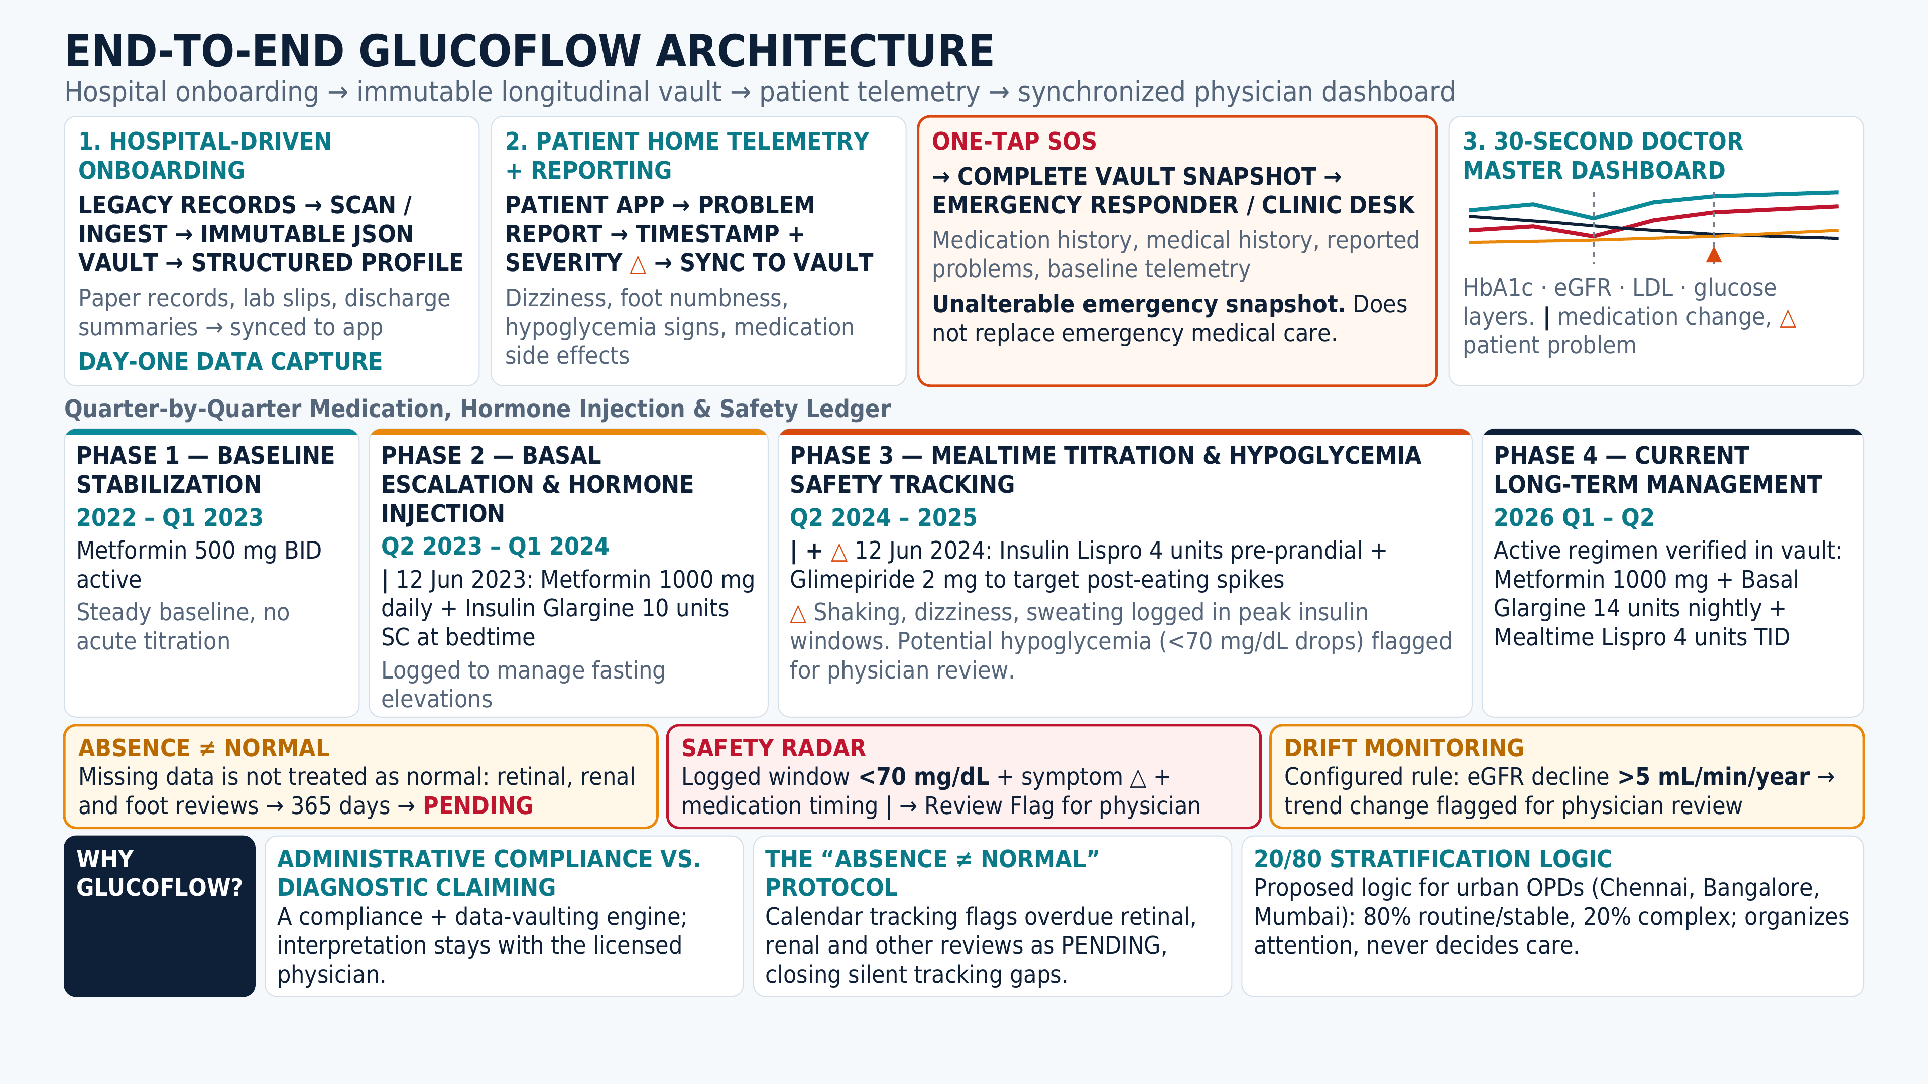
Source page image · non-editable
Notes:
Entire supplied PDF page reproduced unchanged at the user’s request. Source: /Users/wysh/Downloads/GlucoFlow_Master_Dashboard_and_Architecture (1).pdf. Graphs, text and diagrams are preserved as a source page image. Claims and thresholds are those of the supplied source; this reproduction does not establish clinical validation, measured review time, emergency dispatch or immutable infrastructure.

Slide 5
Impact
Doctors
Clinic teams
Patients
Review trends and medication history together. Inspect a source report without searching through separate files.
Manage extraction and approval in one queue. Keep unresolved records and pending follow-up visible.
Upload reports between visits and record home readings and symptoms in the same patient record.
Pilot target: 30% less preparation time
Over 60–90 days, compare combined staff and doctor time with manual preparation. Also measure correction rates and report retrieval. Time savings have not yet been measured.
Notes:
The 30% target is a proposed pilot success criterion, not a measured benefit. Compare both ordinary manual preparation and a structured manual timeline. Current implementation evidence:135 local automated tests; previous hosted baseline25/25API checks and12/12database policy checks. These are engineering checks, not clinical or productivity outcomes.

Slide 6
Scalability and business model
Clinic subscription
Processing at scale
Expansion
Proposed subscription per clinic, with a document-processing allowance. Validate pricing in a supervised diabetes OPD pilot.
Separate services for browsing and report processing. Failed jobs can retry. Clinic and patient access stays isolated.
Support more report layouts and regional languages. Later, add clinic-system integrations and consent-based ABHA access.
Expand after measuring review effort, processing cost and clinic willingness to pay.
Notes:
Subscription and expansion are proposed. No price, revenue or customer count is validated. Live ABHA integration is not implemented. Current stack:Vite React, Fastify API/worker, Supabase Auth/PostgreSQL/Storage, Azure Container Apps, Vercel frontend. Per-document extraction budget gate and scale-to-zero help control operating costs.

Slide 7
Conclusion
Glucoflow brings the follow-up history into one place, so doctors can review progression and inspect the records behind it.
Patients add records. Clinic teams verify them. Doctors review the history.
glucoflow.vercel.app
Choose Doctor, Clinic team or Patient to explore the workflow.
Notes:
Synthetic demo accounts. Physician retains clinical judgment. No clinical diagnosis, treatment recommendation or emergency dispatch. Official hackathon scope:https://healthathon.reskilll.com/ is non-clinical operational workflow improvement, human assistance and measurement within60–90days. Productivity and clinical outcomes require user testing.

