Slide 1

Glucoflow
Diabetes progression, ready before the visit
Reports arrive separately. Staff reconstruct the history,
then the doctor searches for earlier results during the visit.
Built and running locally: records are read, fields are proposed with their source,
and staff approve every fact before it reaches the progression view.
HEALTH-A-THON 2026 · WORKING LOCAL BUILD
Notes:
Glucoflow is a proposed assistive record-preparation workflow. No prototype, performance results, live ABDM integration or clinic partnership is claimed. Synthetic example only. Staff verify source facts. No imputation, clinical interpretation, risk score, diagnosis or treatment advice.
Sources:
https://healthathon.reskilll.com/guide
https://sandbox.abdm.gov.in/sandbox/v3/new-documentation?doc=ABDM_M3_V1
https://sandboxcms.abdm.gov.in/uploads/M3_Dcoument_16_02_2026_2319bac7bf.docx
https://www.nrces.in/ndhm/fhir/r4/index.html
https://diabetesjournals.org/care/article/49/Supplement_1/S61/163931/4-Comprehensive-Medical-Evaluation-and-Assessment
https://www.eka.care/services/eka-smart-report
Submission alignment, 2 October 2026: proposed shared Vite/React/TypeScript web and Capacitor Android application. Patient and clinic roles work on both. Fastify API and a separate worker run on Railway. Supabase provides PostgreSQL/authentication/private file storage; Vercel hosts web assets. Patient-scoped search returns approved source evidence. Digital PDF text extraction, OCR for scans and constrained AI produce drafts. Approval checks run on the server. The primary experience is interactive dated progression with source access, retained approvals and an export. Patient updates are brief pre-visit notes explicitly labelled patient-reported. Optional ABHA/FHIR integration is a later extension and is not an MVP dependency. No working application or clinical benefit has been demonstrated. Official guide confirms Round 1 closes 3 October at 23:59 and build sprint runs 5 October–8 November 2026. Required team identities and relevant experience remain to be supplied. https://healthathon.reskilll.com/guide https://capacitorjs.com/docs https://fastify.dev/docs/latest/Guides/Getting-Started/ https://supabase.com/docs/guides/database/postgres/row-level-security

Slide 2
A clinic morning with Glucoflow
Proposed return visit: one new report joins the clinic’s existing patient file
When | Owner and action | Output
At check-in | Clinic assistant uploads one new report during the usual check-in. | Draft history
Before consultation | A trained intake reviewer checks the new facts while the patient waits. | Approved update
During consultation | Doctor opens the approved progression view from the existing patient file. | Dated history and source references
If review cannot finish before the visit, the doctor uses the original reports. The draft stays on hold until staff approve it.
Scenario to test with a clinic: one return report, six fields to check. Reviewer capacity determines whether the handoff fits.
Notes:
Glucoflow is a proposed assistive record-preparation workflow. No prototype, performance results, live ABDM integration or clinic partnership is claimed. Synthetic example only. Staff verify source facts. No imputation, clinical interpretation, risk score, diagnosis or treatment advice.
Sources:
https://healthathon.reskilll.com/guide
https://sandbox.abdm.gov.in/sandbox/v3/new-documentation?doc=ABDM_M3_V1
https://sandboxcms.abdm.gov.in/uploads/M3_Dcoument_16_02_2026_2319bac7bf.docx
https://www.nrces.in/ndhm/fhir/r4/index.html
https://diabetesjournals.org/care/article/49/Supplement_1/S61/163931/4-Comprehensive-Medical-Evaluation-and-Assessment
https://www.eka.care/services/eka-smart-report
Submission alignment, 2 October 2026: proposed shared Vite/React/TypeScript web and Capacitor Android application. Patient and clinic roles work on both. Fastify API and a separate worker run on Railway. Supabase provides PostgreSQL/authentication/private file storage; Vercel hosts web assets. Patient-scoped search returns approved source evidence. Digital PDF text extraction, OCR for scans and constrained AI produce drafts. Approval checks run on the server. The primary experience is interactive dated progression with source access, retained approvals and an export. Patient updates are brief pre-visit notes explicitly labelled patient-reported. Optional ABHA/FHIR integration is a later extension and is not an MVP dependency. No working application or clinical benefit has been demonstrated. Official guide confirms Round 1 closes 3 October at 23:59 and build sprint runs 5 October–8 November 2026. Required team identities and relevant experience remain to be supplied. https://healthathon.reskilll.com/guide https://capacitorjs.com/docs https://fastify.dev/docs/latest/Guides/Getting-Started/ https://supabase.com/docs/guides/database/postgres/row-level-security

Slide 3
Progression in context
Three dated HbA1c results • verified local build • synthetic patient P0482
12 Jan
8.2
10 Apr
7.9
14 Sep
7.8
09 Jul
7.5
Other dated source records, listed chronologically
15 Jan · Prescription
18 Apr · Prescription
09 Jul · Patient note
04 Sep · Eye exam
Metformin listed
Prescription revised
Diet and walking reported
Report available
HbA1c
Glucose
LDL cholesterol
BP / weight
Kidney (eGFR/UACR)
Eye / foot / nerve
4 results · 7.5–8.2%
5.6 mmol/L · 14 Sep
2.1 mmol/L · 14 Sep
no record — gap
no record — gap
eye exam 04 Sep
Each value opens its source report; each care event retains its date and source.
The doctor interprets the history. Timing alone does not establish a treatment effect.
Dated and source-linked; absent records stay visible as gaps. Assay methods stay with the source; no cross-lab correction.
Notes:
Glucoflow is a proposed assistive record-preparation workflow. No prototype, performance results, live ABDM integration or clinic partnership is claimed. Synthetic example only. Staff verify source facts. No imputation, clinical interpretation, risk score, diagnosis or treatment advice.
Sources:
https://healthathon.reskilll.com/guide
https://sandbox.abdm.gov.in/sandbox/v3/new-documentation?doc=ABDM_M3_V1
https://sandboxcms.abdm.gov.in/uploads/M3_Dcoument_16_02_2026_2319bac7bf.docx
https://www.nrces.in/ndhm/fhir/r4/index.html
https://diabetesjournals.org/care/article/49/Supplement_1/S61/163931/4-Comprehensive-Medical-Evaluation-and-Assessment
https://www.eka.care/services/eka-smart-report
Submission alignment, 2 October 2026: proposed shared Vite/React/TypeScript web and Capacitor Android application. Patient and clinic roles work on both. Fastify API and a separate worker run on Railway. Supabase provides PostgreSQL/authentication/private file storage; Vercel hosts web assets. Patient-scoped search returns approved source evidence. Digital PDF text extraction, OCR for scans and constrained AI produce drafts. Approval checks run on the server. The primary experience is interactive dated progression with source access, retained approvals and an export. Patient updates are brief pre-visit notes explicitly labelled patient-reported. Optional ABHA/FHIR integration is a later extension and is not an MVP dependency. No working application or clinical benefit has been demonstrated. Official guide confirms Round 1 closes 3 October at 23:59 and build sprint runs 5 October–8 November 2026. Required team identities and relevant experience remain to be supplied. https://healthathon.reskilll.com/guide https://capacitorjs.com/docs https://fastify.dev/docs/latest/Guides/Getting-Started/ https://supabase.com/docs/guides/database/postgres/row-level-security

Slide 4
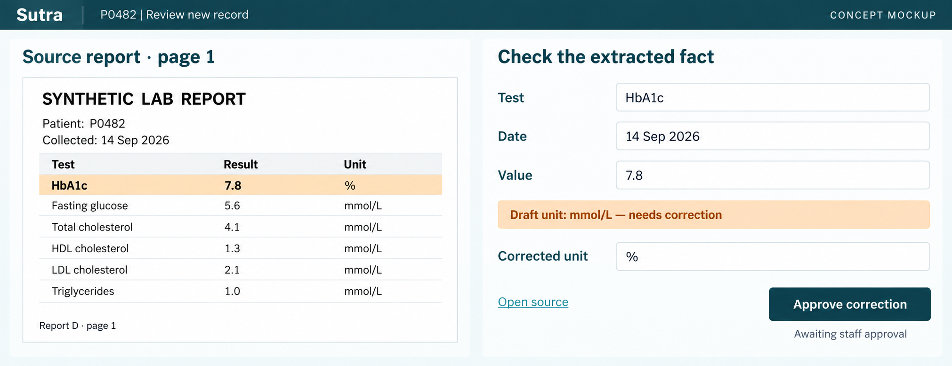
One fact, checked at its source
Implemented extraction and staff review. Synthetic report; deterministic fixture engine, not a live model.
OCR reads the report. AI maps varied layouts and prescription wording into dated fields with source evidence.
The example catches a wrong unit. Staff approve the correction before the fact joins the history.
Built: Vite / React, Capacitor Android, Fastify API + worker, PostgreSQL. Running locally; hosted deployment is configured but not yet exercised.
Notes:
Glucoflow is a proposed assistive record-preparation workflow. No prototype, performance results, live ABDM integration or clinic partnership is claimed. Synthetic example only. Staff verify source facts. No imputation, clinical interpretation, risk score, diagnosis or treatment advice.
Sources:
https://healthathon.reskilll.com/guide
https://sandbox.abdm.gov.in/sandbox/v3/new-documentation?doc=ABDM_M3_V1
https://sandboxcms.abdm.gov.in/uploads/M3_Dcoument_16_02_2026_2319bac7bf.docx
https://www.nrces.in/ndhm/fhir/r4/index.html
https://diabetesjournals.org/care/article/49/Supplement_1/S61/163931/4-Comprehensive-Medical-Evaluation-and-Assessment
https://www.eka.care/services/eka-smart-report
Submission alignment, 2 October 2026: proposed shared Vite/React/TypeScript web and Capacitor Android application. Patient and clinic roles work on both. Fastify API and a separate worker run on Railway. Supabase provides PostgreSQL/authentication/private file storage; Vercel hosts web assets. Patient-scoped search returns approved source evidence. Digital PDF text extraction, OCR for scans and constrained AI produce drafts. Approval checks run on the server. The primary experience is interactive dated progression with source access, retained approvals and an export. Patient updates are brief pre-visit notes explicitly labelled patient-reported. Optional ABHA/FHIR integration is a later extension and is not an MVP dependency. No working application or clinical benefit has been demonstrated. Official guide confirms Round 1 closes 3 October at 23:59 and build sprint runs 5 October–8 November 2026. Required team identities and relevant experience remain to be supplied. https://healthathon.reskilll.com/guide https://capacitorjs.com/docs https://fastify.dev/docs/latest/Guides/Getting-Started/ https://supabase.com/docs/guides/database/postgres/row-level-security

Slide 5
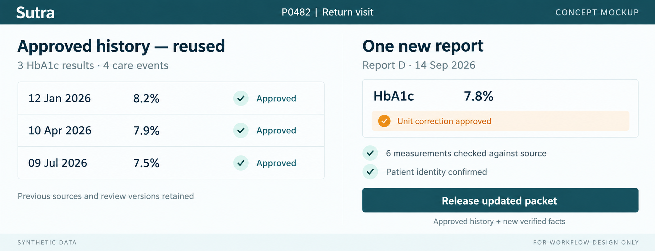
The return visit: review the change
Verified on web and on an Android emulator: approved facts stay available while the new report is reviewed
First intake checks all imported facts. A return visit checks the new report and amendments. Previous approvals stay available.
Notes:
Glucoflow is a proposed assistive record-preparation workflow. No prototype, performance results, live ABDM integration or clinic partnership is claimed. Synthetic example only. Staff verify source facts. No imputation, clinical interpretation, risk score, diagnosis or treatment advice.
Sources:
https://healthathon.reskilll.com/guide
https://sandbox.abdm.gov.in/sandbox/v3/new-documentation?doc=ABDM_M3_V1
https://sandboxcms.abdm.gov.in/uploads/M3_Dcoument_16_02_2026_2319bac7bf.docx
https://www.nrces.in/ndhm/fhir/r4/index.html
https://diabetesjournals.org/care/article/49/Supplement_1/S61/163931/4-Comprehensive-Medical-Evaluation-and-Assessment
https://www.eka.care/services/eka-smart-report
Submission alignment, 2 October 2026: proposed shared Vite/React/TypeScript web and Capacitor Android application. Patient and clinic roles work on both. Fastify API and a separate worker run on Railway. Supabase provides PostgreSQL/authentication/private file storage; Vercel hosts web assets. Patient-scoped search returns approved source evidence. Digital PDF text extraction, OCR for scans and constrained AI produce drafts. Approval checks run on the server. The primary experience is interactive dated progression with source access, retained approvals and an export. Patient updates are brief pre-visit notes explicitly labelled patient-reported. Optional ABHA/FHIR integration is a later extension and is not an MVP dependency. No working application or clinical benefit has been demonstrated. Official guide confirms Round 1 closes 3 October at 23:59 and build sprint runs 5 October–8 November 2026. Required team identities and relevant experience remain to be supplied. https://healthathon.reskilll.com/guide https://capacitorjs.com/docs https://fastify.dev/docs/latest/Guides/Getting-Started/ https://supabase.com/docs/guides/database/postgres/row-level-security

Slide 6
The application workflow, as built
Architecture as built. Staff approve facts before they enter the visit view.
01
02
03
04
Read records
Propose fields
Check and approve
Save and deliver
Upload PDFs or scans. Read digital text directly and use OCR for image pages.
AI maps varied layouts and wording to dates, values and units with source evidence.
Validate patient, date and unit. Staff correct the draft against its source.
Save approved versions. Explore trends, search reports and export the visit summary.
Changed source records reopen affected facts. An unresolved patient identity conflict keeps the update on hold.
Later extension: consented ABHA records
Verify the clinic patient link and request scoped consent. Retrieve permitted provider records through ABDM, validate their structured format and send them through the same review.
Expiry or revocation stops access. Enforce the consent’s erasure deadline. Sandbox and certification precede production.
Implemented locally. NHA ABDM M1 / M3 documentation; NRCeS FHIR R4. No live integration claimed.
Notes:
Glucoflow is a proposed assistive record-preparation workflow. No prototype, performance results, live ABDM integration or clinic partnership is claimed. Synthetic example only. Staff verify source facts. No imputation, clinical interpretation, risk score, diagnosis or treatment advice.
Sources:
https://healthathon.reskilll.com/guide
https://sandbox.abdm.gov.in/sandbox/v3/new-documentation?doc=ABDM_M3_V1
https://sandboxcms.abdm.gov.in/uploads/M3_Dcoument_16_02_2026_2319bac7bf.docx
https://www.nrces.in/ndhm/fhir/r4/index.html
https://diabetesjournals.org/care/article/49/Supplement_1/S61/163931/4-Comprehensive-Medical-Evaluation-and-Assessment
https://www.eka.care/services/eka-smart-report
Proposed implementation details: structured FHIR records bypass OCR and model extraction. Scanned reports use OCR and constrained extraction with page/source references, explicit patient/date/unit checks, and staff approval. Missing values remain gaps. Amended source versions reopen affected facts. The clinic receives an approved PDF packet and retained source references. Planned stack: Vite/React/TypeScript, Capacitor Android, Fastify API and worker, Supabase, Vercel web and Railway server deployment. FHIR integration is a later extension.
Proposed ABDM HIU integration: verify ABHA linkage against the clinic patient identity, request purpose/record types/date range/access validity through the Consent Manager, retrieve only permitted linked HIP records securely, validate FHIR, reconcile duplicates and amendments, stop new access on denial/expiry/revocation, enforce the consent data-erasure deadline, and use role permissions, encrypted storage and access audit logs. Sandbox and applicable certification precede production. No live integration is claimed.
Submission alignment, 2 October 2026: proposed shared Vite/React/TypeScript web and Capacitor Android application. Patient and clinic roles work on both. Fastify API and a separate worker run on Railway. Supabase provides PostgreSQL/authentication/private file storage; Vercel hosts web assets. Patient-scoped search returns approved source evidence. Digital PDF text extraction, OCR for scans and constrained AI produce drafts. Approval checks run on the server. The primary experience is interactive dated progression with source access, retained approvals and an export. Patient updates are brief pre-visit notes explicitly labelled patient-reported. Optional ABHA/FHIR integration is a later extension and is not an MVP dependency. No working application or clinical benefit has been demonstrated. Official guide confirms Round 1 closes 3 October at 23:59 and build sprint runs 5 October–8 November 2026. Required team identities and relevant experience remain to be supplied. https://healthathon.reskilll.com/guide https://capacitorjs.com/docs https://fastify.dev/docs/latest/Guides/Getting-Started/ https://supabase.com/docs/guides/database/postgres/row-level-security

Slide 7
Does the return visit save work?
Illustrative workload model. Every minute below is an assumption to test; extraction accuracy is measured, time is not.
10 min
6 min
The comparison test
Manual timeline
Glucoflow return visit
30 unseen synthetic histories. Use the same reports in both workflows. Test first and return visits separately.
Task | Manual (min) | Glucoflow (min)
Intake | 2 | 1
Verification and sources | 5 | 3
Doctor lookup | 2 | 1
Corrections | 1 | 1
Total | 10 | 6
Use separate participants and balanced task order. Sum time across all roles, including corrections and failed extraction.
Independent reference: patient, test, date, value and unit. Score precision and recall. Report identity, date and unit errors separately.
Gate: at least 30% less median return time, with no worse precision or recall. Identity conflicts block release.
Illustrative clinic day: 20 return visits × 4 minutes = 80 minutes saved across staff and doctor roles.
First intake: Glucoflow 12 min vs manual 10 min. One return visit offsets the assumed 2-minute setup penalty.
Evaluation designed and extraction accuracy measured on synthetic corpora. No time savings measured yet. Reviewer time is included. Existing extraction and trend tools: Eka Care Smart Report.
Notes:
Glucoflow is a proposed assistive record-preparation workflow. No prototype, performance results, live ABDM integration or clinic partnership is claimed. Synthetic example only. Staff verify source facts. No imputation, clinical interpretation, risk score, diagnosis or treatment advice.
Sources:
https://healthathon.reskilll.com/guide
https://sandbox.abdm.gov.in/sandbox/v3/new-documentation?doc=ABDM_M3_V1
https://sandboxcms.abdm.gov.in/uploads/M3_Dcoument_16_02_2026_2319bac7bf.docx
https://www.nrces.in/ndhm/fhir/r4/index.html
https://diabetesjournals.org/care/article/49/Supplement_1/S61/163931/4-Comprehensive-Medical-Evaluation-and-Assessment
https://www.eka.care/services/eka-smart-report
Submission alignment, 2 October 2026: proposed shared Vite/React/TypeScript web and Capacitor Android application. Patient and clinic roles work on both. Fastify API and a separate worker run on Railway. Supabase provides PostgreSQL/authentication/private file storage; Vercel hosts web assets. Patient-scoped search returns approved source evidence. Digital PDF text extraction, OCR for scans and constrained AI produce drafts. Approval checks run on the server. The primary experience is interactive dated progression with source access, retained approvals and an export. Patient updates are brief pre-visit notes explicitly labelled patient-reported. Optional ABHA/FHIR integration is a later extension and is not an MVP dependency. No working application or clinical benefit has been demonstrated. Official guide confirms Round 1 closes 3 October at 23:59 and build sprint runs 5 October–8 November 2026. Required team identities and relevant experience remain to be supplied. https://healthathon.reskilll.com/guide https://capacitorjs.com/docs https://fastify.dev/docs/latest/Guides/Getting-Started/ https://supabase.com/docs/guides/database/postgres/row-level-security

Slide 8



The first build and clinic pilot
Team details to confirm: practising doctor, technical lead and responsibilities. Clinic pilot access remains pending.
Clinic use
First build
Demo and pilot
Patients upload and add notes.
Staff review source facts.
Doctors explore dated history.
Buyer: clinic owner or operations lead.
Test pricing in the pilot.
Web and Android
Patient and clinic accounts.
Upload, review and approve.
Explore progression and notes.
Search reports and open sources.
Save history and export.
Built and verified locally.
Synthetic demo
Patient uploads on Android.
Clinic reviews on web or phone.
Explore progression, find a report and export the saved history.
Then measure time and accuracy.
Differentiation to test: reuse approvals and review only new facts. Compare this workload with report extraction and trend tools.
Next: run the live model, deploy, and time the return visit in a 60–90 day clinic pilot
Build sprint: 5 Oct–8 Nov 2026. healthathon.reskilll.com/guide. Working local build; hosted deployment, live model and time savings not yet verified.
Notes:
Glucoflow is a proposed assistive record-preparation workflow. No prototype, performance results, live ABDM integration or clinic partnership is claimed. Synthetic example only. Staff verify source facts. No imputation, clinical interpretation, risk score, diagnosis or treatment advice.
Sources:
https://healthathon.reskilll.com/guide
https://sandbox.abdm.gov.in/sandbox/v3/new-documentation?doc=ABDM_M3_V1
https://sandboxcms.abdm.gov.in/uploads/M3_Dcoument_16_02_2026_2319bac7bf.docx
https://www.nrces.in/ndhm/fhir/r4/index.html
https://diabetesjournals.org/care/article/49/Supplement_1/S61/163931/4-Comprehensive-Medical-Evaluation-and-Assessment
https://www.eka.care/services/eka-smart-report
Submission alignment, 2 October 2026: proposed shared Vite/React/TypeScript web and Capacitor Android application. Patient and clinic roles work on both. Fastify API and a separate worker run on Railway. Supabase provides PostgreSQL/authentication/private file storage; Vercel hosts web assets. Patient-scoped search returns approved source evidence. Digital PDF text extraction, OCR for scans and constrained AI produce drafts. Approval checks run on the server. The primary experience is interactive dated progression with source access, retained approvals and an export. Patient updates are brief pre-visit notes explicitly labelled patient-reported. Optional ABHA/FHIR integration is a later extension and is not an MVP dependency. No working application or clinical benefit has been demonstrated. Official guide confirms Round 1 closes 3 October at 23:59 and build sprint runs 5 October–8 November 2026. Required team identities and relevant experience remain to be supplied. https://healthathon.reskilll.com/guide https://capacitorjs.com/docs https://fastify.dev/docs/latest/Guides/Getting-Started/ https://supabase.com/docs/guides/database/postgres/row-level-security

Slide 9
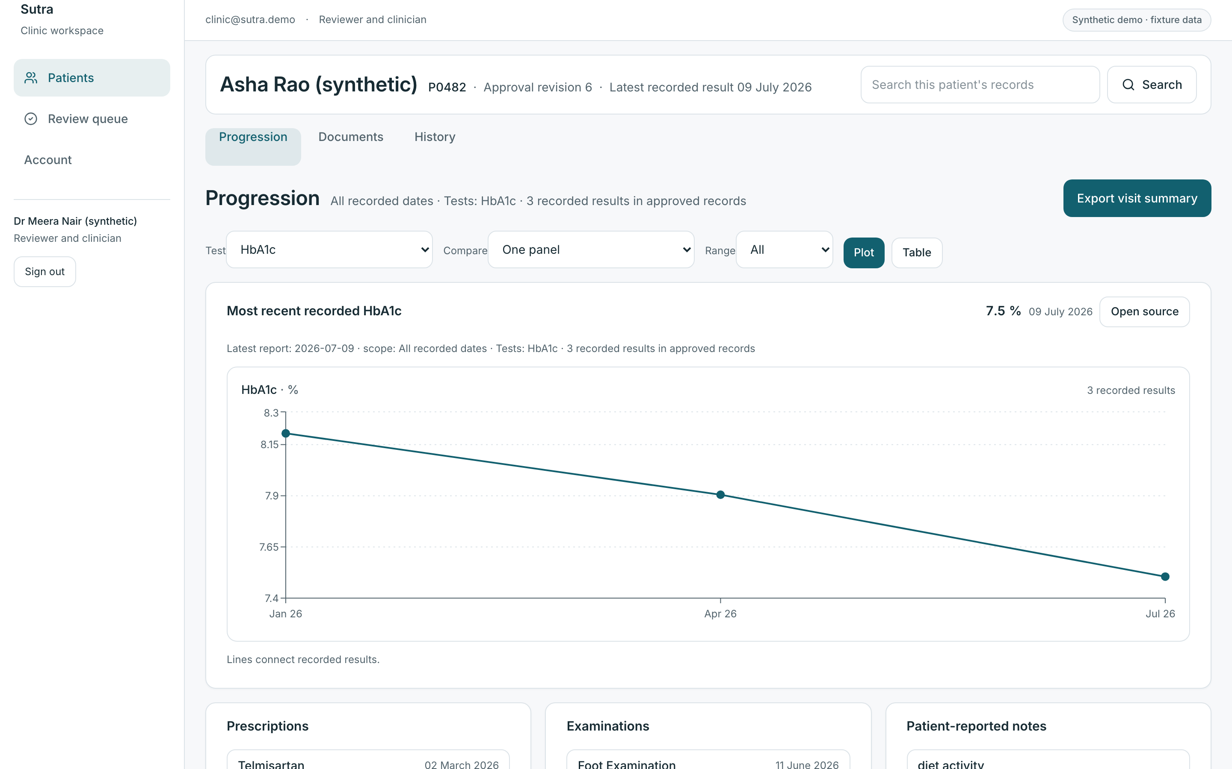
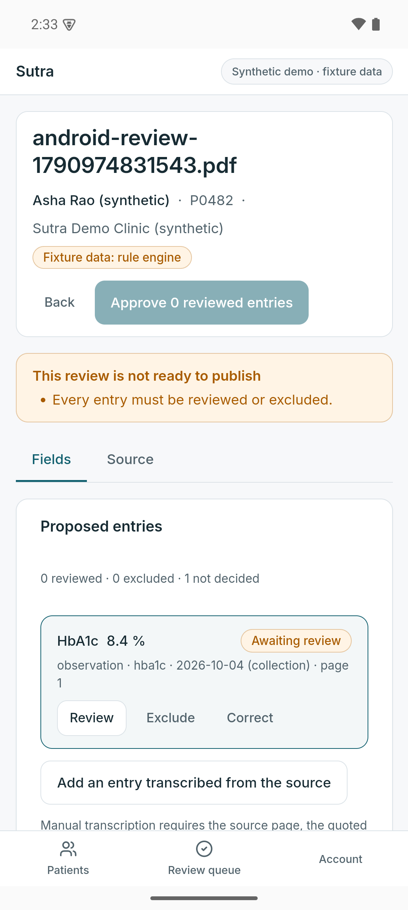
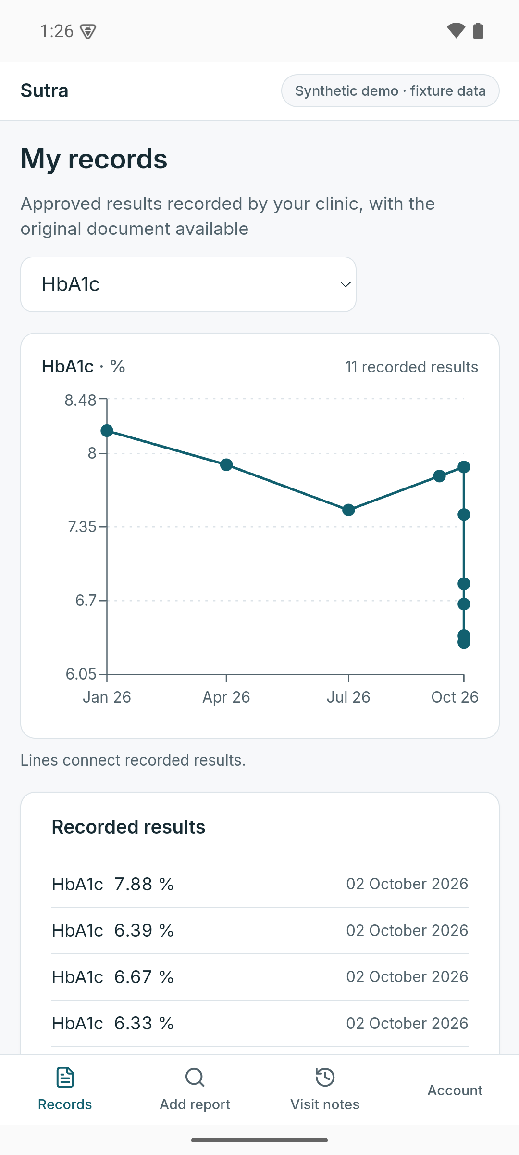
Verified locally, on web and Android
Screenshots from the running build: synthetic patient P0482, deterministic fixture extraction, Android emulator.
Clinic web: approved progression with its coverage scope
Android: reviewer checks one entry
Android: patient records
Verified: upload → processing → review → approval → progression on both roles; 95 automated tests, 25 end-to-end API checks and 43 browser checks pass.
Not yet verified: live model extraction (fixture rule engine only), hosted authentication and storage, a physical Android device, and any time saving.

