Slide 1
CS 1 Task 13
Team Blue | 19.05.2017

Slide 2
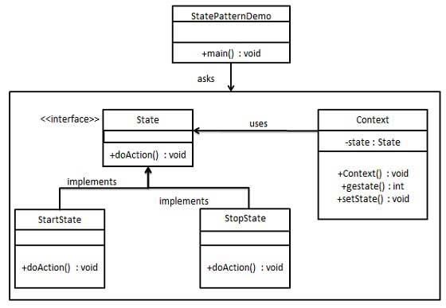

Slide 3
Context
public class DailyExercise extends Exercise {
private State state;
public DailyExercise(String title, String description, String path) {
super(title, description, path);
setState(new ExercisePending());
}
public void setState(State state) {
this.state = state;
}
public State getState() {
return state;
}
}

Slide 4
State
public interface State {
public String getTitle();
public boolean isCancelButtonVisible();
public boolean isStartButtonVisible();
public boolean isDoneButtonVisible();
public String getStateStyle();
}

Slide 5
State Implementations
public class ExercisePending implements State {
@Override
public String getTitle() {
return "Ready";
}
@Override
public boolean isCancelButtonVisible() {
return false;
}
@Override
public boolean isStartButtonVisible() {
return true;
}

Slide 6
All States
ExercisePending
ExerciseStarted
ExerciseCanceled
ExerciseDone

Slide 7
Presenter
@Override
public void exerciseDone() {
currentDailyExercise.setState(new ExcerciseDone());
initExerciseDaily();
}

Slide 8
public void initExerciseDaily(){
. . .
State currentState = currentDailyExercise.getState();
exerciseViewImpl.setDailyExerciseStateDescription(currentS tate.getTitle());
exerciseViewImpl.setDailyExerciseStartButtonVisibility(cur rentState.isStartButtonVisible());
exerciseViewImpl.setDailyExerciseCancelButtonVisibility(cu rrentState.isCancelButtonVisible());
ExerciseViewImpl.setDailyExerciseDoneButtonVisibility(curr entState.isDoneButtonVisible());
exerciseViewImpl.setStateStyle(currentState.getStateStyle( ));
}

Slide 9
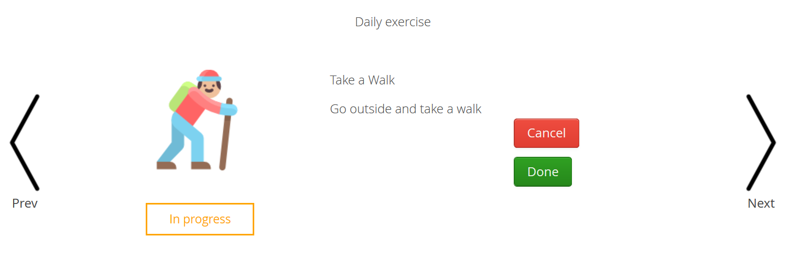
Demo

