Slide 1

Welcome to the Time Variance Authority!
Say hello to Miss Minutes.

Slide 2





PLAY YOUR PART, PRUNE PRODENTLY
SETTINGS
TIMELINE

Slide 3

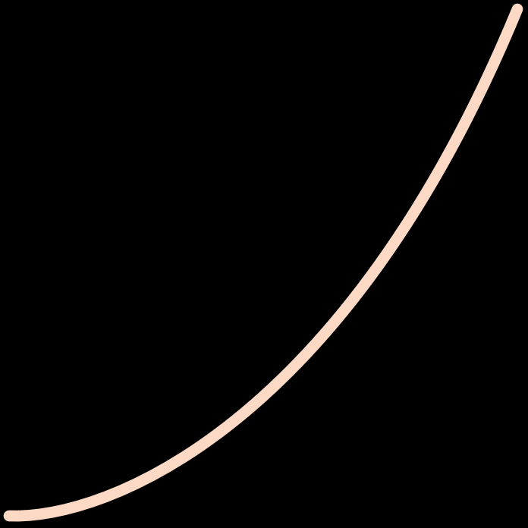
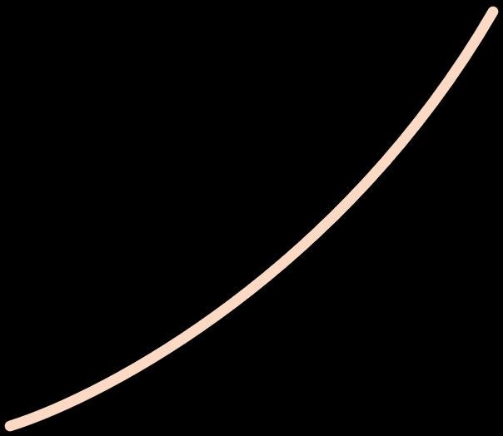
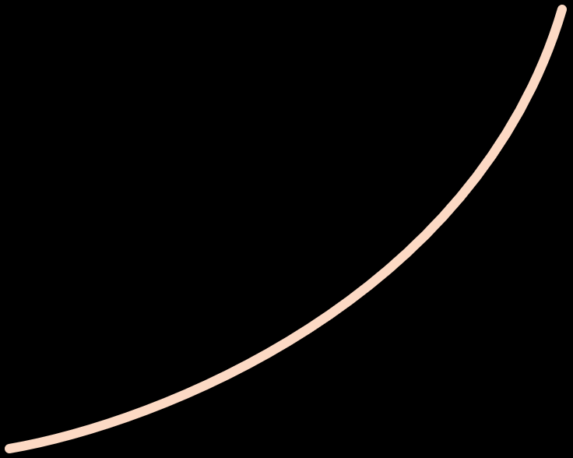










TIDY TIMELINE
HOUR:21
MIN:15
EVENT# | DATE | TIME | LOCATION | TEMP | HMD
46470152=027 | -08.03.1522 | 21:15:01 | Asgard | 25C | 40%

