Slide 1
Should I buy Amazon stock tomorrow?
By Wendy Yuan

Slide 2
Scenario
Trading stock is hard
Stock price fluctuates often due to various factors:
Economic performance
Federal policy
Company performance
Trader sentiment
Supply and demand
These info can be collected via:
Stock news
Technical analysis on historical stock trends
The most frequent question for a new trader is:
should I buy this stock tomorrow for short-term investment?

Slide 3
Thought
Normally, it is easy to buy a stock with previous CLOSE price
If today’s HIGH is higher than previous CLOSE, we will have opportunity to sell it today
A supervised learning solution is designed to make below prediction:
Will today’s HIGH be higher than previous CLOSE?
Nasdaq.com
News Headlines
Sentiment Analysis
Convert
Time Series Data
to
Supervised Learning
Classification
Yahoo Finance
Stock Data
Technical Analysis

Slide 4
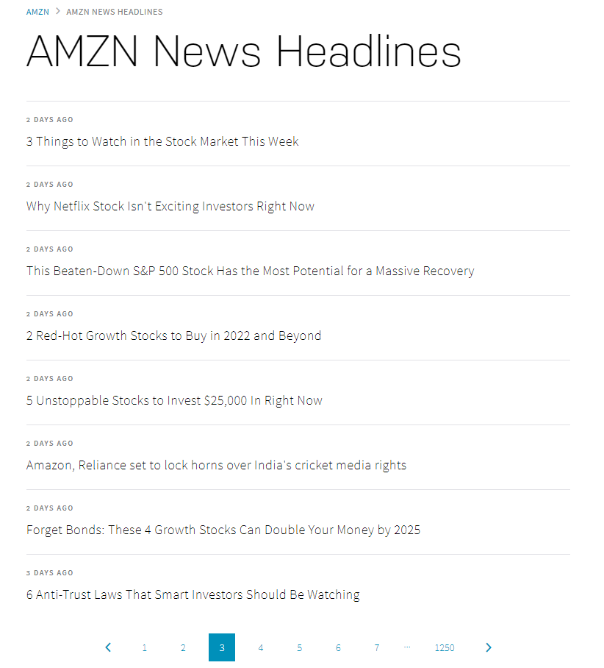
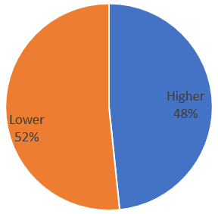
Workflow
Data Exploration
Data Preprocessing
Feature Engineering
Modeling
Testing
From 2020-Sep-08 to 2022-Feb-17, there are 366 trading days

Slide 5
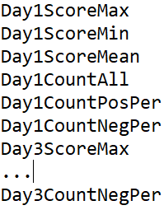
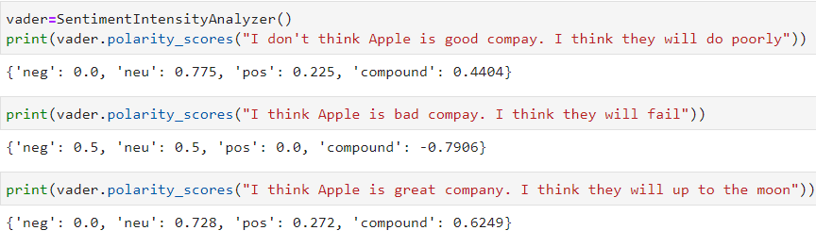
Workflow
Data Exploration
Data Preprocessing
Feature Engineering
Modeling
Testing
Sentiment Analysis for News Headlines from Nasdaq.com

Slide 6
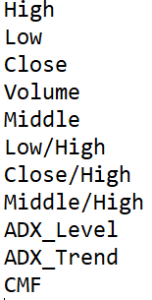
Workflow
Data Exploration
Data Preprocessing
Feature Engineering
Modeling
Testing
Technical Analysis for Stock Data from Yahoo Finance based on TA library
The Average Directional Index (ADX) identifies a strong trend when the ADX is over 25 and a weak trend when the ADX is below 20;
The +DI and -DI measure trend direction over time;
'+DI'>'-DI': Up trend : 1
'+DI'='-DI': Same : 0
'+DI'<'-DI': Down trend: -1
The Chaikin Money Flow (CMF) is a volume-weighted average of accumulation and distribution over a 21-day period. When the CMF volume forex indicator crosses above zero, it’s seen as a buy signal

Slide 7

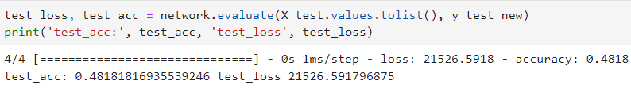
Workflow
Data Exploration
Data Preprocessing
Feature Engineering
Modeling
Testing
XGBoost
Neural Network

Slide 8
Future Work
Sentiment Analysis
Add Federal Reserve news
Add Politic news such as Russia vs Ukraine
Instead of using Web Scraper, find a better way to load historic news
Technical Analysis:
Bring popular indicators such as MA30, MA200, MACD and RSI
Try different methods to identify a short period trend
Find a way to identify whether two trends converge or not, such as MA30 vs MA200
Find a way to identify whether MA200 is stung by recent Candles sticks
Try Different Targets:
Is today the bottom of a short period?
Is today the top of a short period?

