Slide 1
DevOps CA2 — Reflection & Report
SupplyChain Risk Dashboard | Implementation Summary
Developer
GitHub
GitHub
Actions
Ansible
Docker
Kubernetes
Prometheus
Grafana
What was automated
What was monitored
Final outcome
CI validation, Python dependency setup, Docker image creation, Kubernetes deployment and rolling updates.
Kubernetes service targets, application availability and Prometheus/Grafana observability.
A working Streamlit dashboard deployed as two Kubernetes replicas with automated CI and monitoring.
1

Slide 2
1. CI/CD Pipeline
GitHub Actions validates the application on pushes and pull requests to main.
Trigger
Build & Validate
Verification
Push or pull request to the main branch starts the workflow.
Checkout → Python 3.12 → install requirements → generate dataset → compile Python files.
Streamlit installation is checked and the workflow finishes with a successful CI status.
Pipeline file: .github/workflows/ci.yml
Dependencies are installed automatically instead of relying on the developer's local environment.
The workflow provides a repeatable validation step before changes are considered ready.
2

Slide 3
2. Configuration, Containers & Kubernetes
Ansible prepares the runtime; Docker packages the application; Kubernetes manages replicas.
Ansible
Docker
Kubernetes
Local inventory + setup.yml
• Python environment
• Required data directory
• Python dependencies
• Streamlit verification
Python 3.12-slim base image
• requirements installed
• dataset generated
• Streamlit exposed on 8501
• metrics endpoint on 8000
Deployment uses 2 replicas and RollingUpdate strategy.
Service exposes the application and metrics endpoints.
Rolling updates were tested through Kubernetes deployment revisions.
Rollback capability was verified using the deployment history/undo workflow.
Readiness and liveness probes help Kubernetes detect unhealthy application instances.
3

Slide 4
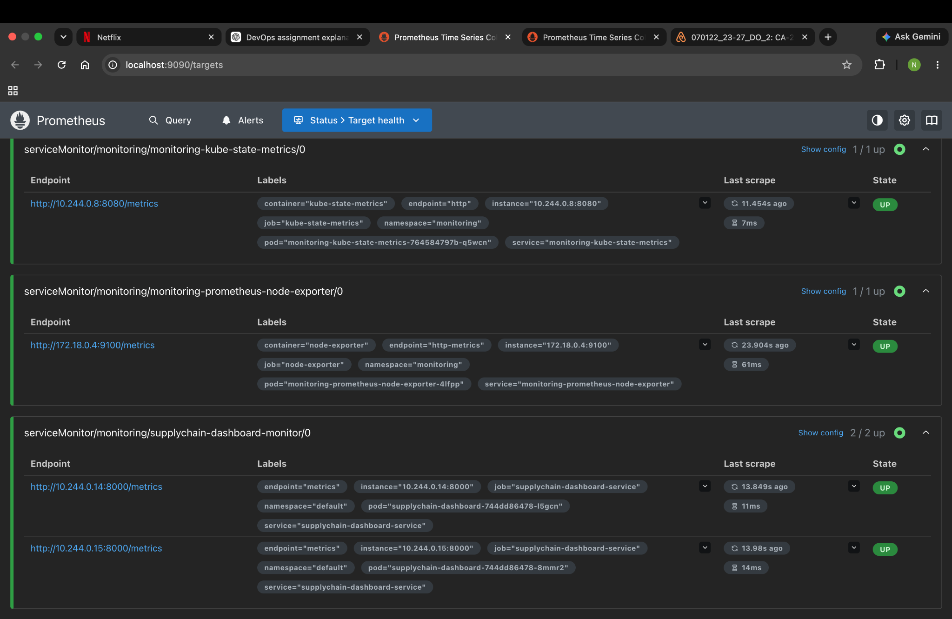
3. Monitoring & Observability
Prometheus discovers both application pods through the ServiceMonitor; Grafana visualizes the collected data.
Prometheus target health
supplychain-dashboard-monitor reports 2/2 targets UP.
Application uptime metric
supplychain_app_up returns 1 for both dashboard pods.
Grafana
A monitoring dashboard was created using the Prometheus data source to visualize application/target health.
Implemented monitoring evidence focuses on uptime and target health; no unsupported application-latency/error claims are made.
4

Slide 5
4. Challenges, Lessons Learned & Conclusion
Key issues encountered during implementation and what the project demonstrated.
Challenge 1 — Kubernetes image/version updates
Challenge 3 — Local DevOps tooling
Multiple Docker image versions were built and deployed while validating Kubernetes rolling updates and revisions.
The project required coordinating GitHub Actions, Ansible, Docker, Kubernetes, Helm, Prometheus and Grafana on a local development environment.
Challenge 2 — Prometheus ServiceMonitor discovery
Lessons learned
The monitor initially showed no application endpoints because the Service did not match the ServiceMonitor selector. Adding the required Service label fixed discovery.
Selectors and labels are critical in Kubernetes monitoring. Reproducible automation reduces manual setup and makes deployment easier to verify.
Conclusion
The final system demonstrates an end-to-end DevOps workflow: automated validation, configuration management, containerization, Kubernetes deployment, rolling updates/rollback, and monitoring.
5

