Slide 1

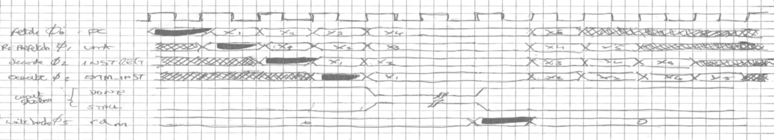
wyvern
semiconductors
14/06/2022
1

Slide 2
Error Detection and Correction
Detection is concerned with finding introduced errors
Parity
Checksum
CRC
Can be used to request retransmission (such as ARQ)
Correction is concerned with compensating for introduced errors to correct at the receiver (forward error correction)
Hamming codes
Reed-Solomon codes
Adds redundancy to spread the data over multiple bits, allowing recovery of errors to a limit of the code

Slide 3
Basic Detection
Parity
XOR (or XNOR) data bits to produce a parity bit.
Even or Odd
Can detect only 1 bit error.
Good for channels with disparate random low level noise
Checksum
Add together data words in a block, modulo checksum width
E.g. Add bytes over 4Kbyte block to produce a 32 bit checksum (i.e. module. 2³²)
Performance is a function of block size and checksum width.
// Parity
wire [7:0] byte;
wire parity_even = ^byte;
wire parity_odd = ~^byte;
// Check sum (behavioural)
reg [7:0] data [0:255];
reg [15:0] chksum = 16'h0000;
integer i;
always (posedge clk)
begin
for(i = 0; i < 256; i = i+1)
chksum = chksum + data[i];
end

Slide 4
Detection: CRC
Use of Linear Feedback Shift Registers (LFSR)
Usually defined in terms of a polynomial
E.g. CCITT CRC-16: x¹⁶ + x¹² + x⁵ + x⁰.
For serial data, a shift register works fine
When all data input, registers contain CRC, shifted out on transmission
When received all bits through LFSR, this is remainder of dividing (modulo-2) the message by the polynomial
If remainder is not zero then an error is detected
For CRC of wider words can expand to tables and calculate multiple bits in single cycle
x⁰
x⁵
x¹²
x¹⁶
data in
crc
out

Slide 5
Error Correction
Hamming Codes
Concept of a Hamming Distance
Choose valid codes that do not become other valid codes in the presence of n bit errors
The n is the Hamming Distance
For example, with a 4-bit code the following values have a Hamming distance of 2
0000b, 0011b, 0101b, 0110b, 1001b, 1111b
It would take two bits to transform one code to another
All other 4-bit values invalid
37.5% code efficiency
With more distance, can be used to correct errors by moving invalid code back to nearest valid code.

Slide 6
Hamming Encoding of 8 bit Data

Slide 7
Encoder Logic for Hamming Code
// ------------------------------ // Encoder // ------------------------------ module hamming8_encoder( input [7:0] data, output [12:0] code); wire p1 = data[0] ^ data[1] ^ data[3] ^ data[4] ^ data[6]; wire p2 = data[0] ^ data[2] ^ data[3] ^ data[5] ^ data[6]; wire p4 = data[1] ^ data[2] ^ data[3] ^ data[7]; wire p8 = data[4] ^ data[5] ^ data[6] ^ data[7]; wire [11:0] hamm_code = {data[7], data[6], data[5], data[4], p8, data[3], data[2], data[1], p4, data[0], p2, p1}; wire parity = ^hamm_code; assign code = {parity, hamm_code}; endmodule
full code, with comments and TB at: http://www.anita-simulators.org.uk/ecc.zip

Slide 8
Decoder Logic for Hamming Code
// ------------------------------ // Decoder // ------------------------------
module hamming8_decoder ( input [12:0] code, output [7:0] data, output error); wire [3:0] e; assign e[0] = code[0] ^ code[2] ^ code[4] ^ code[6] ^ code[8] ^ code[10]; assign e[1] = code[1] ^ code[2] ^ code[5] ^ code[6] ^ code[9] ^ code[10]; assign e[2] = code[3] ^ code[4] ^ code[5] ^ code[6] ^ code[11]; assign e[3] = code[7] ^ code[8] ^ code[9] ^ code[10] ^ code[11]; wire [15:0] flip_mask = 16'h0001 << e; wire [11:0] corr_code = code[11:0] ^ flip_mask[12:1]; wire corr_parity = ^{code[12], corr_code}; assign data = {corr_code[11], corr_code[10], corr_code[9], corr_code[8], corr_code[6], corr_code[5], corr_code[4], corr_code[2]}; // Error if parity on a corrected code fails, or index into codeword invalid (i.e. > 12) assign error = (|e & corr_parity) | (|flip_mask[15:13]); endmodule
full code, with comments and TB at: http://www.anita-simulators.org.uk/ecc.zip

Slide 9
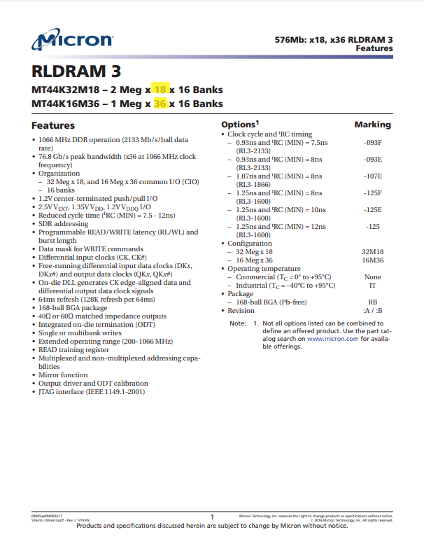
ECC for Larger Data Widths
For 64 bit data we need an additional 8 parity bits
6 bits to index 64 bit data
1 bit to include indexing parity bits
1 bit for code word parity bit
Gives a total of 72 bits
Many DRAM components are in multiples of 9 bits to allow construction of 64 bits with 8 bit ECC (i.e. 72 bits wide)
Datasheet to right for RLDRAM comes in ×18 or ×36 widths

Slide 10
Reed-Solomon Codes
Beyond Hamming codes there are block codes with better properties
More complex to compute
Reed-Solomon codes are a form of block code
Encodes message multi-bit symbols (e.g. bytes) as a block
Adds redundancy parity/check symbols
Corrective ability is half the number of parity symbols
A type of Reed-Solomon code might be RS(255,223)
255 symbol message
32 symbol parity
Can correct up to 16 symbols
Used in optical and other storage (CD, DDS (DAT), DVD, QR codes)
Good for burst errors
Message and parity often interleaved across tracks for better burst robustness
Sometimes have two layers of encoding between interleave to allow for random, as well as burst, errors

Slide 11
Reed-Solomon Terminology
Most explanations of Reed-Solomon Codes are very mathematical and it's hard to extract the information for a logic implementation
Mapping the terminology
Galois Field ⇒ a pseudo-random table generated from an LFSR defined as a polynomial (as per CRC)
Used as the powers (or logs) of a
Primitive element a ⇒ constant (usually 2) used as the seed to the pseudo-random number generator (PRNG)
P and Q ⇒ The parity symbols added to the message symbols
P is used to determine the error pattern (corrector)
Q is used to determine the location of the symbol in error (locator)
Calculated from the generator polynomials
Generator polynomials ⇒ polynomials calculated from a set procedure (solving simultaneous equations)
used to generate the parity symbols

Slide 12
Reed-Solomon Simple Example
Seven Symbol codeword
3-bit symbols
5 data symbols (A to E)
2 parity symbol (P and Q)
On reception, generate two check symbols (syndromes) S₀ and S₁
S₀ = A ⊕ B ⊕ C ⊕ D ⊕ E ⊕ P ⊕ Q
S₁ = a⁷A ⊕ a⁶B ⊕ a⁵C ⊕ a⁴D ⊕ a³E ⊕ a²P ⊕ aQ
These should both be zero if no error
An error at symbol k effectively XORs a pattern with that symbol, so S₀ is then that error pattern
Location
a^{k} = S₁/S₀, so location at k
Or, more practically, multiply (using logs) S₀ with various powers of a until it matches S₁
Powers and multiplication will be avoided using logarithmic modulo2 additions (XOR), with the GF table providing the log values
Example 7 symbol code word
codeword
A | B | C | E | F | P | Q
1 | 1 | 0 | 1 | 1 | 1 | 1
0 | 0 | 1 | 0 | 1 | 0 | 0
1 | 0 | 0 | 0 | 0 | 1 | 0
data symbols
parity symbols

Slide 13
Reed-Solomon Parity Symbol Calculation
From the example 7 symbol code:
P = a⁶A ⊕ aB ⊕ a²C ⊕ a⁵D ⊕ a³E
Q = a²A ⊕ a³B ⊕ a⁶C ⊕ a⁴D ⊕ aE
These polynomials are calculated by solving the simultaneous equations for S₀ and S₁.
This can be done upfront, so no logic required
Values in Galois Field will be the powers raised on a
Thus to multiply symbol 100b by a³, 100b = a² so a² × a³ = a²⁺³ = a⁵ = 111b
If resultant power larger than table, it wraps (skipping 0).
So a¹¹ = a⁴
Galois Field
LFSR polynomial x³ + x + 1
a | 0 | 1 | 0
a² | 1 | 0 | 0
a³ | 0 | 1 | 1
a⁴ | 1 | 1 | 0
a⁵ | 1 | 1 | 1
a⁶ | 1 | 0 | 1
a⁷ | 0 | 0 | 1

Slide 14
Reed-Solomon Multiplication
Logic for multiplying by powers of a now just becomes logic to map that many steps through the table
Two multiplier circuits from example for ×a and ×a².
The rest can just be derived in a similar manner
Can use tables for log/alog and do addition
Which is what we'll do
× a
× a²

Slide 15

Reed-Solomon Error Correction
calculating parity symbols
A | 101 | a⁶A | 111 | a²A | 010
B | 100 | aB | 011 | a³B | 111
C | 010 | a²C | 011 | a⁶C | 001
D | 100 | a⁵D | 001 | a⁴D | 101
E | 111 | a³E | 010 | aE | 101
P | 100 | ⇐ | 100
Q | 100 | ⇐ | ⇐ | ⇐ | 100
A | 101 | a⁷A | 101 | 7
B | 100 | a⁶B | 010 | 6
C' | 110 | a⁵C' | 100 | 5
D | 100 | a⁴D | 101 | 4
E | 111 | a³E | 010 | 3
P | 100 | a²P | 110 | 2
Q | 100 | aQ | 011 | 1
S₀ | 100 | S₁ | 001
calculating syndromes
(with errors)
A | 101 | a⁷A | 101
B | 100 | a⁶B | 010
C | 010 | a⁵C | 101
D | 100 | a⁴D | 101
E | 111 | a³E | 010
P | 100 | a²P | 110
Q | 100 | aQ | 011
S₀ | 000 | S₁ | 000
calculating syndromes
(no errors)
$$ak=\frac{S_{1}}{S_{0}}=\frac{a^{7}}{4}{=\frac{a^{7}}{a^{2}}=a^{7−2}=a}^{5}$$
$${C=C}^{′}\text{⊕} S_{0}=110 \text{⊕} 100=010$$
GF
a | 010
a² | 100
a³ | 011
a⁴ | 110
a⁵ | 111
a⁶ | 101
a⁷ | 001
Any number of error bits in symbol can still be corrected

Slide 16
Reed-Solomon encoder (RS(7,5))
module rs_7_5_encoder
(
input [14:0] idata,
output[20:0] ocode
);
wire [2:0] s [0:6];
integer idx;
reg [2:0] GF_log [1:7];
reg [2:0] GF_alog [1:7];
reg [2:0] p_poly [0:4];
reg [2:0] q_poly [0:4];
reg [3:0] p_data [0:4];
reg [3:0] q_data [0:4];
reg [2:0] P, Q;
assign s[0] = idata[2:0];
assign s[1] = idata[5:3];
assign s[2] = idata[8:6];
assign s[3] = idata[11:9];
assign s[4] = idata[14:12];
assign s[5] = P;
assign s[6] = Q;
assign ocode = {s[6], s[5], s[4], s[3],
s[2], s[1], s[0]};
initial
begin
// Galois field for x3 + x + 1
GF_alog[1] = 3'b010; GF_alog[2] = 3'b100;
GF_alog[3] = 3'b011; GF_alog[4] = 3'b110;
GF_alog[5] = 3'b111; GF_alog[6] = 3'b101;
GF_alog[7] = 3'b001;
// Inverse (log) Galois field for
// x3 + x + 1
GF_log[1] = 3'b111; GF_log[2] = 3'b001;
GF_log[3] = 3'b011; GF_log[4] = 3'b010;
GF_log[5] = 3'b110; GF_log[6] = 3'b100;
GF_log[7] = 3'b101;
// Corrector polynomial (log):
// a6 + a + a2 + a5 + a3
p_poly[0] = 6; p_poly[1] = 1;
p_poly[2] = 2; p_poly[3] = 5;
p_poly[4] = 3;
// Locator polynomial (log):
// a2 + a3 + a6 + a4 + a
q_poly[0] = 2; q_poly[1] = 3;
q_poly[2] = 6; q_poly[3] = 4;
q_poly[4] = 1;
end
always @(*)
begin
P = 3'b000;
Q = 3'b000;
for (idx = 0; idx < 5; idx = idx + 1)
begin
// Calulate P
p_data[idx] = p_poly[idx] + GF_log[s[idx]];
p_data[idx] = p_data[idx][2:0] + p_data[idx][3];
p_data[idx] = GF_alog[p_data[idx]];
P = P ^ p_data[idx];
// Calculate Q
q_data[idx] = q_poly[idx] + GF_log[s[idx]];
q_data[idx] = q_data[idx][2:0] + q_data[idx][3];
q_data[idx] = GF_alog[q_data[idx]];
Q = Q ^ q_data[idx];
end
end
endmodule
full code, with comments and TB at: http://www.anita-simulators.org.uk/ecc.zip

Slide 17
Reed-Solomon decoder (RS(7,5))
module rs_7_5_decoder
(
input [20:0] icode,
output [14:0] odata
);
reg [2:0] s [0:6];
integer idx;
reg [2:0] GF_log [1:7];
reg [2:0] GF_alog [1:7];
reg [3:0] S1_poly [0:6];
reg [3:0] k;
reg [2:0] S0;
reg [2:0] S1;
assign odata = {s[4], s[3], s[2], s[1], s[0]};
initial
begin
// Galois field for x3 + x + 1
GF_alog[1] = 3'b010; GF_alog[2] = 3'b100;
GF_alog[3] = 3'b011; GF_alog[4] = 3'b110;
GF_alog[5] = 3'b111; GF_alog[6] = 3'b101;
GF_alog[7] = 3'b001;
// Inverse (log) Galois field for
// x3 + x + 1
GF_log[1] = 3'b111; GF_log[2] = 3'b001;
GF_log[3] = 3'b011; GF_log[4] = 3'b010;
GF_log[5] = 3'b110; GF_log[6] = 3'b100;
GF_log[7] = 3'b101;
end
always @(icode)
begin
s[0] = icode[2:0]; s[1] = icode[5:3];
s[2] = icode[8:6]; s[3] = icode[11:9];
s[4] = icode[14:12]; s[5] = icode[17:15];
s[6] = icode[20:18];
S0 = s[0] ^ s[1] ^ s[2] ^ s[3] ^
s[4] ^ s[5] ^ s[6];
S1 = 3'b000;
for (idx = 0; idx < 7; idx = idx + 1)
begin
S1_poly[idx] = (7 - idx) + GF_log[s[idx]];
S1_poly[idx] = S1_poly[idx][2:0] + S1_poly[idx][3];
S1_poly[idx] = s[idx] ? GF_alog[S1_poly[idx]] : 3'b000;
S1 = S1 ^ S1_poly[idx];
end
if (S0 != 3'b000)
begin
k = GF_log[S1] - GF_log[S0];
k = k[2:0] - k[3];
k = (k == 4'b0000) ? GF_log[3'b001] : k;
s[7-k] = s[7-k] ^ S0;
end
end
endmodule
full code, with comments and TB at: http://www.anita-simulators.org.uk/ecc.zip

Slide 18
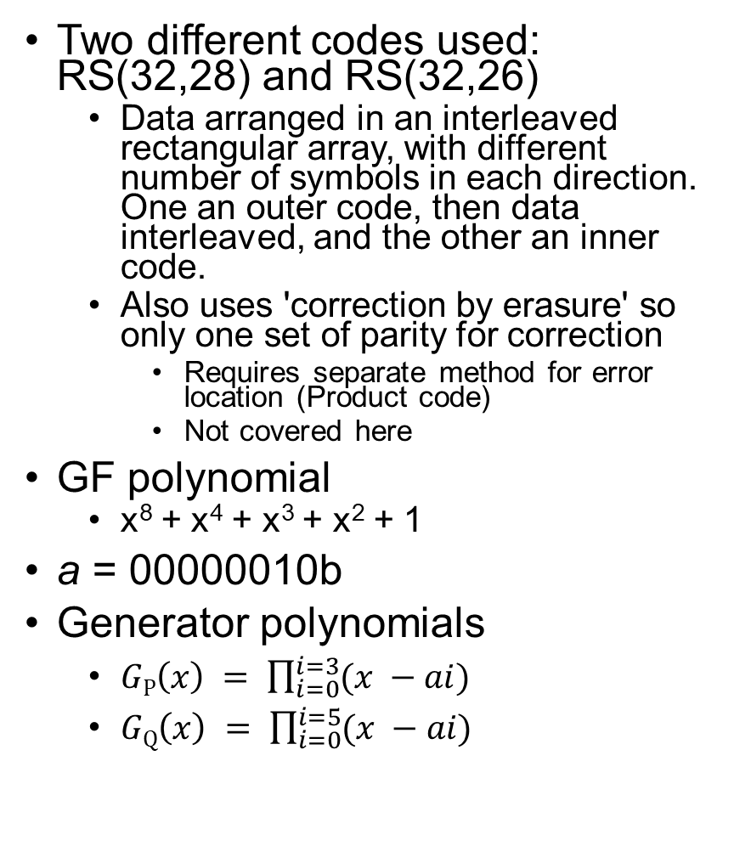
Reed-Solomon Codes for DAT/DDS
Two different codes used: RS(32,28) and RS(32,26)
Data arranged in an interleaved rectangular array, with different number of symbols in each direction. One an outer code, then data interleaved, and the other an inner code.
Also uses 'correction by erasure' so only one set of parity for correction
Requires separate method for error location (Product code)
Not covered here
GF polynomial
x⁸ + x⁴ + x³ + x² + 1
a = 00000010b
Generator polynomials
$GP\left(x\right) = \prod_{i=0}^{i=3}{(x −ai)}$
$GQ\left(x\right) = \prod_{i=0}^{i=5}{(x −ai)}$
Check Matrices
1 | 1 | 1 | … | 1 | 1 | 1
a³¹ | a³⁰ | a²⁹ | … | a² | a | 1
a⁶² | a⁶⁰ | a⁵⁸ | … | a⁴ | a² | 1
a⁹³ | a⁹⁰ | a⁸⁷ | … | a⁶ | a³ | 1
H_{P} =
1 | 1 | 1 | … | 1 | 1 | 1
a³¹ | a³⁰ | a²⁹ | … | a² | a | 1
a⁶² | a⁶⁰ | a⁵⁸ | … | a⁴ | a² | 1
a⁹³ | a⁹⁰ | a⁸⁷ | … | a⁶ | a³ | 1
a¹²⁴ | a¹²⁰ | a¹¹⁶ | … | a⁸ | a⁴ | 1
a¹⁵⁵ | a¹⁴⁵ | a¹⁴⁰ | … | a¹⁰ | a⁵ | 1
H_{Q} =
note: P and Q here are not the same as in example,
but are for rows and columns of the interleaved array

Slide 19

Other Topics That Might Be Of Interest
Data Compression Articles on LinkedIn
Lossless Data Compression Overview
Lempel-Ziv-Welch (LZW) Algorithm
LZW Implementation in C
JPEG Image Compression
JPEG/JFIF Decoder Implementation in C++
Logic Simulator Programming Interface Articles on LinkedIn
Introduction to SystemVerilog's DPI, Verilog's PLI and VPI, and VHDL's FLI
A "Virtual Processor" Simulation Verification IP Component
Co-simulating Embedded Software with Logic
Planned LinkedIn Articles to look out for
Instruction Set Simulator Architecture and C/C++ system models
Using make for front-end chip development
C++ for Logic Engineers
Logic Design for High Speed
TCP/IPv4 Protocol with Pattern Generator Verification IP
PCIe 2.0 Protocol with Root Complex model Verification IP
Auto-generation of source code
Some of the topics covered in the mentoring sessions may also appear as articles on LinkedIn

Slide 20
References
[1] Hamming, R.W., Error-detecting and error-correcting codes. Bell System Tech. J., 26,147–160 (1950)
[2] Watkinson, J., The Art of Digital Audio (3rd Edition), Focal Press (2001)
[3] Anon., Standard ECMA-139, 3,81mm Wide Magnetic Tape Cartridge for Information Interchange – Helical Scan Recording – DDS Format, ECMA (June 1990)

Slide 21
end

Slide 22
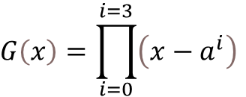
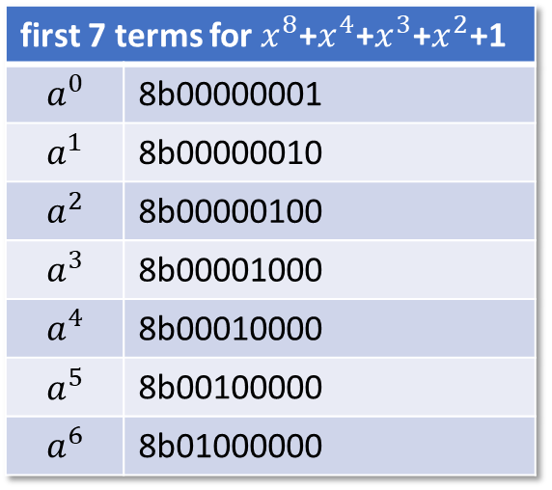
Calculating Generator Polynomial
first 7 terms for $x^{8}$+$x^{4}$+$x^{3}$+$x^{2}$+1
$$a^{0}$$ | 8b00000001
$$a^{1}$$ | 8b00000010
$$a^{2}$$ | 8b00000100
$$a^{3}$$ | 8b00001000
$$a^{4}$$ | 8b00010000
$$a^{5}$$ | 8b00100000
$$a^{6}$$ | 8b01000000
$$G\left(x\right)=\prod_{i=0}^{i=3}{\left(x−a^{i}\right)}$$
NB: $\left(x−a^{i}\right)=\left(x+a^{i}\right)$ since using modulo 2 arithmetic (XOR)
$G\left(x\right)=\left(x+a^{0}\right)$ $\left(x+a^{1}\right)\left(x+a^{2}\right)$ $\left(x+a^{3}\right)$
$$G\left(x\right)=\left(x^{2}+(a^{1}+a^{0})x+a^{1}\right)\left(x+a^{2}\right)\left(x+a^{3}\right)$$
$$G\left(x\right)=\left(x^{2}+(a^{1}+a^{0})x+a^{1}\right)\left(x+a^{2}\right)\left(x+a^{3}\right)$$
$$G\left(x\right)=\left(x^{3}+\left(a^{1}+a^{0}\right)x^{2}+a^{1}x+a^{2}x^{2}+\left(a^{3}+a^{2}\right)x+a^{3}\right)\left(x+a^{3}\right)$$
$$G\left(x\right)=\left(x^{3}+\left(a^{2}+a^{1}+a^{0}\right)x^{2}+\left(a^{3}+a^{2}+a^{1}\right)x+a^{3}\right)\left(x+a^{3}\right)$$
$$G\left(x\right)=x^{4}+\left(a^{2}+a^{1}+a^{0}\right)x^{3}+\left(a^{3}+a^{2}+a^{1}\right)x^{2}+a^{3}x+a^{3}x^{3}+a^{3}\left(a^{2}+a^{1}+a^{0}\right)x^{2}+a^{3}\left(a^{3}+a^{2}+a^{1}\right)x+a^{6}$$
$$G\left(x\right)=x^{4}+\left(a^{2}+a^{1}+a^{0}\right)x^{3}+\left(a^{3}+a^{2}+a^{1}\right)x^{2}+a^{3}x+a^{3}x^{3}+\left(a^{5}+a^{4}+a^{3}\right)x^{2}+\left(a^{6}+a^{5}+a^{4}\right)x+a^{6}$$
$$G\left(x\right)=x^{4}+\left(a^{3}+a^{2}+a^{1}+a^{0}\right)x^{3}+\left({a^{5}+a^{4}+a^{3}+a}^{3}+a^{2}+a^{1}\right)x^{2}+\left(a^{6}+a^{5}+a^{4}+a^{3}\right)x+a^{6}$$
$$G\left(x\right)=x^{4}+\left(a^{3}+a^{2}+a^{1}+a^{0}\right)x^{3}+\left(a^{5}+a^{4}+a^{2}+a^{1}\right)x^{2}+\left(a^{6}+a^{5}+a^{4}+a^{3}\right)x+a^{6}$$
$$G\left(x\right)={0x01x}^{4}+0x0fx^{3}+0x36x^{2}+0x78x+0x40 ⇒(a^{0}x^{4}+a^{75}x^{3}+a^{249}x^{2}+a^{78}x+a^{6})$$

