Slide 1

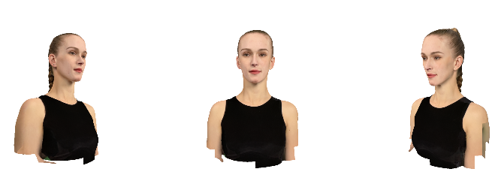
实现BundleAdjustment
https://github.com/YudongGuo/DIP-Teaching/tree/main/Assignments/03_BundleAdjustment

Slide 2
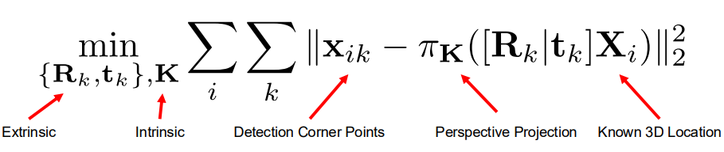

Part 1: BundleAdjustment using Pytorch
OPT Them using Pytorch

Slide 3
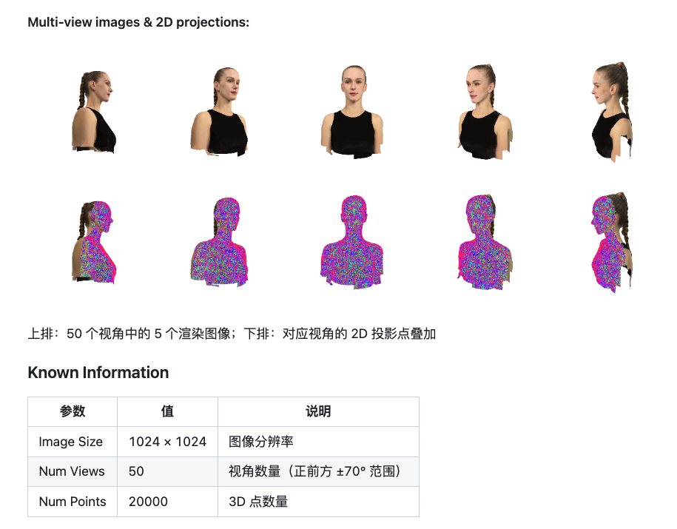
Knowns:
2D projections
Unknowns:
R、T、focal length
3D Pts

Slide 4
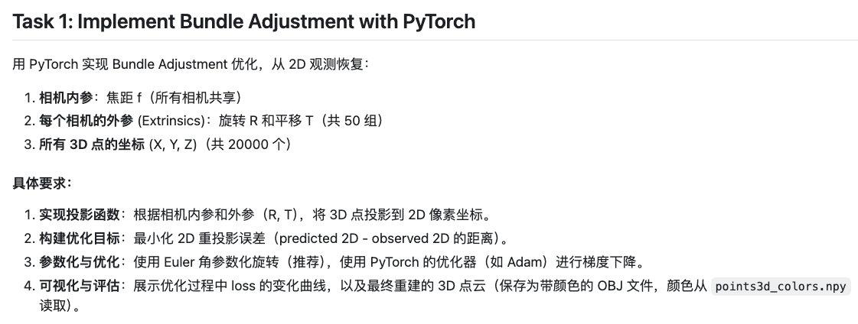
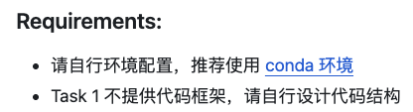

Slide 5
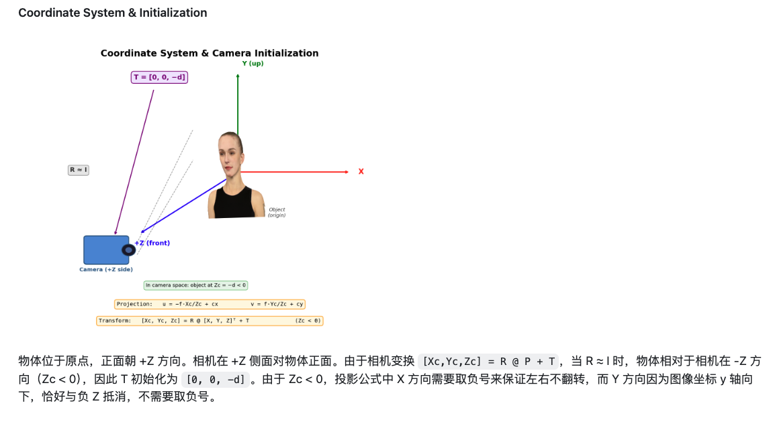
关于相机坐标

Slide 6
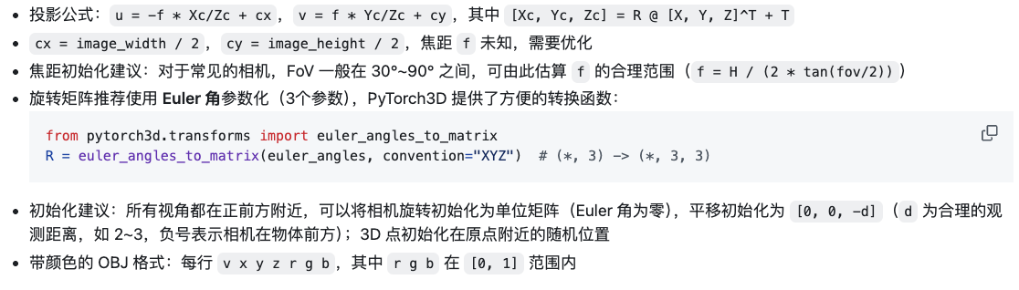
关于初始化和结果

Slide 7
实际演示

Slide 8
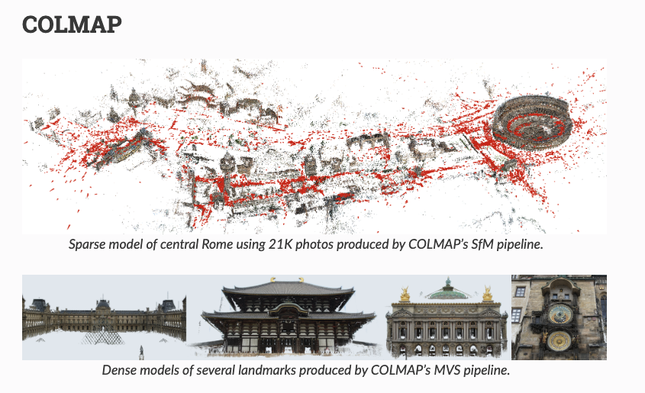
Part 2: BundleAdjustment using Colmap
https://colmap.github.io/

Slide 9
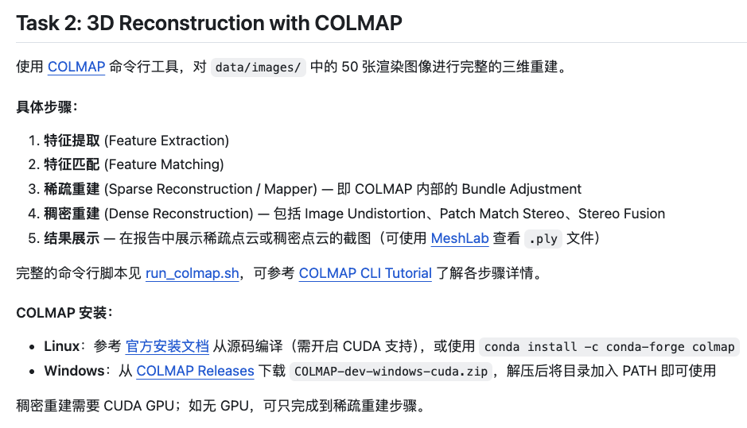

Slide 10
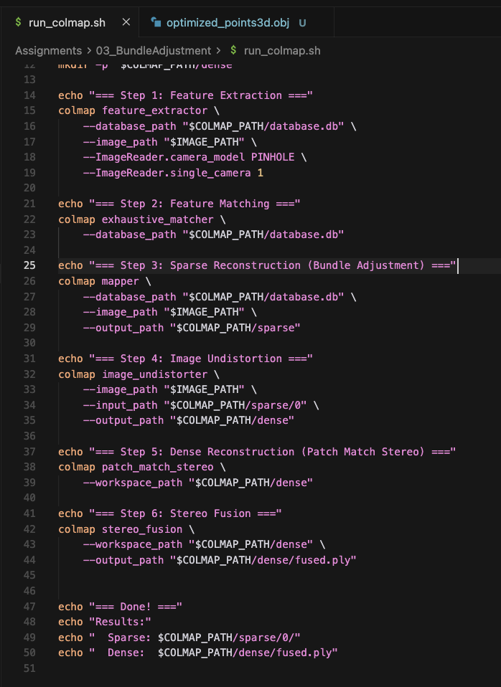
Part 2: BundleAdjustment using Colmap
无代码要求
配置环境和熟悉使用

Slide 11
实际演示

Slide 12
Q&A

