Slide 1
VISION SDK Use-Case Auto-Generation Tool Overview July 2016

Slide 2
Agenda
Introduction
Motivation
Use-case Generation process
Error Handling cases
Extending the tool - Ease for Developer

Slide 3
What is Vision SDK ?
VISION SDK is multi processor software development platform for TI family of ADAS SoCs.
The software framework allows users to create different ADAS application data flows involving video capture, video pre-processing, video analytics algorithms, and video display.
The SDK has sample ADAS data flows which exercises different CPUs and HW accelerators in the ADAS SoC and shows customers how to effectively use different SoC sub-systems.
VISION SDK will be based on a framework named as the “Links and Chains” framework and user API to this framework is called “Link API”
The SDK installer package includes all tools and components necessary to build such applications, including code gen tools, BIOS, IPC, starterware, BSP drivers, networking stacks, codecs, algorithm kernels

Slide 4
Example ADAS data flow – LVDS surround view – system diagram
VSS28 SoC1A
LVDS Cam 1
1MP @ 30fps1A
VIP1-1A
VPE
4CH VGA @ 30fps1A
1MP @ 30fps1A
4CH 1MP @ 30fps1A
Boundary info @ 5fps1A
LVDS Cam 2
VIP1-1B
2D SV Stage – 1
DSP or EVE or A15 ?
2D SV Stage – 2
DSP or EVE or A15 ?
1MP @ 30fps1A
LVDS Cam 3
VIP1-2A
1MP @ 30fps1A
Alignment info @ 5fps1A
Stitching Matrix @ 30fps1A
LVDS Cam 4
VIP1-2B
2D SV Stage – 3
DSP or EVE or A15 ?
LCD
DSS
“Stitched” 1MP @ 30fps1A
800x480 @ 60fps1A
Logical design, not yet sure where to run different algorithm stages

Slide 5
Example ADAS data flow – LVDS surround view in Vision SDK
VSS28 SoC1A
6CH 1MP @ 30fps1A
6CH VGA @ 30fps1A
Time synced 6CH VGA @ 30fps1A
LVDS Cam 1
1MP @ 30fps1A
VPE Link
IPC Link
IPC Link
Capture
1MP @ 30fps1A
LVDS Cam 2
Boundary info @ 30fps
1MP @ 30fps1A
2D SV Stage – 1
DSP1
2D SV Stage – 2
DSP1
LVDS Cam 3
IPC Link
LVDS Cam 4
1MP @ 30fps1A
IPC Link
Alignment info @ 30fps
Stitching Matrix @ 30fps1A
2D SV Stage – 3
EVE1
IPC Link
LCD
Display Link
IPC Link
“Stitched” 1MP @ 30fps1A
800x480 @ 60fps1A
First cut implementation, based on DSP and EVE
IPU1 Core0
IPU1 Core1
DSP1
DSP2
EVE1
EVE2
A15
5
5
5
5
5

Slide 6
Normal Use-Case Generation Process
User has to determine the flow of connections
C code has to be written for the use-case which
Set LinkID and Parameters
Insert IPC links when buffers are exchanged across CPUs
Connect Links
Create links in sequence of source to sink
Write functions for use-case Create, Start, Stop, Delete (PrintBufferStatistics, Print Link Statistics)

Slide 7
Normal Use-Case Generation Process: Drawbacks
Typically usecase files have around 1000+ lines
Writing a given usecase requires a lot of time
It took 1 week to write the surround view use-case file
This method is more error prone
It took one week to make sure surround view use-case create, start, stop, delete passes
Common mistakes include – this would take 1 week to resolve on HW board
Wrong connection of previous link ID to next link ID
Wrong link ID setting
Wrong insertion of IPC link

Slide 8
Motivation
Help end user generate use-case in minimum time
Give overall summary of use-case code using visual representation of data flow via images and logs
Help user focus to main problem, i.e. determine flow of connections
Detect and report errors during use-case generation stage itself and therefore reduce time required to debug on actual HW board
Takes very less effort for changes in data flow. For e.g. change in Algorithm, or adding a new algorithm in a existing data flow

Slide 9
Example Results
Single Capture Display Use-case:
Generated 210 lines
Using 2 lines of configuration file
Dense Optical Flow Use-Case
Generated 895 lines
Using 14 lines of configuration file
Single Camera Frame copy to Single Camera Edge Detection
Required change of algorithm name in configuration file
Changing algorithm parameters in C code, which in this case 4 lines

Slide 10
Use-Case Coding Process using the tool
Step 1 Configuration File
Write Configuration file
Step 2 Code generation
Generate .h and .c files
Step 3 Fill in missing code
Link Parameters
Main control loop
Generate .jpg and log files
Process :
Write Configuration file
Code generation using the tool
Fill in missing code
Link parameters
Main control loop
Ready for use

Slide 11

Use-Case Coding Process: Config File
A Link is named as [Link name] or [Link name]_[user readable suffix].
For e.g Capture, Capture_lvds, Capture_ov10640
“-help” option displays all supported link names. All links in Vision SDK 2.3 are supported in the tool
Different suffix for different instances, i.e. Display_Video, Display_Grpx
Suffix can be any sequence of char’s or number’s readable to end user.
Example: Single camera display
Use-case name should be mentioned
Files are generated with the use-case name and used for struct name and prefix of other function names
IPC links, if required, are auto-detected and code for IPC links are autogenerated. So, no need to mention IPC IN/OUT links explicitly in config file
Link Instance ID is auto-generated, Ex, in example shown above Display_Video will be Display Instance 0 and Display_Grpx will be Display Instance 1. No need to specify explicit instance number.

Slide 12
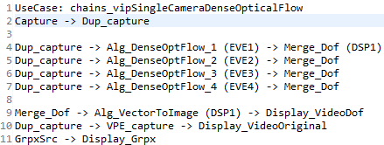
Configuration file: Grammar
Grammar:
Connection: ID (optional CPU name) | ID (optional CPU name) -> Connection;
When CPU name is not mentioned IPU1_0 CPU is assumed
Example: Dense optical flow view

Slide 13
Code generation
Demo of how to generate code:
Options available:
-help Show help and supported basename and processors
-file Create .c and .h file
-img Create in .jpg image (or out.jpg)
-log Creates a .txt log file with debugging info
-debug Prints file name(in source code) and line no. in error statement
-path takes the next argument as output path
-v Verbose
Examples:
./vsdk_win32 –file test
./vsdk_win32 –file –img test –path output

Slide 14
Generated Code and Files
Auto-Generated code includes
Usecase object have link ID variables and create structure for all links used in the use case
Assignment of link ID including instance numnber and CPU on which it runs
Reseting of all link create parameters to default values
Detecting and inserting IPC OUT/IN links as required
Setting of all parameters of DUP, MERGE, IPC links
Setting of inQueParams and outQueParams for all links - this defines the usecase graph connection in C code
Calling link create for all links in source to sink order
Calling start / stop / delete / print statistics of all links in the use-case
Generated Files:
[use case name]_priv.h and [use case name]_priv.c file
Image file (optional) showing visual representation of the use-case graph
log file (optional) for advanced debug

Slide 15
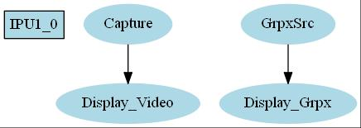
Example Generated Image
Single Camera Capture Display

Slide 16
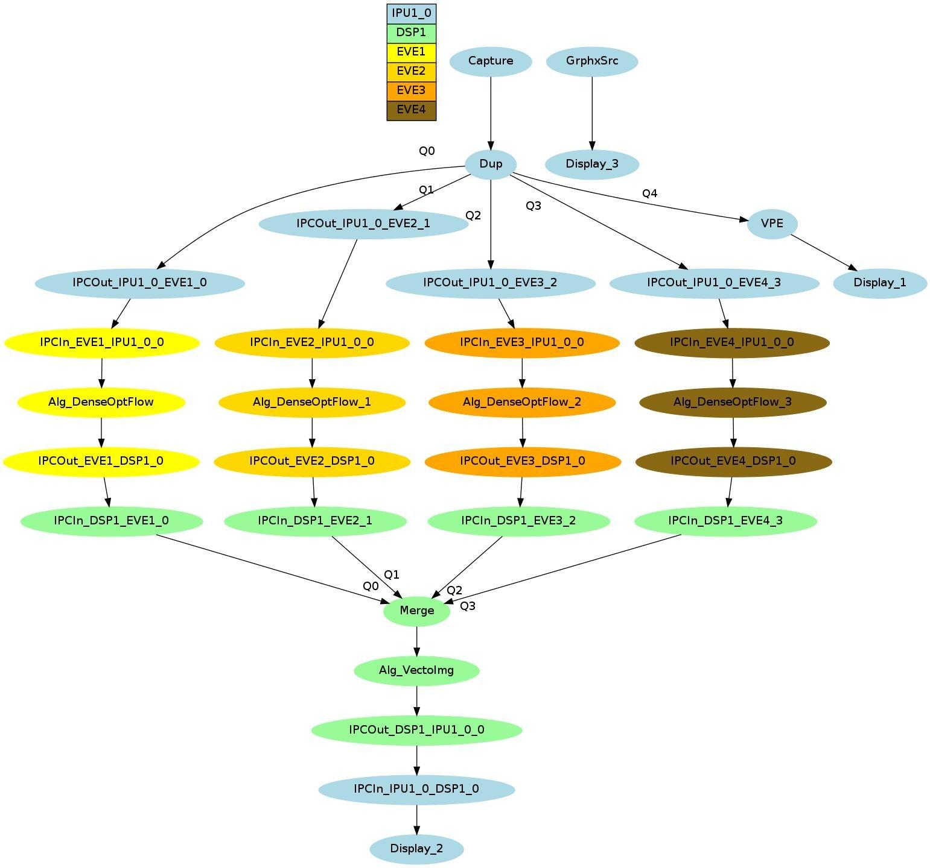
Example Generated Image: Dense Optical Flow

Slide 17
Manually Written Code
Following code needs to manually written to complete the use-case and make it run on the HW board
Set Create Parameters of all links except inQueParams and outQueParams.
DUP, Merge, IPC IN, IPC OUT parameters are completely setup by the generated code
Algorithm Plugin baseClassCreate.size, baseClassCreate.algId are setup by the generated code
numOutQueue of Select, numInQueue of Null are setup by the generated code
Create DisplayCtrl link and configure it
Written main loop for use case and call generated API to create, start, stop, delete a use-case

Slide 18
Define custom link
User can define a custom link which is not supported by the tool
It is named as DefLink_[Link name] in configuration file
Here additionally edit DefLink_CreateParams struct name in [use case]_priv.h file and replace with actually parmaeter structure name of the custom link
Set LinkID in [use case]_priv.c file and call reset create params function in [use case]_priv.c file

Slide 19
Define custom Algorithm
User can define a custom link which is not supported by the tool
It is named as Alg_[alg name] in configuration file
Here additionally edit “[alg name]Link_CreateParams” struct name in [use case]_priv.h file and replace with actually parameter structure name of the custom link
Set baseClassCreate.size, baseClassCreate.algId in [use case]_priv.c file and call reset create params function in [use case]_priv.c file

Slide 20
Error Handling cases
Wrong number of input or output to a link
Ex, previous link specified for capture link
Invalid CPU name
Same link instance is assigned two different CPUs
Naming of Link does not follow the rules, i.e. Linkname, Linkname_suffix
Warnings for unsupported links and algorithm plugin’s

Slide 21
Extending the tool - Ease for developer
In case extra link or alg plugin is added just include extra class in link.h
Each class has it’s separate functionalities which makes easier for user to determine where to change to include additional functionalities, etc.
UseCase class handles overall usecase information
Link class handles information regarding a particular link
In debug mode (-debug option) line number and file name is also given in case of errors
See VisionSDK_UsecaseGen_UserGuide for step by steps details on extending the tool to support more link types and alg plugin types

Slide 22
Thank You

