Slide 1

Quant Research by
Machine Learning
Case by CSI300 Daily Data and LightGBM Model
Yuxuan WANG
30 June 2026

Slide 2
CONTENTS
01
CSI Daily Data
02
Alpha 158
03
Model
04
Parameters
05
Experiment
06
Appendix

Slide 3
Part 01
CSI Daily Data

Slide 4
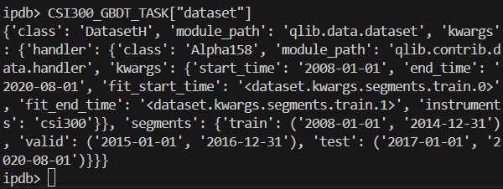
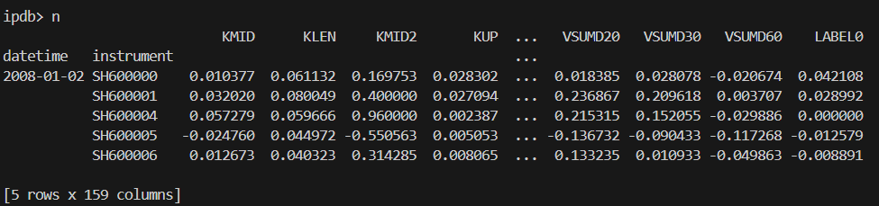
CSI Daily Data
Time-series Segments
Training set (7 years): (2008-01-01) – (2014-12-31)
Validation set (2 years): (2015-01-01 ) – (2016-12-31)
Test set (3 years 7 months): (2017-01-01) – (2020-08-01)
Example Data

Slide 5
Part 02
Alpha 158

Slide 6
Alpha 158
Category | Operators | Windows | Features | Description
A. K-bar (Candlestick) | 9 | — | 9 | Intraday price structure and candlestick morphology metrics capturing single-bar price distribution
B. Raw Price (normalized) | 4 | [0] | 4 | Price level indicators normalized by closing price for cross-sectional comparability
C. Rolling Technical | 29 | [5, 10, 20, 30, 60] | 145 | Rolling-window technical indicators spanning trend, volatility, momentum, support/resistance and volume dynamics across multiple horizons
TOTAL | 42 |  | 158 | Alpha158 = 158 standardized feature columns for alpha factor modeling
D. Label | 1 | — | 1 | Forward return target variable for supervised predictive modeling

Slide 7
Alpha 158 (A — K-bar Features)
# | Name | Expression | Description
1 | KMID | (close−open)/open | Intraday price return relative to opening price
2 | KLEN | (high−low)/open | Intraday trading range normalized by opening price
3 | KMID2 | (close−open)/(high−low+1e-12) | Real body ratio – price move relative to full daily range
4 | KUP | (high−Greater(open,close))/open | Upper shadow length normalized by opening price
5 | KUP2 | (high−Greater(open,close))/(high-low+1e-12) | Upper shadow ratio relative to full trading range
6 | KLOW | (Less(open,close)-low)/open | Lower shadow length normalized by opening price
7 | KLOW2 | (Less(open,close)-low)/(high-low+1e-12) | Lower shadow ratio relative to full trading range
8 | KSFT | (2*close−high-low)/open | Closing price positional bias relative to opening price
9 | KSFT2 | (2*close−high-low)/(high-low+1e-12) | Candlestick softness – closing position within daily high-low range

Slide 8
Alpha 158 (B — Raw Price Features)
# | Name | Expression | Description
10 | OPEN0 | open/close | Opening price normalized by closing price
11 | HIGH0 | high/close | Daily high price normalized by closing price
12 | LOW0 | low/close | Daily low price normalized by closing price
13 | VWAP0 | vwap/close | Volume-weighted average price normalized by closing price

Slide 9
Alpha 158 (C — Rolling Technical)
# | Group | Operator | Expression | Windows | Count | Description
14 | Price Trend | ROC | Ref(close,d)/close | [5,10,20,30,60] | 5 | Rate of change – price momentum indicator over rolling window
15 | Price Trend | MA | Mean(close,d)/close | [5,10,20,30,60] | 5 | Moving average – trend level benchmarked to current price
16 | Price Trend | STD | Std(close,d)/close | [5,10,20,30,60] | 5 | Realized price volatility – standard deviation of closing prices
17 | Price Trend | BETA | Slope(close,d)/close | [5,10,20,30,60] | 5 | Linear trend slope – directional trend strength coefficient
18 | Price Trend | RSQR | Rsquare(close,d) | [5,10,20,30,60] | 5 | R-squared of linear trend – measure of trend stability
19 | Price Trend | RESI | Resi(close,d)/close | [5,10,20,30,60] | 5 | Trend residual – price deviation from fitted trend line
20 | Price Trend | MAX | Max(high,d)/close | [5,10,20,30,60] | 5 | Rolling maximum high – near-term resistance level
21 | Price Trend | MIN | Min(low,d)/close | [5,10,20,30,60] | 5 | Rolling minimum low – near-term support level

Slide 10
Alpha 158 (C — Rolling Technical)
# | Group | Operator | Expression | Windows | Count | Description
22 | Quantile/Rank | QTLU | Quantile(close,d,0.8)/close | [5,10,20,30,60] | 5 | Upper price quantile (80th percentile) – upside resistance threshold
23 | Quantile/Rank | QTLD | Quantile(close,d,0.2)/close | [5,10,20,30,60] | 5 | Lower price quantile (20th percentile) – downside support threshold
24 | Quantile/Rank | RANK | Rank(close,d) | [5,10,20,30,60] | 5 | Price percentile rank – relative price strength within window
25 | Quantile/Rank | RSV | (close−Min(low,d))/(Max(high,d)−Min(low,d)+1e-12) | [5,10,20,30,60] | 5 | Raw stochastic value – overbought/oversold market condition indicator
26 | Aroon | IMAX | IdxMax(high,d)/d | [5,10,20,30,60] | 5 | Days since highest high – Aroon up trend indicator
27 | Aroon | IMIN | IdxMin(low,d)/d | [5,10,20,30,60] | 5 | Days since lowest low – Aroon down trend indicator
28 | Aroon | IMXD | (IdxMax(high,d)−IdxMin(low,d))/d | [5,10,20,30,60] | 5 | Time gap between high and low extremes – price cycle timing indicator
29 | Price-Vol Corr | CORR | Corr(close,Log(volume+1), d) | [5,10,20,30,60] | 5 | Price-volume correlation – overall co-movement of price and trading volume
30 | Price-Vol Corr | CORD | Corr(close/Ref(close,1), Log(volume/Ref(volume,1)+1), d) | [5,10,20,30,60] | 5 | Return-volume change correlation – momentum and volume alignment

Slide 11
Alpha 158 (C — Rolling Technical)
# | Group | Operator | Expression | Windows | Count | Description
31 | Count Direction | CNTP | Mean(close>Ref(close,1), d) | [5,10,20,30,60] | 5 | Proportion of up days – bullish trading day frequency
32 | Count Direction | CNTN | Mean(close<Ref(close,1), d) | [5,10,20,30,60] | 5 | Proportion of down days – bearish trading day frequency
33 | Count Direction | CNTD | Mean(close>Ref(...),d)−Mean(close<Ref(...),d) | [5,10,20,30,60] | 5 | Net up-day proportion – directional strength differential
34 | RSI-like | SUMP | Sum(Greater(close−Ref(close,1),0),d)/(Sum(Abs(close−Ref(close,1)),d)+1e-12) | [5,10,20,30,60] | 5 | Upside magnitude ratio – RSI-style bullish momentum strength
35 | RSI-like | SUMN | Sum(Greater(Ref(close,1)−close,0),d)/(Sum(Abs(...),d)+1e-12) | [5,10,20,30,60] | 5 | Downside magnitude ratio – RSI-style bearish momentum strength
36 | RSI-like | SUMD | SUMP - SUMN | [5,10,20,30,60] | 5 | Net magnitude differential – RSI-style net momentum

Slide 12
Alpha 158 (C — Rolling Technical)
# | Group | Operator | Expression | Windows | Count | Description
37 | Volume | VMA | Mean(volume,d)/(volume+1e-12) | [5,10,20,30,60] | 5 | Volume moving average – trading volume trend relative to current volume
38 | Volume | VSTD | Std(volume,d)/(volume+1e-12) | [5,10,20,30,60] | 5 | Volume standard deviation – trading volume volatility
39 | Volume | WVMA | Std(Abs(close/Ref(close,1)-1)*volume,d)/(Mean(Abs(...),d)+1e-12) | [5,10,20,30,60] | 5 | Volume-weighted volatility – volume-adjusted price fluctuation intensity
40 | Volume | VSUMP | Sum(Greater(volume−Ref(volume,1),0),d)/(Sum(Abs(...),d)+1e-12) | [5,10,20,30,60] | 5 | Upside volume ratio – volume expansion momentum strength
41 | Volume | VSUMN | Sum(Greater(Ref(volume,1)−volume,0),d)/(Sum(Abs(...),d)+1e-12) | [5,10,20,30,60] | 5 | Downside volume ratio – volume contraction momentum strength
42 | Volume | VSUMD | VSUMP - VSUMN | [5,10,20,30,60] | 5 | Net volume differential – volume momentum net direction
0 | Label | LABEL0 | Ref(close, -2)/Ref(close, -1) - 1 | - | 1 | 1-day forward return (shifted by 1)

Slide 13
Part 03
Model

Slide 14
LightGBM
Light Gradient Boosting Machine (LightGBM) is an efficient gradient boosting framework. It uses decision trees as base learners, built on the Gradient Boosting Decision Tree (GBDT) ensemble principle where trees are trained sequentially to fit the residuals of prior models. As an optimized GBDT implementation, LightGBM adopts leaf-wise growth, Gradient-based One-Side Sampling (GOSS) and Exclusive Feature Bundling (EFB) to deliver faster training and lower memory usage while retaining strong predictive accuracy.
ID3
C4.5
Decision Tree
CART
GBDT
XGBoost
LightGBM
Fast Speed
Accurate
Appropriate for Sparse Financial Data
Appropriate for Large-scale Data
Histogram-based Split Finding
Gradient-based One-Side Sampling
Exclusive Feature Bundling

Slide 15
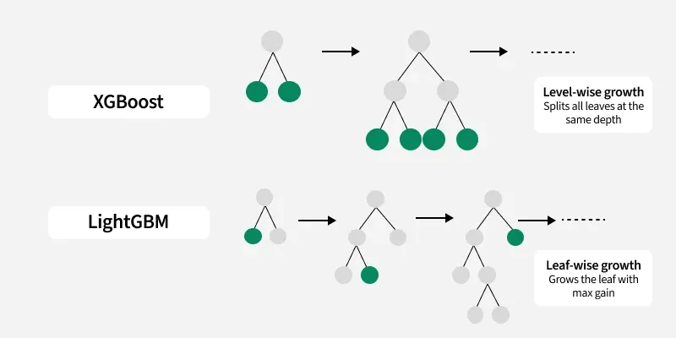
LightGBM

Slide 16
LightGBM (Model Parameters)
Parameter | Value | Description
loss | mse | Loss function (MSE for regression)
colsample_bytree | 0.8879 | Column sampling ratio per tree (feature fraction)
learning_rate | 0.0421 | Shrinkage rate / step size boosting
subsample | 0.8789 | Row sampling ratio per tree (bagging fraction)
lambda_l1 | 205.6999 | L1 regularization (lasso) on leaf weights
lambda_l2 | 580.9768 | L2 regularization (ridge) on leaf weights
max_depth | 8 | Maximum tree depth (limits overfitting)
num_leaves | 210 | Max number of leaves per tree (model complexity)
num_threads | 20 | Number of parallel threads for training
colsample_bytree列特征采样参考Random Forest
Subsample样本随机抽样而非GOSS抽样
二者同时存在，本质是为了提供L1+L2 组合的弹性网（Elastic Net）正则化能力。Lambda1做叶子剪枝，Lambda2做权重衰减，抑制极端值

Slide 17
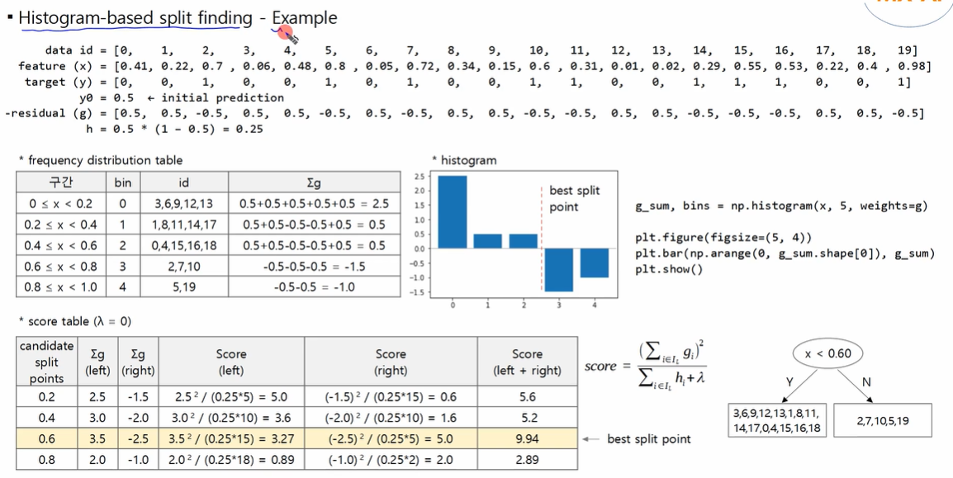
LightGBM (Histogram-based Split Finding)

Slide 18
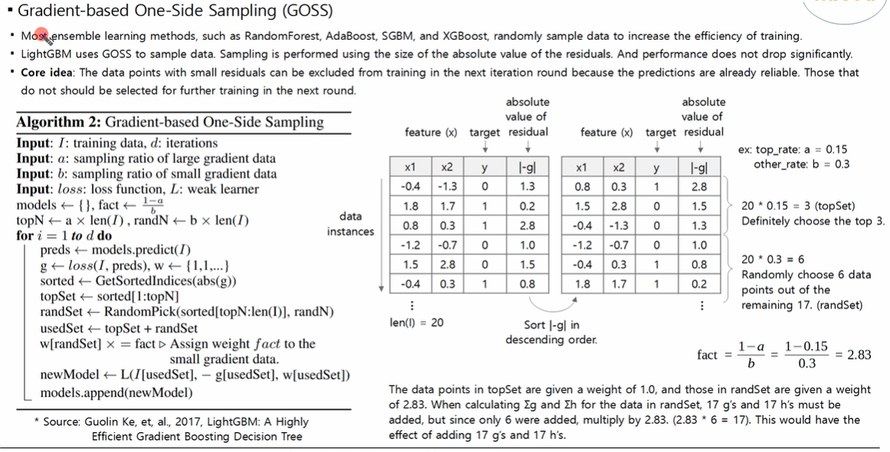
LightGBM (Gradient-based One-Side Sampling)

Slide 19
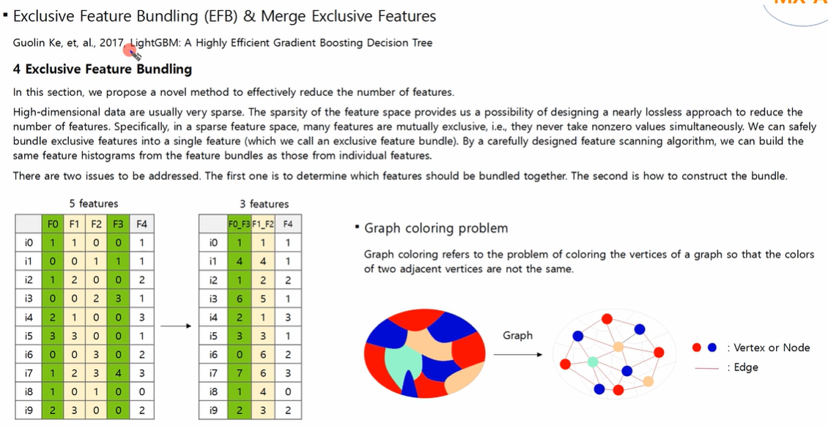
LightGBM (Exclusive Feature Bundling)

Slide 20
Part 04
Parameters

Slide 21
Parameters
层级 | 参数 | 含义
executor | class | SimulatorExecutor — 模拟执行器
executor | time_per_step | 以天为单位撮合
executor | generate_portfolio_metrics | 生成组合维度绩效指标（收益率、夏普、最大回撤等）
strategy | class | TopkDropoutStrategy — 选股策略
strategy | topk | 每天选 top-50 只股票买入
strategy | n_drop | 从持仓中剔除 5 只
strategy | signal | 用训练好的模型+数据生成每日预测信号，驱动选股
backtest | start_time | 回测开始：2017-01-01
backtest | end_time | 回测结束：2020-08-01（约 3.5 年）
backtest | account | 初始资金 1 亿元
backtest | benchmark | 基准为沪深 300 指数
backtest | freq | 日频交易
backtest | limit_threshold | 涨跌停限制 9.5%（略低于实际 10%，留安全边际）
backtest | deal_price | 以收盘价成交
backtest | open_cost | 买入佣金 万 5
backtest | close_cost | 卖出佣金+印花税 万 15
backtest | min_cost | 每笔最低佣金 5 元

Slide 22
Part 05
Experiment

Slide 23
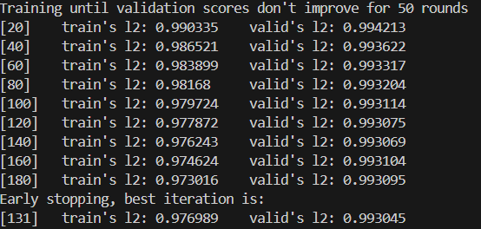
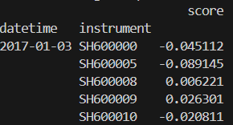

Experiment
Score - Daily Return
IC, ICIR
某一天（如 2017-01-03）：
所有股票的 pred 和 label 组成一对一对的数据
→ pred = [-0.045, -0.089, 0.006, 0.026, ...]
→ label = [真实收益率]
IC = pred 与 label 的 Pearson 相关系数 (当天预测准不准)
Rank IC = pred 与 label 的 Spearman 秩相关系数 (当天排序准不准)

Slide 24
Experiment
TopkDropoutStrategy
每天用模型给所有股票打分 → 卖掉持仓里分最低的 5 只 → 买入没持仓里分最高的若干只 → 保持持仓约 50 只股票 → 等权分配资金。
每天开盘前:
用 model.predict() 算出当天所有股票的 score
当前持仓 = [A, B, C, D, E, F, G] (7只)
topk=50, n_drop=5
Step 1: 按 score 排序所有股票
Step 2: 要卖的 = 持仓中 score 最低的 5 只 (n_drop)
→ 比如 F, G, D, C, B
Step 3: 要买的 = 不在持仓中 score 最高的 (n_drop + topk - 当前持仓数) 只 → 从候选池里挑最好的补进来
Step 4: 最终持仓始终维持在 topk ≈ 50 只
资金分配:
cash_to_spend = 当前现金 × 0.95 (risk_degree)
每只买入股票分到 = cash_to_spend / 买入只数

Slide 25
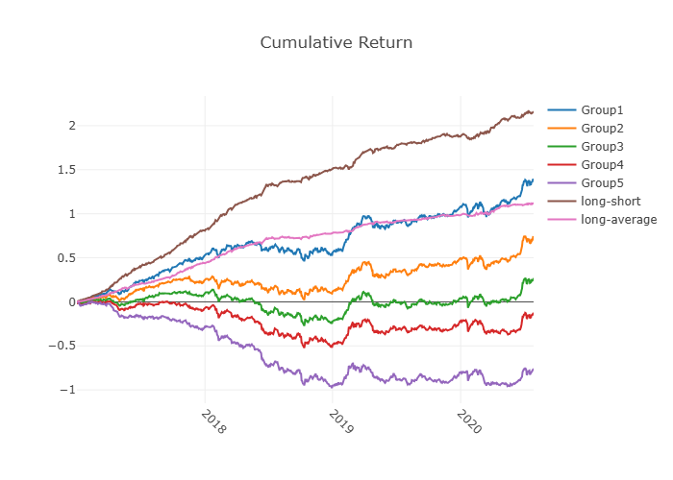
Experiment

Slide 26
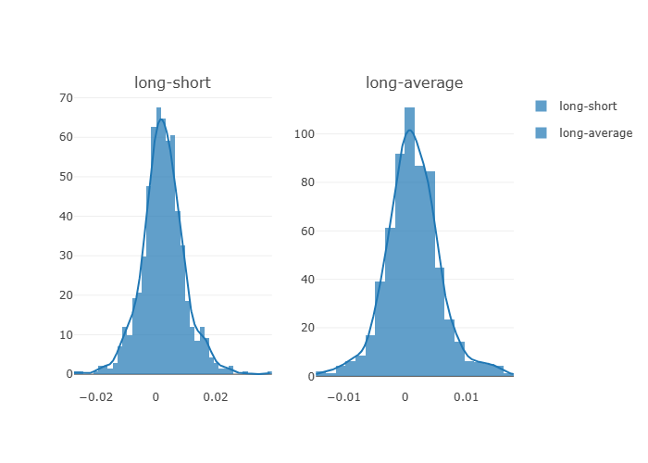
Experiment

Slide 27
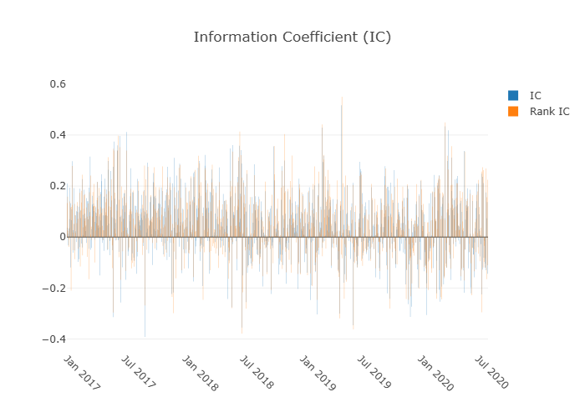
Experiment

Slide 28
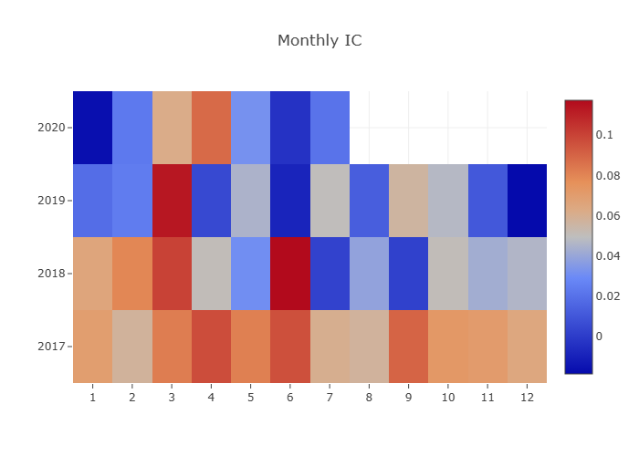
Experiment

Slide 29
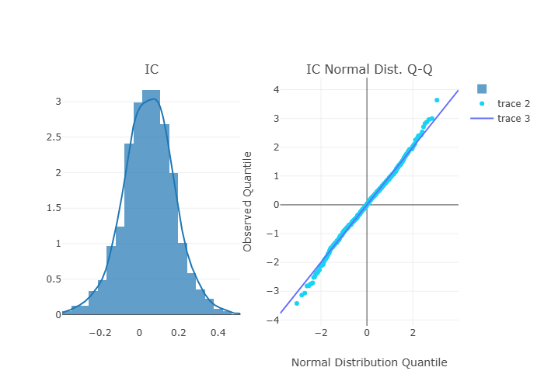
Experiment

Slide 30
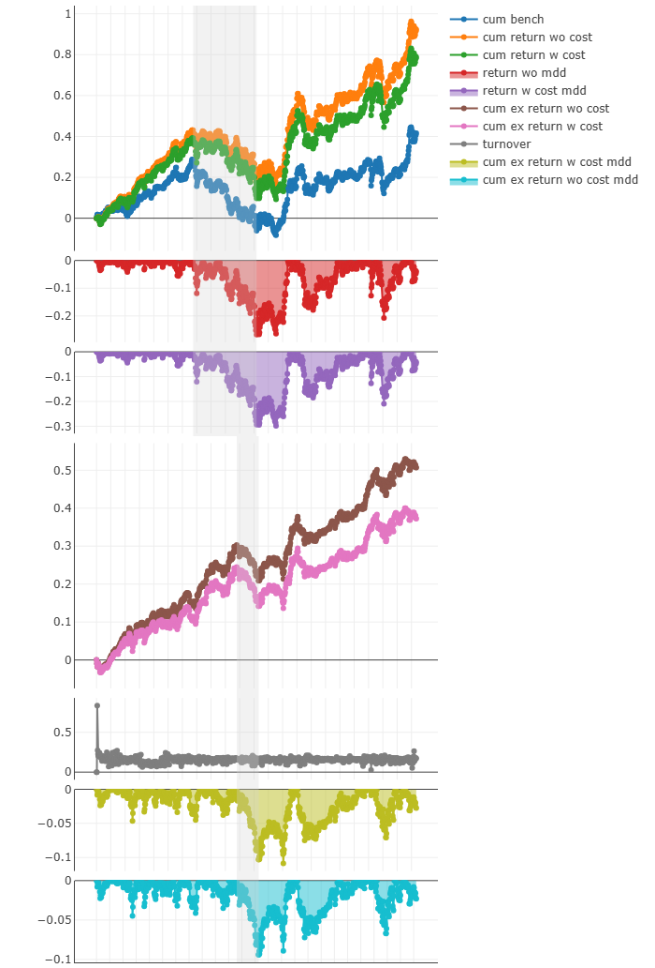
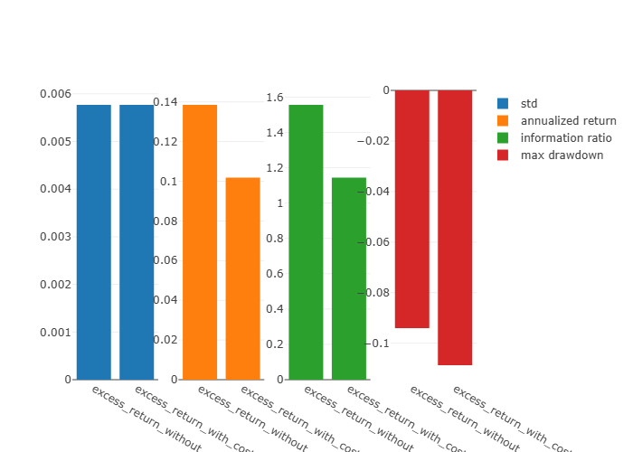
Experiment

Slide 31
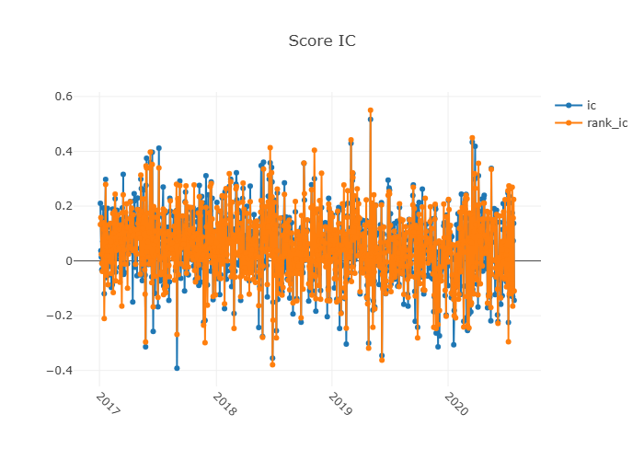
Experiment

Slide 32
Thanks!
Q&A
WorldQuant Platform:
Practical Experience
Yuxuan WANG
30 June 2026

