Slide 1
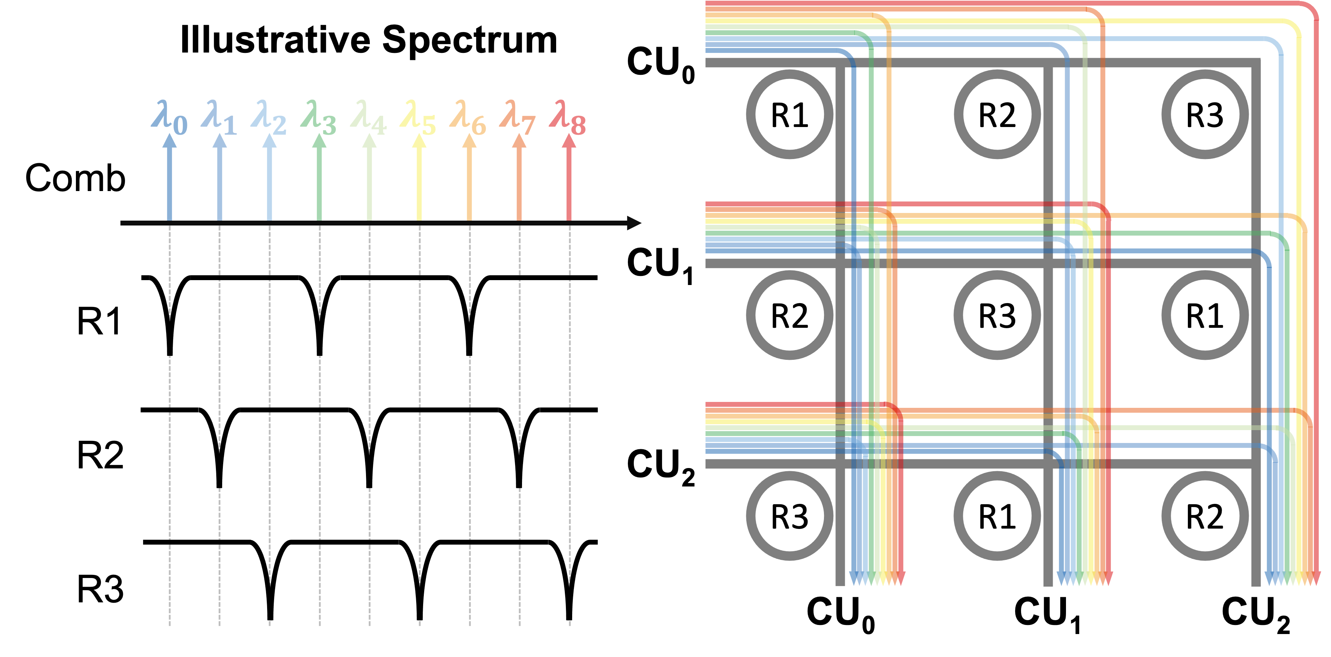


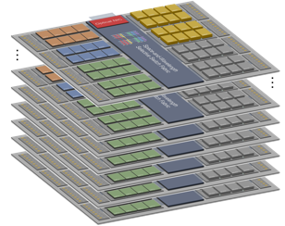
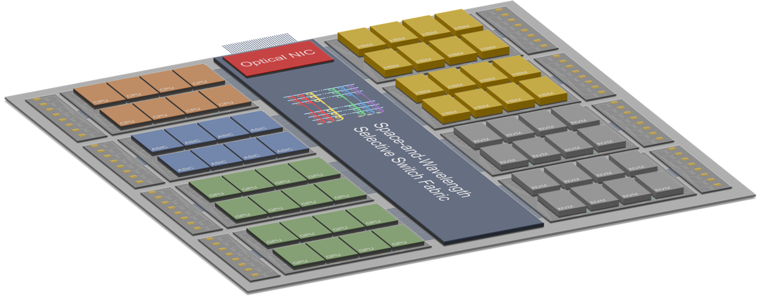
Spatial-Wavelength Selective Switch
AI/ML Computing Cluster
Optical DWDM I/O
Silicon Photonics
DWDM Transceivers
Computing Resources

