Slide 1
基于共享单车数据的需求预测
特征构造 · 模型设计 · 误差分析

Slide 2
任务概述
数据来源：深圳市政府数据开放平台 - 共享单车企业每日订单表
约300万条订单记录，2021年1月1日 - 2月2日
空间划分：0.01° x 0.01° 网格，选取订单量最大的30个网格
时间粒度：30分钟，聚合借车量与还车量，构建 [T, 60] 需求矩阵
预测目标：未来30分钟各网格的借还车量

Slide 3
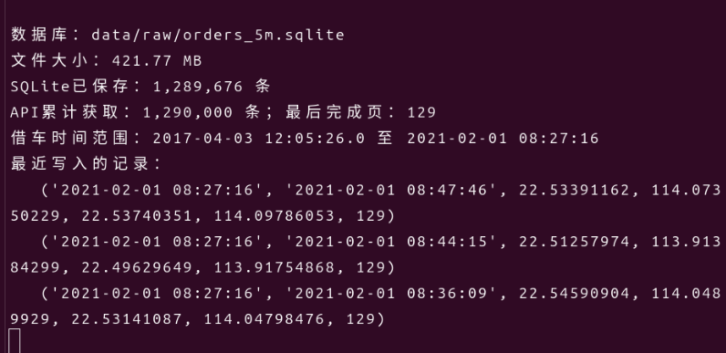
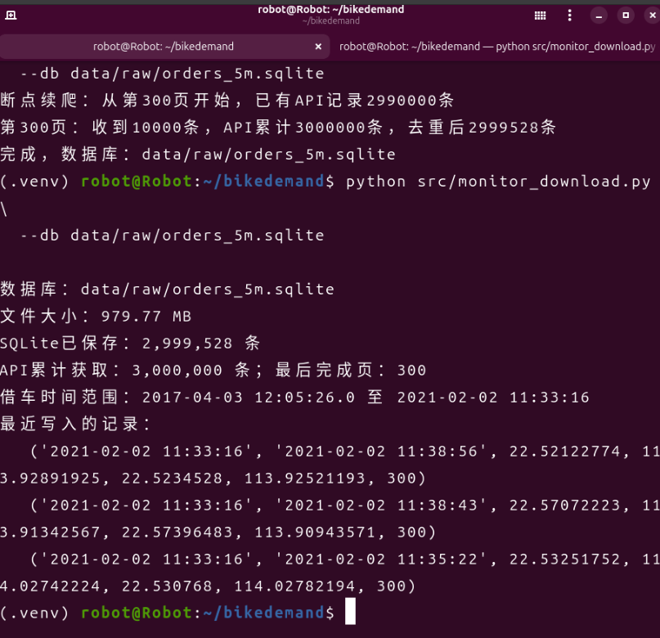
开发过程：数据爬取
通过API爬取约300万条订单数据存入SQLite

Slide 4
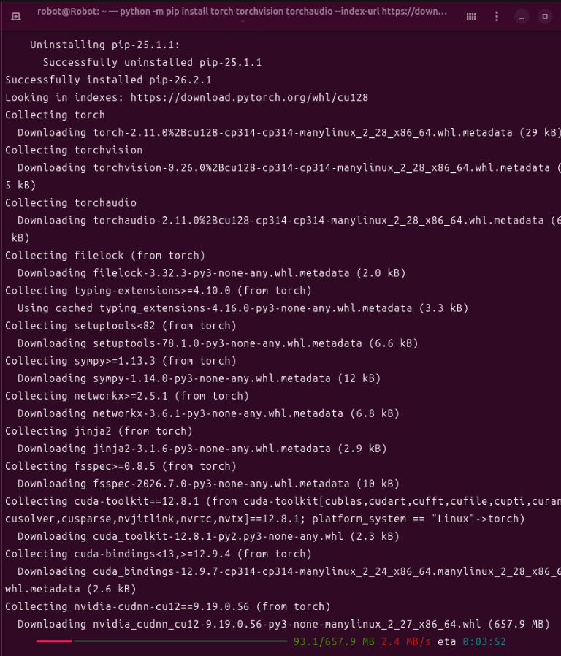
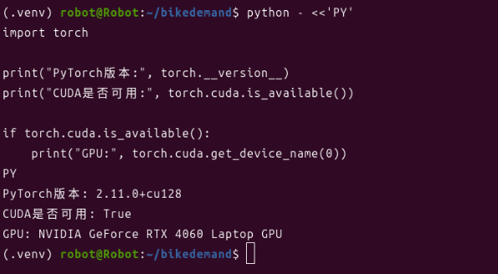
开发过程：环境配置
PyTorch虚拟环境配置与CUDA验证

Slide 5
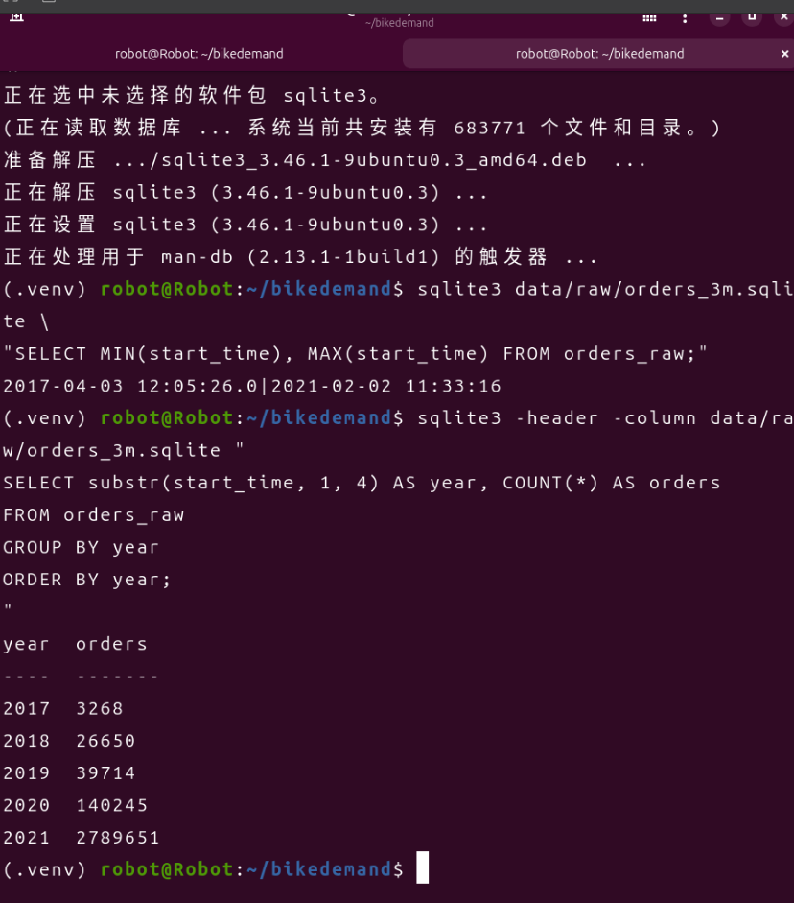
开发过程：空间网格划分
城市空间划分成0.01°×0.01°网格，筛选高需求区域

Slide 6
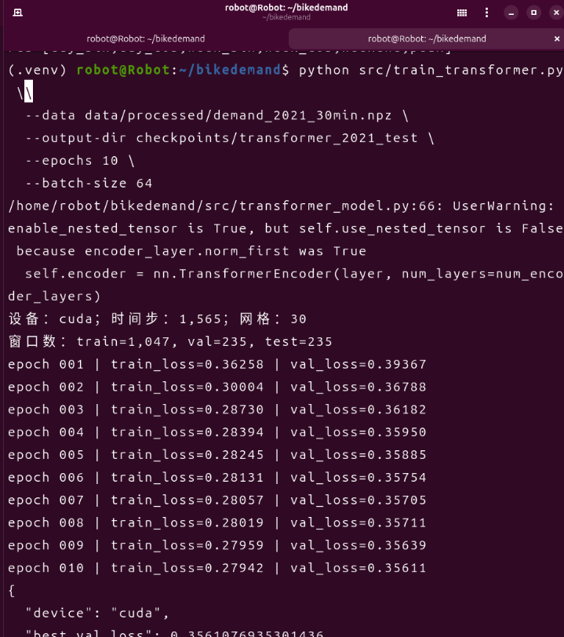
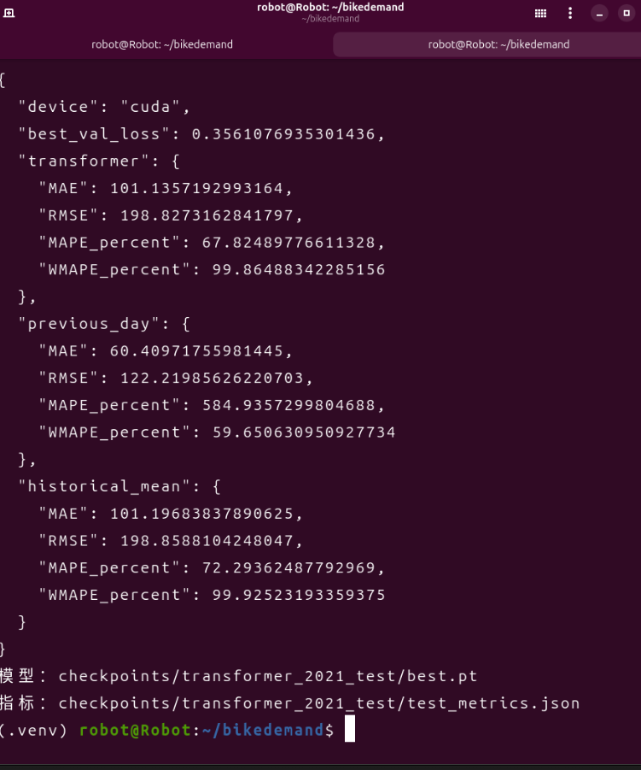
开发过程：Transformer首次训练

Slide 7
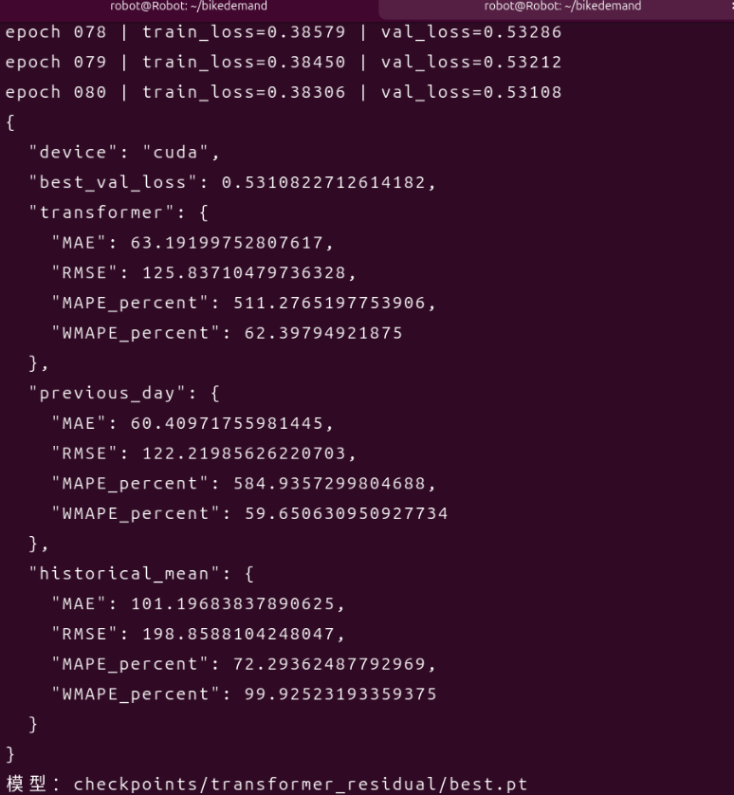
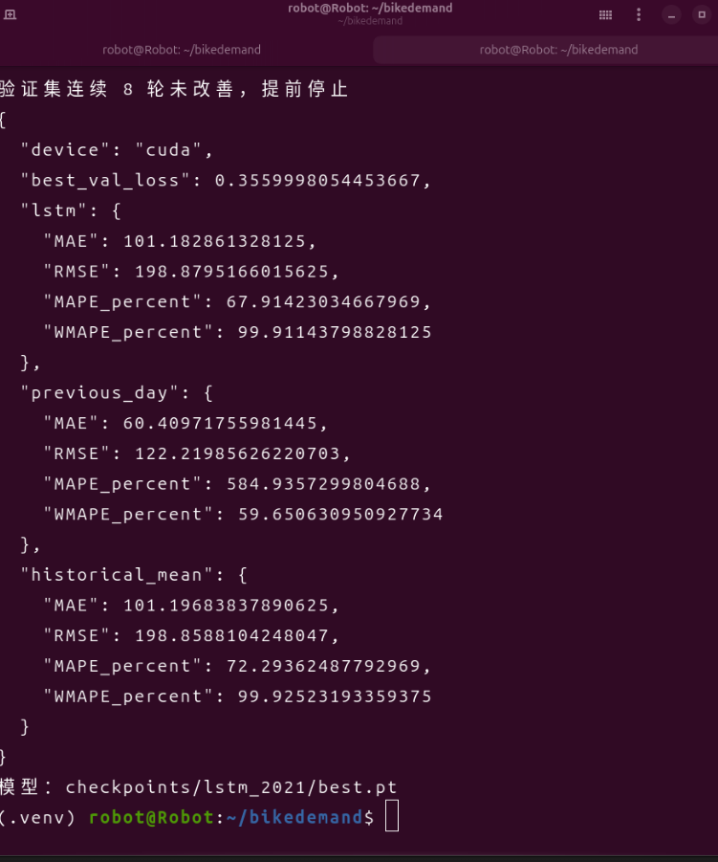
开发过程：LSTM与调优
Transformer调优后 vs LSTM首次训练结果

Slide 8
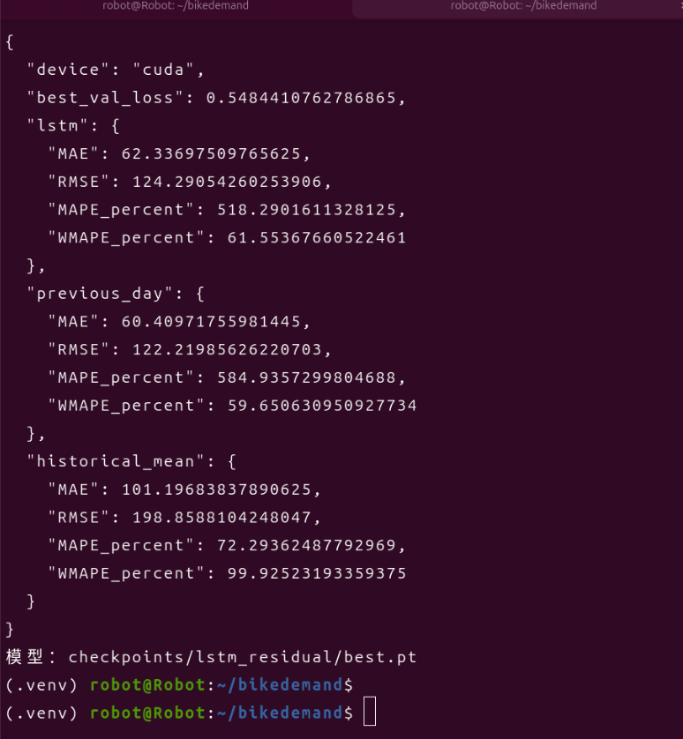
开发过程：LSTM调优
LSTM调优后训练曲线

Slide 9
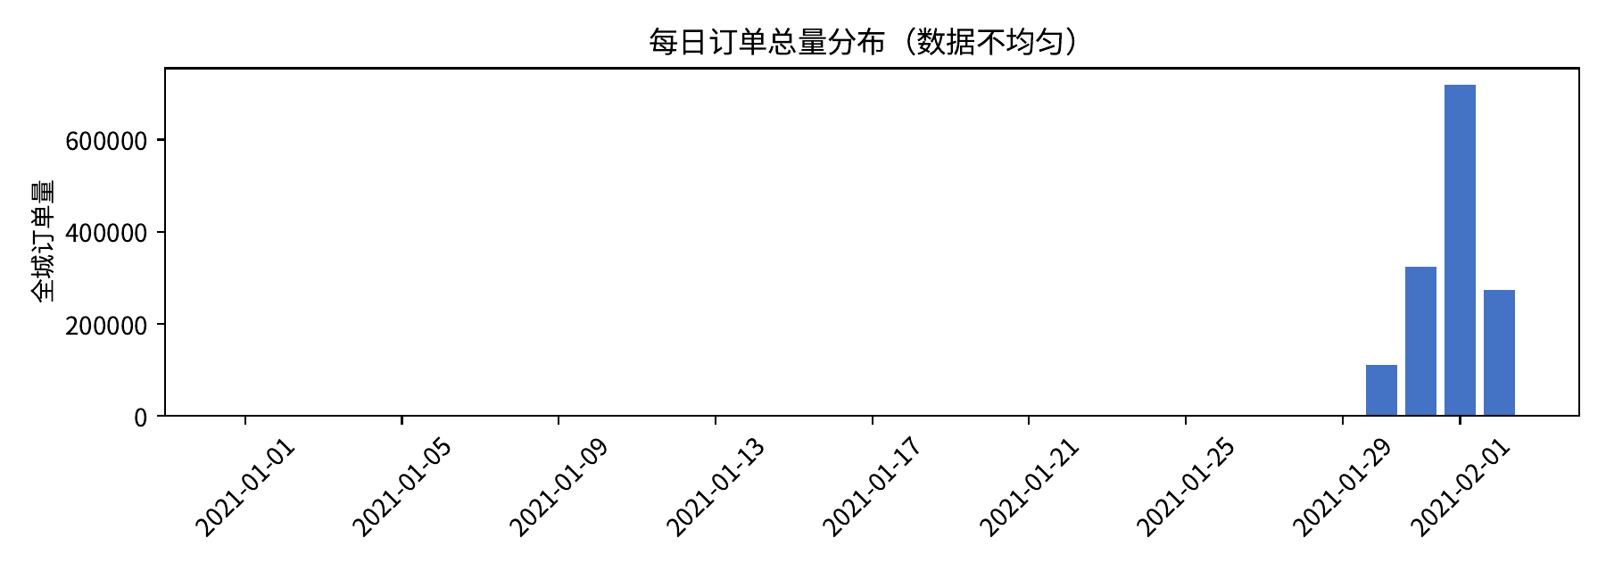
数据特征：时间分布（1/5）

Slide 10
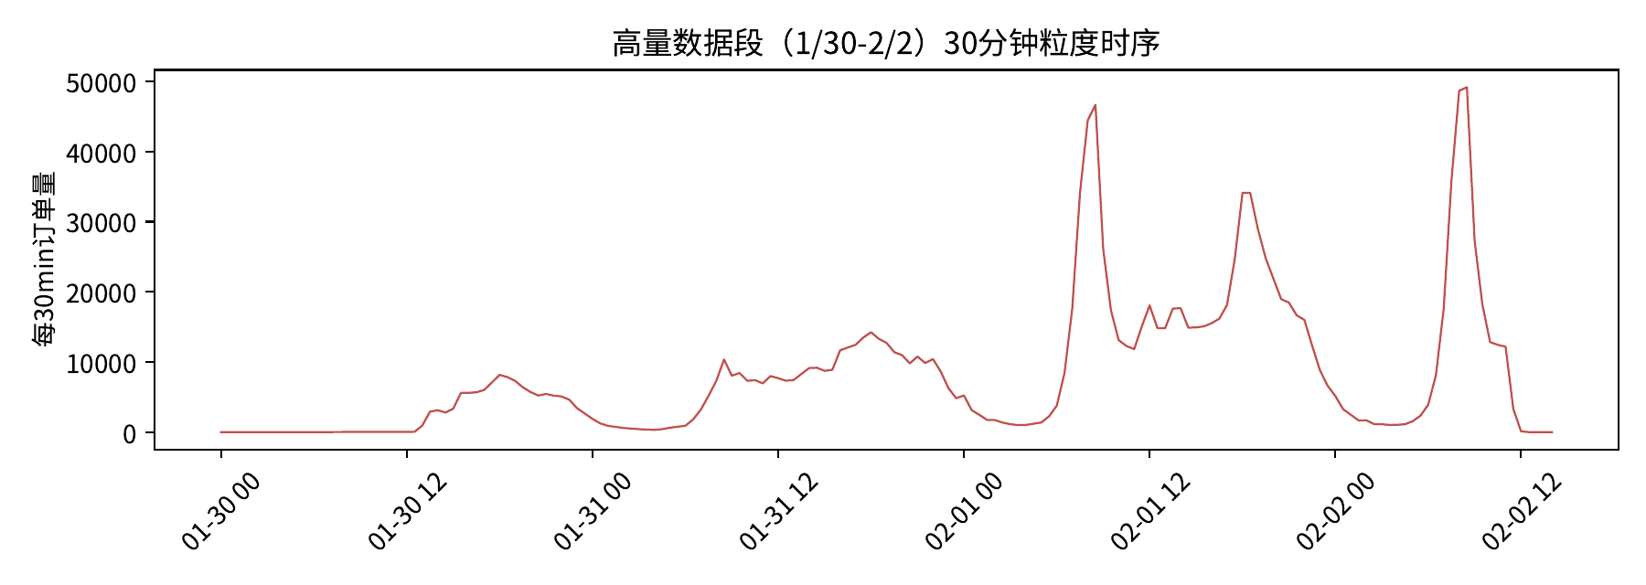
数据特征：高量段日内双峰（2/5）

Slide 11
特征构造方法
需求特征：过去24小时（48步）30网格借/还车量，共 48 × 60 = 2880 维
滞后特征：前一日同时刻（lag=48）借/还车量，共60维 → 显式提供previous-day信号
时间周期特征（5维）：
  日内正弦/余弦：sin(2πt/48), cos(2πt/48)
  周内正弦/余弦：sin(2πd/7), cos(2πd/7)
  周末二值标记：周六日=1，其余=0
标准化：训练集上z-score，避免数据泄露
输出：未来30分钟60维需求向量（借车30 + 还车30）

Slide 12
训练集与测试集划分（按日期）
发现数据分布严重不均匀（前29天几乎无订单），改为按日期划分：
训练集：2021-01-30 13:00 — 2021-01-31 20:00（高量段）
验证集：2021-01-31 20:00 — 2021-02-01 04:00
测试集：2021-02-01 04:00 — 2021-02-02 14:00
lookback = 48（过去24小时） → 预测 horizon = 1（未来30分钟）

Slide 13
模型架构：Transformer + 残差学习
核心设计：预测目标 = 需求 - 前一日同时刻需求（残差），评估时加回基线还原
输入投影：Linear(2945 → d_model=64) + LayerNorm + 正弦位置编码
时间编码器：2层TransformerEncoder，nhead=4，FFN=128，norm_first=True
输出头：LayerNorm + Linear(d_model → 60)，取最后时间步输出
残差学习使模型从previous-day水平出发学习修正量，稳定训练过程

Slide 14
评价指标
MAE（平均绝对误差）：对异常值不敏感，直观反映平均偏差
RMSE（均方根误差）：对大误差敏感，反映峰值时段表现
MAPE（百分比误差）：当真值接近0时数值爆炸，本数据夜间时段MAPE可达数千%
WMAPE（加权百分比误差）：以总需求为分母，更稳健，本实验主要参考指标

Slide 15
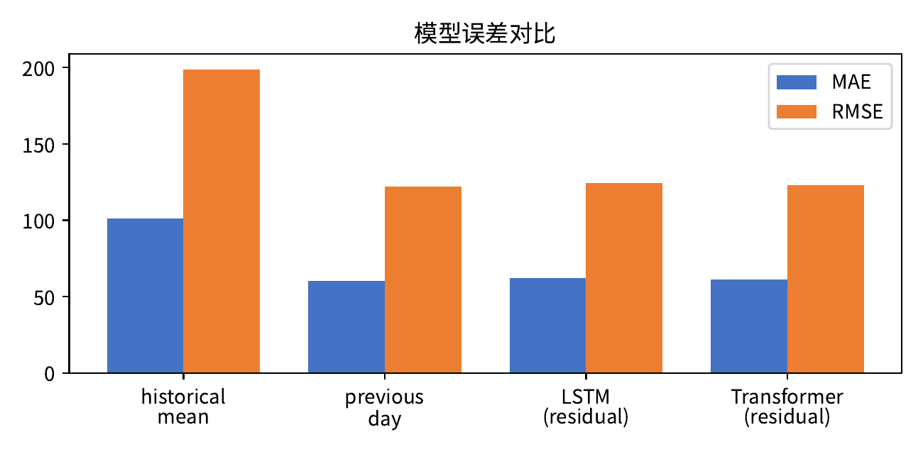
模型误差对比（3/5）

Slide 16
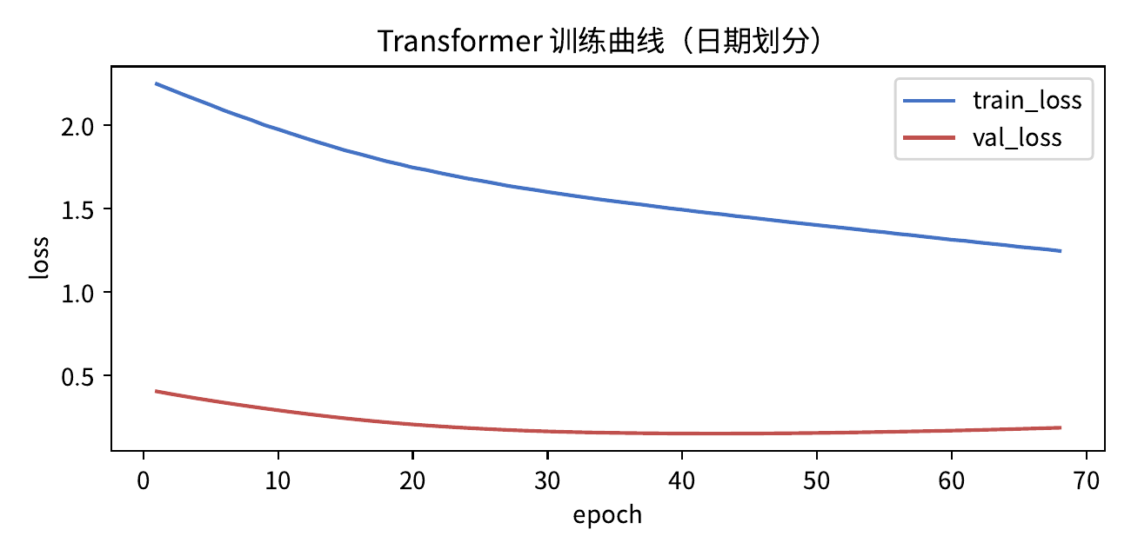
训练过程（4/5）

Slide 17
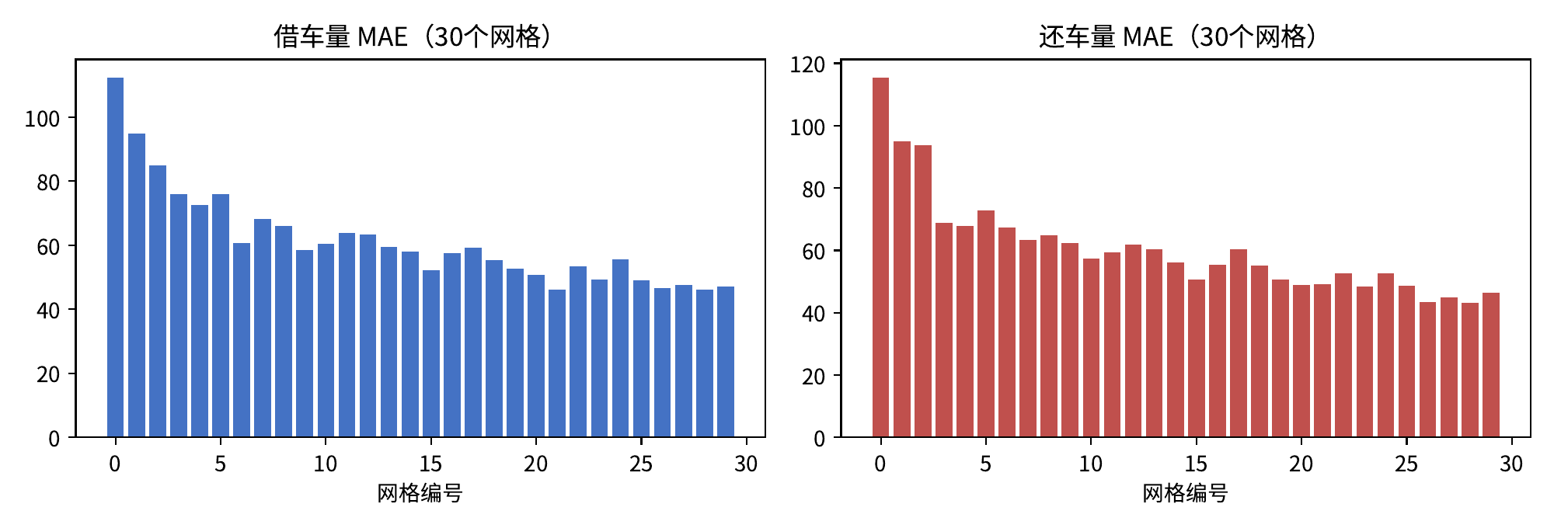
误差空间分布（5/5）

Slide 18
误差空间分布的原因
高需求 — 高误差：高峰期单网格30分钟订单可达数千辆，相对误差10%对应绝对MAE远高于低需求网格
需求波动性强：高需求网格对突发事件（天气、管制、活动）更敏感，昨日同期基线难以捕捉
数据量不足：训练段仅约31小时高量数据，模型无法学习各网格差异化模式，只能学到全局周期修正

Slide 19
总结与讨论
previous-day基线凭强日周期惯性表现最强（MAE=60.4），Transformer残差模型接近（MAE=61.0）
historical_mean明显较差（MAE=101.2），说明数据有明显时间模式可利用
残差建模有效稳定训练，Transformer验证loss从0.41降至0.14
深度模型要超越简单基线，需要：更长时间跨度数据、真实分布差异、额外特征（天气/POI/空间拓扑）
当前32天、时段单一的数据条件下，简单基线的竞争力难以被超越

Slide 20
源代码与GitHub仓库
GitHub仓库：https://github.com/wyyy520/BikeDemand
主要源代码结构：
  src/fetch_orders_sqlite.py - API爬取订单数据，存入SQLite
  src/clean_orders.py - 数据清洗（去重、去异常）
  src/aggregate_demand.py - 时空网格聚合，生成30min需求矩阵
  src/transformer_model.py - Transformer模型定义（含空间注意力）
  src/lstm_model.py - LSTM模型定义
  src/train_transformer.py - Transformer训练与评估脚本
  src/train_lstm.py - LSTM训练与评估脚本
  report/analysis.pdf - 完整分析报告
  report/presentation.pptx - 汇报PPT

Slide 21
源代码：Transformer模型定义 - transformer_model.py (1/4)
"""多区域时序 Transformer Encoder。
输入：X.shape == [batch, lookback, input_dim]
输出：y_hat.shape == [batch, horizon, output_dim]
对于 N 个空间网格，output_dim=2*N，前 N 个输出为借车量，后 N 个输出为还车量。
"""
from __future__ import annotations
import math
import torch
from torch import Tensor, nn
class SinusoidalPositionalEncoding(nn.Module):
def __init__(self, d_model: int, max_len: int = 512) -> None:
super().__init__()
position = torch.arange(max_len, dtype=torch.float32).unsqueeze(1)
div_term = torch.exp(
torch.arange(0, d_model, 2, dtype=torch.float32)
* (-math.log(10000.0) / d_model)
)
encoding = torch.zeros(max_len, d_model)
encoding[:, 0::2] = torch.sin(position * div_term)
encoding[:, 1::2] = torch.cos(position * div_term[: encoding[:, 1::2].shape[1]])
self.register_buffer("encoding", encoding.unsqueeze(0), persistent=False)
def forward(self, x: Tensor) -> Tensor:
return x + self.encoding[:, : x.size(1)]

Slide 22
源代码：Transformer模型定义 - transformer_model.py (2/4)
class SpatialAttention(nn.Module):
"""在输出通道维度做自注意力，模拟网格间的信息交互。
输入 z: [batch, time, d_model]，转置后在 d_model 维度上做注意力，
相当于让每个时间步内不同"通道"（对应各网格的表征）互相交换信息。
"""
def __init__(self, d_model: int, nhead: int, dropout: float = 0.1) -> None:
super().__init__()
self.mix_logits = nn.Parameter(torch.randn(d_model, d_model) * 0.02)
self.norm = nn.LayerNorm(d_model)
def forward(self, z: Tensor, num_nodes: int) -> Tensor:
# 把 d_model 通道当作注意力序列，模拟节点间交互
batch, time, d = z.shape
# 每个时间步独立做：把d_model个通道看成序列，需要每个位置是d_model维向量，
# 但通道本身是标量，所以用1x1卷积做Q/K/V投影不可行。改为简单可学习加权混合。
# 简化：用可学习参数矩阵在d维度做注意力式混合（等效单头自注意力的值域）
weight = torch.softmax(self.mix_logits, dim=-1) # [d, d]
mixed = torch.matmul(z, weight.T) # [batch, time, d]
attn_out = mixed
return self.norm(z + attn_out)
class TemporalTransformer(nn.Module):
def __init__(
self,
input_dim: int,
output_dim: int,
d_model: int = 128,
nhead: int = 4,

Slide 23
源代码：Transformer模型定义 - transformer_model.py (3/4)
num_encoder_layers: int = 2,
num_nodes: int = 0,
use_spatial_attention: bool = False,
dim_feedforward: int = 256,
dropout: float = 0.1,
horizon: int = 1,
max_len: int = 512,
) -> None:
super().__init__()
if d_model % nhead != 0:
raise ValueError("d_model必须能被nhead整除")
self.horizon = horizon
self.output_dim = output_dim
self.num_nodes = num_nodes
if use_spatial_attention and num_nodes <= 0:
raise ValueError("启用空间注意力时必须提供num_nodes")
self.input_projection = nn.Sequential(
nn.Linear(input_dim, d_model),
nn.LayerNorm(d_model),
)
self.position = SinusoidalPositionalEncoding(d_model, max_len=max_len)
layer = nn.TransformerEncoderLayer(
d_model=d_model,
nhead=nhead,
dim_feedforward=dim_feedforward,
dropout=dropout,
activation="gelu",
batch_first=True,
norm_first=True,
)
self.encoder = nn.TransformerEncoder(layer, num_layers=num_encoder_layers)
self.spatial = (

Slide 24
源代码：Transformer模型定义 - transformer_model.py (4/4)
SpatialAttention(d_model, nhead, dropout=dropout)
if use_spatial_attention and num_nodes > 1
else None
)
self.head = nn.Sequential(
nn.LayerNorm(d_model),
nn.Linear(d_model, horizon * output_dim),
)
def forward(self, x: Tensor) -> Tensor:
if x.ndim != 3:
raise ValueError("输入必须是[batch, time, feature]三维张量")
z = self.input_projection(x)
z = self.position(z)
z = self.encoder(z)
if self.spatial is not None:
z = self.spatial(z, self.num_nodes)
last_state = z[:, -1]
prediction = self.head(last_state)
return prediction.view(x.size(0), self.horizon, self.output_dim)
if __name__ == "__main__":
model = TemporalTransformer(input_dim=80, output_dim=60)
sample = torch.randn(4, 48, 80)
result = model(sample)
print("input:", tuple(sample.shape))
print("output:", tuple(result.shape))

Slide 25
源代码：Transformer训练脚本 - train_transformer.py (1/8)
#!/usr/bin/env python3
"""训练多区域时序 Transformer，并和两个简单基线比较。
典型运行：
python src/aggregate_demand.py
python src/train_transformer.py --epochs 30
目标改为残差：y 减去前一天同期需求（lag48），模型学习对 previous-day 基线的修正量，评估时把残差加回基线后还原为订单数。
"""
from __future__ import annotations
import argparse
import json
import random
from pathlib import Path
import numpy as np
import torch
from torch import nn
from torch.utils.data import DataLoader, Dataset
from transformer_model import TemporalTransformer
class WindowDataset(Dataset):
def __init__(self, x: np.ndarray, y: np.ndarray, targets: np.ndarray, lookback: int, horizon: int):
self.x, self.y, self.targets = x, y, targets
self.lookback, self.horizon = lookback, horizon
def __len__(self) -> int:
return len(self.targets)

Slide 26
源代码：Transformer训练脚本 - train_transformer.py (2/8)
def __getitem__(self, index: int):
t = int(self.targets[index])
lag48 = np.repeat(self.x[t - 48:t - 47], self.lookback, axis=0)
features = np.concatenate(
[self.x[t - self.lookback:t], self.y[t - self.lookback:t], lag48], axis=1
)
baseline = np.repeat(self.x[t - 48:t - 48 + self.horizon], self.horizon, axis=0)
target = self.x[t:t + self.horizon] - baseline
return torch.from_numpy(features).float(), torch.from_numpy(target).float()
def set_seed(seed: int) -> None:
random.seed(seed)
np.random.seed(seed)
torch.manual_seed(seed)
if torch.cuda.is_available():
torch.cuda.manual_seed_all(seed)
def make_targets(start: int, end: int, lookback: int, horizon: int) -> np.ndarray:
first = max(start, lookback)
last = end - horizon + 1
return np.arange(first, max(first, last), dtype=np.int64)
def metrics(y_true: np.ndarray, y_pred: np.ndarray) -> dict[str, float]:
err = y_pred - y_true
denom = np.maximum(np.abs(y_true), 1.0)
return {
"MAE": float(np.mean(np.abs(err))),
"RMSE": float(np.sqrt(np.mean(err ** 2))),

Slide 27
源代码：Transformer训练脚本 - train_transformer.py (3/8)
"MAPE_percent": float(np.mean(np.abs(err) / denom) * 100),
"WMAPE_percent": float(np.sum(np.abs(err)) / max(np.sum(np.abs(y_true)), 1.0) * 100),
}
@torch.no_grad()
def predict(model, loader, device, mean, std):
model.eval()
all_true, all_pred = [], []
for features, target in loader:
prediction = model(features.to(device)).cpu().numpy()
true = target.numpy()
baseline = np.repeat(features[:, -48:-47, :prediction.shape[2]].cpu().numpy(), prediction.shape[1], axis=1)
pred_count = np.expm1((prediction + baseline) * std + mean).clip(0)
true_count = np.expm1((true + baseline) * std + mean).clip(0)
all_pred.append(pred_count)
all_true.append(true_count)
return np.concatenate(all_true), np.concatenate(all_pred)
def train_epoch(model, loader, optimizer, criterion, device):
model.train()
total, n = 0.0, 0
for features, target in loader:
features, target = features.to(device), target.to(device)
optimizer.zero_grad(set_to_none=True)
prediction = model(features)
loss = criterion(prediction, target)
loss.backward()
torch.nn.utils.clip_grad_norm_(model.parameters(), 1.0)
optimizer.step()
total += float(loss.item()) * len(features)

Slide 28
源代码：Transformer训练脚本 - train_transformer.py (4/8)
n += len(features)
return total / max(n, 1)
def main() -> None:
parser = argparse.ArgumentParser(description="训练共享单车需求 Transformer")
parser.add_argument("--data", default="data/processed/demand_30min.npz")
parser.add_argument("--output-dir", default="checkpoints/transformer")
parser.add_argument("--lookback", type=int, default=48)
parser.add_argument("--horizon", type=int, default=1)
parser.add_argument("--train-ratio", type=float, default=None)
parser.add_argument("--val-ratio", type=float, default=None)
parser.add_argument("--train-start", default=None, help="如 2021-01-30T13:00")
parser.add_argument("--train-end", default=None)
parser.add_argument("--val-end", default=None)
parser.add_argument("--d-model", type=int, default=128)
parser.add_argument("--nhead", type=int, default=4)
parser.add_argument("--layers", type=int, default=2)
parser.add_argument("--ffn-dim", type=int, default=256)
parser.add_argument("--dropout", type=float, default=0.1)
parser.add_argument("--spatial-attention", action="store_true", help="启用空间注意力")
parser.add_argument("--batch-size", type=int, default=64)
parser.add_argument("--epochs", type=int, default=50)
parser.add_argument("--lr", type=float, default=3e-4)
parser.add_argument("--weight-decay", type=float, default=1e-5)
parser.add_argument("--patience", type=int, default=5)
parser.add_argument("--seed", type=int, default=42)
args = parser.parse_args()
set_seed(args.seed)
data_path = Path(args.data)
if not data_path.exists():

Slide 29
源代码：Transformer训练脚本 - train_transformer.py (5/8)
raise SystemExit(f"找不到聚合数据：{data_path}，请先运行 aggregate_demand.py")
raw = np.load(data_path)
demand = raw["demand"].astype(np.float32)
time_features = raw["time_features"].astype(np.float32)
times = raw["times"].astype(np.int64)
steps, output_dim = demand.shape
if len(times) != steps or steps <= args.lookback + args.horizon:
raise SystemExit("时间序列太短，无法构造训练窗口")
import pandas as pd
if args.train_start:
# 按日期划分（针对不均匀数据）
ts = pd.to_datetime(times, unit="s")
mask = ts >= pd.Timestamp(args.train_start)
first_idx = int(np.argmax(mask))
train_end = int(np.argmax(ts >= pd.Timestamp(args.train_end))) if args.train_end else steps
val_end = int(np.argmax(ts >= pd.Timestamp(args.val_end))) if args.val_end else steps
if not (first_idx + args.lookback + args.horizon < train_end < val_end <= steps):
raise SystemExit("按日期划分后窗口不足，请检查日期范围")
steps_offset = first_idx
train_start_idx = first_idx
else:
train_start_idx = 0
train_end = int(steps * args.train_ratio)
val_end = int(steps * (args.train_ratio + args.val_ratio))
if not (0 < train_end < val_end < steps):
raise SystemExit("train/val比例不合法")
# 只用训练时段估计变换参数，避免测试集信息泄漏。
log_demand = np.log1p(demand)
mean = log_demand[train_start_idx:train_end].mean(axis=0).astype(np.float32)
std = log_demand[train_start_idx:train_end].std(axis=0).astype(np.float32)
std[std < 1e-4] = 1.0

Slide 30
源代码：Transformer训练脚本 - train_transformer.py (6/8)
scaled = ((log_demand - mean) / std).astype(np.float32)
train_targets = make_targets(train_start_idx, train_end, args.lookback, args.horizon)
val_targets = make_targets(train_end, val_end, args.lookback, args.horizon)
test_targets = make_targets(val_end, steps, args.lookback, args.horizon)
if min(len(train_targets), len(val_targets), len(test_targets)) == 0:
raise SystemExit("某个数据划分没有可用窗口，请减少lookback或调整划分比例")
train_ds = WindowDataset(scaled, time_features, train_targets, args.lookback, args.horizon)
val_ds = WindowDataset(scaled, time_features, val_targets, args.lookback, args.horizon)
test_ds = WindowDataset(scaled, time_features, test_targets, args.lookback, args.horizon)
train_loader = DataLoader(train_ds, batch_size=args.batch_size, shuffle=True, num_workers=0)
val_loader = DataLoader(val_ds, batch_size=args.batch_size, shuffle=False, num_workers=0)
test_loader = DataLoader(test_ds, batch_size=args.batch_size, shuffle=False, num_workers=0)
device = torch.device("cuda" if torch.cuda.is_available() else "cpu")
model = TemporalTransformer(
input_dim=output_dim + time_features.shape[1] + output_dim, output_dim=output_dim,
d_model=args.d_model, nhead=args.nhead, num_encoder_layers=args.layers,
dim_feedforward=args.ffn_dim, dropout=args.dropout, horizon=args.horizon,
num_nodes=output_dim, use_spatial_attention=args.spatial_attention,
).to(device)
optimizer = torch.optim.AdamW(model.parameters(), lr=args.lr, weight_decay=args.weight_decay)
criterion = nn.HuberLoss()
best_val, stale = float("inf"), 0
output_dir = Path(args.output_dir)
output_dir.mkdir(parents=True, exist_ok=True)
checkpoint = output_dir / "best.pt"
print(f"设备：{device}；时间步：{steps:,}；网格：{output_dim // 2}")
print(f"窗口数：train={len(train_ds):,}, val={len(val_ds):,}, test={len(test_ds):,}")
for epoch in range(1, args.epochs + 1):
train_loss = train_epoch(model, train_loader, optimizer, criterion, device)

Slide 31
源代码：Transformer训练脚本 - train_transformer.py (7/8)
model.eval()
val_loss, n = 0.0, 0
with torch.no_grad():
for features, target in val_loader:
loss = criterion(model(features.to(device)), target.to(device))
val_loss += float(loss.item()) * len(features)
n += len(features)
val_loss /= max(n, 1)
print(f"epoch {epoch:03d} | train_loss={train_loss:.5f} | val_loss={val_loss:.5f}", flush=True)
if val_loss < best_val:
best_val, stale = val_loss, 0
torch.save({"model": model.state_dict(), "args": vars(args), "mean": mean, "std": std}, checkpoint)
else:
stale += 1
if stale >= args.patience:
print(f"验证集连续 {args.patience} 轮未改善，提前停止")
break
saved = torch.load(checkpoint, map_location=device, weights_only=False)
model.load_state_dict(saved["model"])
true, pred = predict(model, test_loader, device, mean, std)
result = {"device": str(device), "best_val_loss": best_val, "transformer": metrics(true, pred)}
# 前一天同一时刻基线：测试目标 t 使用 t-48 的真实需求。
if args.horizon == 1:
baseline_prev = demand[test_targets - 48]
result["previous_day"] = metrics(true[:, 0], baseline_prev)
# 训练集的星期几+半小时槽历史均值基线。
train_dt = __import__("pandas").to_datetime(times[train_start_idx:train_end], unit="s")
test_dt = __import__("pandas").to_datetime(times[test_targets], unit="s")
slot = train_dt.dayofweek.to_numpy() * 48 + (train_dt.hour.to_numpy() * 2 + train_dt.minute.to_numpy() // 30)
mean_by_slot = {int(k): demand[train_start_idx:train_end][slot == k].mean(axis=0) for k in np.unique(slot)}

Slide 32
源代码：Transformer训练脚本 - train_transformer.py (8/8)
hist = np.stack([mean_by_slot.get(int(d.dayofweek * 48 + d.hour * 2 + d.minute // 30), demand[:train_end].mean(axis=0)) for d in test_dt])
result["historical_mean"] = metrics(true[:, 0], hist) if args.horizon == 1 else {"note": "历史平均基线当前实现为单步"}
metrics_path = output_dir / "test_metrics.json"
metrics_path.write_text(json.dumps(result, ensure_ascii=False, indent=2), encoding="utf-8")
np.savez_compressed(output_dir / "test_predictions.npz", times=times[test_targets], y_true=true, y_pred=pred)
print(json.dumps(result, ensure_ascii=False, indent=2))
print(f"模型：{checkpoint}\n指标：{metrics_path}")
if __name__ == "__main__":
main()

Slide 33
源代码：LSTM模型定义 - lstm_model.py (1/2)
#!/usr/bin/env python3
"""多区域时序 LSTM 模型。
输入：[batch, lookback, demand_dim + time_feature_dim]
输出：[batch, horizon, demand_dim]
"""
from __future__ import annotations
import torch
from torch import Tensor, nn
class DemandLSTM(nn.Module):
def __init__(
self,
input_dim: int,
output_dim: int,
hidden_dim: int = 128,
num_layers: int = 2,
dropout: float = 0.1,
horizon: int = 1,
) -> None:
super().__init__()
self.horizon = horizon
self.output_dim = output_dim
self.input_projection = nn.Sequential(
nn.Linear(input_dim, hidden_dim),
nn.LayerNorm(hidden_dim),
)
self.lstm = nn.LSTM(
input_size=hidden_dim,

Slide 34
源代码：LSTM模型定义 - lstm_model.py (2/2)
hidden_size=hidden_dim,
num_layers=num_layers,
batch_first=True,
dropout=dropout if num_layers > 1 else 0.0,
)
self.head = nn.Sequential(
nn.LayerNorm(hidden_dim),
nn.Linear(hidden_dim, horizon * output_dim),
)
def forward(self, x: Tensor) -> Tensor:
if x.ndim != 3:
raise ValueError("输入必须是[batch, time, feature]三维张量")
z = self.input_projection(x)
z, _ = self.lstm(z)
prediction = self.head(z[:, -1])
return prediction.view(x.size(0), self.horizon, self.output_dim)
if __name__ == "__main__":
model = DemandLSTM(input_dim=66, output_dim=60)
sample = torch.randn(4, 48, 66)
print("input:", tuple(sample.shape))
print("output:", tuple(model(sample).shape))

Slide 35
源代码：需求聚合脚本 - aggregate_demand.py (1/4)
#!/usr/bin/env python3
"""把清洗后的订单聚合成 Transformer 可直接使用的 30 分钟网格序列。
输出：
data/processed/demand_30min.npz
data/processed/demand_30min_meta.json
每个时间步的 demand 向量按 ``[out_grid_1..N, in_grid_1..N]`` 排列，
time_features 包含日周期、周周期、周末和高峰标记。
"""
from __future__ import annotations
import argparse
import json
import sqlite3
from pathlib import Path
import numpy as np
import pandas as pd
def grid_id(lat: pd.Series, lng: pd.Series, min_lat: float, min_lng: float, size: float) -> pd.Series:
gy = np.floor((lat.to_numpy() - min_lat) / size).astype(np.int32)
gx = np.floor((lng.to_numpy() - min_lng) / size).astype(np.int32)
return pd.Series(gy * 1000 + gx, index=lat.index, dtype="int32")
def make_features(index: pd.DatetimeIndex) -> np.ndarray:
minute = index.hour * 60 + index.minute
day_phase = 2 * np.pi * minute / 1440.0
week_phase = 2 * np.pi * (index.dayofweek * 1440 + minute) / (7 * 1440.0)

Slide 36
源代码：需求聚合脚本 - aggregate_demand.py (2/4)
weekend = (index.dayofweek >= 5).astype(np.float32)
peak = (((index.hour.isin([7, 8, 9, 17, 18, 19])))).astype(np.float32)
return np.column_stack([
np.sin(day_phase), np.cos(day_phase),
np.sin(week_phase), np.cos(week_phase), weekend, peak,
]).astype(np.float32)
def main() -> None:
parser = argparse.ArgumentParser(description="订单聚合为30分钟空间网格序列")
parser.add_argument("--input", default="data/processed/orders_5m_clean.sqlite")
parser.add_argument("--output", default="data/processed/demand_30min.npz")
parser.add_argument("--top-grids", type=int, default=30)
parser.add_argument("--grid-size", type=float, default=0.01, help="网格边长，单位为经纬度度数")
parser.add_argument("--min-lat", type=float, default=22.4)
parser.add_argument("--min-lng", type=float, default=113.7)
parser.add_argument("--chunk-size", type=int, default=200_000)
args = parser.parse_args()
source = Path(args.input)
output = Path(args.output)
if not source.exists():
raise SystemExit(f"输入数据库不存在：{source}")
if args.top_grids <= 0 or args.grid_size <= 0:
raise SystemExit("--top-grids和--grid-size必须大于0")
output.parent.mkdir(parents=True, exist_ok=True)
conn = sqlite3.connect(source)
query = """SELECT start_time, end_time, start_lat, start_lng, end_lat, end_lng
FROM orders_clean"""
parts: list[pd.DataFrame] = []
total = 0

Slide 37
源代码：需求聚合脚本 - aggregate_demand.py (3/4)
for chunk in pd.read_sql_query(query, conn, chunksize=args.chunk_size):
total += len(chunk)
chunk["start_time"] = pd.to_datetime(chunk["start_time"], errors="coerce").dt.floor("30min")
chunk["end_time"] = pd.to_datetime(chunk["end_time"], errors="coerce").dt.floor("30min")
chunk = chunk.dropna(subset=["start_time", "end_time", "start_lat", "start_lng", "end_lat", "end_lng"])
chunk["out_grid"] = grid_id(chunk["start_lat"], chunk["start_lng"], args.min_lat, args.min_lng, args.grid_size)
chunk["in_grid"] = grid_id(chunk["end_lat"], chunk["end_lng"], args.min_lat, args.min_lng, args.grid_size)
out = chunk.groupby(["start_time", "out_grid"], observed=True).size().rename("out_count").reset_index()
out = out.rename(columns={"start_time": "time", "out_grid": "grid"})
inc = chunk.groupby(["end_time", "in_grid"], observed=True).size().rename("in_count").reset_index()
inc = inc.rename(columns={"end_time": "time", "in_grid": "grid"})
parts.append(pd.concat([out, inc], ignore_index=True))
if total % (args.chunk_size * 5) < len(chunk):
print(f"已读取 {total:,} 条订单", flush=True)
conn.close()
if not parts:
raise SystemExit("没有可聚合的订单")
events = pd.concat(parts, ignore_index=True).fillna(0)
events = events.groupby(["time", "grid"], as_index=False)[["out_count", "in_count"]].sum()
grid_totals = events.groupby("grid")[["out_count", "in_count"]].sum().sum(axis=1)
selected = grid_totals.nlargest(args.top_grids).index.to_numpy(dtype=np.int32)
selected_set = set(int(x) for x in selected)
events = events[events["grid"].isin(selected_set)]
if events.empty:
raise SystemExit("top-grids过滤后没有数据")
start = events["time"].min()
end = events["time"].max()
times = pd.date_range(start=start, end=end, freq="30min")
grid_to_col = {int(g): i for i, g in enumerate(selected)}
demand = np.zeros((len(times), 2 * len(selected)), dtype=np.float32)

Slide 38
源代码：需求聚合脚本 - aggregate_demand.py (4/4)
time_pos = {t: i for i, t in enumerate(times)}
for row in events.itertuples(index=False):
t, g = row.time, int(row.grid)
i = time_pos.get(t)
j = grid_to_col.get(g)
if i is not None and j is not None:
demand[i, j] += float(row.out_count)
demand[i, len(selected) + j] += float(row.in_count)
time_features = make_features(times)
times_int = (times.as_unit("ns").asi8 // 10**9).astype(np.int64)
np.savez_compressed(output, times=times_int, demand=demand, time_features=time_features)
metadata = {
"source": str(source), "orders_read": total, "time_frequency": "30min",
"grid_size": args.grid_size, "min_lat": args.min_lat, "min_lng": args.min_lng,
"top_grids": [int(x) for x in selected], "num_grids": len(selected),
"num_time_steps": len(times), "start_time": str(times[0]), "end_time": str(times[-1]),
"feature_layout": "demand=[out_1..out_N,in_1..in_N], time_features=[day_sin,day_cos,week_sin,week_cos,weekend,peak]",
}
meta_path = output.with_name(output.stem + "_meta.json")
meta_path.write_text(json.dumps(metadata, ensure_ascii=False, indent=2), encoding="utf-8")
print(f"聚合完成：{output}")
print(f"时间步：{len(times):,}，网格：{len(selected)}，需求特征：{demand.shape[1]}")
if __name__ == "__main__":
main()

