Slide 1
nonStickyTerminals property
Subtitle 24pt Arial sentence case
Presenter Name and Title
Date

Slide 2
nonStickyTerminals
This is a property for an individual instance or instance master
This property is used by the Layout XL connectivity extractor to remove the connectivity on the listed terminals if the instance terminal is unabutted or moved away from another device, a stickyNet figure
You set the nonStickyTerminals property in the Add property form
Since the connectivity is not stuck on the terminals, connectivity extractor will not report open or short
Layout instance Add Property form
Name | nonStickyTerminals
Type | string
Value | List of terminals

Slide 3
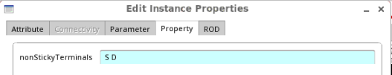
Example
The following instance I0 has 3 terminals S, D and G
nonStickyTerminals set on terminal S and D of instance I0
S_1 and S, G and G_1 are must connect terminals
S
D
S_1
G
G_1
I0

Slide 4
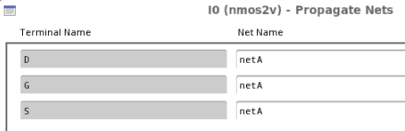
Example1
Connectivity > Nets > propagate. User sets a netA on the 3 terminals. Interactive/batch XL connectivity extractor remove the connectivity on S, S_1 and D. On terminal G, the connectivity is not removed
Connectivity > Nets > Propagate
nonStickyTerminals = S D
nonStickyTerminals = S D
I0
I0
Interactive/Batch
extraction
\S\
\D\
\S_1\
\S\netA
\D\netA
\S_1\netA
\G\netA
\G_1\netA
\G\netA
\G_1\netA
\S\, \S_1\ and \D\ are getting unassigned by extractor
\G\ and \G_1\ terminal are not unassigned by extractor

Slide 5
Example2
nonStickyTerminals = S D
I0
I0
I0
Creating 2 shapes
on netA
Interactive/batch
extraction
\G\netA
\G_1\netA
\G\
\G_1\
\S\
\D\
\S_1\
\S\
\D\
\S_1\
\S\netA
\D\netA
\S_1\netA
netA
netA
\G\
\G_1\
netA
netA
\S\, \S_1\, \D\, \G\ and \G_1\
assigned on netA
Deleting 2 shapes
on netA
I0
I0
\G\netA
\G_1\netA
Interactive/batch
extraction
\G\netA
\G_1\netA
Net removed on \S\, \S_1 and \D\ because nonStickyTerminals
Net netA not removed on \G\
\S\
\D\
\S_1\
\S\netA
\D\netA
\S_1\netA

