Slide 1
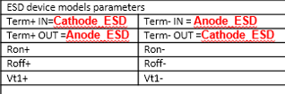

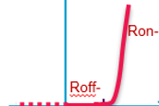
Anode_ESD
ESD
Cathode_ESD
Current
Electrical parameters to be extracted on TLP I(V) curves
Cathode_ESD
Vt1+
Voltage
Cathode_ESD
ESD
Anode_ESD
Current
Anode_ESD
Vt1-
Voltage

Slide 2
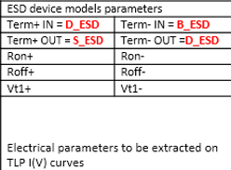
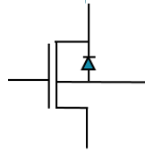
D_ESD
S_ESD
ESD
Current
D_ESD
B_ESD
B_ESD
D_ESD
ESD
Vt1+
Voltage
Current
S_ESD
Vt1-
Voltage

