Slide 1
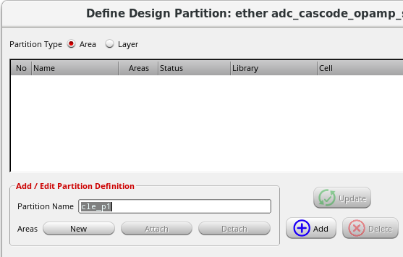
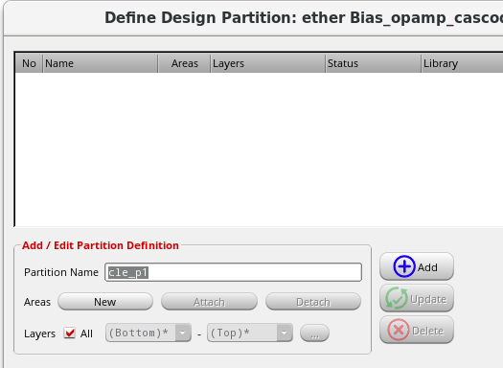
In previous versions, only one type of design partition
could be defined at one time.
You can now define both types of design partitions and
a mixed design partition at the same time.

