Slide 1
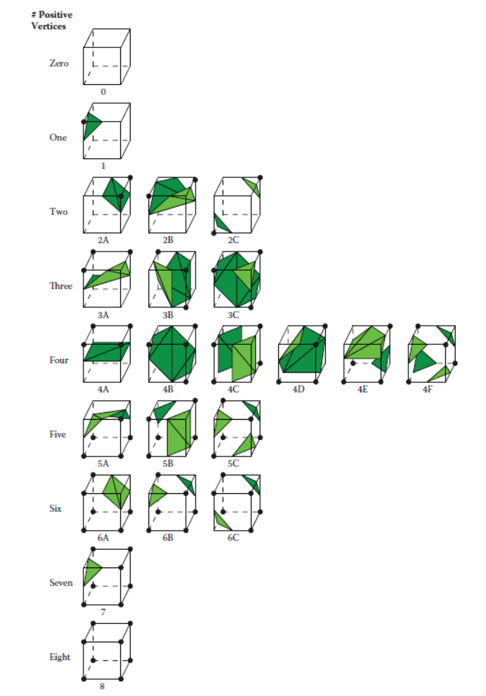

Slide 2


















p0
p1
p1
p4
p5
p4
p4
p4
p2
p0
p1
p5
p6
p7
p2
p1
p2
p2
p3
p0
p5
p0
p3
p3
p0
p3
p5
p2
p5
p3
p3
p2
p1
p1
p3
p0
p1
p4
p0
p2
p8
p4
p3
p5
p6
P11
p3
p4
p6
p6
p8
p2
p7
p9
P10
p5
p5
p0
p1
p2
p3
p4
p2
p4
p2
p5
p7
p4
p5
p6
p0
p3
p3
p4
p0
p1
p7
p2
p1
p1
p1
p2
p3
p0
p0
p0
p1
4G
p4
p3
p4
p0
p1
p4
p6
p5
p7
p3
p5
p6
p2
p2
p3
p8
p1
p2
p1
p1
p0
p0
p2
p2
p4
p0
p3
p5
p5
p3
p4
p0
p2
p1
p1
p3
p0
p1

