Slide 1
Audit-ready Multi-Agent Clinical Diagnosis System
Wangshu Zhu
<<Confidential>> Copyright © 2025 Graphen Drugomics, inc.
1

Slide 2
Motivation & Problem
Clinical diagnosis is inherently challenging
Medical language is nuanced: symptoms ≠ free-text inputs.
High uncertainty, overlapping symptoms.
LLMs show potential in diagnosis
Can reason across large medical knowledge
But single-agent systems are uncontrollable and not auditable
Our Goal
Build a multi-agent framework for clinical diagnosis
Ensures transparency, interpretability, and auditability
<<Confidential>> Copyright © 2025 Graphen Drugomics, inc.
2

Slide 3
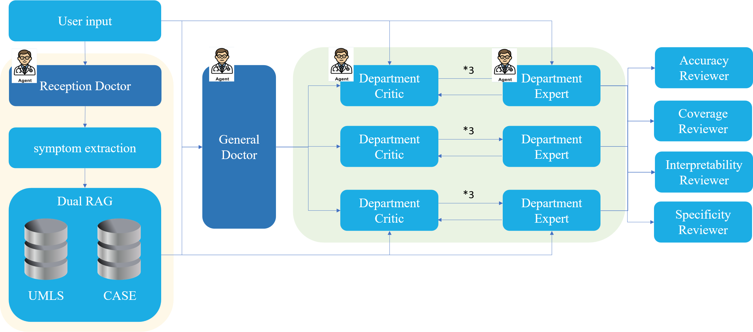
Framework
<<Confidential>> Copyright © 2025 Graphen Drugomics, inc.
3

Slide 4
System Overview -- Reception Doctor
Two Modes:
Student Mode
Used in inference for processing real patient input.
Extracts structured symptoms from free-text.
Returns concise, machine-usable features for downstream agents.
Teacher Mode
Used for building and expanding the case-base RAG.
From existing cases(free-text & ground-truth), generates standardized symptom summaries + diagnostic reasoning.
Ensures consistent case encoding → reduces noise from raw natural language.
Key Contributions
Bridges natural language input → structured clinical representation.
Enables dual RAG encoding and
Dramatically improves retrieval accuracy vs. vanilla text embedding.
<<Confidential>> Copyright © 2025 Graphen Drugomics, inc.
4

Slide 5
System Overview -- Dual RAG
Two Stores, Two Roles
UMLS RAG (KRAG)
Scope: medical ontology & definitional knowledge (synonyms, hierarchies, prototypical symptom clusters).
Use: normalize terms, expand synonyms, anchor differentials.
Case RAG (CRAG)
Scope: curated historical cases produced by Reception Doctor – Teacher Mode.
Content per case:
symptoms_structured (canonical list)
diagnostic_reasoning (short trace)
free_text (original input)
final_diagnosis (label)
Continuous self-improvement: each finished run can be distilled back into new cases
Query: free text → normalized symptom set S = {s₁, s₂, …}
<<Confidential>> Copyright © 2025 Graphen Drugomics, inc.
5

Slide 6
System Overview -- General Doctor
Role
First diagnosing agent after Reception Doctor & Dual RAG.
Provides broad but grounded differential diagnoses.
Bridges raw patient input → structured candidates for Critic–Expert dialogue.
Innovations
Input enhancement: consumes structured symptoms (from Reception Doctor) + retrieved evidence (Dual RAG), not noisy raw text.
Structured output: each candidate includes diagnosis, department, confidence, reasoning, references.
Explainability: reasoning explicitly cites RAG evidence & symptom overlap patterns.
Top-K control: configurable number of candidates forwarded to next stage.
<<Confidential>> Copyright © 2025 Graphen Drugomics, inc.
6

Slide 7
System Overview -- Expert-Critic Discussion
Expert Agent Output
Critic Agent Output
{
"diagnosis": ["Gastroesophageal reflux disease "],
"critique": [
“A1: The food getting stuck in the throat occurs regularly with every meal, making swallowing consistently difficult and uncomfortable, indicating frequent esophageal obstruction or motility issues.”,
“A2: There is no mention of blood or unusual color in the vomit from the history provided, suggesting no obvious mucosal bleeding detected by the patient.”,
“A3: The upper abdominal pain tends to worsen after meals and when lying down, consistent with acid reflux exacerbation.”],
“reference" : [
“[History RAG] Patient reports frequent food impaction during swallowing, typical of severe GERD or stricture formation”
“[History RAG] No report of hematemesis or abnormal vomitus appearance. “
“[Clinical] GERD symptoms commonly worsen postprandially and in recumbent position due to increased acid exposure.”]
}
{
"diagnosis": ["Gastroesophageal reflux disease "],
"critique": [
“Q1: How frequent and severe is the food getting stuck in your throat during swallowing?”,
“Q2: Have you noticed any blood or unusual color in your vomit that might indicate mucosal damage?”,
“Q3: Does the upper abdominal pain worsen after meals or when lying down?”],
" review" : []
}
{
"diagnosis": ["Gastroesophageal reflux disease "],
"critique": [],
" review" : [“Q1 fixed”, -- adequately answered
“Q2 not_fixed”, -- answered but not convinced
“Q3 cannot_fixed” ”, -- expert indicates inability to answer]
}
<<Confidential>> Copyright © 2025 Graphen Drugomics, inc.
7

Slide 8
System Overview -- Review-Agent
Role
Acts as a quality auditor of candidate diagnoses.
Evaluates each candidate along four dimensions:
Accuracy
Coverage
Interpretability
Specificity
Conditional Trigger
Not always active → saves cost & avoids noise.
Triggered only if:
Doctor’s top candidates are too close (Δconfidence < margin).
Or doctor shows low confidence lock (p_lock threshold not satisfied).
Otherwise, pipeline skips reviewers → faster, cheaper, less overfitting.
Why It Matters
Efficiency: reviewer invoked only in ambiguous cases.
Safety net: provides extra scrutiny when doctor alone is uncertain.
Balance: prevents reviewers from overruling strong doctor outputs (which led to accuracy drop).
Interpretability: reviewer scores and rationales explain why a diagnosis is strong/weak.
<<Confidential>> Copyright © 2025 Graphen Drugomics, inc.
8

Slide 9

Results -- symptom2diease
 | Top1 | Top2 | Top3 | mean_mrr
SingleAgent | 45.28% | 14.15% | 6.13% | 54.4%
SingleAgent+CoT | 46.23% | 9.91% | 0.66% | 53.38%
SingleAgent+CoT+RAG | 74.53% | 6.60% | 0.47% | 77.99%
MultiAgent (113 cases) | 96.46% | 1.77% | 1.77% | 97.97%
MRR (Mean Reciprocal Rank) is the average of the reciprocal ranks of the first correct answer across all cases. If the correct diagnosis appears at rank ri​ for case i, then
Ablation Settings
SingleAgent
Plain LLM, directly maps symptom text → disease prediction.
SingleAgent + CoT
Encourages reasoning steps, but still grounded only in the LLM’s internal knowledge.
SingleAgent + CoT + RAG
Adds vanilla retrieval-augmented generation from free-text encoding directly.
<<Confidential>> Copyright © 2025 Graphen Drugomics, inc.
9

Slide 10
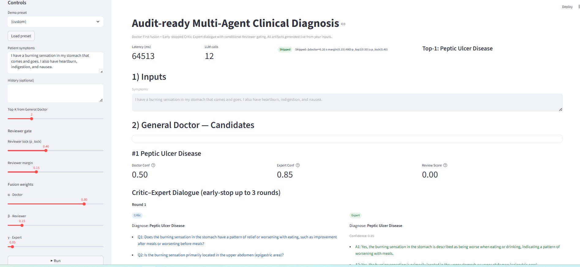
Web -- demo
Input area
Inference information
Candidate information
Adjusting parameters
<<Confidential>> Copyright © 2025 Graphen Drugomics, inc.
10

Slide 11
Thanks for listening
Code Repository: ssh://git@web2.graphen.ai:8022/wangshuzhu/multiagentsformedicaldiagnosis.git
<<Confidential>> Copyright © 2025 Graphen Drugomics, inc.
11

