Slide 1
Systemic review of human norovirus challenge studies
W. Zane Billings, Anne Marie Dye, Andreas Handel

Slide 2
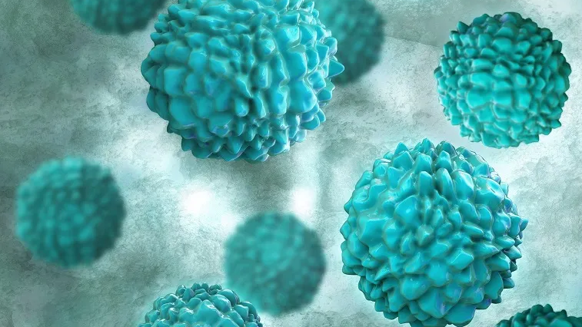
Human norovirus (noro / NoV)
Small, nonenveloped, linear +SS RNA virus
Causes > 50% of foodborne illnesses in the US each year, AKA: “food poisoning”, “stomach bug”, “nonbacterial gastroenteritis”
About 1 in every 15 people in the US will get noro each year!
Transmission is by fecal-oral and vomit-oral routes via food, water, surfaces, being too close to sick people
Small inoculum dose + high shedding + environmental persistence + potential for aerosolization = high transmissibility
Summary: PLEASE close the toilet lid before you flush
Image source: https://www.nfid.org/infectious-diseases/norovirus/

Slide 3




Challenge studies (yes they are legal)
Experimental infection with “biologic” (noro)
Tracking disease progress and infection outcomes
Cohort of young, healthy people
(usually paid)

Slide 4
How many NoV challenge studies have been conducted?
SR of literature is a proxy to address this question—not every paper reflects a unique study. So capture all relevant papers.
From literature, abstract data to identify unique studies.

Slide 5
Inclusion/exclusion criteria
Study was conducted in human volunteers of any age.
Participants were experimentally infected with norovirus. (Infection must be controlled!!!)
The study was published in English.
No exclusion based on location, date of publication, peer-review status, etc. No exclusion made based on presence/type of comparator or outcome.

Slide 6
Search strategy
PubMed search strategy:
(“norovirus” [MeSH Major Topic]) AND
(“norovirus” OR “Norwalk virus” OR “snow mountain virus” OR "Norwalk agent" OR "nonbacterial gastroenteritis" OR "viral gastroenteritis" [Title/Abstract]) AND
(human OR challenge OR experimental OR infect* OR volunteer OR vaccin* OR adult OR clinical OR randomized OR individual [Title/Abstract]) NOT
(“mouse” or “murine” or “mice” [Title])
Web of Science search strategy:
(TS=("norovirus" OR "Norwalk virus" OR "snow mountain virus" OR "Norwalk agent" OR "nonbacterial gastroenteritis" OR "viral gastroenteritis")) AND
(TS=(human OR man OR adult OR volunteer)) AND
(TS=(volunteer OR challenge OR experimental OR infect* OR vaccin* OR inoculum))

Slide 7
Results
From PubMed: 3460
From WoS: 2866
After deduplication: 5301 included in title/abstract review
Title/abstract review is currently ongoing (I identified 104 papers identified for full text review, second reviewer is still working).
Dr. Handel identified 18 studies for inclusion before the search—these will all be included but the overlap is uncertain right now.

Slide 8
Some good references
Robilotti E, Deresinski S, Pinsky BA. Norovirus. Clin Microbiol Rev. 2015;28(1):134-164. doi:10.1128/CMR.00075-14
Ludwig-Begall LF, Mauroy A, Thiry E. Noroviruses-The State of the Art, Nearly Fifty Years after Their Initial Discovery. Viruses. 2021;13(8):1541. Published 2021 Aug 4. doi:10.3390/v13081541
Example of what we are looking for:
Williams AM, Ladva CN, Leon JS, et al. Changes in micronutrient and inflammation serum biomarker concentrations after a norovirus human challenge. Am J Clin Nutr. 2019;110(6):1456-1464. doi:10.1093/ajcn/nqz201

