Slide 1
Infectivity of human norovirus in live challenge studies
W. Zane Billings, Anne Marie Dye, Andreas Handel

Slide 2
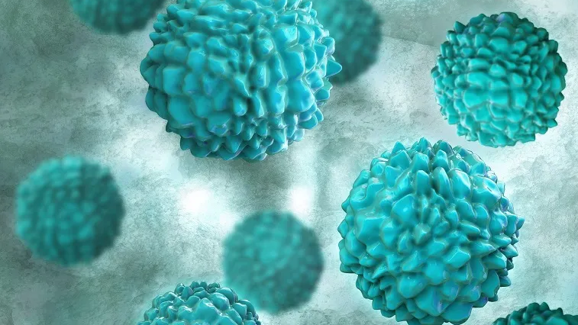
Human norovirus (noro / NoV)
Nonenveloped, linear +SS RNA virus
AKA: “food poisoning”, “stomach bug”, “nonbacterial gastroenteritis”
Causes > 50% of foodborne illnesses in the US anually
1 in every 15 Americans get NoV each year!
Transmission is by fecal-oral and vomit-oral routes
FUT2+ (“secretor”) blood groups affect susceptibility
Summary: PLEASE close the toilet lid before you flush
Image source: https://www.nfid.org/infectious-diseases/norovirus/

Slide 3




Challenge studies
(yes they are legal)
Experimental infection with “biologic” (noro)
Tracking disease progress and infection outcomes
Cohort of young, healthy people
(usually paid)

Slide 4
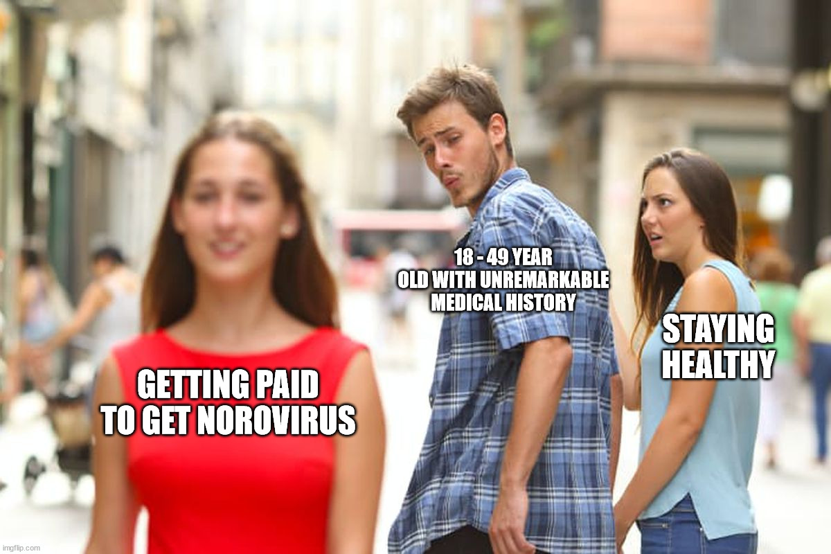
Challenge studies
(yes they are legal)

Slide 5
Q1: How many NoV challenge studies have been conducted?
SR of literature is a proxy to address this question—not every paper reflects a unique study. So capture all relevant papers.
From literature, abstract data to identify unique studies.

Slide 6
Q2: How infectious is NoV in human challenge studies?
Q3: How does inoculum dose relate to infectivity?

Slide 7
Q1: How many NoV challenge studies have been conducted?

Slide 8
Inclusion/exclusion criteria
Study was conducted in human volunteers of any age.
Participants were experimentally infected with norovirus. (Infection must be controlled!!!)
The study was published in English.
No exclusion based on location, date of publication, peer-review status, etc. No exclusion made based on presence/type of comparator or outcome.

Slide 9
PubMed search strategy:
(“norovirus” [MeSH Major Topic]) AND
(“norovirus” OR “Norwalk virus” OR “snow mountain virus” OR "Norwalk agent" OR "nonbacterial gastroenteritis" OR "viral gastroenteritis" [Title/Abstract]) AND
(human OR challenge OR experimental OR infect* OR volunteer OR vaccin* OR adult OR clinical OR randomized OR individual [Title/Abstract]) NOT
(“mouse” or “murine” or “mice” [Title])
Web of Science search strategy:
(TS=("norovirus" OR "Norwalk virus" OR "snow mountain virus" OR "Norwalk agent" OR "nonbacterial gastroenteritis" OR "viral gastroenteritis")) AND
(TS=(human OR man OR adult OR volunteer)) AND
(TS=(volunteer OR challenge OR experimental OR infect* OR vaccin* OR inoculum))
Notes:
The first AND in pubmed strategy should probably be an OR, but because we found so many unique abstracts we thought it was fine and did not want to redo the search once we found the mistake.

Slide 10
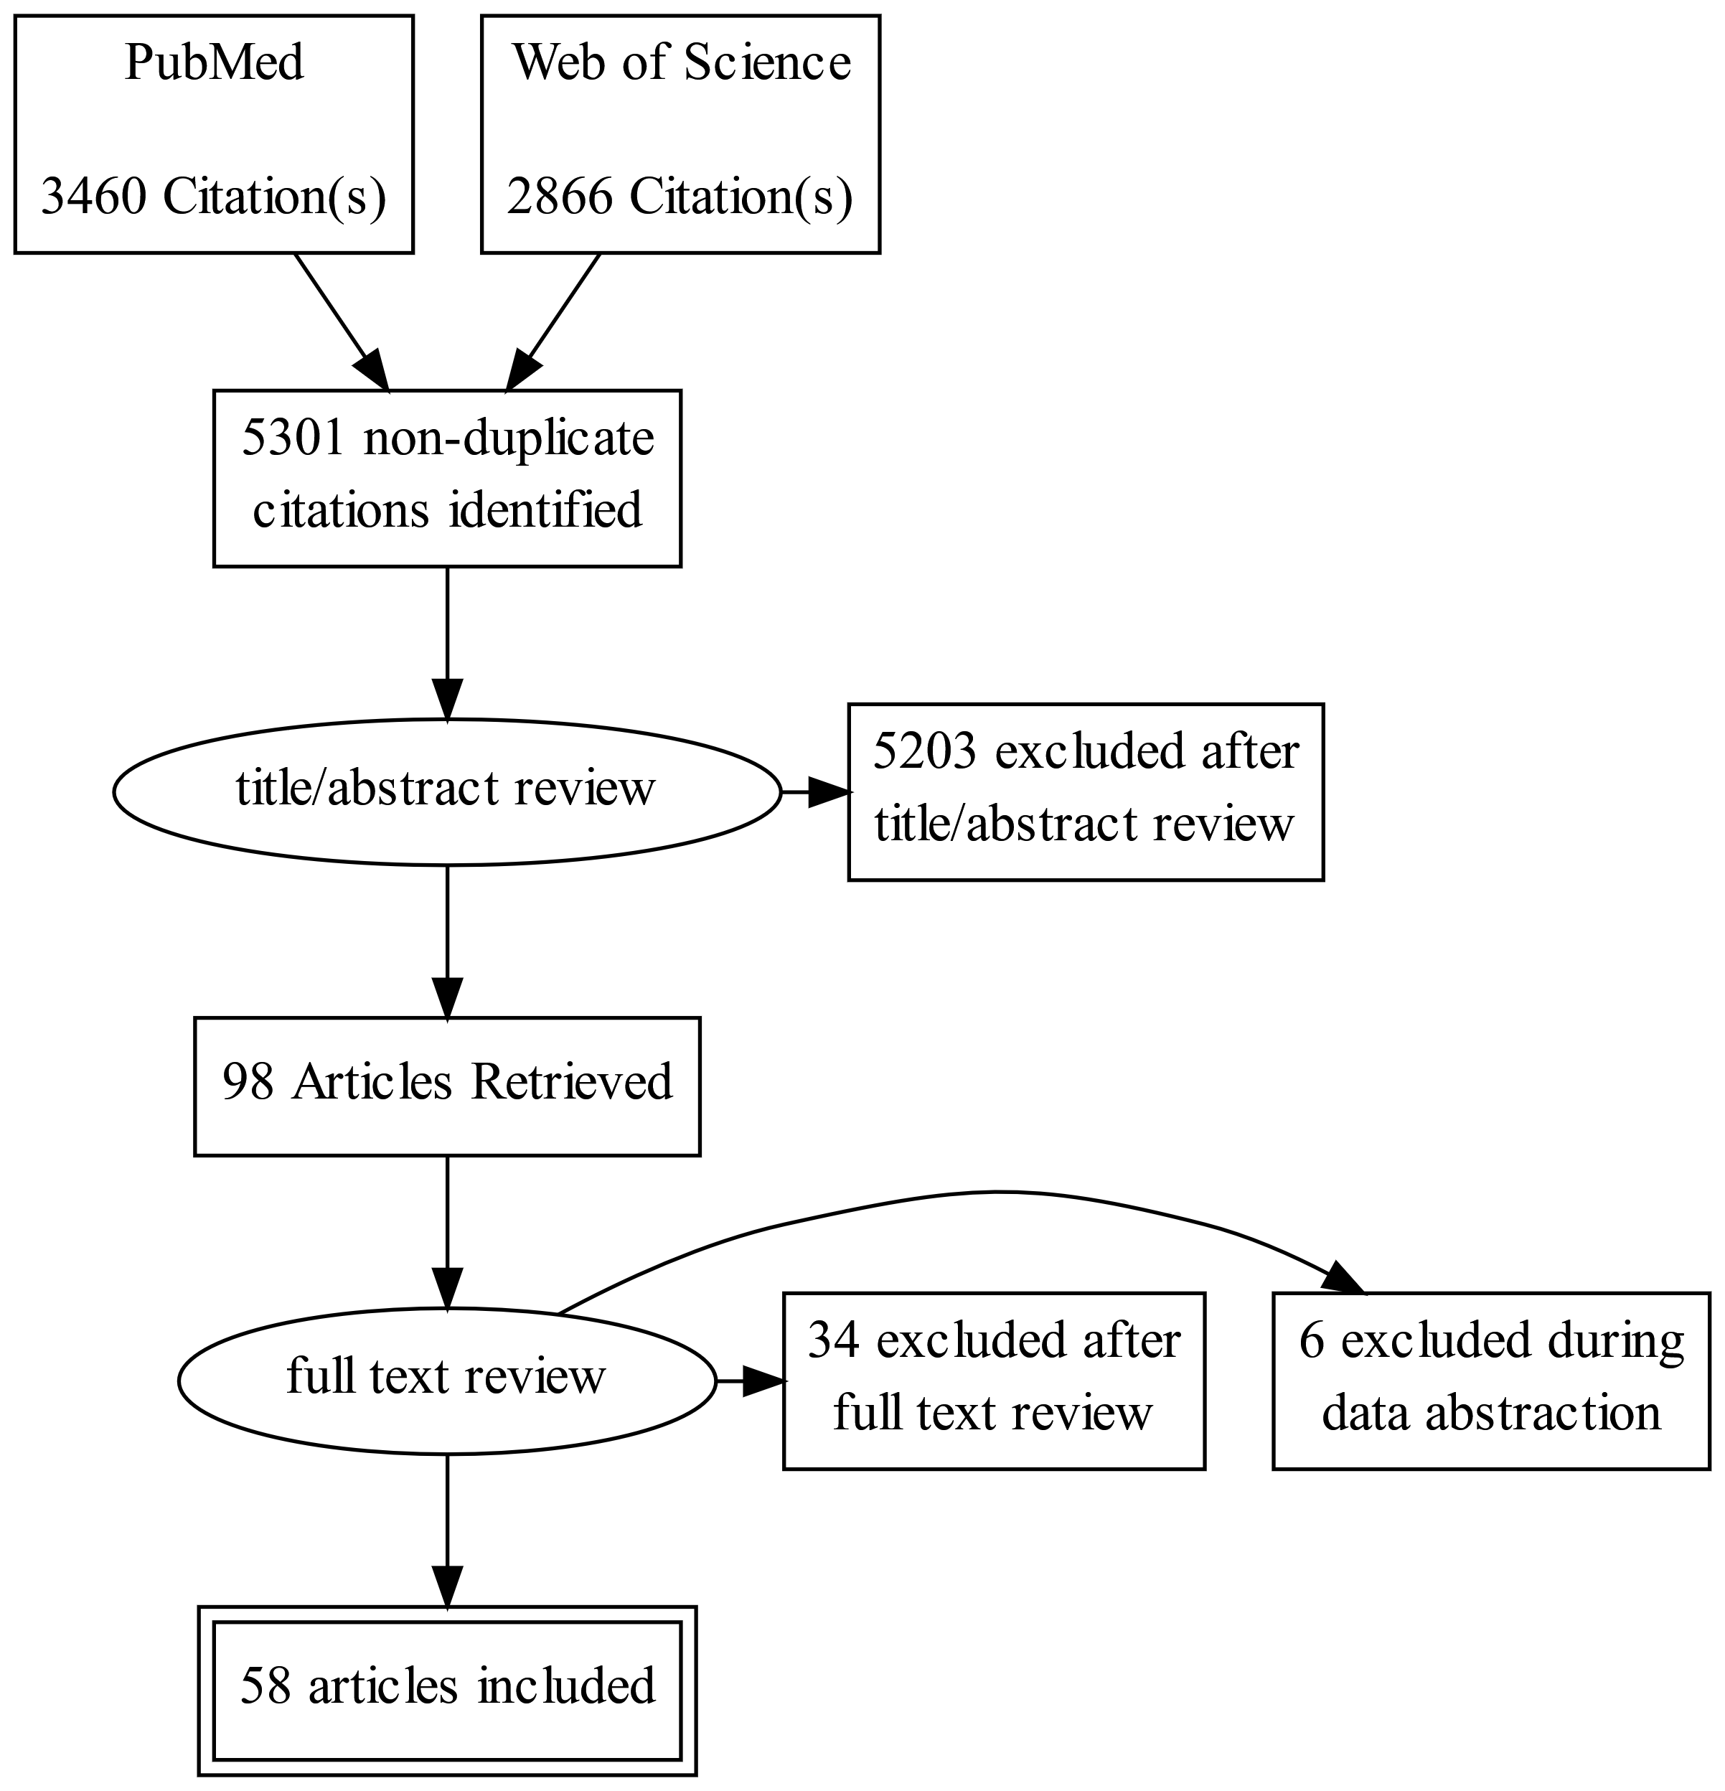
Search results
Ran searches in September
Anne Marie and I independently did Ti/Ab and full text reviews, Dr. Handel judged disagreements.
Some studies identified before search, and from references—we still need to review these.
Notes:
Reasons for exclusion during FTR: studies had VLPs only, were reviews, were not accessible (2)
Reasons for exclusion during DA: studies didn’t report original infection data in a suitable format for usage

Slide 11
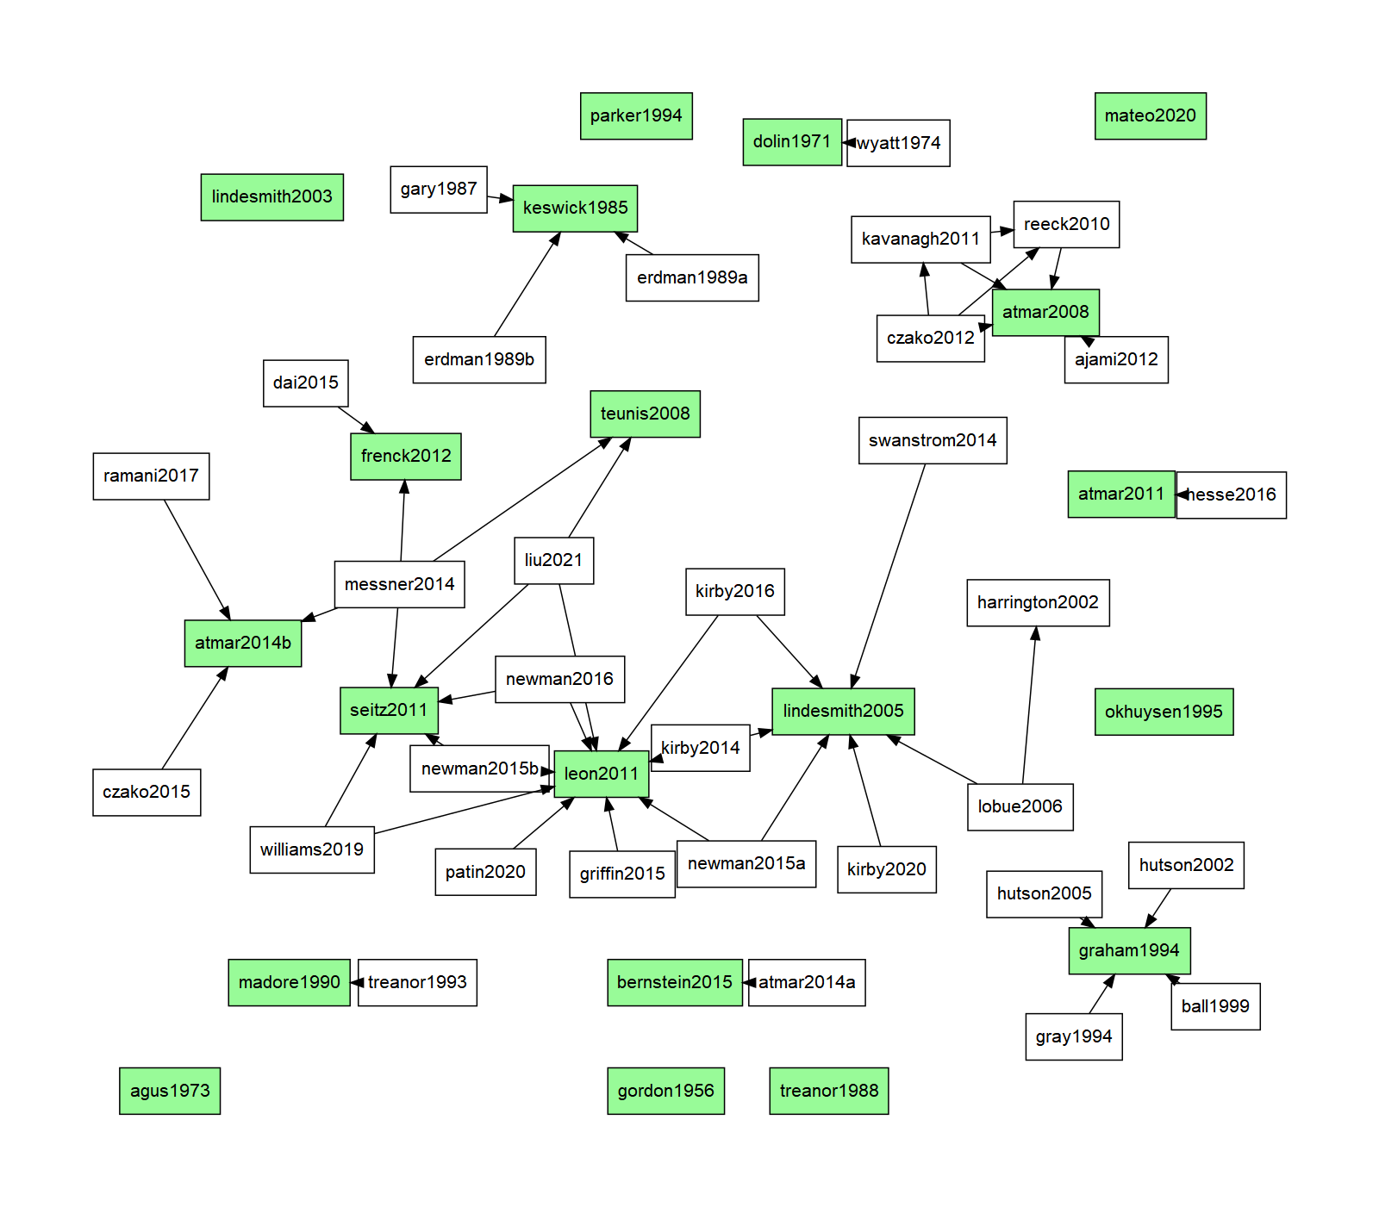
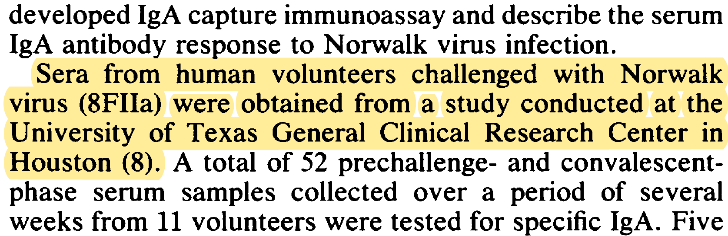
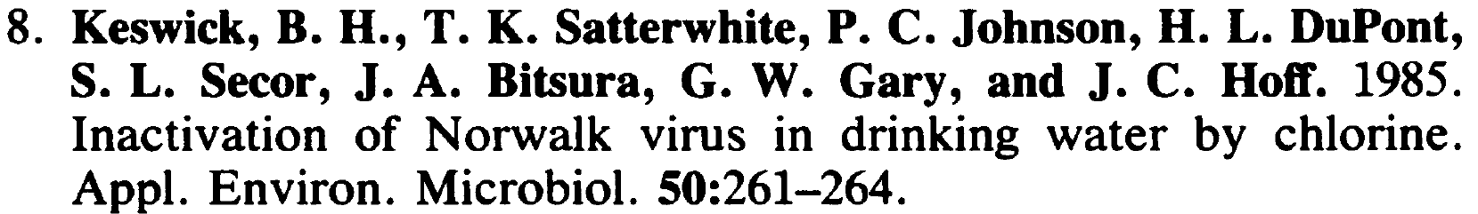
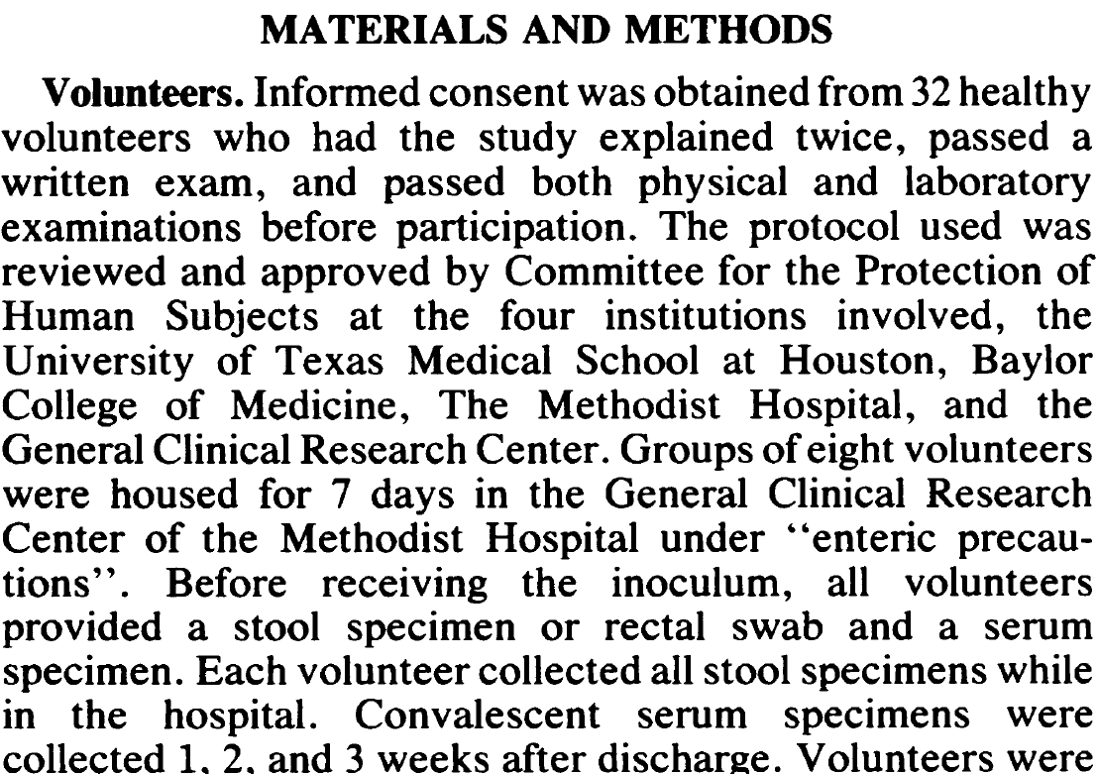
Articles to Studies
(I know it looks bad, the R package wouldn’t cooperate with me -_- )
So we have 58 articles now. But NOT 58 studies.
Solution: let’s make a DAG
Example from Erdman 1989:
Where do the authors say their volunteer data comes from?
OK, so let’s go to Keswick’s paper. Nice, it is also in the search.
This appears to be the actual challenge study.

Slide 12
Study characteristics (summary)
Characteristic | # Missing | Reported range | Notes
Age | 5 | 18 - 54 | Three reported “adults”
Sex | 8 | 49 % - 59% male (median 48%) | Three oldest had 100% male subjects
Race | 12 | 23% - 84% white, not Hispanic (median 50%)
Country | 0 | NY (3), MD (2), TX (6), NC (2), GA, OH, CA | 2 conducted at “multiple sites”
FUT2+ stratification | 0 | No stratification: 12 Stratified: 3 Only FUT2+: 5
Year of publication | 0 | 1956 - 2020 | 15/20: after 1990 11/20: after 2000 7/20: after 2010

Slide 13
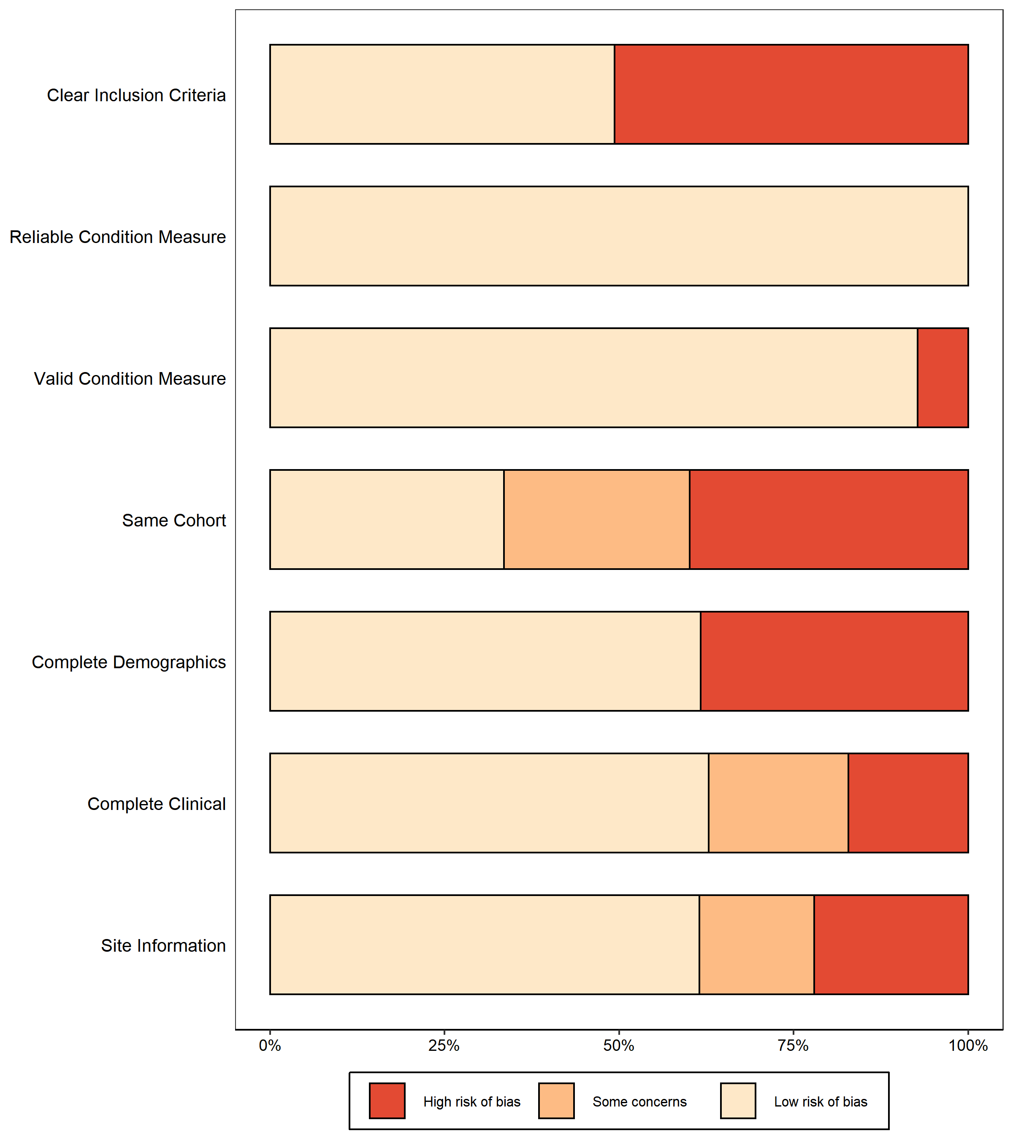
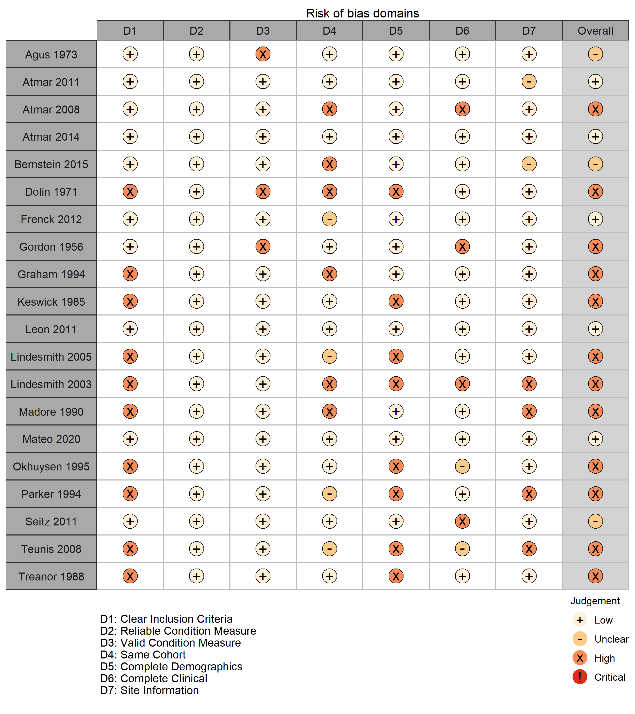

Slide 14
Q2: How infectious is NoV in human challenge studies?

Slide 15
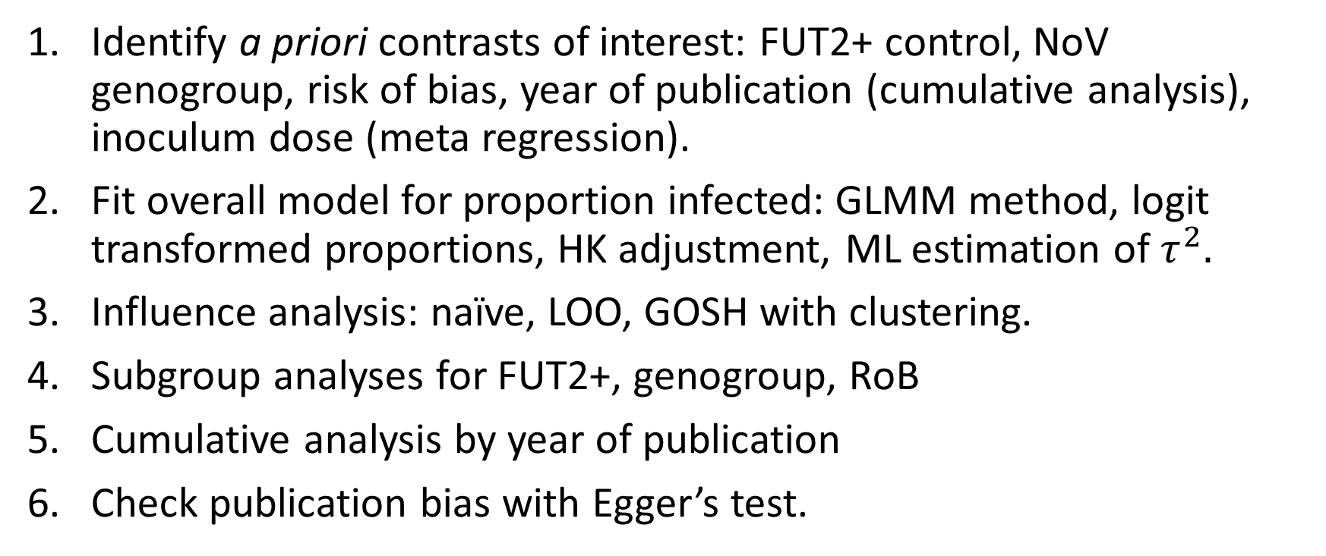
Analysis methods
Identify a priori contrasts of interest: FUT2+ control, NoV genogroup, risk of bias, year of publication (cumulative analysis), inoculum dose (meta regression).
Fit overall model for proportion infected: GLMM method, logit transformed proportions, HK adjustment, ML estimation of $τ^{2}.$
Influence analysis: naïve, LOO, GOSH with clustering.
Subgroup analyses for FUT2+, genogroup, RoB
Cumulative analysis by year of publication
Check publication bias with Egger’s test.
(As a statistician I have to do this first or I will be executed.)
Notes:
Note that GLMM method assigns NO WEIGHTS to studies. This method is recommended by Harrer for meta analysis of proportions. ML is the only valid estimator of tau^2 in this framework.

Slide 16
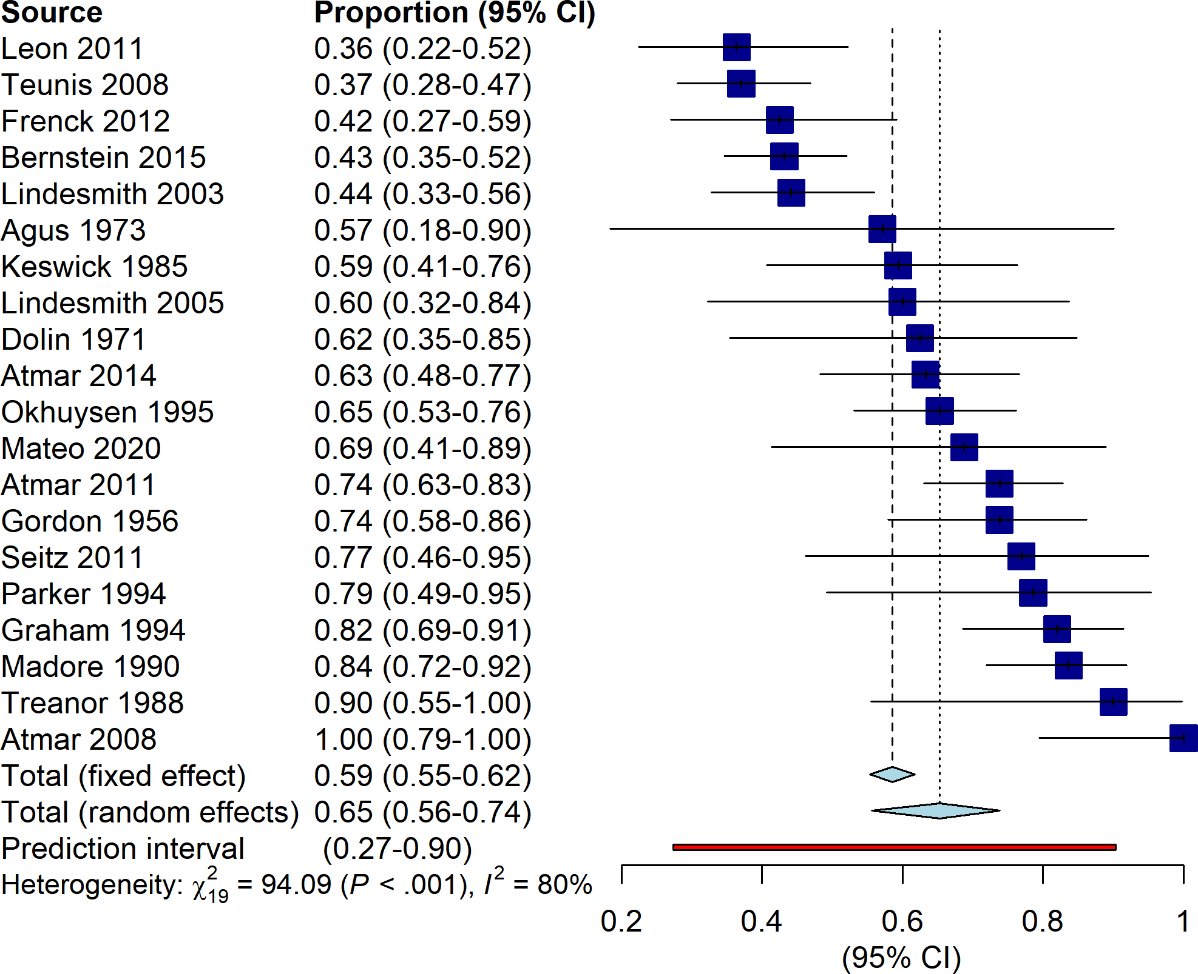

So wide!

Slide 17
Simple outliers

Slide 18
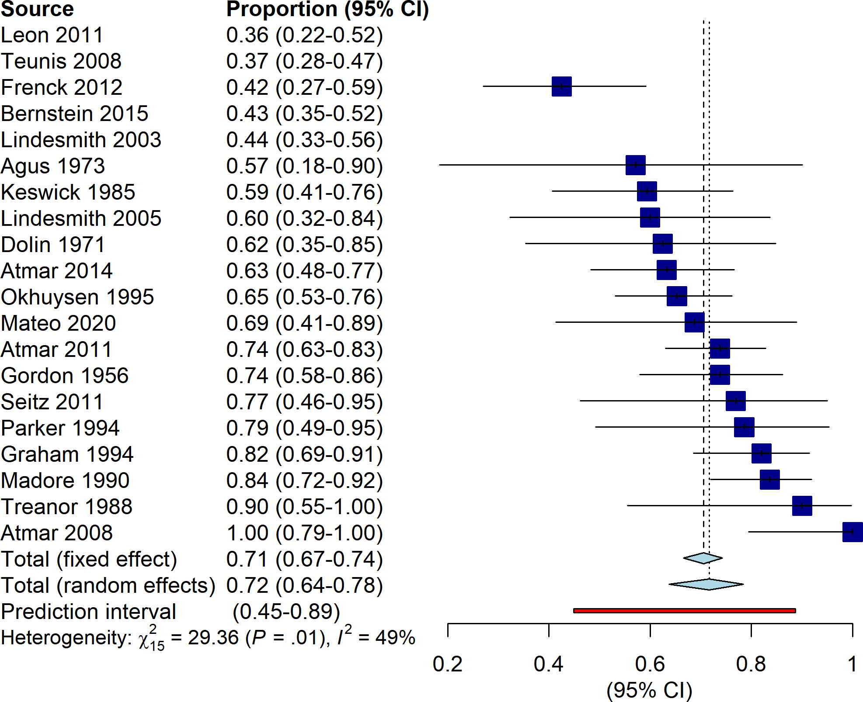
?

Slide 19
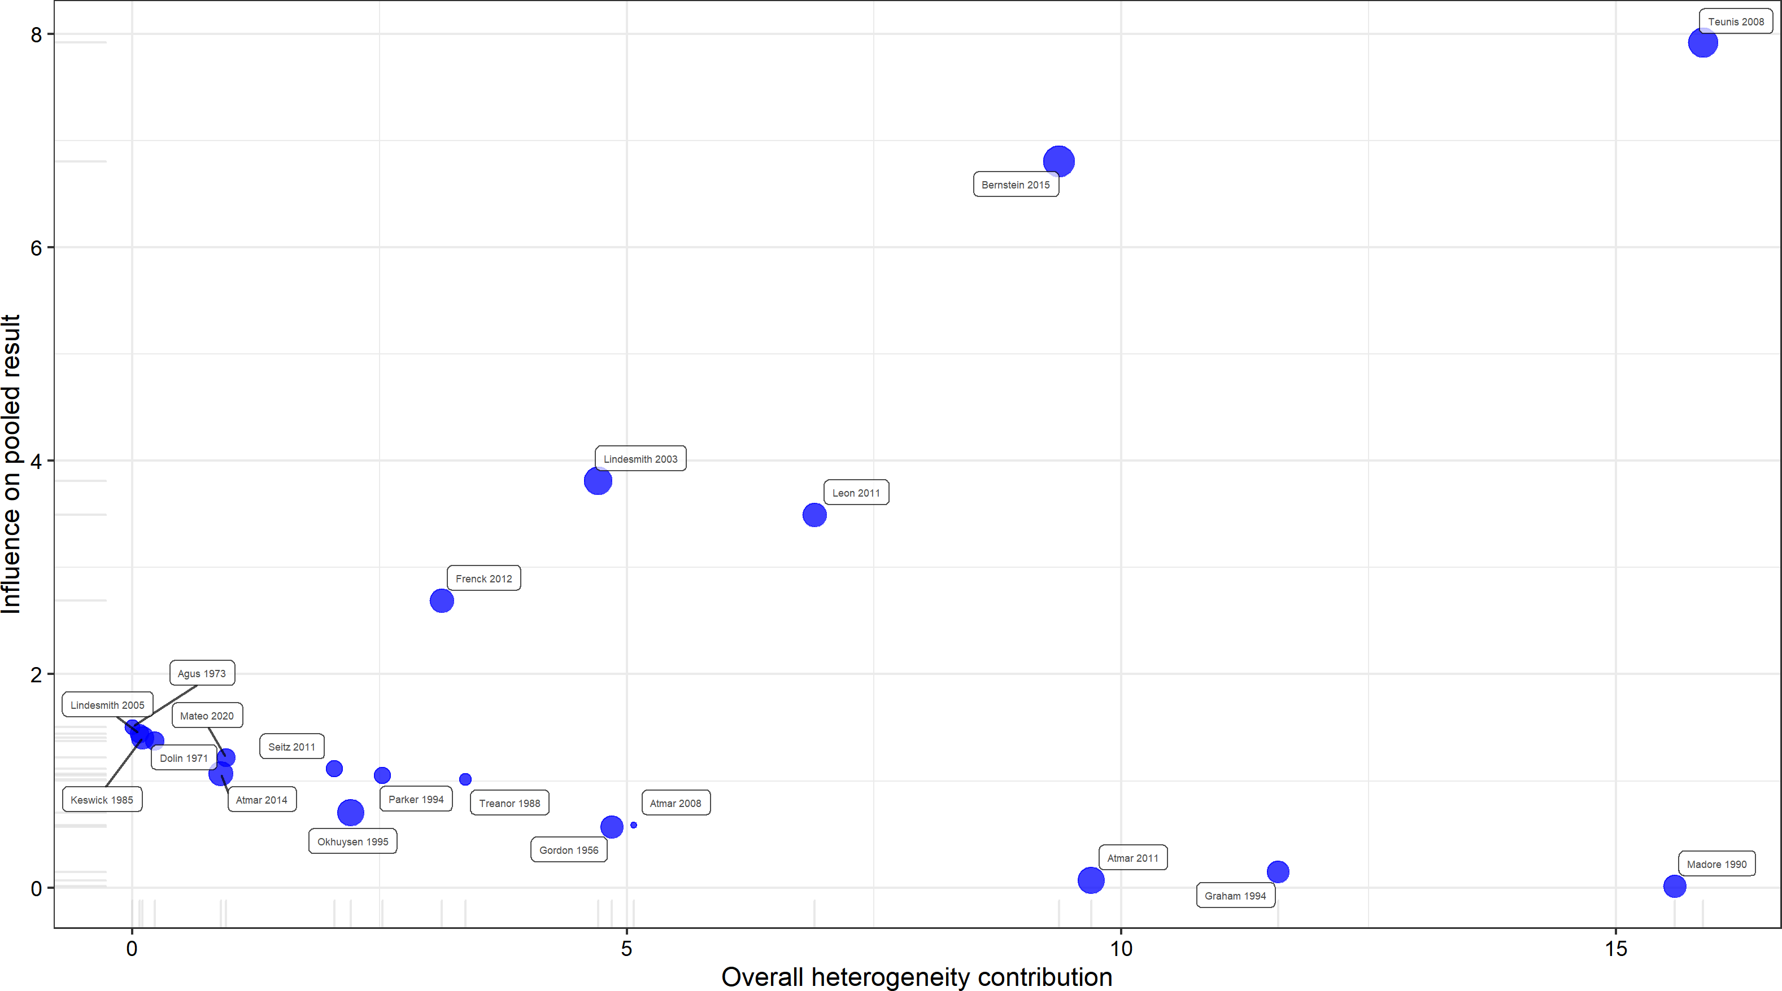
Influence analysis summary
Baujat plot: which studies influence both heterogeneity and effect size?
We also removed these two before. They seem influential.
We removed these two before, but they seem OK.
Of course the naïve method reduces heterogeneity. But it doesn’t explain anything.
Next step: try LOO analysis
Analyzed study influence by:
Simple method: Bernstein 2015, Leon 2011, Lindesmith 2003, Teunis 2008
LOO method: Teunis 2008, Madore 1990
GOSH method:
Got my eyes on you two…
This one is new, but seems suspect.

Slide 20
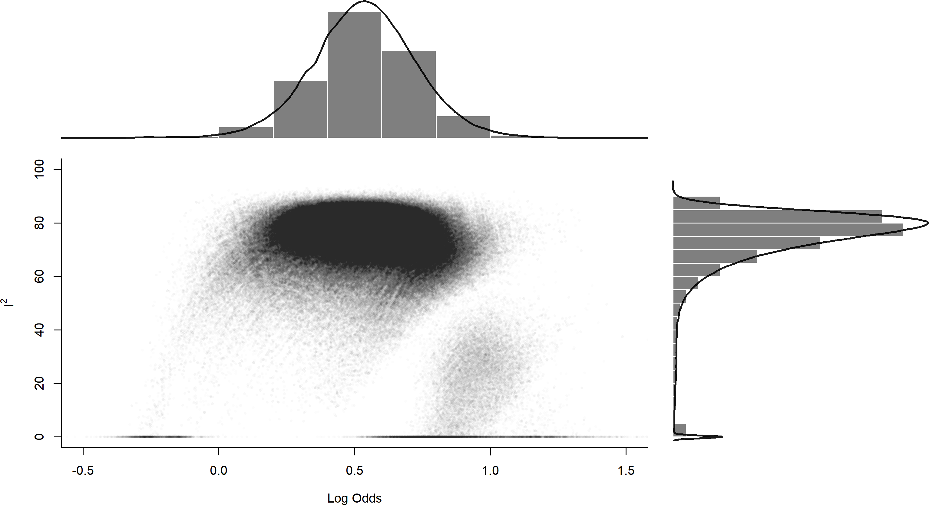
“GOSH” analysis: 1,000,000 random subset models (using inverse variance method)

Slide 21
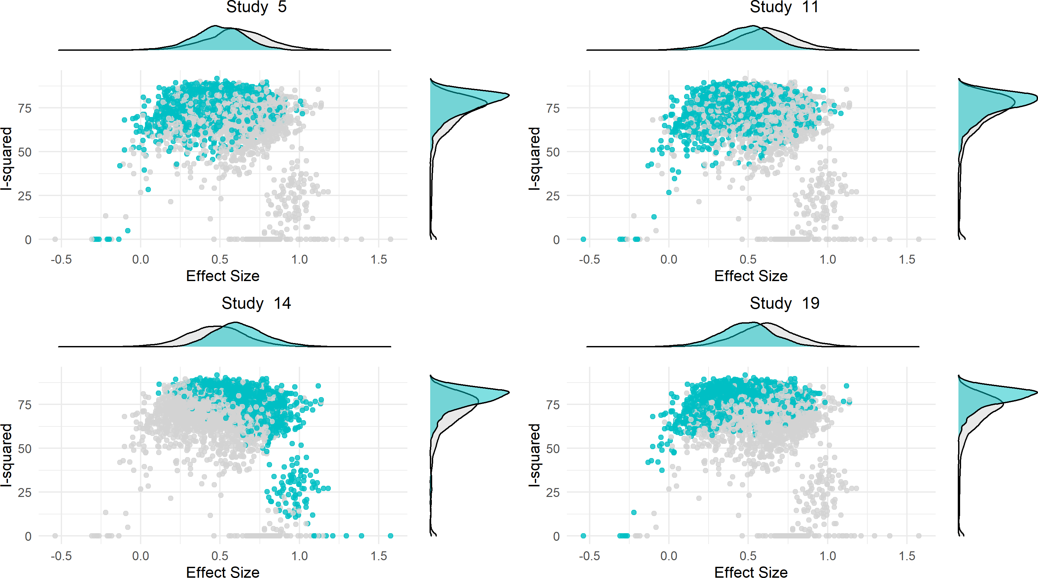
Bernstein 2015
Leon 2011
Madore 1990
Teunis 2008

Slide 22
Study | Naïve | LOO | GOSH | Setting | FUT2+ | Dose stratified? | Rob | NoV genogroup
Bernstein 2015 |  |  |  | Multiple | FUT2+ only | No | M | GI.1
Teunis 2008 |  |  |  | NY | No | Yes | H | GI.1
Madore 1990 |  |  |  | NY | No | No | H | GI.1, GII.1, GII.2
Leon 2011 |  |  |  | GA | No | No | L | GI.1
Lindesmith 2003 |  |  |  | NC | Yes | Yes | H | GI.1
Nothing stands out here…
Random effects summary: 0.70 (0.62 – 0.77); I^2 = 39%
Let’s see if planned subgroup analyses are more informative.

Slide 23
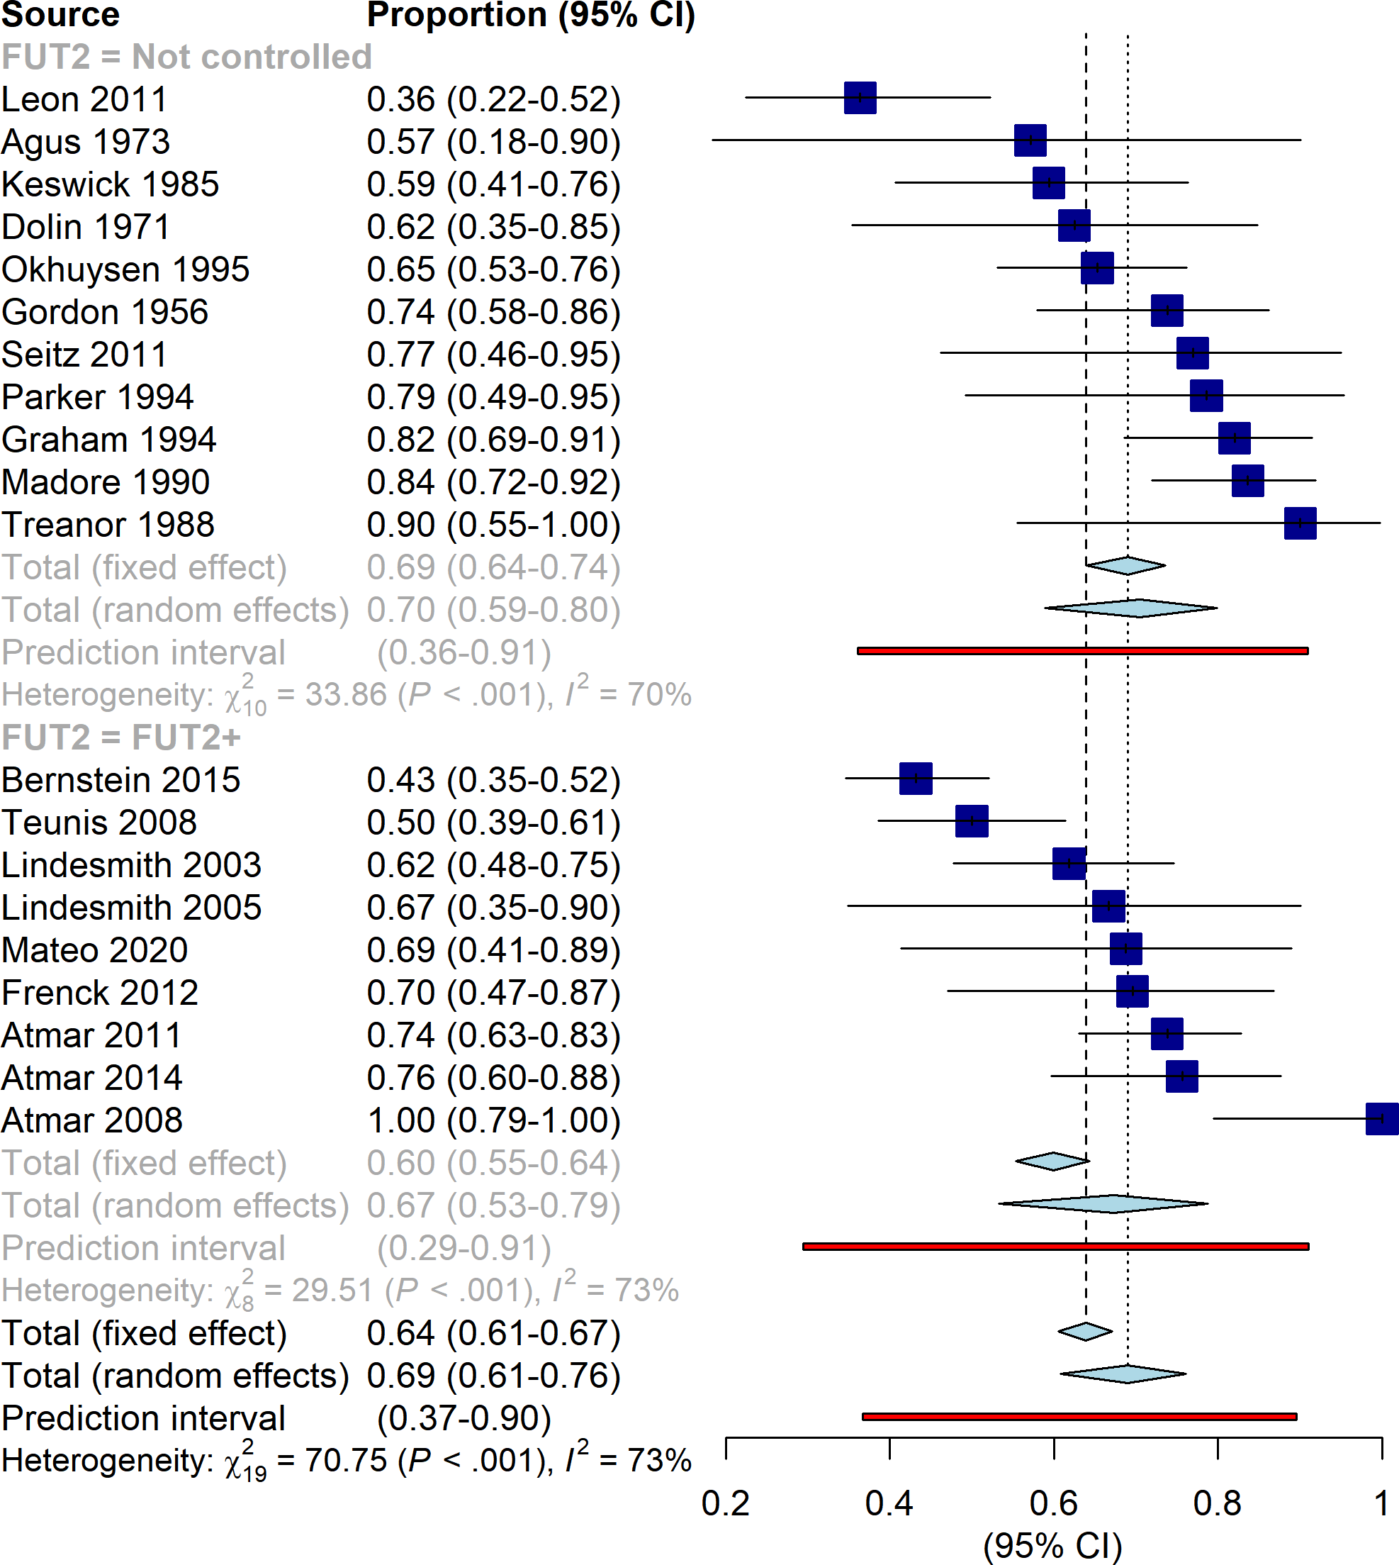
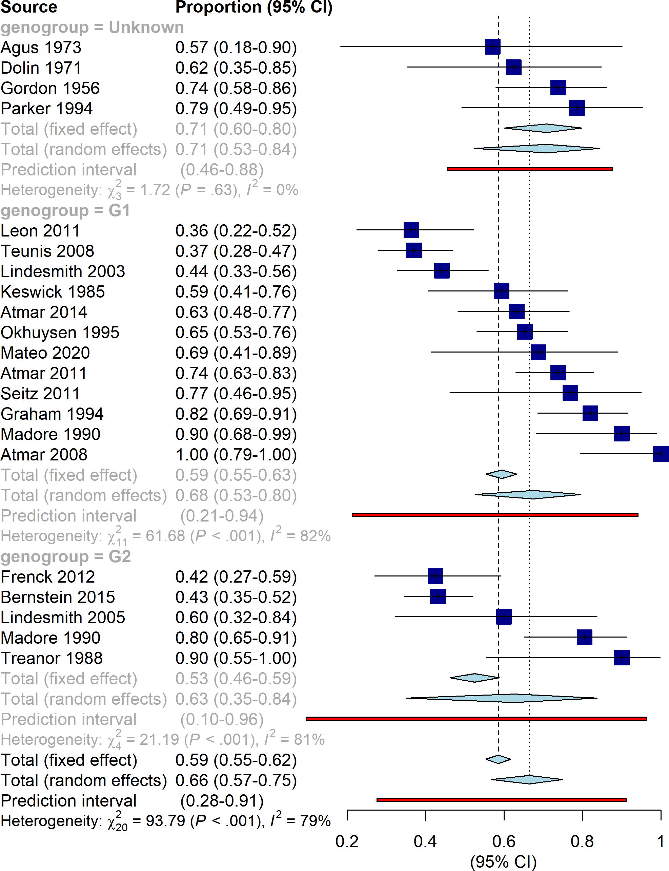

Slide 24
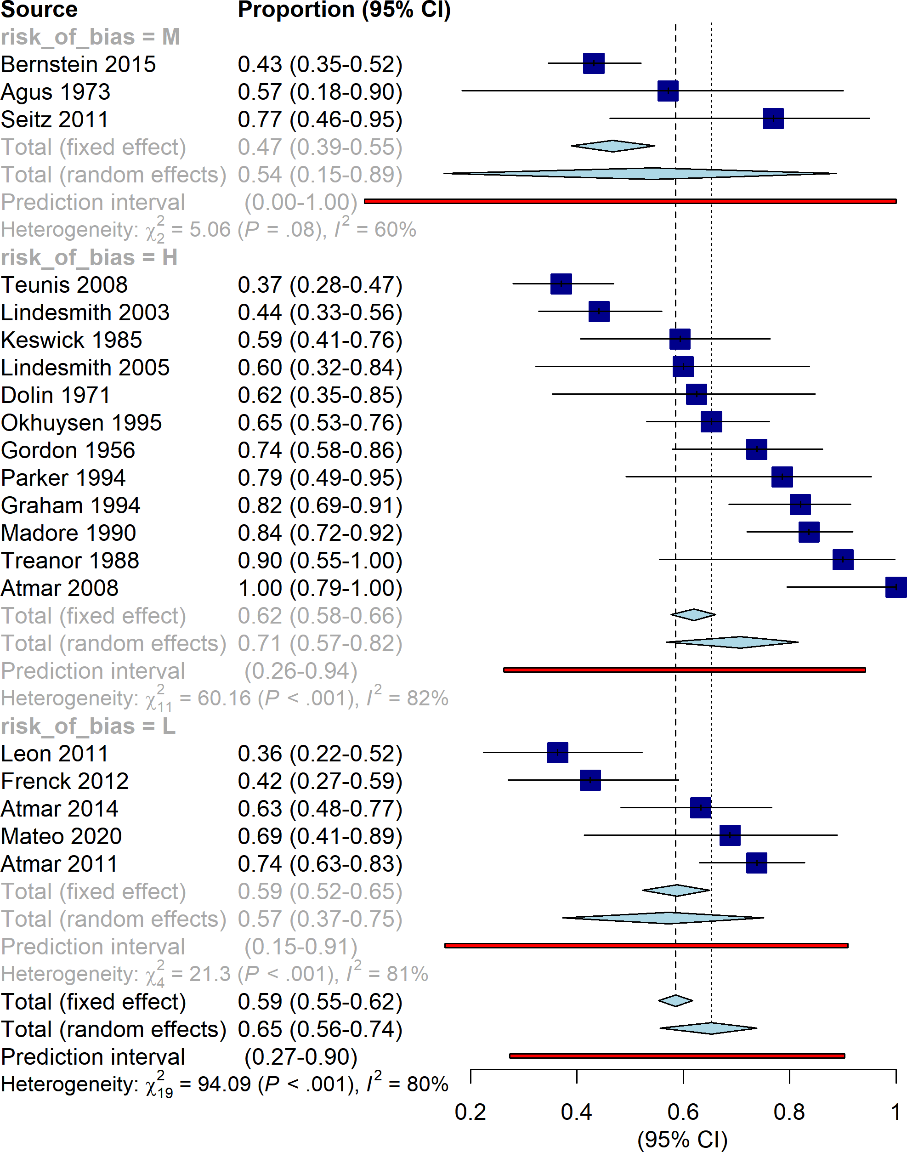
Well, I’m running out of ideas fast.
FUT2+, genogroup, and risk of bias don’t explain heterogeneity.
Maybe exploring the effect of dose or using multilevel techniques could help, but that is future work.

Slide 25
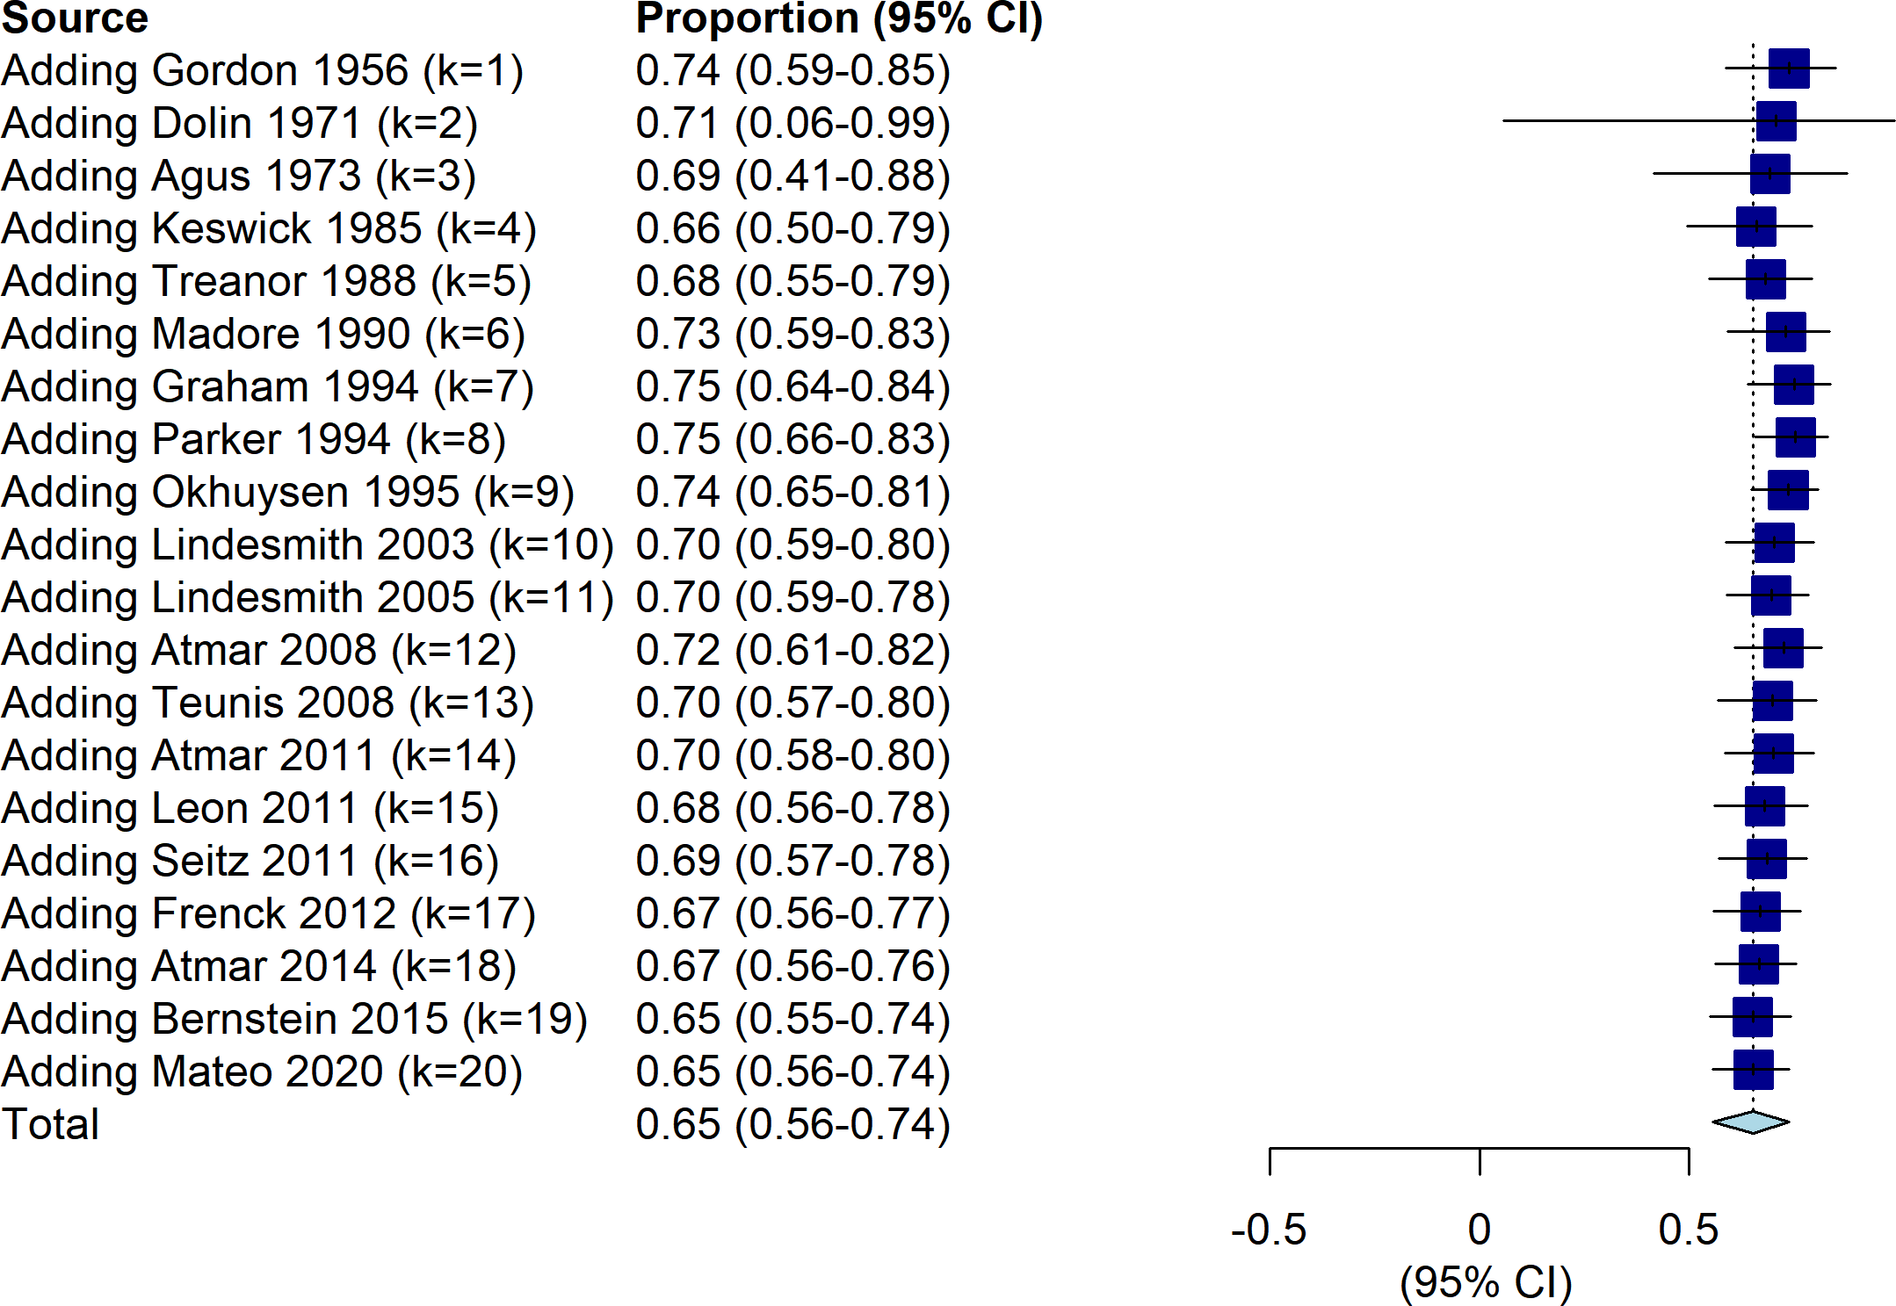




$$I^{2}< 5\%$$
$$I^{2}≈40\%$$
$$I^{2}≈70\%$$
$$I^{2}≈80\%$$

Slide 26
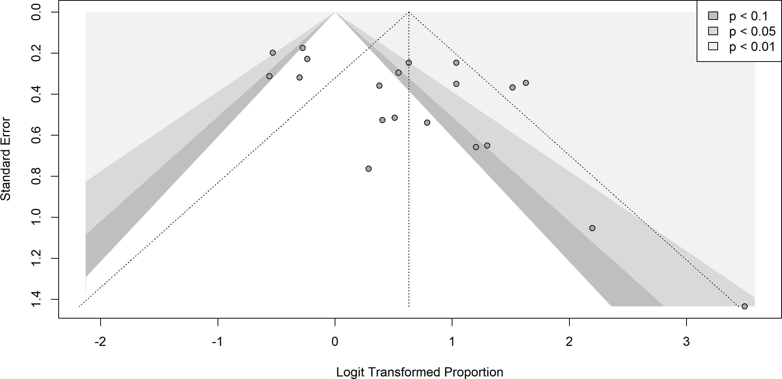
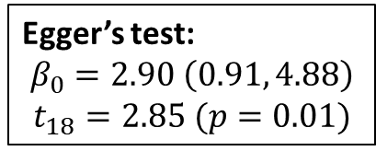
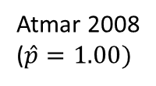
Bernstein 2015
Teunis 2008
Lindesmith 2003
Leon 2011
Madore 1990
Egger’s test:
$$β_{0}=2.90 \left(0.91, 4.88\right)$$
$$t_{18}=2.85 (p=0.01)$$
Atmar 2008
($\hat{p}=1.00)$

Slide 27
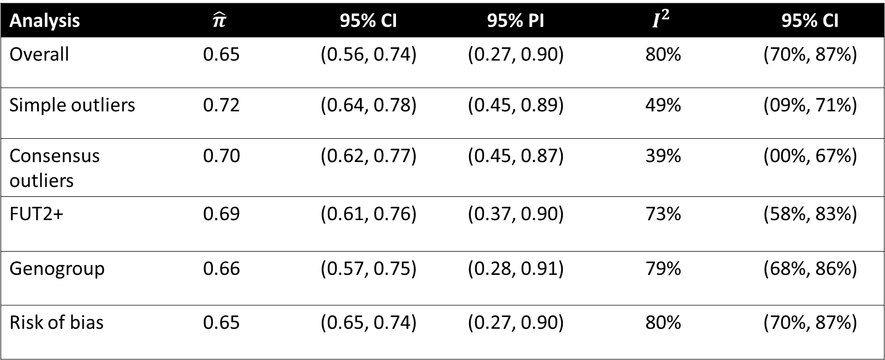
Conclusions
No apparent reason for heterogeneity in studies.
Funnel plot is definitely asymmetrical.
Analysis | $$\hat{π}$$ | 95% CI | 95% PI | $$I^{2}$$ | 95% CI
Overall | 0.65 | (0.56, 0.74) | (0.27, 0.90) | 80% | (70%, 87%)
Simple outliers | 0.72 | (0.64, 0.78) | (0.45, 0.89) | 49% | (09%, 71%)
Consensus outliers | 0.70 | (0.62, 0.77) | (0.45, 0.87) | 39% | (00%, 67%)
FUT2+ | 0.69 | (0.61, 0.76) | (0.37, 0.90) | 73% | (58%, 83%)
Genogroup | 0.66 | (0.57, 0.75) | (0.28, 0.91) | 79% | (68%, 86%)
Risk of bias | 0.65 | (0.65, 0.74) | (0.27, 0.90) | 80% | (70%, 87%)

Slide 28
Presentation references
Robilotti E, Deresinski S, Pinsky BA. Norovirus. Clin Microbiol Rev. 2015;28(1):134-164. doi:10.1128/CMR.00075-14
Ludwig-Begall LF, Mauroy A, Thiry E. Noroviruses-The State of the Art, Nearly Fifty Years after Their Initial Discovery. Viruses. 2021;13(8):1541. Published 2021 Aug 4. doi:10.3390/v13081541
Harrer, M., Cuijpers, P., Furukawa, T.A., & Ebert, D.D. (2021). Doing Meta-Analysis with R: A Hands-On Guide. Boca Raton, FL and London: Chapmann & Hall/CRC Press. ISBN 978-0-367-61007-4.

Slide 29
Study characteristics
First author | Year | Age range | Male (%) | White (%) | Setting | FUT2+ stratified
Gordon | 1956 | 21, 30 | 100 | NA | USA, New York | No
Dolin | 1971 | 18, 45 | 100 | NA | USA, Maryland | No
Agus | 1973 | 19, 21 | 100 | NA | USA, Maryland | No
Keswick | 1985 | NA | NA | NA | USA, Texas | No
Treanor | 1988 | adults | NA | NA | USA, New York | No
Madore | 1990 | 18, 35 | NA | NA | USA, New York | No
Graham | 1994 | 19, 39 | 41 | 84 | USA, Texas | No
Parker | 1994 | adults | NA | NA | USA, multiple | No
Okhuysen | 1995 | adults | NA | NA | USA, Texas | No
Lindesmith | 2003 | 20, 49 | 49 | 71 | USA, North Carolina | Yes
Lindesmith | 2005 | 21, 54 | 47 | 73 | USA, North Carolina | Yes
Atmar | 2008 | 18, 50 | NA | NA | USA, Texas | FUT2+ only
Teunis | 2008 | NA | NA | NA | USA, New York | No
Atmar | 2011 | 18, 50 | 59 | NA | USA, Texas | FUT2+ only
Leon | 2011 | 18, 48 | 48 | 34 | USA, Georgia | No
Seitz | 2011 | 18, 50 | NA | NA | USA, Georgia | No
Frenck | 2012 | 19, 48 | 48 | 23 | USA, Ohio | Yes
Atmar | 2014 | 20, 50 | 54 | 53 | USA, Texas | FUT2+ only
Bernstein | 2015 | 18, 49 | 52 | 25 | USA, multiple | FUT2+ only
Mateo | 2020 | 18, 49 | 47 | 47 | USA, California | FUT2+ only

Slide 30
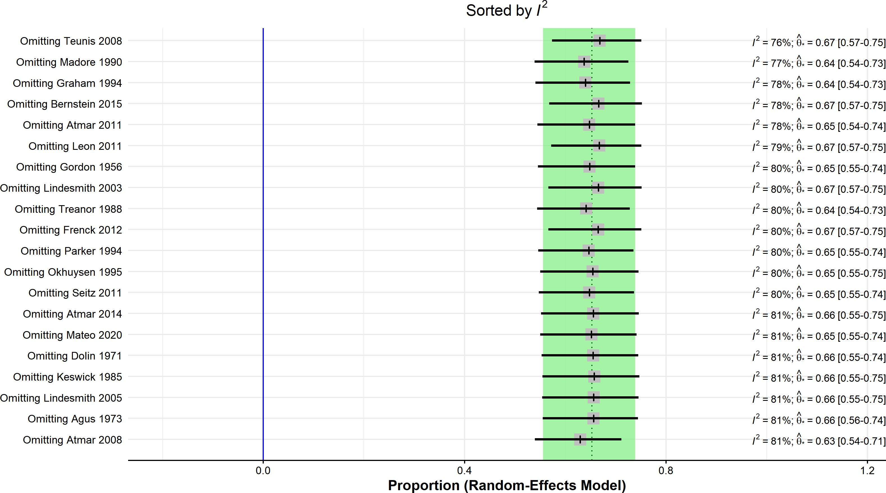
Removing any one study has little effect. We are probably looking for a group effect.

Slide 31
“GOSH” analysis: 1,000,000 random subset models (using inverse variance method)
Bulk of subsets give normally-distributed
effect size with
high heterogeneity

Slide 32

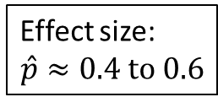
“GOSH” analysis: 1,000,000 random subset models (using inverse variance method)
Some clusters with low-moderate heterogeneity
Effect size:
$$\hat{p}≈0.4 to 0.6$$
Effect size:
$$\hat{p}≈0.75$$

Slide 33
“GOSH” analysis: 1,000,000 random subset models (using inverse variance method)
Subsets with zero I^2 but a wide range of effect size estimates?!?

Slide 34
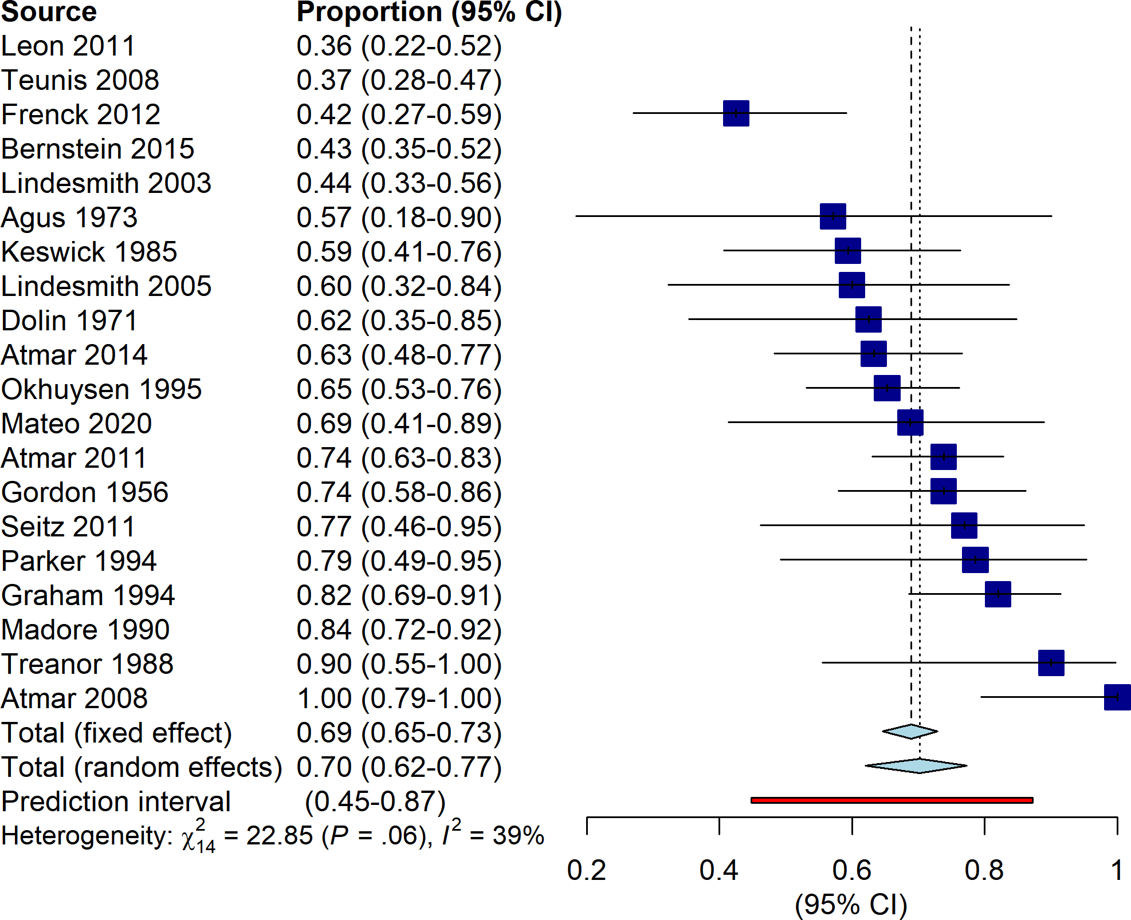
Naïve,
LOO,
GOSH
consensus
outliers

