Slide 1




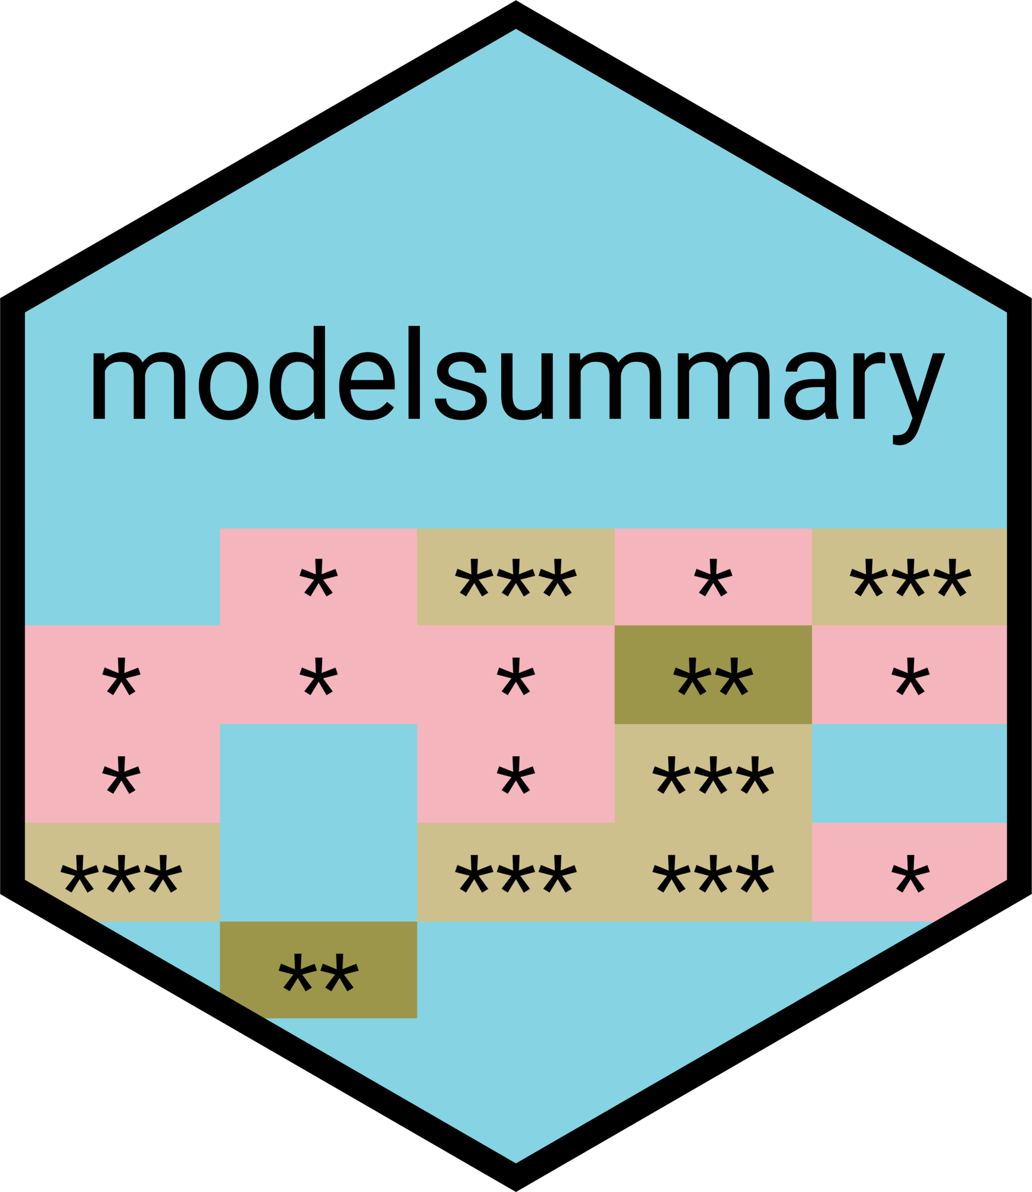
Beautiful, reproducible tables in R
Zane Billings
2024-01-24

Slide 2
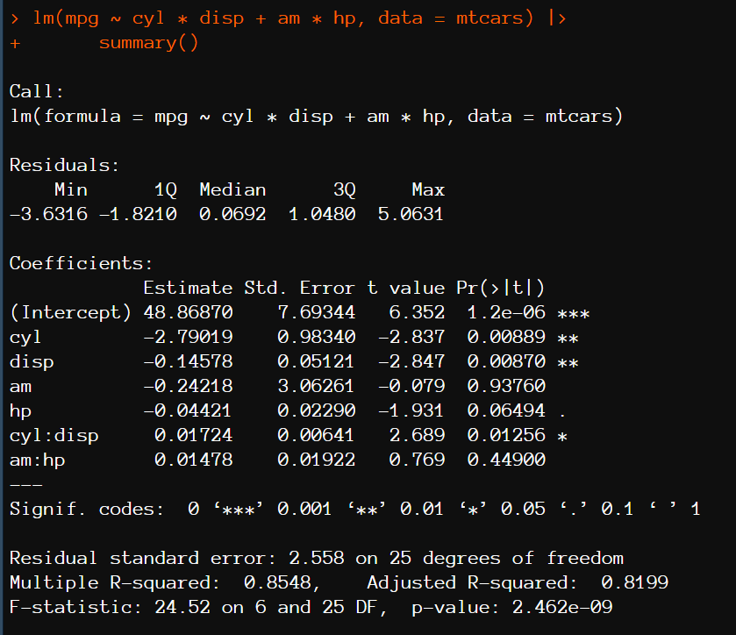
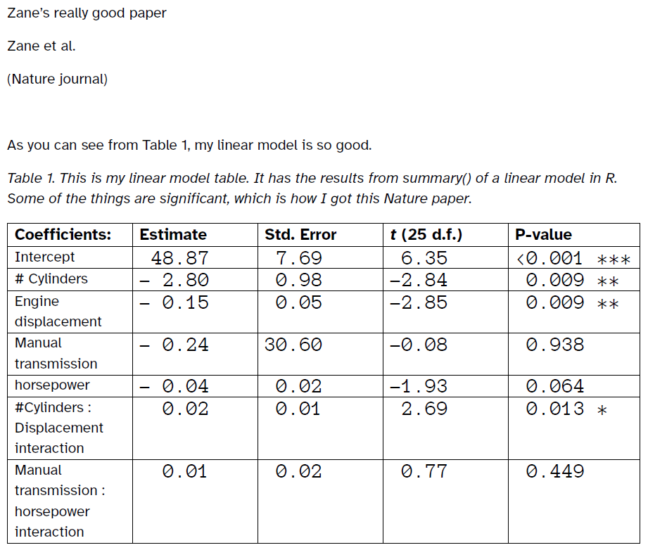

It takes 5 minutes to type the table. Why would I spend time to code it?

Slide 3
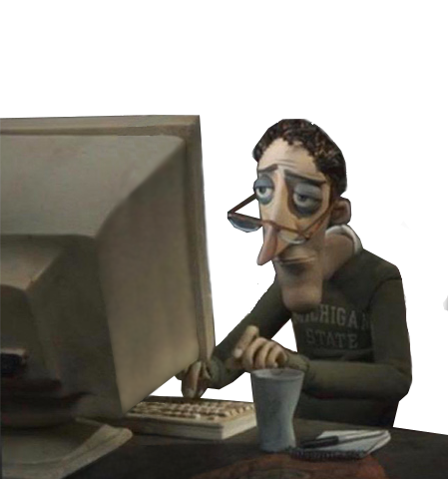


(Later that day in the office)
I am retyping the table into
Word for the 12th time today
No, I said put drat:hp interaction in the model, this doesn’t even make sense
You got it, boss
(me)

Slide 4
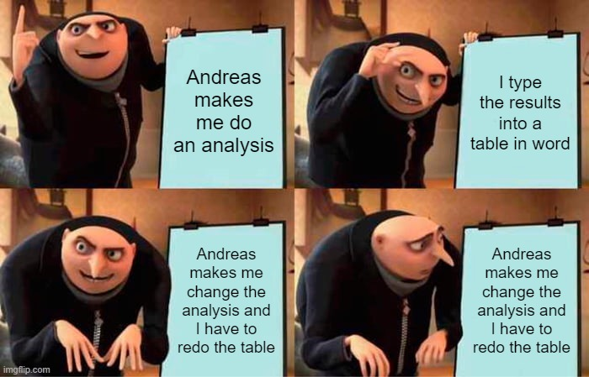

Slide 5
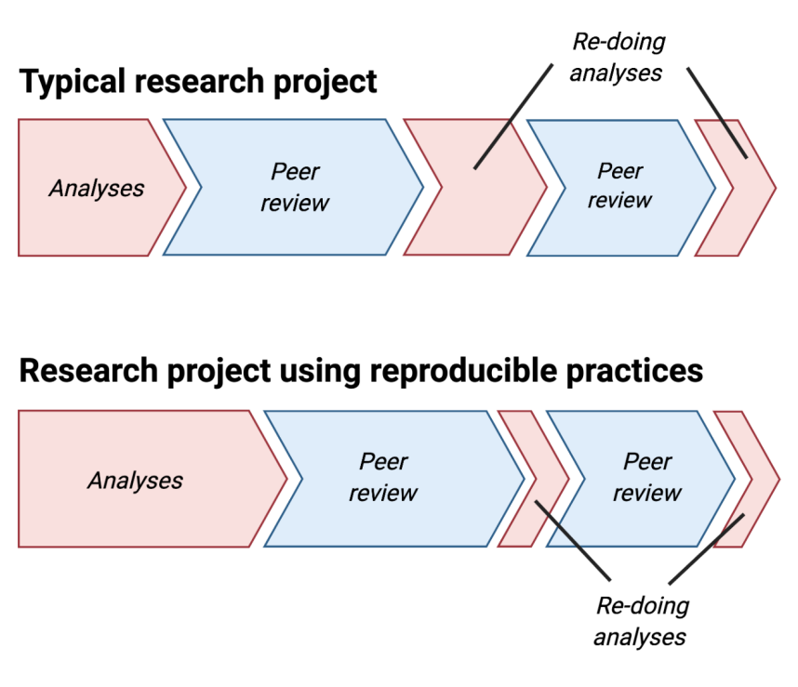
Daniel Quintana
https://osf.io/zy2pc

Slide 6
Daniel Quintana
https://osf.io/zy2pc
It takes the same amount of time, there’s just more front-end investment.

Slide 7
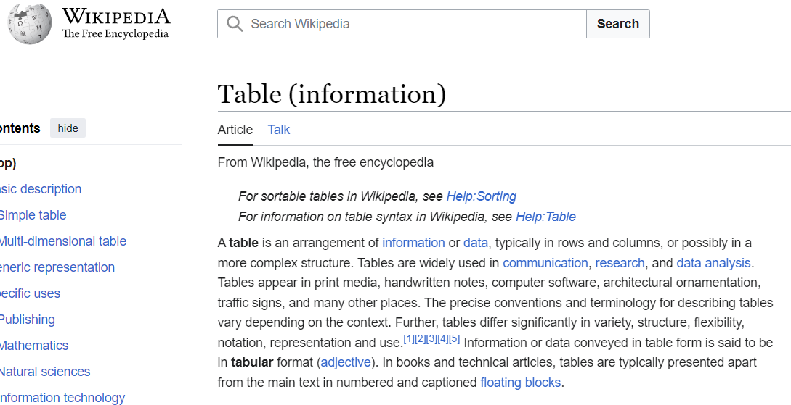
Prelude: what is a table?

Slide 8
Prelude: what is a table?

Slide 9







Prelude: what is a table?
etc..
Code
Display Language
Document

Slide 10
Prelude: what is a table?
Package That Makes Your Life Easier
etc..
Code
Display Language
Document

Slide 11
Example 1: data frame to table

Slide 12
Example 2: spicing it up

Slide 13
Example 3: summary statistics by hand

Slide 14
Example 4: automatic summary stats

Slide 15
Example 5: automatic regression

Slide 16
Example 6: automated model reports

Slide 17
Example 7: putting it together with Quarto

Slide 18
Postlude: the end of the presentation

