Slide 1
当GNN遇到NLP
王智彬
Notes:
Hello everyone, I'm Xi Lin from Nanjing University.
Today I'm going to share our work "Swift Unfolding of Communities: GPU-Accelerated Louvain Algorithm". This work was done in collaboration with Alibaba Group and Rutgers University.

Slide 2
大纲
GNN介绍
使用GNN处理NLP问题
大模型时代下的GNN

Slide 3
大纲
GNN介绍
使用GNN处理NLP问题
大模型时代下的GNN

Slide 4
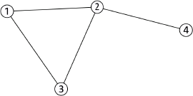
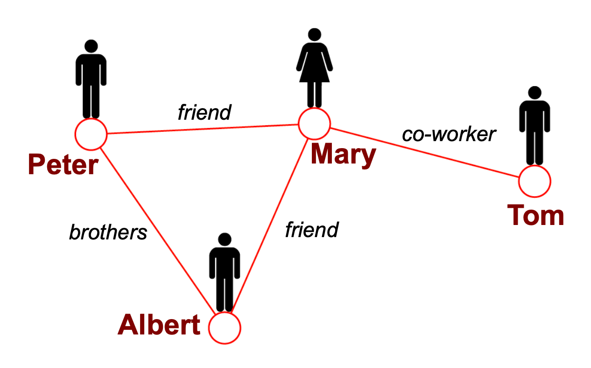
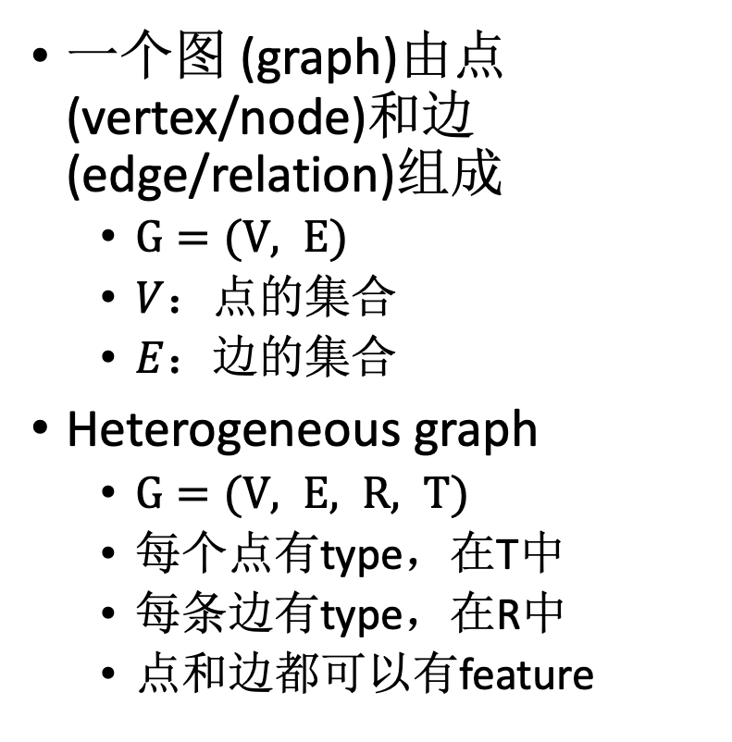
什么是graph
一个图 (graph)由点(vertex/node)和边 (edge/relation)组成
$G=(V, E)$
$V$：点的集合
$E$：边的集合
Heterogeneous graph
$G=(V, E, R, T)$
每个点有type，在T中
每条边有type，在R中
点和边都可以有feature

Slide 5
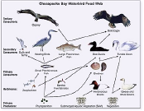
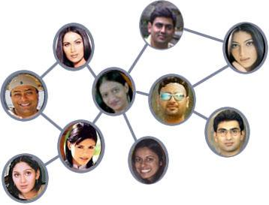
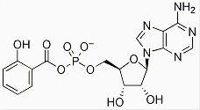
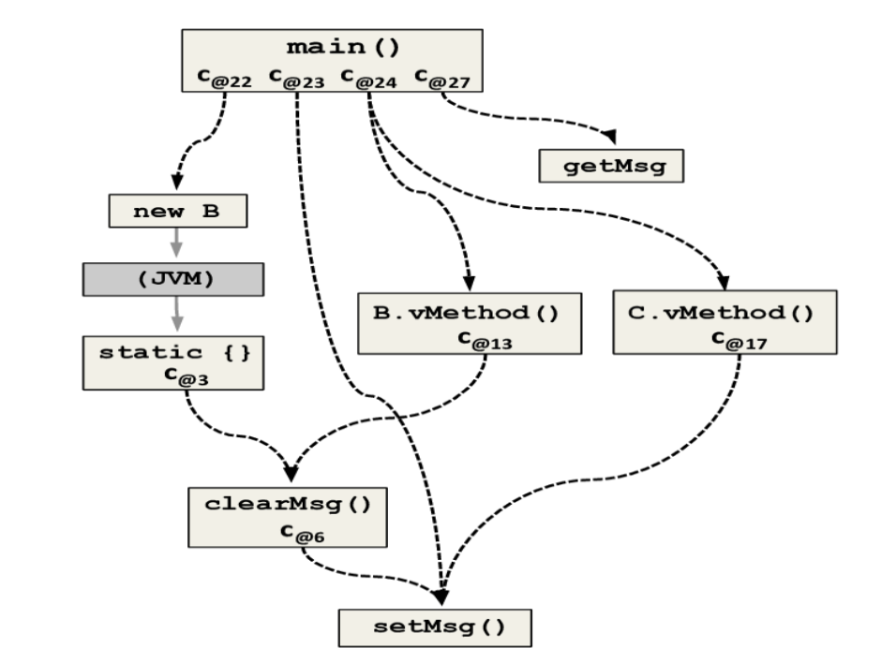
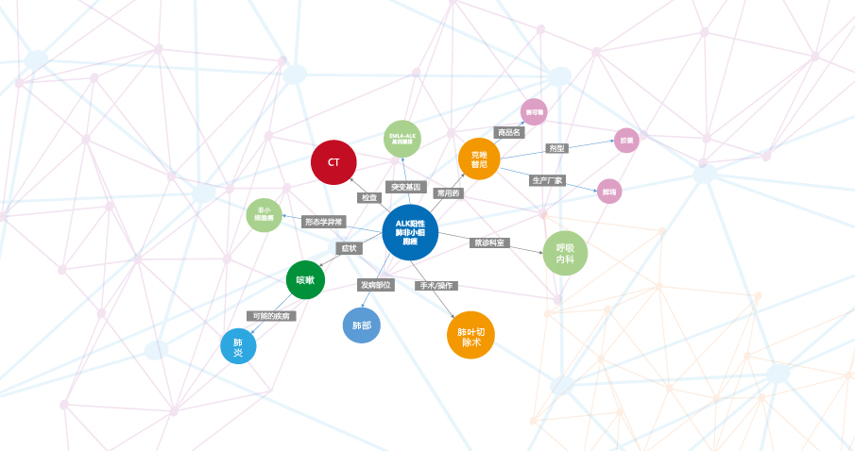
图无处不在
社交网络
化学分子图
食物链
代码图
知识图谱
交通图

Slide 6
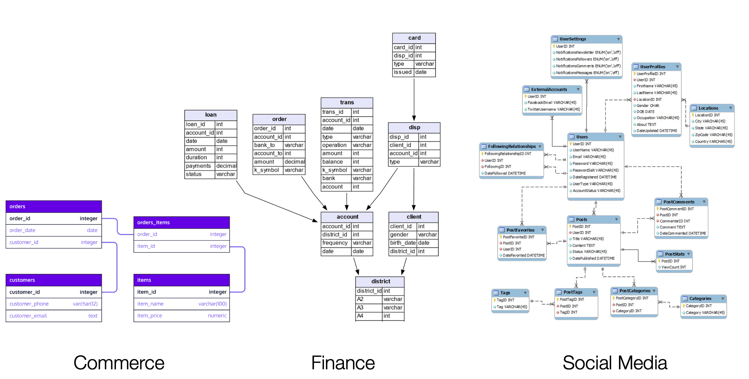
数据库也是图

Slide 7
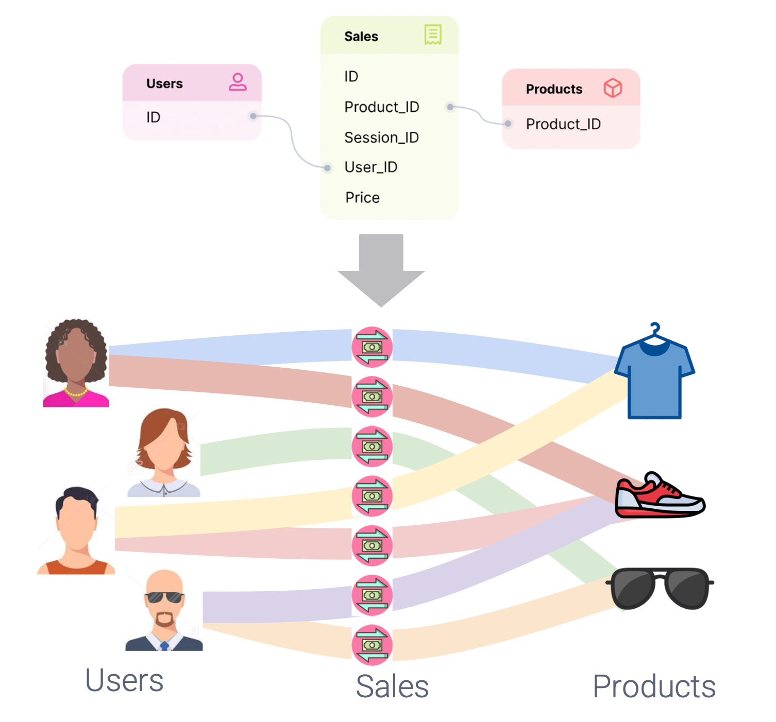
Relation is graph
用户购买商品
在数据库中是一个表格
可以表示成二分图
有巨大的商业价值
商品推荐
广告

Slide 8
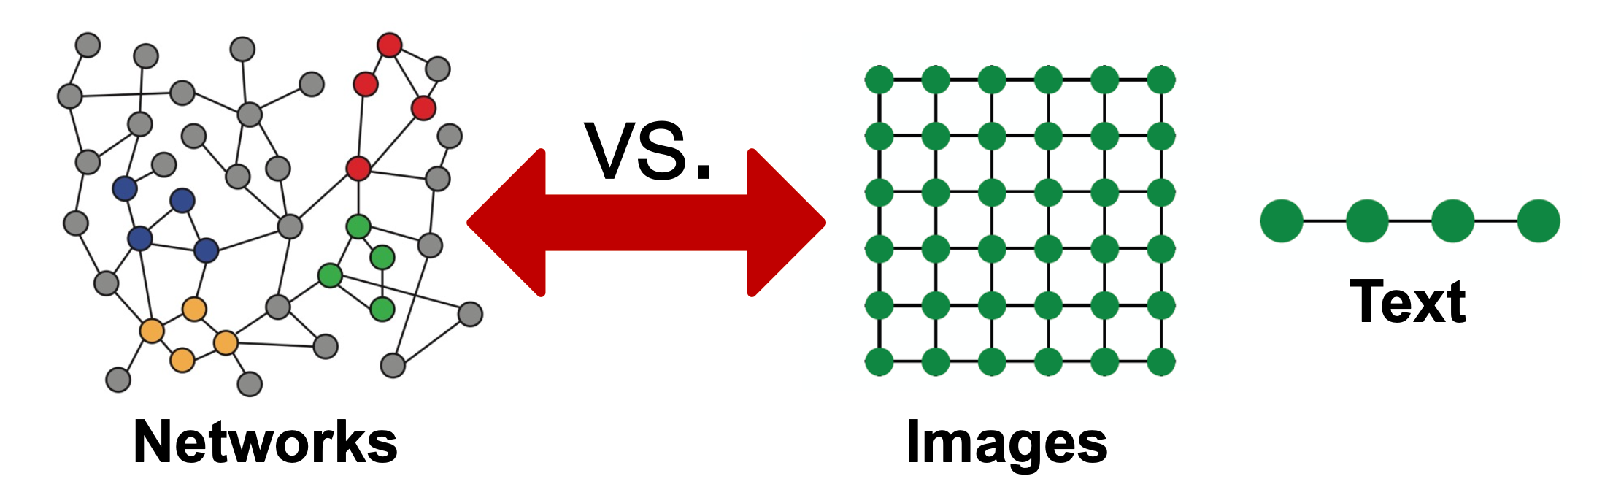
图像和文字是特殊的graph
但graph比image和text更复杂

Slide 9
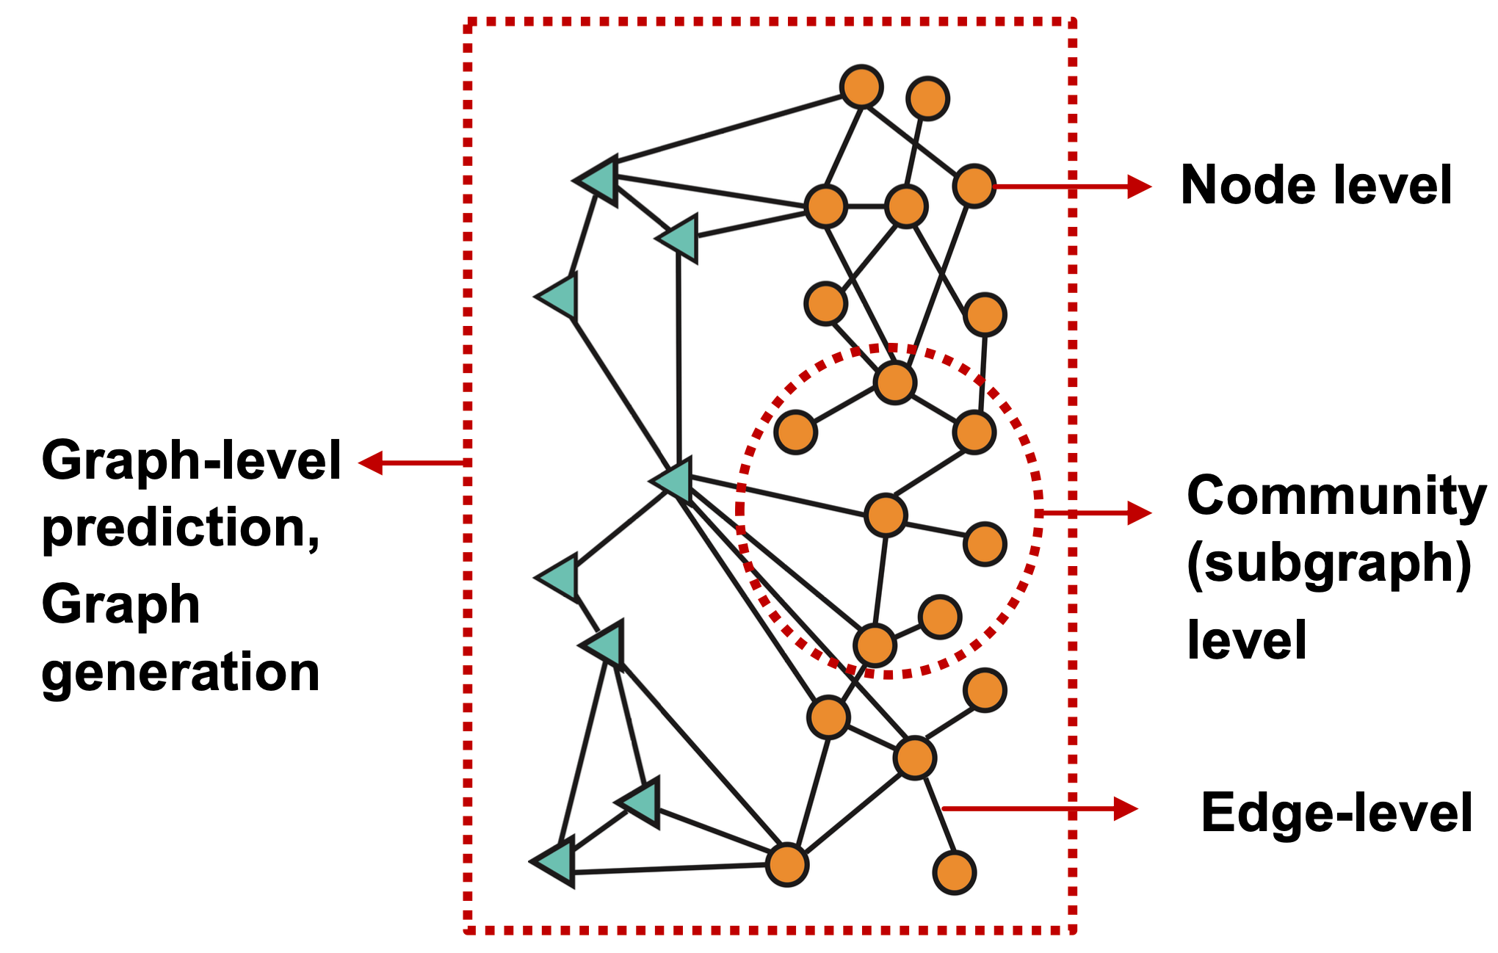
不同的图上的任务

Slide 11
Thanks
Q&A
wzbwangzhibin@gmail.com
Notes:
That's all and thank you for your listening. If you have any questions, feel free to contact/ˈkɑːntækt/ this email.
You can get it on GitHub.
This is not the main focus of this work.
Pruning happens after each iteration, where all the vertices are checked, but there is no need to traverse all the edges, making it very time-efficient.
Because ncclAllGather introduces some additional overhead due to data reordering.

