Slide 1
RecLLMSim: A Task-based Recommendation Conversation Dataset
Zhefan Wang
wzf23@mails.tsinghua.edu.cn

Slide 2
Introduction
Recommendation Form
Single item for traditional recommendation
Task-level recommendation in the era of LLMs
Conversational Dataset Construction
Time-consuming and laborious
Large language models brought new possibilities
LLMs’ strong role-playing abilities

Slide 3
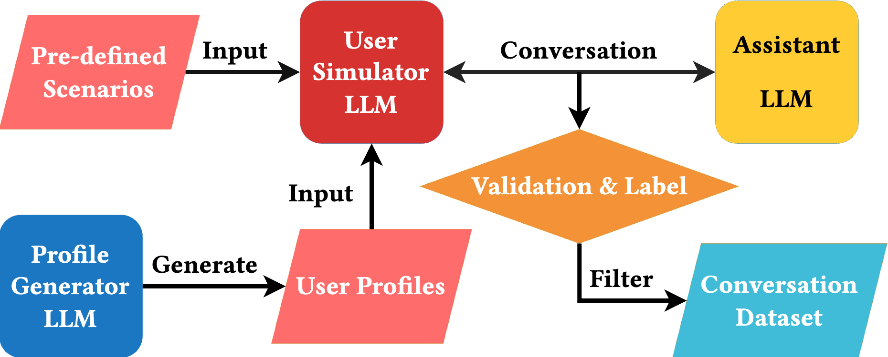
Introduction

Slide 4
Related Work: Synthetic Data Generation via LLMs
LLM-based Data Annotation
Manually engineered prompts: ZEROGEN, SuperICL
Alignment via pairwise feedback: RLAIF, Self-Rewarding
LLM-based Data Generation
Instruction generation: WizardLM, Self-Instruct
Complete data generation: Chataug, UltraLLaMA
For Information Retrieval
InPars-v2: Generate relevant queries for documents via few-show examples

Slide 5
Related Work: LLMs for CRS
LLMs as a CRS
Zero-shot CRS: Prompting and grounding, Conversational Movie Recommender
Multi-agent: MACRS
User Simulation via LLMs:
Evaluate CRS via LLMs: iEvaLM, SimpleUserSim
Data leakage, simple user profile, fixed scenarios
No dataset is generated

Slide 6
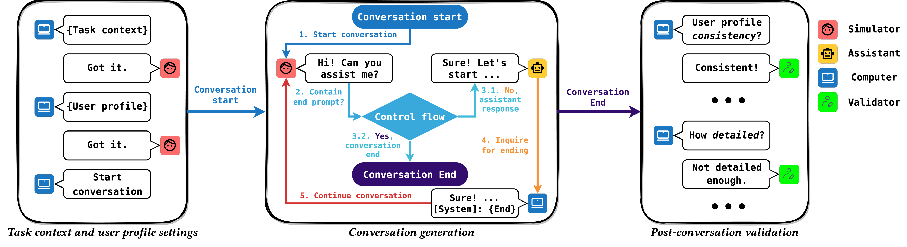
Dataset Construction

Slide 7
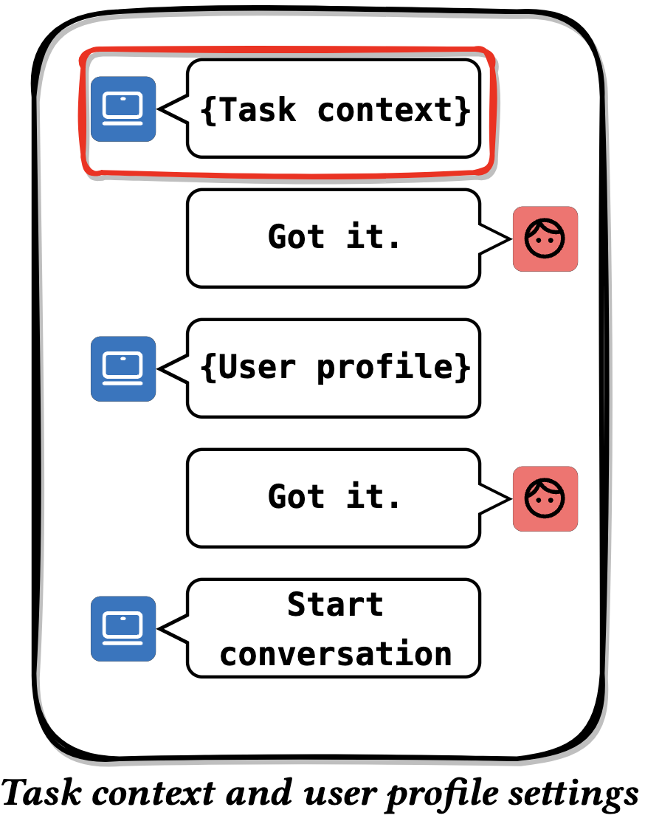
Dataset Construction
Pre-defined Tasks for Conversations
Complex and difficult enough
Relate to the user’s preferences
Pre-defined 4 tasks:
Travel planning, skill learning planning, recipe planning, gift preparation
Construct different scenarios from several aspects
E.g. the season, travel duration, travel type
Filling the template with optional categories

Slide 8
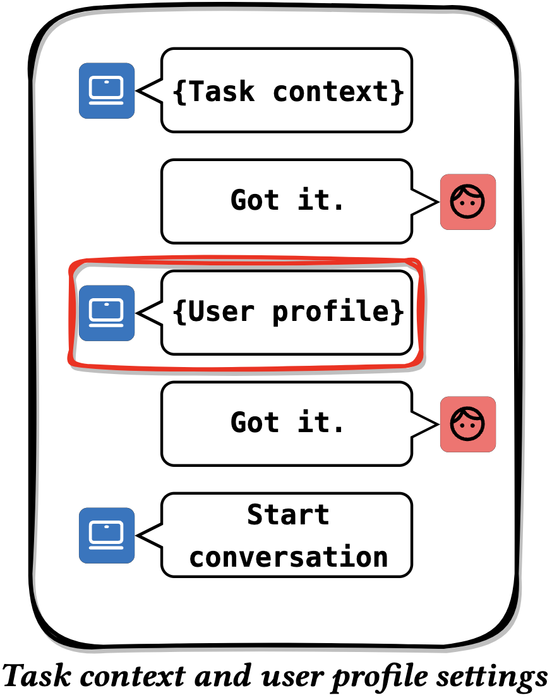
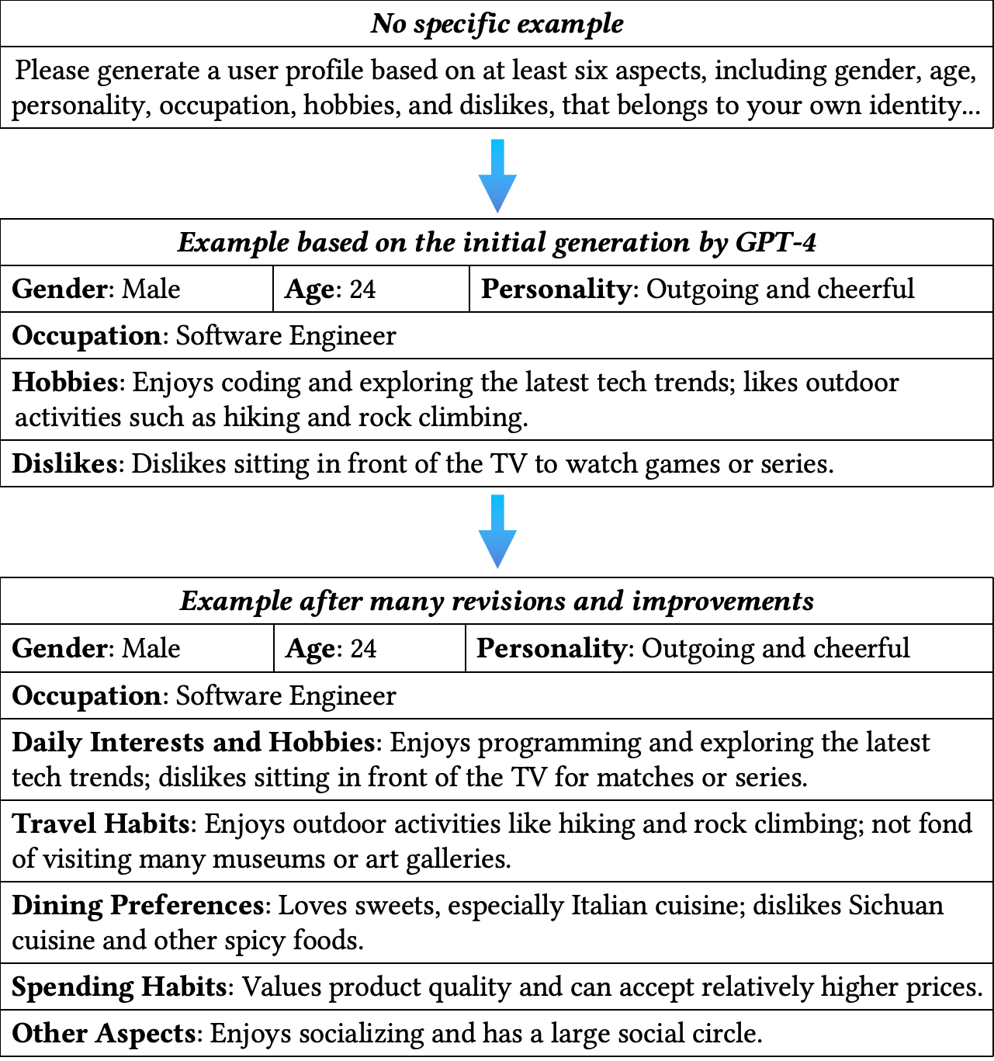
Dataset Construction
User Profile Generation
Generate in the same conversation
Generate in terms of several domains
According to the pre-defined task
Adopt human-involved example generation
See the right figure

Slide 9
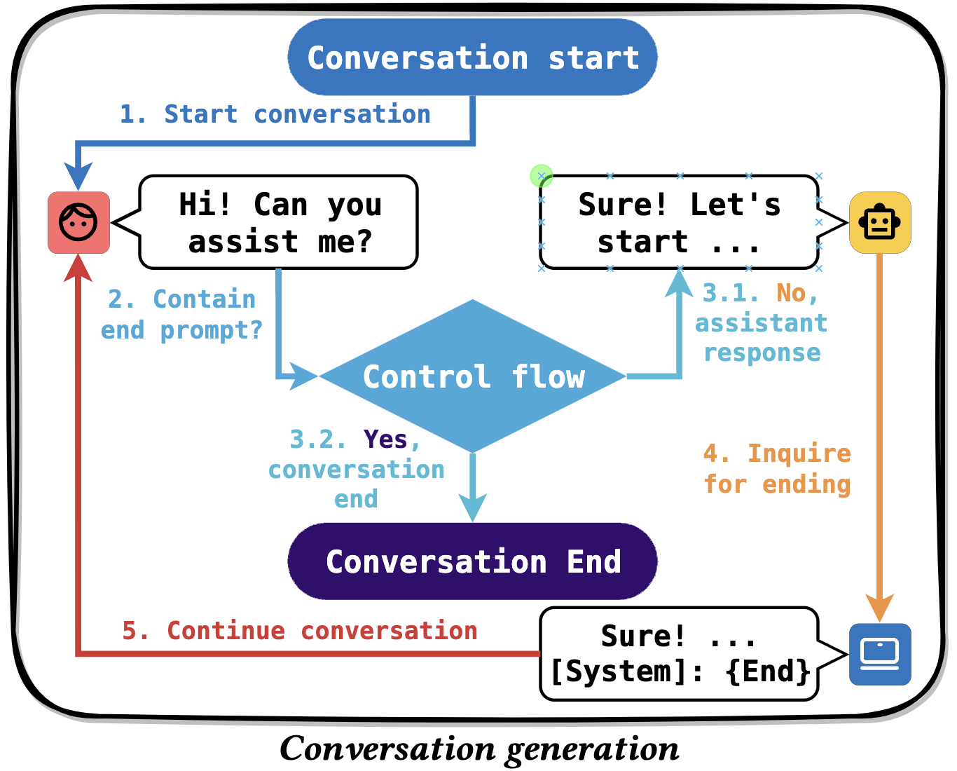
Dataset Construction
Conversation Generation
Two LLMs to task to each other
Use system-command-like end prompt to control the length of conversation
[System]: If you wish to conclude this conversation, …

Slide 10
Dataset Construction
Filtering
Use LLMs to automatic detect conflicts between the preferences and task descriptions
Manually label the data with obvious hallucinations
Processing
Translate all the text into Chinese via ChatGPT

Slide 11
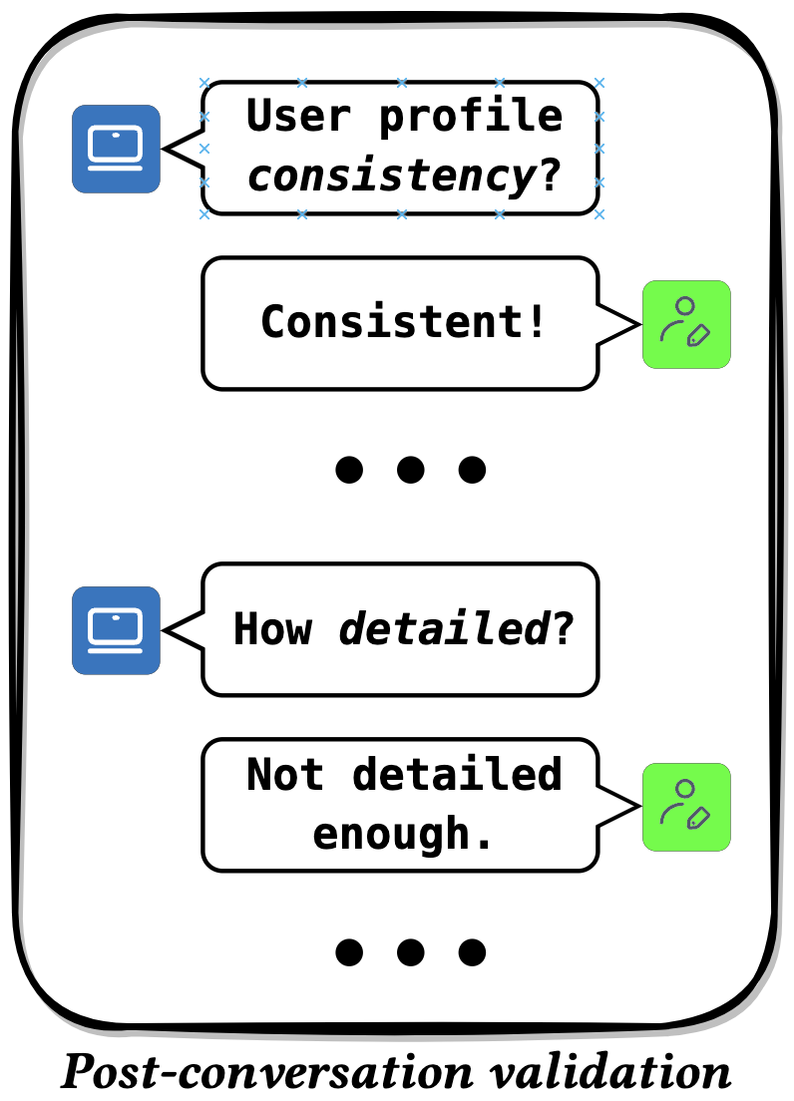
Dataset Construction
Manual Labeling
Simulator: User Intent
Preference Consistency
Additional Preference
Role-playing Completeness
Assistant: Hallucinations
Memorization
Detail
Practical Usability
Diversity

Slide 12
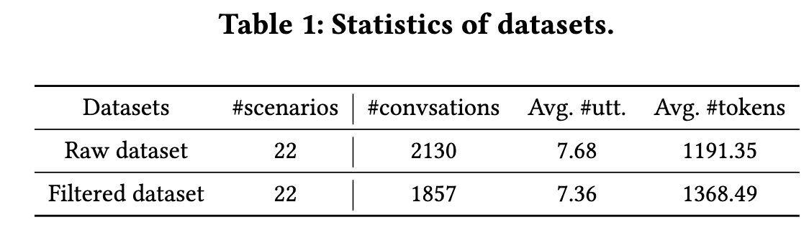
Overall Characteristics

Slide 13
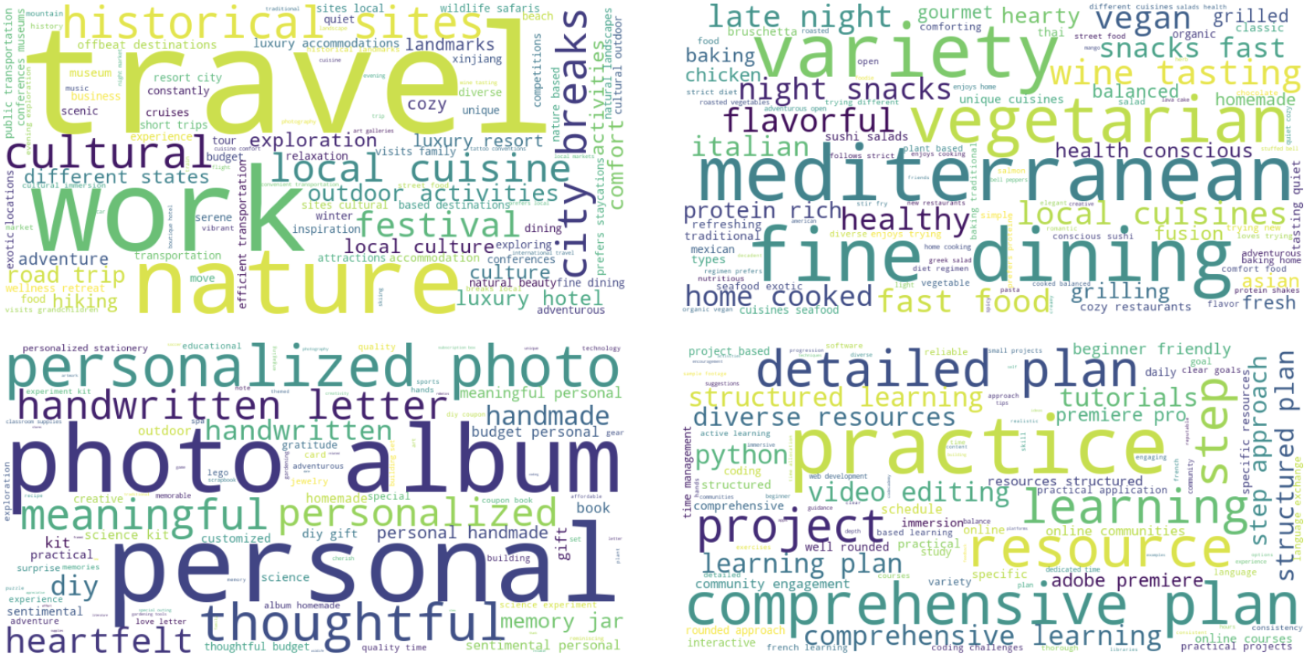
User Profiles Distributions
Travel Planning
Recipe Planning
Preparing Gifts
Skills Learning

Slide 14
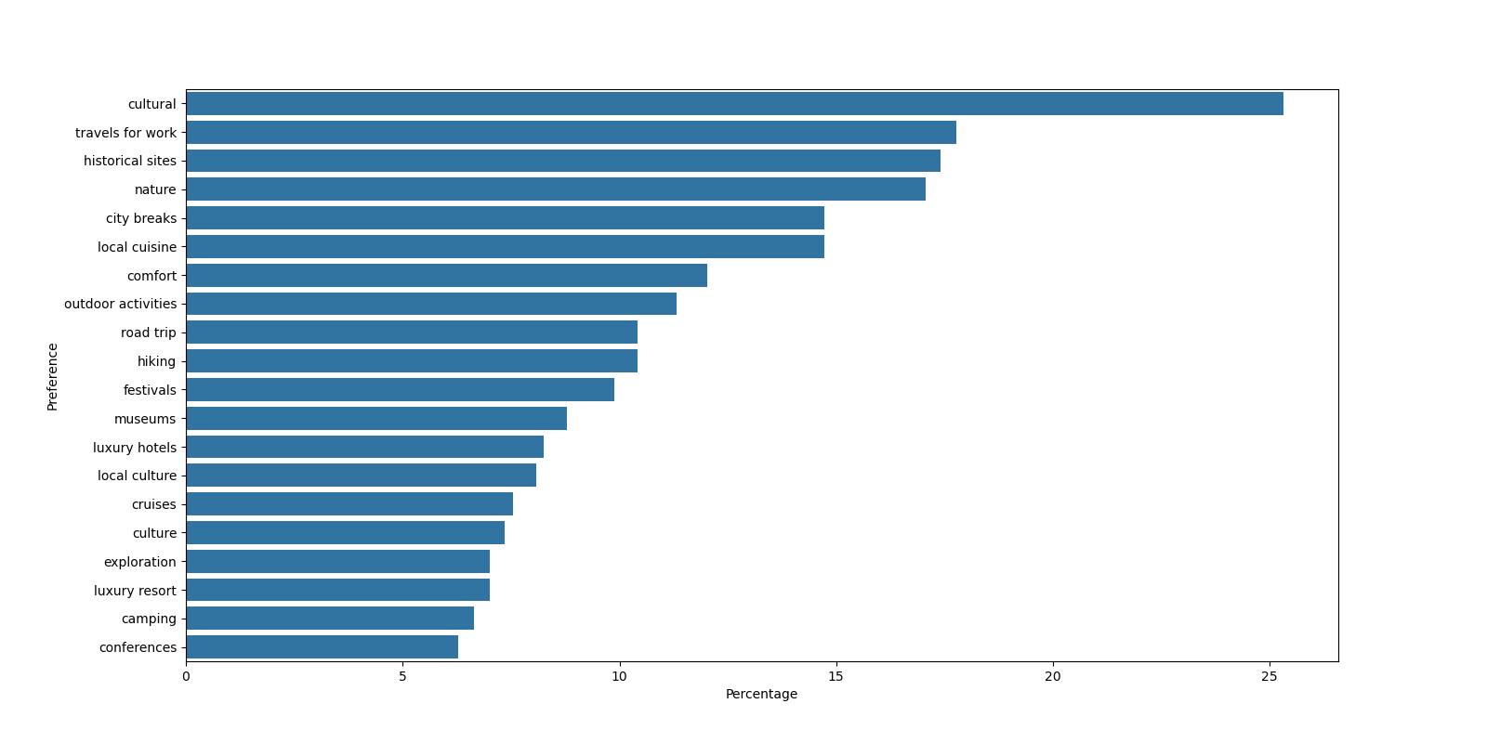
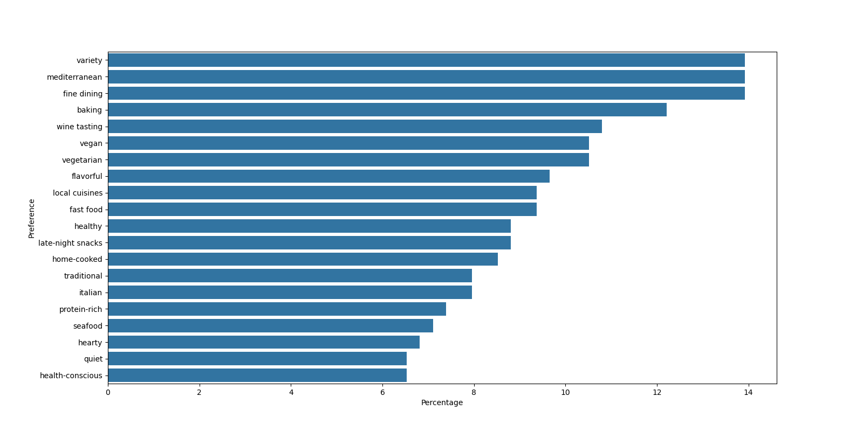
User Profiles Distributions
Travel Planning
Recipe Planning

Slide 15
Dataset Characteristics
Validation of Task Completeness
Being annotated by a crowdsourcing company...

Slide 16
Case Study
Assistant Response
Assistant: …Based on your preferences and the available options, here are two potential flights:
1. United Airlines: Departure from San Francisco (SFO) with a layover in Beijing (PEK) - Total travel time: 19h 20m. The layover in Beijing is 2h 20m.
2. Air China: Departure from San Francisco (SFO) with a layover in Shanghai (PVG) - Total travel time: 20h 40m. The layover in Shanghai is 3h 10m.
Both options offer a relatively short layover and provide a balance between travel time and comfort…

Slide 17
Potential Usage
Conversational Search & Recommendation
Contain retrieval requests and active recommendations, annotated with intent
Could be used to train for the strategy module
LLM-based Personalized Recommendation
Hallucination Detection
Mainly from assistant

Slide 18
Conclusion and Future Work
Conclusion
The first work to generate task-specific conversational recommendation data wholly based on LLMs
LLMs as both the user simulator and respond assistant
The dataset can be leveraged into various recommendation tasks
Future Work
Conversations between real humans and LLMs within the same settings
Introduce external item list to help generation
More scenarios can also be involved

Slide 19
Thanks!
Zhefan Wang
wzf23@mails.tsinghua.edu.cn

