Slide 1
Computer Architecture Chapter 1: Abstractions and Technology
[Adapted from Computer Organization and Design,
Patterson & Hennessy]
Notes:
Combinations to AV system, etc. 0808 (1988 in 113 IST)
Call AV hot line at 8-777-0035

Slide 2
Course Content
Memory hierarchy and design, CPU design, pipelining, multiprocessor architecture.
“This course will introduce students to the architecture-level design issues of a computer system. They will apply their knowledge of digital logic design to explore the high-level interaction of the individual computer system hardware components. Concepts of sequential and parallel architecture including the interaction of different memory components, their layout and placement, communication among multiple processors, effects of pipelining, and performance issues, will be covered. Students will apply these concepts by studying and evaluating the merits and demerits of selected computer system architectures.”
To learn what determines the capabilities and performance of computer systems and to understand the interactions between the computer’s architecture and its software so that future software designers (compiler writers, operating system designers, database programmers, application programmers, …) can achieve the best cost-performance trade-offs and so that future architects understand the effects of their design choices on software.

Slide 3
What You Should Know
Basic logic design & machine organization
logical minimization, FSMs, component design
processor, memory, I/O
Create, assemble, run, debug programs in an assembly language
MIPS preferred
Create, simulate, and debug hardware structures in a hardware description language
VHDL or verilog
Create, compile, and run C (C++, Java) programs
Create, organize, and edit files and run programs on Unix/Linux

Slide 4
Classes of Computers
Desktop computers
Designed to deliver good performance to a single user at low cost usually executing 3rd party software, usually incorporating a graphics display, a keyboard, and a mouse
Servers
Used to run larger programs for multiple, simultaneous users typically accessed only via a network and that places a greater emphasis on dependability and (often) security
Supercomputers
A high performance, high cost class of servers with hundreds to thousands of processors, terabytes of memory and petabytes of storage that are used for high-end scientific and engineering applications
Embedded computers (processors)
A computer inside another device used for running one predetermined application

Slide 5
Review: Some Basic Definitions
Kilobyte – 2¹⁰ or 1,024 bytes
Megabyte– 2²⁰ or 1,048,576 bytes
sometimes “rounded” to 10⁶ or 1,000,000 bytes
Gigabyte – 2³⁰ or 1,073,741,824 bytes
sometimes rounded to 10⁹ or 1,000,000,000 bytes
Terabyte – 2⁴⁰ or 1,099,511,627,776 bytes
sometimes rounded to 10¹² or 1,000,000,000,000 bytes
Petabyte – 2⁵⁰ or 1024 terabytes
sometimes rounded to 10¹⁵ or 1,000,000,000,000,000 bytes
Exabyte – 2⁶⁰ or 1024 petabytes
Sometimes rounded to 10¹⁸ or 1,000,000,000,000,000,000 bytes

Slide 6
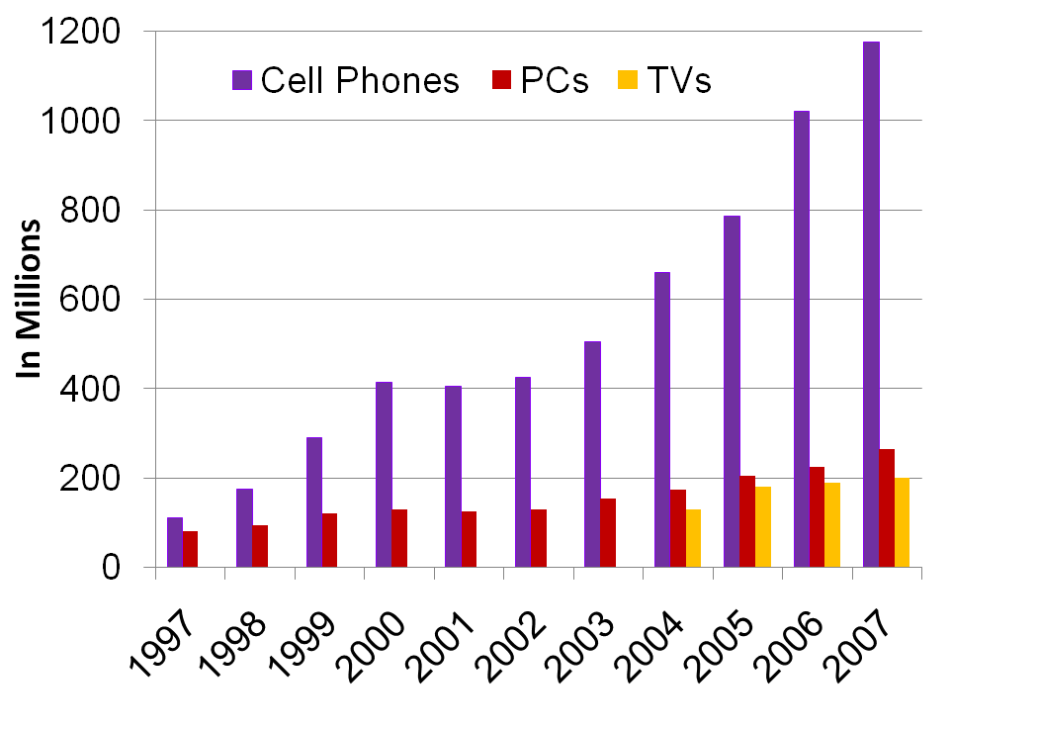
Growth in Cell Phone Sales (Embedded)
embedded growth >> desktop growth
Where else are embedded processors found?
Notes:
Cell phone sales exceeded PCs by only a factor of 1.4 in 1997, but the ratio grew to 4.5 in 2007.
The total number in use in 2004 estimated to be about 2.0B televisions, 1.8B cell phones, and 0.8B PCs. As the worlds population was about 6.4B in 2004, that makes about 1PC, 2.2 cell phones, and 2.5 televisions for every 8 people on the planet.

Slide 7
Embedded Processor Characteristics
The largest class of computers spanning the widest range of applications and performance
Often have minimum performance requirements. Example?
Often have stringent limitations on cost. Example?
Often have stringent limitations on power consumption. Example?
Often have low tolerance for failure. Example?

Slide 8
Below the Program
Applications software
Systems software
Hardware
System software
Operating system – supervising program that interfaces the user’s program with the hardware (e.g., Linux, MacOS, Windows)
Handles basic input and output operations
Allocates storage and memory
Provides for protected sharing among multiple applications
Compiler – translate programs written in a high-level language (e.g., C, Java) into instructions that the hardware can execute

Slide 9
Below the Program, Con’t
High-level language program (in C)
swap (int v[], int k)
(int temp;
temp = v[k];
v[k] = v[k+1];
v[k+1] = temp;
)
Assembly language program (for MIPS)
swap: sll $2, $5, 2
add $2, $4, $2
lw $15, 0($2)
lw $16, 4($2)
sw $16, 0($2)
sw $15, 4($2)
jr $31
Machine (object, binary) code (for MIPS)
000000 00000 00101 0001000010000000
000000 00100 00010 0001000000100000
. . .
one-to-many
C compiler
one-to-one
assembler
Notes:
Computer only understands zeros and ones – instructions of 0’s and 1’s
Early programmers found representing machine instructions in a symbolic notation – assembly language
And developed programs that translate from assembler to machine code
Eventually, programmers found working even in assembler too tedious so migrated to higher-level languages and developed compilers that would translate from the higher-level languages to assembler

Slide 10
Advantages of Higher-Level Languages ?
Higher-level languages
As a result, very little programming is done today at the assembler level

Slide 11
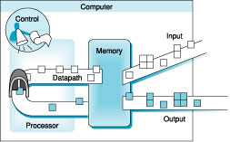
Under the Covers
Five classic components of a computer – input, output, memory, datapath, and control
datapath + control = processor (CPU)

Slide 12
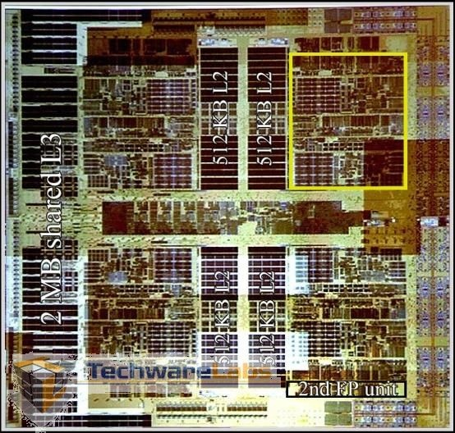
AMD’s Barcelona Multicore Chip
Four out-of-order cores on one chip
1.9 GHz clock rate
65nm technology
Three levels of caches (L1, L2, L3) on chip
Integrated Northbridge
Core 1
512KB L2
Core 2
512KB L2
2MB shared L3 Cache
Northbridge
512KB L2
Core 3
512KB L2
Core 4
http://www.techwarelabs.com/reviews/processors/barcelona/

Slide 13
Instruction Set Architecture (ISA)
ISA, or simply architecture – the abstract interface between the hardware and the lowest level software that encompasses all the information necessary to write a machine language program, including instructions, registers, memory access, I/O, …
Enables implementations of varying cost and performance to run identical software
The combination of the basic instruction set (the ISA) and the operating system interface is called the application binary interface (ABI)
ABI – The user portion of the instruction set plus the operating system interfaces used by application programmers. Defines a standard for binary portability across computers.

Slide 14
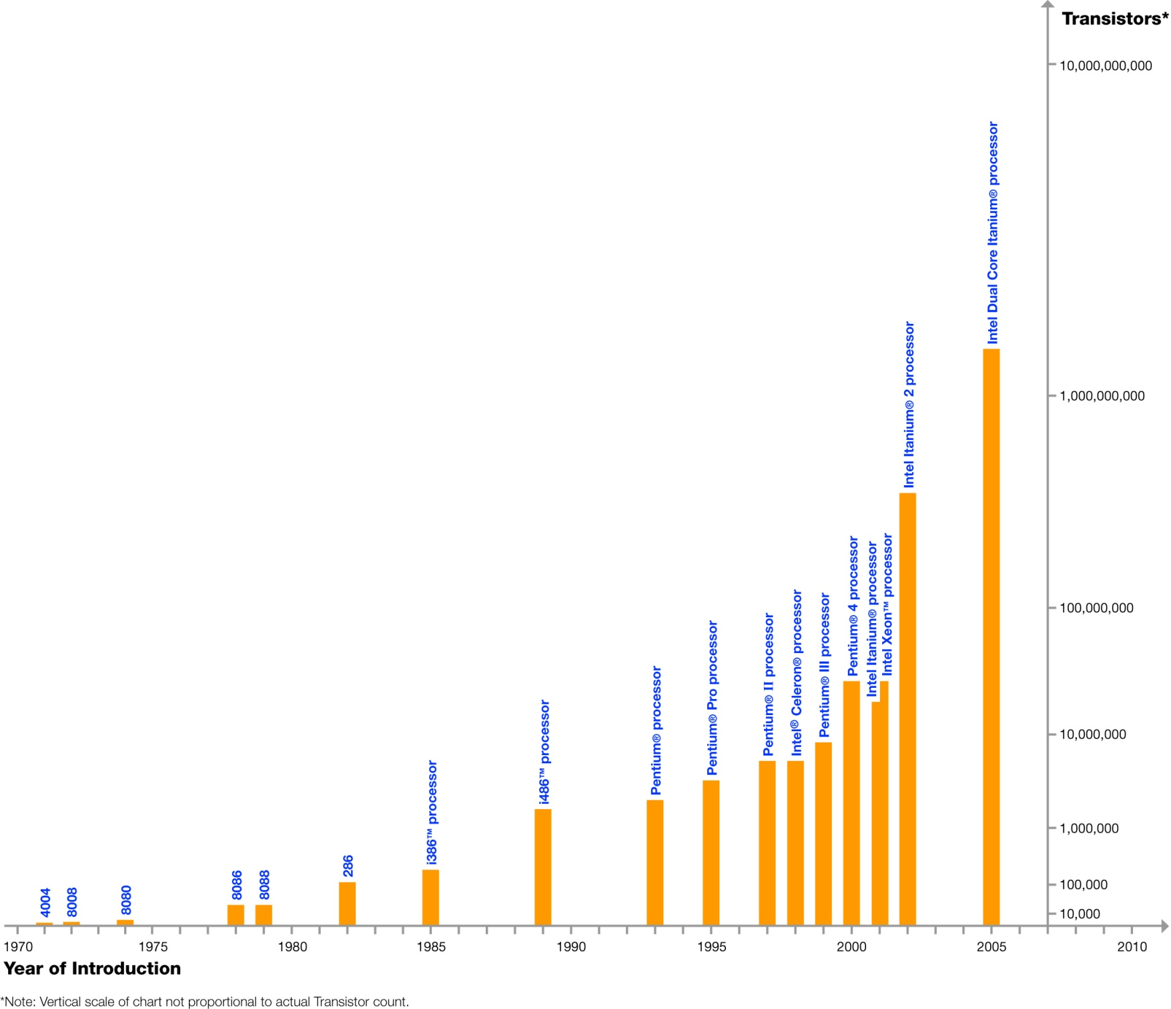
Moore’s Law
In 1965, Intel’s Gordon Moore predicted that the number of transistors that can be integrated on single chip would double about every two years
Dual Core Itanium with 1.7B transistors
feature size
&
die size
Log Scale
Courtesy, Intel ®

Slide 15
Technology Scaling Road Map (ITRS)
Year | 2004 | 2006 | 2008 | 2010 | 2012
Feature size (nm) | 90 | 65 | 45 | 32 | 22
Intg. Capacity (BT) | 2 | 4 | 6 | 16 | 32
Fun facts about 45nm transistors
30 million can fit on the head of a pin
You could fit more than 2,000 across the width of a human hair
If car prices had fallen at the same rate as the price of a single transistor has since 1968, a new car today would cost about 1 cent
Notes:
International Technology Roadmap for Semiconductors

Slide 16
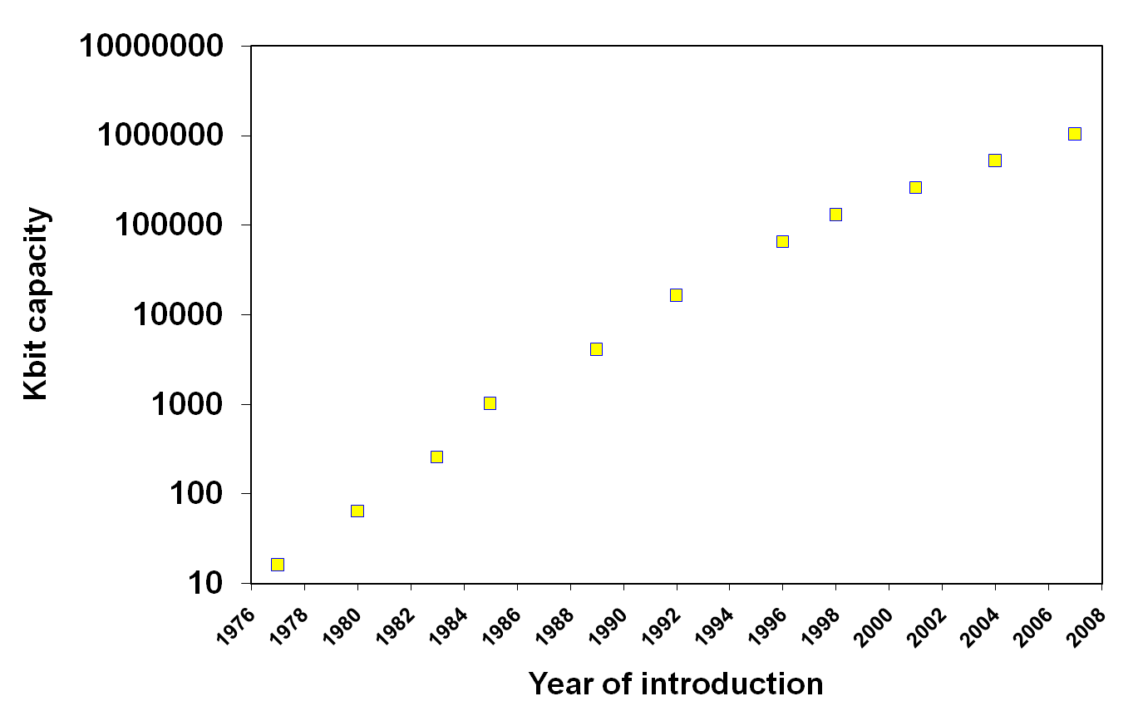
Another Example of Moore’s Law Impact
DRAM capacity growth over 3 decades
1G
256M
64M
512M
128M
4M
16M
1M
64K
256K
16K
Notes:
Memories have quadrupled capacity every 3 years (up until 1996) – a 60% increase per year for 20 years. Now is doubling in capacity every two to three years.

Slide 17
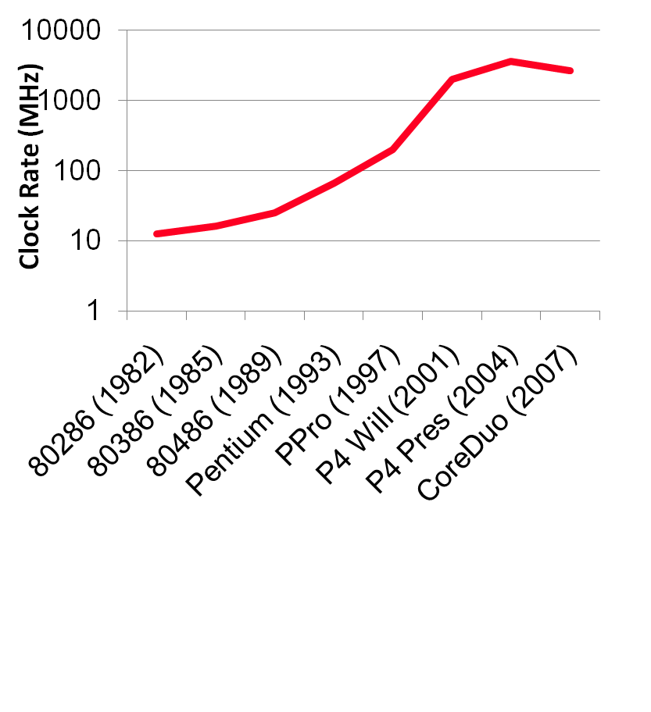
But What Happened to Clock Rates and Why?
Clock rates hit a “power wall”
Notes:
Packaging issues for laptop and desktop PC set the “power” limit at 100 Watts.

Slide 18
A Sea Change is at Hand
The power challenge has forced a change in the design of microprocessors
Since 2002 the rate of improvement in the response time of programs on desktop computers has slowed from a factor of 1.5 per year to less than a factor of 1.2 per year
As of 2006 all desktop and server companies are shipping microprocessors with multiple processors – cores – per chip
Product | AMD Barcelona | Intel Nehalem | IBM Power 6 | Sun Niagara 2
Cores per chip | 4 | 4 | 2 | 8
Clock rate | 2.5 GHz | ~2.5 GHz? | 4.7 GHz | 1.4 GHz
Power | 120 W | ~100 W? | ~100 W? | 94 W
Plan of record is to double the number of cores per chip per generation (about every two years)
Notes:
Multicore issues
Hard for programmers to write explicitly parallel programs - task scheduling with load balancing and minimal communication and synchronization overhead.

Slide 19
Performance Metrics
Purchasing perspective
given a collection of machines, which has the
best performance ?
least cost ?
best cost/performance?
Design perspective
faced with design options, which has the
best performance improvement ?
least cost ?
best cost/performance?
Both require
basis for comparison
metric for evaluation
Our goal is to understand what factors in the architecture contribute to overall system performance and the relative importance (and cost) of these factors
Notes:
Or smallest/lightest
Longest battery life
Most reliable/durable (in space)

Slide 20
Throughput versus Response Time
Response time (execution time) – the time between the start and the completion of a task
Important to individual users
Throughput (bandwidth) – the total amount of work done in a given time
Important to data center managers
Will need different performance metrics as well as a different set of applications to benchmark embedded and desktop computers, which are more focused on response time, versus servers, which are more focused on throughput

Slide 21
Defining (Speed) Performance
To maximize performance, need to minimize execution time
performance_{X} = 1 / execution_time_{X}
If X is n times faster than Y, then
performance_{X} execution_time_{Y}
-------------------- = --------------------- = n
performance_{Y} execution_time_{X}
Decreasing response time almost always improves throughput
Notes:
Increasing performance requires decreasing execution time

Slide 22
Relative Performance Example
If computer A runs a program in 10 seconds and computer B runs the same program in 15 seconds, how much faster is A than B?
We know that A is n times faster than B if
performance_{A} execution_time_{B}
-------------------- = --------------------- = n
performance_{B} execution_time_{A}
The performance ratio is
15
------ = 1.5
10
So A is 1.5 times faster than B

Slide 23
Performance Factors
CPU execution time (CPU time) – time the CPU spends working on a task
Does not include time waiting for I/O or running other programs
CPU execution time # CPU clock cycles
= x clock cycle time
for a program for a program
or
CPU execution time # CPU clock cycles for a program
= -------------------------------------------
for a program clock rate
Can improve performance by reducing either the length of the clock cycle or the number of clock cycles required for a program
Notes:
Many techniques that decrease the number of clock cycles also increase the clock cycle time

Slide 24
Review: Machine Clock Rate
Clock rate (clock cycles per second in MHz or GHz) is inverse of clock cycle time (clock period)
CC = 1 / CR
one clock period
10 nsec clock cycle => 100 MHz clock rate
5 nsec clock cycle => 200 MHz clock rate
2 nsec clock cycle => 500 MHz clock rate
1 nsec (10⁻⁹) clock cycle => 1 GHz (10⁹) clock rate
500 psec clock cycle => 2 GHz clock rate
250 psec clock cycle => 4 GHz clock rate
200 psec clock cycle => 5 GHz clock rate
Notes:
A clock cycle is the basic unit of time to execute one operation/pipeline stage/etc.

Slide 25
Improving Performance Example
A program runs on computer A with a 2 GHz clock in 10 seconds. What clock rate must computer B run at to run this program in 6 seconds? Unfortunately, to accomplish this, computer B will require 1.2 times as many clock cycles as computer A to run the program.
CPU time_{A} CPU clock cycles_{A}
= -------------------------------
clock rate_{A}
CPU clock cycles_{A} = 10 sec x 2 x 10⁹ cycles/sec = 20 x 10⁹ cycles
CPU time_{B} 1.2 x 20 x 10⁹ cycles
= -------------------------------
clock rate_{B}
clock rate_{B} 1.2 x 20 x 10⁹ cycles
= ------------------------------- = 4 GHz
6 seconds
Notes:
For lecture

Slide 26
Clock Cycles per Instruction
Not all instructions take the same amount of time to execute
One way to think about execution time is that it equals the number of instructions executed multiplied by the average time per instruction
# CPU clock cycles # Instructions Average clock cycles
= x
for a program for a program per instruction
Clock cycles per instruction (CPI) – the average number of clock cycles each instruction takes to execute
A way to compare two different implementations of the same ISA
 | CPI for this instruction class
 | A | B | C
CPI | 1 | 2 | 3

Slide 27
Using the Performance Equation
Computers A and B implement the same ISA. Computer A has a clock cycle time of 250 ps and an effective CPI of 2.0 for some program and computer B has a clock cycle time of 500 ps and an effective CPI of 1.2 for the same program. Which computer is faster and by how much?
Each computer executes the same number of instructions, I, so
CPU time_{A} = I x 2.0 x 250 ps = 500 x I ps
CPU time_{B} = I x 1.2 x 500 ps = 600 x I ps
Clearly, A is faster … by the ratio of execution times
performance_{A} execution_time_{B} 600 x I ps
------------------- = --------------------- = ---------------- = 1.2
performance_{B} execution_time_{A} 500 x I ps
Notes:
For lecture

Slide 28
Effective (Average) CPI
Computing the overall effective CPI is done by looking at the different types of instructions and their individual cycle counts and averaging
n
Overall effective CPI = Σ (CPI_{i} x IC_{i})
i = 1
Where IC_{i} is the count (percentage) of the number of instructions of class i executed
CPI_{i} is the (average) number of clock cycles per instruction for that instruction class
n is the number of instruction classes
The overall effective CPI varies by instruction mix – a measure of the dynamic frequency of instructions across one or many programs

Slide 29
THE Performance Equation
Our basic performance equation is then
CPU time = Instruction_count x CPI x clock_cycle
or
Instruction_count x CPI
CPU time = -----------------------------------------------
clock_rate
These equations separate the three key factors that affect performance
Can measure the CPU execution time by running the program
The clock rate is usually given
Can measure overall instruction count by using profilers/ simulators without knowing all of the implementation details
CPI varies by instruction type and ISA implementation for which we must know the implementation details
Notes:
Note that instruction count is dynamic – i.e., its not the number of lines in the code, but THE NUMBER OF INSTRUCTIONS EXECUTED

Slide 30
Determinates of CPU Performance
CPU time = Instruction_count x CPI x clock_cycle
 | Instruction_count | CPI | clock_cycle
Algorithm
Programming language
Compiler
ISA
Core organization
Technology
X
X
X
X
X
X
X
X
X
X
X
X
Notes:
For lecture

Slide 31
A Simple Example
Op | Freq | CPI_{i} | Freq x CPI_{i}
ALU | 50% | 1
Load | 20% | 5
Store | 10% | 3
Branch | 20% | 2
 |  |  | Σ =
.5
1.0
.3
.4
.5
.4
.3
.4
.5
1.0
.3
.2
.25
1.0
.3
.4
2.2
1.6
2.0
1.95
How much faster would the machine be if a better data cache reduced the average load time to 2 cycles?
How does this compare with using branch prediction to shave a cycle off the branch time?
What if two ALU instructions could be executed at once?
CPU time new = 1.6 x IC x CC so 2.2/1.6 means 37.5% faster
CPU time new = 2.0 x IC x CC so 2.2/2.0 means 10% faster
CPU time new = 1.95 x IC x CC so 2.2/1.95 means 12.8% faster
Notes:
For lecture

Slide 32
Workloads and Benchmarks
Benchmarks – a set of programs that form a “workload” specifically chosen to measure performance
SPEC (System Performance Evaluation Cooperative) creates standard sets of benchmarks starting with SPEC89. The latest is SPEC CPU2006 which consists of 12 integer benchmarks (CINT2006) and 17 floating-point benchmarks (CFP2006).
www.spec.org
There are also benchmark collections for power workloads (SPECpower_ssj2008), for mail workloads (SPECmail2008), for multimedia workloads (mediabench), …

Slide 33
SPEC CINT2006 on Barcelona (CC = 0.4 x 10⁹)
Name | ICx10⁹ | CPI | ExTime | RefTime | SPEC ratio
perl | 2,1118 | 0.75 | 637 | 9,770 | 15.3
bzip2 | 2,389 | 0.85 | 817 | 9,650 | 11.8
gcc | 1,050 | 1.72 | 724 | 8,050 | 11.1
mcf | 336 | 10.00 | 1,345 | 9,120 | 6.8
go | 1,658 | 1.09 | 721 | 10,490 | 14.6
hmmer | 2,783 | 0.80 | 890 | 9,330 | 10.5
sjeng | 2,176 | 0.96 | 837 | 12,100 | 14.5
libquantum | 1,623 | 1.61 | 1,047 | 20,720 | 19.8
h264avc | 3,102 | 0.80 | 993 | 22,130 | 22.3
omnetpp | 587 | 2.94 | 690 | 6,250 | 9.1
astar | 1,082 | 1.79 | 773 | 7,020 | 9.1
xalancbmk | 1,058 | 2.70 | 1,143 | 6,900 | 6.0
Geometric Mean |  |  |  |  | 11.7
Notes:
Perl – interpreted string processing
Bzip2 – block-sorting compression
Gcc – GNU C compiler
Mcf – combinatorial optimization
Go – Go came (AI)
Hmmer – search gene sequence
Sjeng – chess game (AI)
Libquantum – quantum computer simulation
H264avc – video compression
Omnetpp – discret event simulation library
Astar – games/path finding
Xalancbmk – XML parsing

Slide 34
Comparing and Summarizing Performance
How do we summarize the performance for benchmark set with a single number?
First the execution times are normalized giving the “SPEC ratio” (bigger is faster, i.e., SPEC ratio is the inverse of execution time)
The SPEC ratios are then “averaged” using the geometric mean (GM)
n
GM = n Π SPEC ratio_{i}
i = 1

Slide 35
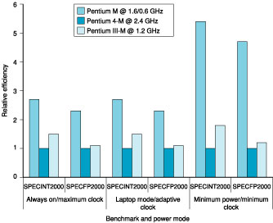
Other Performance Metrics
Power consumption – especially in the embedded market where battery life is important
For power-limited applications, the most important metric is energy efficiency
Notes:
From Version 3 of the book – probably needs replaced or dropped (based on SPEC2000)

Slide 36
Summary: Evaluating ISAs
Design-time metrics:
Can it be implemented, in how long, at what cost?
Can it be programmed? Ease of compilation?
Static Metrics:
How many bytes does the program occupy in memory?
Dynamic Metrics:
How many instructions are executed? How many bytes does the processor fetch to execute the program?
How many clocks are required per instruction?
How "lean" a clock is practical?
Best Metric: Time to execute the program!
CPI
depends on the instructions set, the processor organization, and compilation techniques.
Inst. Count
Cycle Time

