Slide 1
Abstract Algebra
抽象代数
华东师范大学计算机系 石东昱
dyshi@cs.ecnu.edu.cn

Slide 2
What
- What is abstract? (“抽象”是什么意思)
- What is abstract algebra about? (抽象代数是关于什么的)
E.g. plus: natural number, integers, rational, real, complex, scalar-vector-matrix-tensor, digit, time(hh:mm:ss) …

Slide 3
Why
Axiomatization and formalization
E.g in computer science.
- computer programming, classes (程序设计，类)
- cryptography (密码学)
- advances in AI (人工智能进展)
…

Slide 4
How
- Reading books, trying to induce the results in the book by yourself
- Doing exercises, taking quizzes in class
40%
- Examination
60%

Slide 5
Textbooks & references
"A First Course in Abstract Algebra (Third Edition)", Joseph J. Rotman, Pearson，2005 (main)
"Abstract Algebra: Theory and Applications", Thomas W. Judson, Orthogonal Publishing L3C, 2016 (complementary)
References：
《离散数学》第3版，章炯民，陶增乐，华东师范大学出版社，2009年
《应用近世代数》第3版，胡冠章，王殿军， 清华大学出版社， 2006年

Slide 6
Notations
N : the set of natural numbers, INCLUDING 0.
Z : the set of integers.
Z⁻ | Z⁺ : negative | positive integers.
Q : the set of rational numbers. Q⁻ | Q⁺
R : the set of real numbers. R⁻ | R⁺
C : the set of complex numbers.

Slide 7
Inductive reasoning 归纳推理
the assertion (断言) that a frequently observed phenomenon will always occur.
E.g.
- 太阳每天从东边升起；
- 物体间的引力大小总是与它们的质量成正比，与它们距离的平方成反比；
- 光速在真空中是恒定的，且没有任何物质的速度超过光速；
- 自然环境一直在淘汰和进化生物物种；
……

Slide 8
Inductive reasoning 归纳推理
The process of inductive reasoning 归纳推理过程：
collecting evidence (收集证据) -> making assertion (产生结论-断言)
(归纳推理是自然科学研究的基本方法之一)
question：
Is inductive reasoning fully reliable (归纳推理是否完全可靠)?

Slide 9
Inductive reasoning 归纳推理
Perfect square: 0, 1, 4, 9, 16, 25, 36, ……
Conjecture(猜想):
S(n)=991n²+1 is not perfect square for any integer n>0.
Evidence(证据):
n=1,2,3,4,5,……,10¹⁰,……,10²⁰,……
All TRUE until
n= 12, 055, 735, 790, 331, 359, 447, 442, 538, 767 ≈ 1.2 ×10²⁸

Slide 10
Inductive reasoning 归纳推理
The most generous estimate of the age of the Earth is 10 billion years (4 billion most accepted), or 3.65 ×10¹² days, 3.15 ×10¹⁷ seconds,
which means:
The EVIDENCE of “S(n) is not a perfect square” is much stronger than “the sun rises every morning”.
However, the assertion is not correct.

Slide 11
Mathematical induction 数学归纳
Least Integer Axiom (最小数公理)
There is a smallest integer in every nonempty subset C of the natural numbers N .
对自然数的任何非空集合，都存在一个最小的数。

Slide 12
Mathematical induction 数学归纳
Mathematical Induction：
Given statements S(n), one for each natural number n, suppose that:
(i) Base Step : S(0) is true;
(ii) Inductive Step : if S(n) is true, then S(n + 1) is true.
Then S(n) is true for all natural numbers n

Slide 13
Mathematical induction 数学归纳
Second Form of Induction：
Let S(n) be a family of statements, one for each natural number n, and suppose that:
(i) S(0) is true;
(ii) if S(k) is true for all predecessors (前列) k of n, then S(n) is itself true.
Then S(n) is true for all natural numbers n.

Slide 14
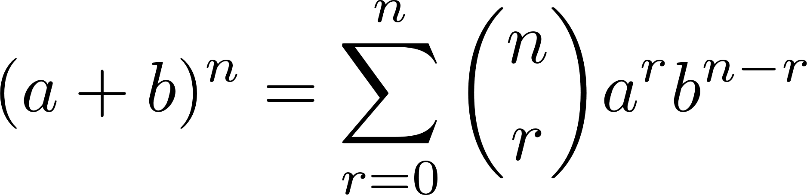
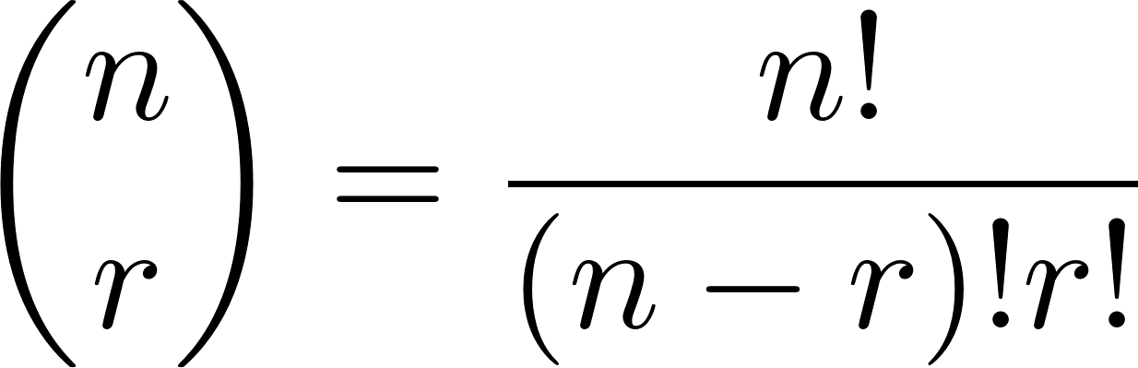
Binomial coefficients 二项系数
Where the coefficients
“n choose r”, Pascal.
It can be proved by mathematical induction.

Slide 15
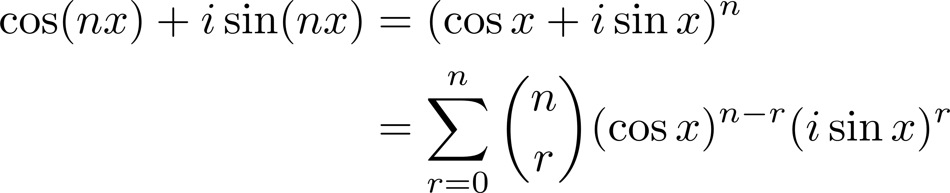
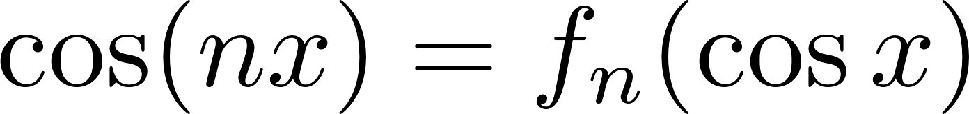
Binomial coefficients 二项系数
By De Moivre’s theorem, we have
Comparing the real part of the equation, we conclude
Where f_{n} is a polynomial (多项式) with all coefficients being integers.

Slide 16
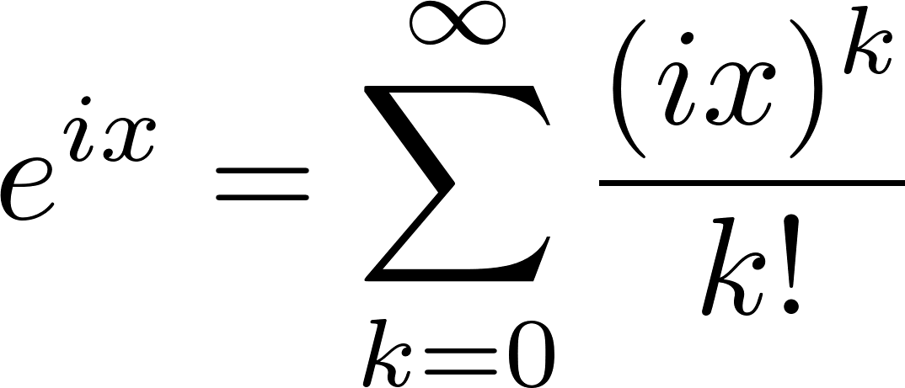
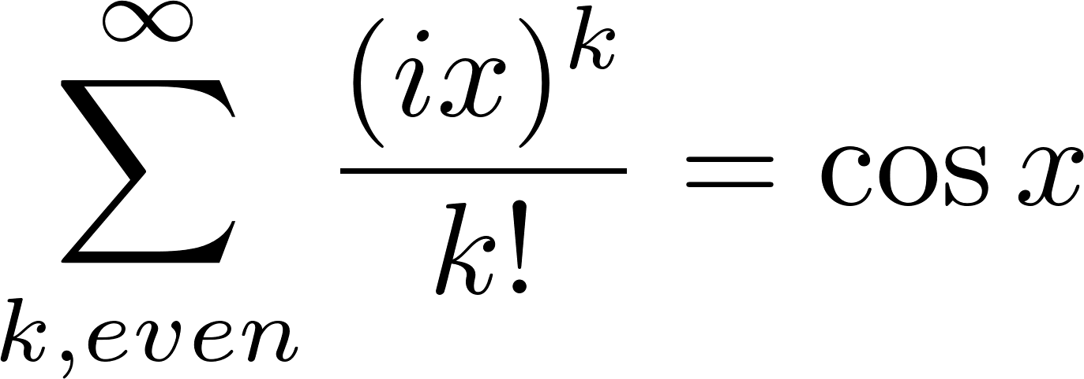
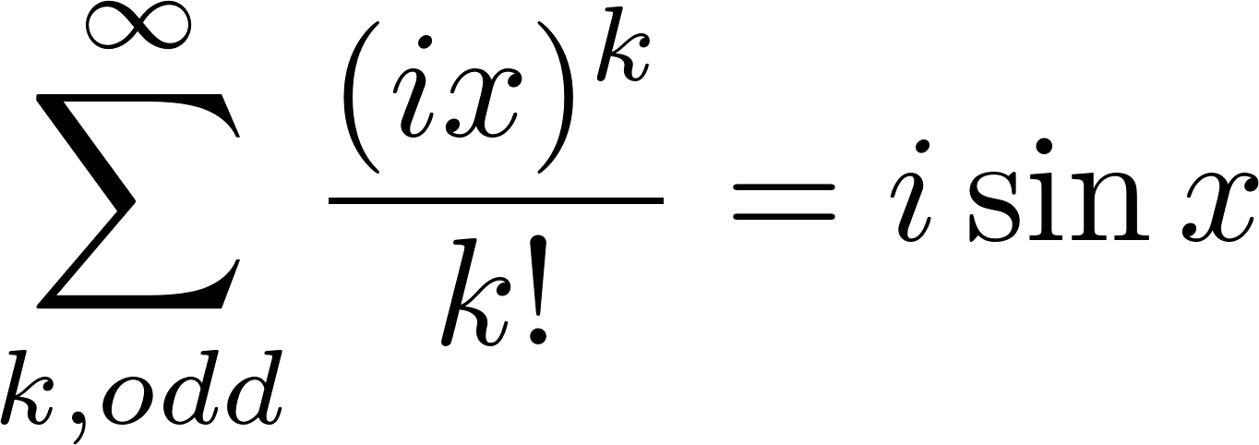
Euler’s theorem 欧拉定理（简介）
By Tyler Series:
The real part:
The imaginary part:

Slide 17
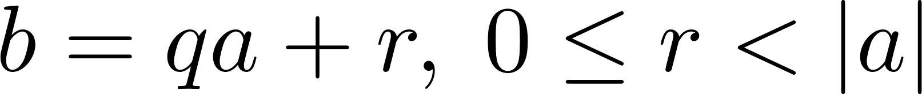
Greatest common divisors 最大公约数
Division algorithm
Given integers a and b with divisor (除数) a≠0, there exists a unique (唯一的) integers q (quotient, 商) and r (remainder, 余数) with
Corollary: there are infinitely (无穷) many primes (质数).

Slide 18
Greatest common divisors 最大公约数
Common divisor c of integers a and b:
c|a, c|b
Gcd (a,b): the greatest one.
A conclusion: (a,b) is a linear combination of a and b .
(a,b) = sa + tb, s,t ∈ Z

Slide 19
Greatest common divisors 最大公约数
Proof.
Consider the set I = {sa + tb, s,t ∈ Z}
I has positive integers: ±ka, ±kb are in the set
There must be a smallest d=s₀a+t₀b>0, Least Number Axiom
Unique form: a=qd+r, 0≤r<d , division algorithm
So r=a-q(s₀a+t₀b)=(1-qs₀)a+(-qt₀)b ∈ I
r has to be 0, thus d|a ; for the same reason, d|b
d is a common divisor

Slide 20
Greatest common divisors 最大公约数
For any common divisor c,
let a=mc, b=nc,
so d=s₀mc+t₀nc,
thus c|d
Proof completes.
gcd(a,b) is the only positive common divisor that is the linear combination of a and b with integer coefficients.

Slide 21
Rational numbers 有理数
a and b are relatively prime: gcd(a,b)=1
Every nonzero rational number r has a lowest term a/b with a and b being relatively prime.
sqrt(2) is not a rational number (it is irrational).

Slide 22
Euclidean Algorithm 欧几里得算法
Let a and b be positive integers.
There is an algorithm that finds the gcd d = (a, b);
There is an algorithm that finds a pair of integers s and t with d = sa + tb.
Top-down: repeat division algorithm
Bottom-up:

Slide 23
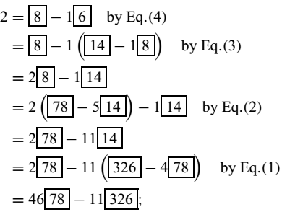
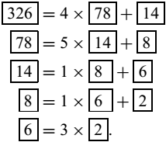
Euclidean Algorithm 欧几里德算法

Slide 24
Programming:
Implement Euclidean algorithm by ipython notebook:
Input:
a 1000×2 random integer matrix, each random number is in [-100000, 100000]
Output:
a 1000×3 integer matrix, each line has the gcd and the coefficients of the corresponding integers.

Slide 25
Fundamental Theorem of Arithmetic 算术基本定理
Every integer a ≥ 2 is either a prime or a product of primes. Moreover, if a has factorizations
a = p₁ · · · p_{m} and
a = q₁ · · · q_{n},
where the p’s and q’s are primes, then n = m and the q’s can be re-indexed so that q_{i} = p_{i} for all i.
(proved by mathematical induction from m=1, 2, … +∞)

Slide 26
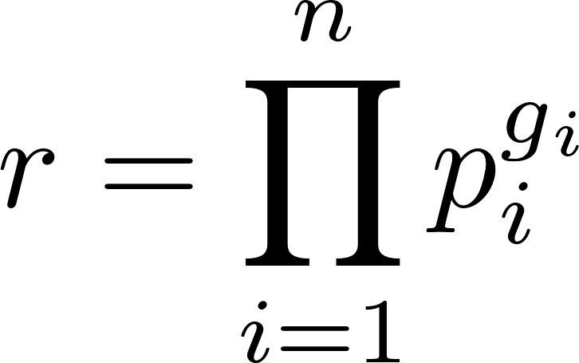
Rational number factorization 有理数分解
Every positive rational number r≠1 has a unique factorization:
where the p_{i} are distinct primes and the g_{i} are nonzero integers.
Moreover, r is an integer if and only if g_{i} > 0 for all i.

Slide 27
Congruence 同余
If m ≥ 0 is fixed, then integers a and b are congruent modulo m, denoted by
a ≡ b mod m
if m | (a − b) .
m is called modulus (模数).
a ≡ b mod 2 is said to have the same parity (odd or even, 奇偶同性)

Slide 28
Congruence 同余
Reflexive:
a ≡ a mod m
Symmetric:
if a ≡ b mod m, then b ≡ a mod m
Transitive:
if a ≡ b mod m and b ≡ c mod m,
then a ≡ c mod m

Slide 29
Congruence 同余
If p is a prime, a and b are integers, then
(a+b)^{p} ≡ a^{p} + b^{p} mod p
(examining the binomial coefficients)
a^{p} ≡ a mod p
(mathematical induction on a=1,2,… , examining (a+1)^{p} mod p)

Slide 30
Congruence 同余
If the gcd (a, m) = 1,
then for every integer b, the congruence
ax ≡ b mod m
can be solved for x (integer x exists);
In fact, let x = sb, where sa ≡ 1 mod m (since 1=sa+tm).
Moreover, any two solutions are congruent mod m.

