Slide 1
Abstract Algebra
抽象代数
华东师范大学计算机系 石东昱
dyshi@cs.ecnu.edu.cn

Slide 2
Commutative Rings 交换环
A commutative ring R is a set with (closed on) two operations, addition (+) and multiplication (·), such that:
(i) a+b = b+a for all a,b∈R;
(ii) a+(b+c) = (a+b)+c for all a,b,c∈R;
(iii) there is an element 0∈R with 0+a = a for all a∈R;
(iv) for each a∈R, there is a'∈R with a'+a = 0;
(so (R,+) is an abelian group)

Slide 3
Commutative Rings 交换环
(v) a·b = b·a for all a,b∈R;
(vi) a· (b·c) = (a·b) ·c for every a,b,c∈R;
(vii) there is an element 1∈R, with 1·a = a for every a∈R;
(viii) a·(b+c) = a·b+a·c for every a,b,c∈R (distributive law).
Is (C,+,*) on complex numbers a commutative ring?
Is matrix addition and product on k-square matrices a commutative ring?

Slide 4
Properties of Commutative Rings 交换环性质
- 0·a=0 for every number a∈R.
0 = 0 + 0
0·a = (0+0) ·a = 0·a + 0·a
Add -(0·a) to both sides of the equation
- if -a is a number satisfying -a+a=0, then (-1)·(-a) = a .
(-1 + 1) ·(-a) = (-1)·(-a) + (-a)
Note the left side is 0. Add a to both sides.
- (-1)·a = -a for every member a∈R.
- a-b for a,b∈R is defined as a+(-b) .

Slide 5
Rings 环
A (associative) ring R is a set with + and ·, such that:
(i) (R,+) is an abelian group with an addictive identity as 0;
(ii) It has left and right distributivity:
∀a,b,c∈R, a·(b+c) = a·b+a·c , (b+c)·a = b·a +c·a ;
(iii) (R, ·) is associative (but may not be commutative);
(Virtually all texts of “ring” require (iii), but non-associative rings exist.)

Slide 6
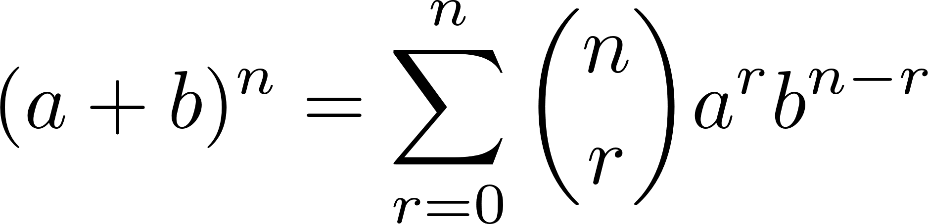
Binomial Theorem (交换环)二项式定理
Define 0x=0, x⁰=1 for every member x (including 0) in a commutative ring R, and define nx=(n-1)x+x, x^{n}=x^{n-1}·x for n∈Z⁺, then for a,b∈R ,
Prove it by mathematical induction.
Note: “·” can be omitted when it refers to the only multiplication.

Slide 7
Integral domains 整环
zero ring: 1=0, R={0}
Integral domain (or simply domain):
1) A commutative ring with 1≠0
2) satisfies the cancellation law for multiplication:
if ca=cb, and c≠0, then a=b

Slide 8
Integral domains 整环
A commutative ring is an integral domain iff it’s not a zero ring and the product of nonzero elements is nonzero.
For x,y in an integral domain R, if ∃a∈R that ax=y, then x is said to divide y in R, denoted as x|y.
For a,b,c∈R, if c|a and c|b, then c is a common divisor. When a or b is nonzero, a common divisor d is the greatest common divisor (may not be unique), denoted by gcd(a,b) or (a,b), if for every common divisor c, c|d. gcd(0,0) is defined to be 0.

Slide 9
Subrings 子环
A subset S of a commutative ring R is a subring of R if:
(i) 1∈S;
(ii) if a,b∈S, then a-b∈S;
(iii) if a,b∈S, then ab∈S.
(ii) makes it a subgroup of (R,+) and 0∈S; the associative, commutative and distributive properties are guaranteed by its closure on both + and · .

Slide 10
Commutative Rings on functions 函数上的交换环
Let F(R) be the set of all functions: R→R , equipped with pointwise (点对点) addition and pointwise multiplication:
for all x∈R , f,g∈F(R) ,
f+g : x ↦ f(x)+g(x) fg : x ↦ f(x)g(x)
Then F(R) is a commutative ring with the 0-element z(x)=0 , and the 1-element ε(x)=1, both are constant functions.
It can be extended to multi-tuples (多元组) of functions.

Slide 11
Commutative Rings on functions 函数上的交换环
However F(R) is NOT an integral domain.
Consider special functions f=ReLU and g=neg_ReLU , where
for all x∈R , ReLU(x) = {x, if x≥0; 0, if x<0} ,
neg_ReLU(x) = -ReLU(-x) = {0, if x≥0; x, if x<0}
Clearly both f and g are not z.
But fg : x ↦ f(x)g(x)=z(x)=0.

Slide 12
Commutative Rings on functions 函数上的交换环
Let D(R)⊂F(R) be the set of all differentiable functions (可微函数) that if f∈D(R) , f'(x) exists for all x∈R .
Then D(R) is a subring of F(R).
Proof:
ε(x) is differentiable;
If both f and g are differentiable, both f-g and fg are differentiable.

Slide 13
Commutative Rings on congruence classes 同余类上的交换环
(i) I_{m} (with + and ·) is a commutative ring.
(ii) I_{m} is an integral domain iff m is a prime.
[0] [1] are corresponding 0, 1 element. Check the associative, commutative and distributive properties.
Check whether [a][b]=[0] for a≠0, b≠0, while m is (or is not) a prime.

Slide 14
Divisions on Commutative Rings 交换环除法
Let R be a commutative ring. For a,b∈R, if ∃c∈R , b=ca, then a divides b in R, denoted as a|b. a is the divisor.
(i) if a|b and b|c , then a|c.
(ii) if a|b and a|c, then a divides every member of the form sb+tc, where s,t∈R.

Slide 15
Divisions on Commutative Rings 交换环除法
For u∈R , if u|1, i.e.(即是) ∃v, uv=1, then u is called a unit.
(i) The inverse of a unit is unique, denoted by u⁻¹.
if uv'=1, v=uv'v=v'.
(ii) if u is a unit, uw≠0 for any w≠0.
if uw=0, 0=uvw=w.
(iii) The set of units in R forms an abelian group under ·.

Slide 16
Divisions on Commutative Rings 交换环除法
Let R be an integral domain. If nonzero a,b∈R, then a|b and b|a iff ∃u∈R, u is a unit, and b=ua.
ax=b, by=a, so b=xyb, xy=1
uv=1, b=ua, so bv=a
For a∈Z, [a] is a unit in I_{m} iff gcd(a,m)=1 .
let d=gcd(a,m), sa≡1 mod m, sa=tm+1 → (sp-tq)d=1
1=sa+tm → ∃s: [s][a]≡1 mod m

Slide 17
fields 域
A field is a commutative ring with 1≠0 in which every nonzero element is a unit.
- Z is not a field, Q, R and C are fields.
- every field is an integral domain.
- I_{m} is a field iff m is a prime. The field is denoted as F_{p}.

Slide 18
From Integral Domains to Fields 整环到域
A field F can be established from an integral domain R :
(1) for all a,b∈R, b≠0, define F={[a,b]}
(2) define equivalence: [a,b]=[c,d] if ad=bc
prove that it’s an equivalence relation;
(3) define plus operation: [a,b]+[c,d]=[ad+bc,bd];
(4) define multiplication operation: [a,b]·[c,d]=[ac,bd];

Slide 19
From Integral Domains to Fields 整环到域
[0,1] is the 0-element in F (so is any [0,b], b≠0);
[1,1] is the 1-element in F (so is any [b,b], b≠0);
- prove that F is an abelian group on the defined +;
- prove its commutativity and associativity on the defined ·, and prove its distributivity on + and ·;
- prove that every nonzero element is a unit (has an inverse on ·).

Slide 20
Fraction Fields 分式域
The field constructed from an integral domain R through (1) to (4) is called a fraction field, denoted by Frac(R).
The element [a,b]∈Frac(R) is denoted by a/b.
a/1 can be simplified as a.
0/a, a≠0 , can be simplified as 0.
1/a, a≠0 , is also denoted as a⁻¹.
Frac(Z)=Q

Slide 21
Subfields 子域
The subfield of a field is a subring of it that is also a field.
- which means, it is a subring that is closed under inverses.
- the intersection of subfields of a field is also its subfield.
- the intersection of all subfields of a field is called its prime subfield.

Slide 22
Polynomials 多项式
A sequence (序列) in a commutative ring R is a function
σ:N→R σ(i)=s_{i}∈R (s₀,s₁,s₂,…)
- A sequence is called a polynomial if integer n≥0 exists that for all i>n, σ(i)=0.
- If σ(n)≠0, it is the leading coefficient (最高系数) of σ, and n is the degree (次数) of σ, denoted by deg(σ)
(note: deg(σ)=0 means s₀≠0).

Slide 23
Polynomials 多项式
- The sequence is monic (首一) if σ(n)=1.
The set of all polynomials with coefficients in a commutative ring R is denoted by R[x].

Slide 24
Multiplications on Polynomials 多项式乘法
If R is a commutative ring and r,s_{i},t_{j}∈R for i,j∈N, then
(s₀+s₁r+s₂r²+…)(t₀+t₁r+t₂r²+…)=a₀+a₁r+…+a_{k}r^{k}+… ,
where a_{k}= Σ_{i+j=k}s_{i}t_{j} for all k ≥ 0
Let σ,τ∈R[x] be nonzero polynomials:
(i) either στ=0 (deg not defined) or deg(στ) ≤ deg(σ)+deg(τ)
(ii) if R is an integral domain, στ≠0 , deg(στ)=deg(σ)+deg(τ)

Slide 25
Indeterminate 未知数
Define the indeterminate to be the element
x=(0,1,0,0…) ∈ R[x]
(i) for σ=(s₀,s₁,…,s_{n},…)∈R[x], xσ=(0,s₀,s₁,…,s_{n},…)∈R[x]
(ii) for n∈Z⁺, x^{n} is the polynomial having 0 everywhere except for 1 in the n-th coordinate (第n维坐标)
(iii) for r∈R, (r,0,0,…)σ=(rs₀,rs₁,rs₂,…)∈R[x]
(iv) σ = s₀x⁰+s₁x¹+…+s_{n}x^{n}

Slide 26
Rings of Polynomials 多项式环
Define ”+”: (s₀,s₁,…, s_{m},0,…)+(t₀,t₁,…,t_{n},0,…) = (s₀+t₀, s₁+t₁, …)
Define ”·”: (s₀,s₁,…, s_{m},0,…)·(t₀,t₁,…,t_{n},0,…) = (Σ_{i+j=0}s_{i}t_{j} , Σ_{i+j=1}s_{i}t_{j} , …, Σ_{i+j=m+n}s_{i}t_{j} , 0, …)
For a commutative ring R, R[x] is a commutative ring under the defined + and · , called ring of polynomials over R;
If R is an integral domain, R[x] is also an integral domain;
0-element: (0,0,…) ; 1-element: (1,0,…)

Slide 27
Polynomial functions 多项式函数
Each polynomial s₀+s₁x+…+s_{n}x^{n}∈R[x] defines a polynomial function f: R→R by evaluation:
If r∈R, s₀+s₁r+…+s_{n}r^{n}∈R
Let F be a field. The fraction field of F[x], denoted by Frac(F(x)), is called the field of rational functions (有理函数域) over F.
Elements of Frac(F(x)) have the form f(x)/g(x) , where f(x),g(x)∈F[x] and g(x)≠0

Slide 28
Polynomials in multi-variables 多变量多项式
If we write A=R[x], then the polynomial ring A[y] is called the ring of all polynomials over R in two variables x and y (indeterminates), denoted by R[x,y].
E.g. ax²+bxy+cy²+dx+ey+f = cy²+(bx+e)y+(ax²+dx+f)
a polynomial in y with coefficients in R[x].
R[x₁,x₂,…,x_{n}] can be formed in similar way.

Slide 29
Home project
Represent the commutative ring as an abstract class by an object-oriented programming language, with operations + and · . Then implement the following rings by inheriting from the class with operator overloading:
1) complex numbers;
2) real coefficient polynomials R[x];
3) Frac(R[x]), with R[x] defined as above.
Each should have test programs to show objects and methods.

Slide 30
Ring Homomorphism 环同态
If A and R are commutative rings, a (ring) homomorphism is a function f: A→R such that
(i) f(1) = 1;
(ii) f(a+b) = f(a)+f(b) for all a,b∈A;
(iii) f(ab) = f(a)f(b) for all a,b∈A;
A homomorphism that is also a bijection is an isomorphism.

Slide 31
Properties of Ring Homomorphism 环同态性质
If f: A→R is a ring homomorphism, then for all a∈A,
(i) f(a^{n}) = f(a)^{n} for all n≥0; (define a⁰=1, a^{n}=a^{n-1}·a)
(ii) if a is a unit, then f(a) is a unit and f(a⁻¹) = f(a)⁻¹ ;
(iii) if a is a unit, then f(a^{-n}) = f(a)^{-n} for all n≥0; (a^{-n}=a^{-n+1}·a⁻¹)
(iv) define U(A): the group of units of A (under ·).
f(U(A)) ⊆ U(R)
If f is an isomorphism, U(A) ≌ U(R)

Slide 32
Evaluation map 计值映射
If R is a commutative ring and s∈R, then evaluation at s is the function e_{s}: R[x]→R, defined by e_{s}(f(x))=f(s); that is, e_{s}(Σ_{i}r_{i}x^{i} )=Σ_{i}r_{i}s^{i}.
The evaluation map e_{s}: R[x]→R is a homomorphism.

Slide 33
Kernel and Image 核与像
If f: A→R is a ring homomorphism, then its kernel is
ker f = {a∈A with f(a)=0}
Its image is im f = {r=f(a) for a∈A}
(i) If R is not zero ring, ker f is a proper subset of A, 0∈ker f;
(ii) if x,y∈ker f , x+y∈ker f ;
(iii) if x∈ker f, a∈A, ax∈ker f .

Slide 34
Ideals 理想
An ideal in a commutative ring R is a subset I of R such that
(i) 0∈I ;
(ii) if a,b∈I , a+b∈I ;
(iii) if a∈I, and r∈R, then ra∈I .
An ideal I≠R is called a proper ideal.
A prime ideal (素理想) is a proper ideal such that if ab∈I, then either a∈I or b∈I.

Slide 35
Principal Ideals 主理想
If b₁, b₂,...,b_{n} lie in R, I={r₁b₁+…+ r_{n}b_{n} : r_{i}∈R for all i} is an ideal in R. One writes I=(b₁, b₂,...,b_{n}) in this case.
If n=1, I=(b)={rb: r∈R} is the principal ideal generated by b.
Note: R=(1) , {0}=(0)
Every ideal in Z is a principal ideal.
prove that {r₁b₁+r₂b₂ : r₁,r₁∈ Z} = {rd : r∈Z}, where d=gcd(b₁,b₂)

Slide 36
Ideals and Rings 理想与环
- If R is a commutative ring and ∃u∈R, u is a unit that a=ub, then (a)=(b). ( {sa}={rb} )
- if R is an integral domain, then (a)=(b) implies ∃u∈R, u is a unit that a=ub. (if a≠0, 1a=r₁b, s₁a=1b. )
- a nonzero commutative ring R is a field iff its only ideals are {0} and R itself.
(1∈I so I includes every element; construct a principal ideal with non-unit element)

Slide 37
Ideals and Rings 理想与环
- the ideal {0} in a commutative ring R is a prime ideal iff R is an integral domain;
- the prime ideals in Z are precisely the ideals (p), where p=0 or p(-p) is a prime.
(0)={0} is a prime ideal; (1)=(-1)=Z is not a proper ideal;
(p) is not Z, and if any ab∈(p), then a∈(p) or b∈(p);
If a composite number m=ab generates (m), both a,b are not in (m).

Slide 38
Polynomial Division Algorithm 多项式除法算法
Let R be a commutative ring, let f(x),g(x)∈R[x] , and let the leading coefficient of f(x) be a unit in R.
(i) There are polynomials q(x),r(x)∈R[x] with g(x)=q(x)f(x)+r(x) , where either r(x)=0 or deg(r)<deg(f) .
(ii) If R is an integral domain, then the polynomials q(x) and r(x) in (i) are unique.
We denote a leading term of a polynomial with degree n as LT(f)=s_{n}x^{n}

Slide 39
Polynomial Division Algorithm 多项式除法算法
Proof:
(i) let LT(f)=s_{n}x^{n},
r=r_{m} is the polynomial with the least degree that satisfying g=qf+r, with LT(r_{m})=t_{m}x^{m} and m≥n.
Let h=r-t_{m}s_{n}⁻¹x^{m-n}f, so g=(q+t_{m}s_{n}⁻¹x^{m-n})f+h.
But deg(h)<deg(r), contradicting that r has the least degree.

Slide 40
Polynomial Division Algorithm 多项式除法算法
(ii) let g=q'f+r', so (q-q')f=r-r'.
If r≠r', deg((q-q')f)≥deg(f),
while deg(r-r')<deg(f), a contradiction.
q(x) is the quotient (商), and r(x) is the remainder (余数).

Slide 41
Roots of Polynomials 多项式的根
If f(x)∈k[x], where k is a field, then a root of f(x) in k is an element a∈k with f(a)=0.
For any a∈k , there is a q(x)∈k[x] with f(x)=q(x)(x-a)+f(a).
(division algorithm, evaluating x=a)
A a∈k is a root iff x-a divides f(x) (f(x)=q(x)(x-a)).

Slide 42
Roots of Polynomials 多项式的根
Let k be a field and let f(x)∈k[x] .
(i) If f(x) has degree n, then f(x) has at most n roots in k.
(ii) If f(x) has degree n and a₁, a₂, ... , a_{n}∈k are distinct roots of f(x) in k, then there is c∈k and a factorization f(x) = c(x − a₁) · · ·(x − a_{n}) .
(we can use math-induction and f(x)=q(x)(x-a) iff a is a root)

Slide 43
GCD of Polynomials 多项式的最大公约式
Define linear combination of f(x),g(x)∈k[x] , where k is a field: h(x) = s(x)f(x)+t(x)g(x) , s(x),t(x)∈k[x]
A general gcd of f(x) and g(x) is a linear combination of them.
Let I={s(x)f(x)+t(x)g(x), s(x),t(x)∈k[x]}, f(x) and g(x) are in I. Consider a d(x)∈I with the least degree, the division algorithm gives f=qd+r . If r≠0, it must have deg(r)<deg(d), and r=f-q(sf+tg)∈I, contradicting d having the least degree.

Slide 44
GCD of Polynomials 多项式的最大公约式
The gcd of f(x),g(x)∈k[x] , where k is a field, is defined to be monic if one of them is not 0, and 0 otherwise.
- A monic common divisor d(x) is the gcd iff d(x) is divisible by every common divisor.
- Every two polynomials f(x) and g(x) have a unique gcd.
k[x] is an integral domain ⇒ gcd a|b and b|a iff ∃ unit u∈k[x] , b=ua ⇒ u has to be (w,0,0,…) , a nonzero constant, but the gcd is defined to be monic.

Slide 45
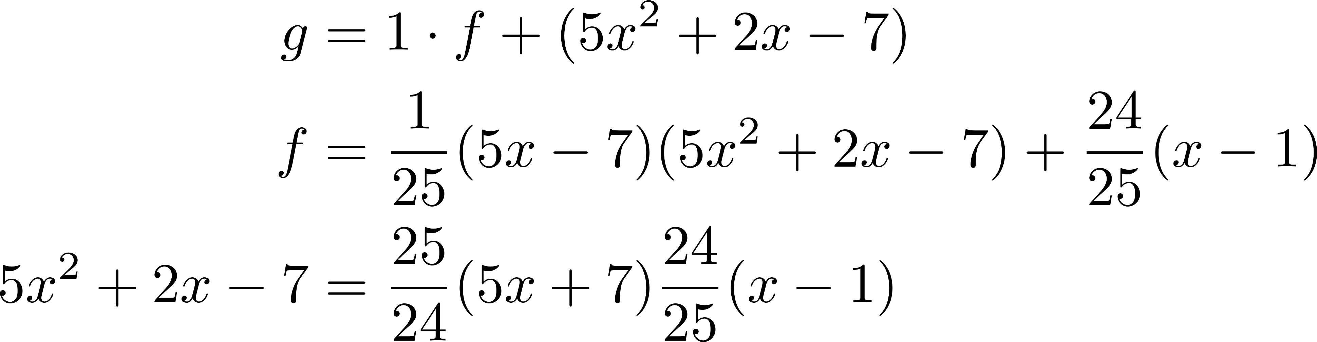
GCD of Polynomials: examples
Find the gcd and the corresponding linear combination coefficients of f(x)=x³-x²-x+1 and g(x)=x³+4x²+x-6 in Q[x].
Thus the monic gcd is x-1.

Slide 46
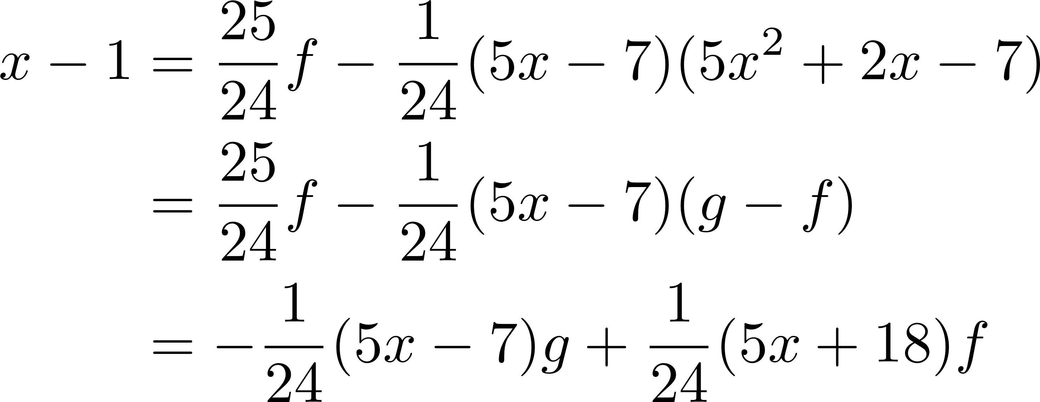
GCD of Polynomials: examples
Thus we get the polynomial coefficients.

Slide 47
Ideals of Polynomials 多项式的理想
If k is a field, then every ideal I in k[x] is a principal ideal. If I≠{0}, there is a monic polynomial that generates I.
Choose the monic d∈I with the least degree. Every f∈I must have f=qd+r. Prove that r is in I by definition of the ideal. d having the least degree makes r=0.
Principal ideal domain (PID): an integral domain that every ideal is a principal ideal.

Slide 48
Irreducibles 不可约简项
An element p of a commutative ring R is irreducible if p is neither 0 nor a unit and if, in any factorization p=ab in R, either a or b is a unit.
If k is a field, then a non-constant polynomial p(x)∈k[x] is irreducible in k[x] iff p(x) has no factorization in k[x] of the form p(x)=f(x)g(x), where f(x) and g(x) are non-constant polynomials.

Slide 49
Euclidean Rings 欧几里得环
A euclidean ring is an integral domain that there is a degree function
∂ : R× → N
(where R× denotes the nonzero elements of R), such that
(i) ∂(f)≤∂(fg) for all f,g∈R×;
(ii) for all f,g∈R with f∈R×, there exist q,r∈R with g=qf+r, and either r=0 or ∂(r)<∂(f) .

Slide 50
Examples of Euclidean Rings 欧氏环例子
- Every field R is a euclidean ring with degree function ∂ identically 0.
- Z is a euclidean ring with ∂(m)=|m| for m∈Z.
- For a field k, k[x] is a euclidean ring with ∂(f)=deg(f) for f∈ k[x].

Slide 51
Unique Factorization 唯一分解
If k is a field, then every polynomial f(x)∈k[x] of degree ≥1 is a product of a nonzero constant and monic irreducibles. Moreover, if
f(x) = ap₁(x) · · · p_{m}(x) and f(x) = bq₁(x) · · · q_{n}(x) ,
where a and b are nonzero constants and the p’s and q’s are monic irreducibles, then a = b, m = n, and the q’s can be re-indexed so that q_{i} = p_{i} for all i.

Slide 52
Congruence Classes (交换环上的)同余类
Given a commutative ring R with an ideal I, define the relation congruence mod I on R:
a≡b mod I iff a-b∈I
It is an equivalence relation on R.
(a-a=0∈I; -1(a-b)∈I; a-c=a-b+b-c∈I)
The congruence class of a mod I: [a]={a≡b mod I, b∈R}
The set of all congruence classes mod I: R/I

Slide 53
Quotient Rings 商环
Given a commutative ring R with an ideal I, then R/I with the addition and multiplication defined as following is a commutative ring:
addition: [a]+[b]=[a+b] multiplication: [a]·[b]=[ab]
Proof is omitted.
R/I is the quotient ring of R modulo I.
A proper ideal I is a prime ideal iff R/I is an integral domain, since [0]∈I.

Slide 54
First Isomorphism Theorem 第一环同构定理
If ϕ: R→S is a homomorphism of commutative rings R and S, then ker ϕ is an ideal in R, im ϕ is a subring of S, and there is an isomorphism φ: R/ ker ϕ → im ϕ
defined by φ(a + ker ϕ) = ϕ(a), for a∈R.
As an introduction, proof is omitted.

Slide 55
Maximal Ideals 极大理想
An ideal I in a commutative ring R is a maximal ideal if I is a proper ideal and there is no ideal J with I⊂J⊂R.
- {0} is a maximal ideal in R iff R is a field.
- If R is a PID, then every nonzero prime ideal is maximal.
if (b)⊃(a), then ∃r∈R, a=rb,
b is not in (a), so r has to be in (a),
r=sa ⇒ 1=sb ⇒ (b)=R.

Slide 56
Summary 总结
Commutative rings
Integral domains
Fields
Subrings
Ideals
Fraction fields
Polynomials

Slide 57
Summary 总结
Ring homomorphism / isomorphism
Kernels & images
Congruence classes
Quotient rings
Proper / prime / principal / maximal ideals
Euclidean rings
Division algorithm

