Slide 1
第三章
路由算法与路由协议(1)
An Introduction to Interdomain Routing and BGP
江 勇
jiangy@sz.tsinghua.edu.cn

Slide 2
Outline
The basics of interdomain routing and BGP
  Forwarding vs. Routing
  Autonomous Systems (basic units of interdomain routing)
  The Border Gateway Protocol (BGP)
    BGP fundamentals
    BGP route attributes
    Implementing policy with BGP
    A wee bit of theory

Slide 3
Outline (Cont.)
BGP in practice: Issues of Scale
  Scaling internal BGP
  BGP table growth
    Address aggregation vs. Multihoming
  Growth in number of autonomous systems
  Dynamics of BGP
    Route flapping
    BGP convergence
    Rates of BGP updates

Slide 4
Outline
The basics of interdomain routing and BGP
  Forwarding vs. Routing
  Autonomous Systems (basic units of interdomain routing)
  The Border Gateway Protocol (BGP)
    BGP fundamentals
    BGP route attributes
    Implementing policy with BGP
    A wee bit of theory
BGP in practice: Issues of Scale

Slide 5








Routing vs. Forwarding
Net
Nxt Hop
Forwarding always works
Routing can be badly broken
A
B
C
D
E
default
R1
Direct
R3
R1
R3
R1
Default to
upstream
router
B
Net
Nxt Hop
R
R2
A
B
C
D
E
default
R2
R2
Direct
R5
R5
R2
A
R
R
R1
R3
C
R4
R5
D
Net
Nxt Hop
E
A
B
C
D
E
default
R4
R3
R3
R4
Direct
R4
Forwarding: determine next hop
Routing: establish end-to-end paths

Slide 6
How Are Forwarding Tables Populated to Implement Routing?
Statically
Dynamically
Administrator
manually configures
forwarding table entries
Routers exchange network reachability information using ROUTING PROTOCOLS. Routers use this to compute best routes
+ More control
+ Not restricted to
destination-based
forwarding
- Doesn’t scale
- Slow to adapt to
network failures
+ Can rapidly adapt to changes
in network topology
+ Can be made to scale well
- Complex distributed algorithms
- Consume CPU, Bandwidth, Memory
- Debugging can be difficult
- Current protocols are destination-based
In practice : a mix of these.
Static routing mostly at the “edge”

Slide 7

Routers Talking to Routers
Routing computation is distributed among routers within a routing domain
Computation of best next hop based on routing information is the most CPU/memory intensive task on a router
Routing messages are usually not routed, but exchanged via layer 2 between physically adjacent routers (internal BGP and multi-hop external BGP are exceptions)
Routing info
Routing info

Slide 8
Before We Go Any Further …
IP ROUTING PROTOCOLS DO NOT
DYNAMICALLY ROUTE AROUND
NETWORK CONGESTION
IP traffic can be very bursty
Dynamic adjustments in routing typically operate more slowly than fluctuations in traffic load
Dynamically adapting routing to account for traffic load can lead to wild, unstable oscillations of routing system

Slide 9
Outline
The basics of interdomain routing and BGP
  Forwarding vs. Routing
  Autonomous Systems (basic units of interdomain routing)
  The Border Gateway Protocol (BGP)
    BGP fundamentals
    BGP route attributes
    Implementing policy with BGP
    A wee bit of theory
BGP in practice: Issues of Scale

Slide 10
Autonomous Routing Domains
A collection of physical networks glued together using IP, that have a unified administrative routing policy.
  Campus networks
  Corporate networks
  ISP Internal networks
  …

Slide 11
Autonomous Systems (ASes)
An autonomous system is an autonomous routing domain that has been assigned an Autonomous System Number (ASN).
  RFC 1930: Guidelines for creation, selection, and registration of an Autonomous System

Slide 12
AS Numbers (ASNs)
ASNs are 16 bit values.
  64512 through 65535 are “private”
Currently over 11,000 in use.
  Genuity: 1
  MIT: 3
  Harvard: 11
  UC San Diego: 7377
  AT&T: 7018, 6341, 5074, …
  UUNET: 701, 702, 284, 12199, …
  Sprint: 1239, 1240, 6211, 6242, …
  Cernet: 4538, 4789, …
  …
ASNs represent units of routing policy

Slide 13
Architecture of Dynamic Routing
OSPF
BGP
AS 1
EIGRP
IGP = Interior Gateway Protocol
Metric based: OSPF, IS-IS, RIP,
EIGRP (cisco)
AS 2
EGP = Exterior Gateway Protocol
Policy based: BGP
The Routing Domain of BGP is the entire Internet

Slide 14
Technology of Distributed Routing
Link State
  Topology information is flooded within the routing domain
  Best end-to-end paths are computed locally at each router.
  Best end-to-end paths determine next-hops.
  Based on minimizing some notion of distance
  Works only if policy is shared and uniform
  Examples: OSPF, IS-IS
Vectoring
  Each router knows little about network topology
  Only best next-hops are chosen by each router for each destination network.
  Best end-to-end paths result from composition of all next-hop choices
  Does not require any notion of distance
  Does not require uniform policies at all routers
  Examples: RIP, BGP

Slide 15
The Gang of Four
Link State
Vectoring
OSPF
IGP
RIP
IS-IS
BGP
EGP

Slide 16




Many Routing Processes Can Run on a Single Router
RIP Process
BGP Process
RIP Routing tables
BGP Routing tables
BGP
OSPF Process
OSPF Routing tables
RIP
Domain
OS kernel
OSPF
Domain
Forwarding Table Manager
Forwarding Table

Slide 17

Nontransit vs. Transit ASes
Internet Service
providers (often)
have transit
networks
ISP 2
ISP 1
NET A
Nontransit AS
might be a corporate
or campus network.
Could be a “content
provider”
Traffic NEVER
flows from ISP 1
through NET A to ISP 2
(At least not intentionally!)
IP traffic

Slide 18
Selective Transit
NET B
NET C
NET A provides transit
between NET B and NET C
and between NET D
and NET C
NET A DOES NOT
provide transit
Between NET D
and NET B
NET A
NET D
IP traffic
Most transit networks transit in a selective manner…

Slide 19
Customers and Providers
provider
provider
customer
IP traffic
customer
Customer pays provider for access to the Internet

Slide 20

Customers Don’t Always Need BGP
provider
Nail up routes 192.0.2.0/24
pointing to customer
Nail up default routes 0.0.0.0/0
pointing to provider.
customer
192.0.2.0/24
Static routing is the most common way of connecting an
autonomous routing domain to the Internet.
This helps explain why BGP is a mystery to many …

Slide 21
Customer-Provider Hierarchy
provider
customer
IP traffic

Slide 22
The Peering Relationship
ISP 1
ISP 2
ISP 3
NET A
NET B
NET C
peer
peer
Peers provide transit between
their respective customers
Peers do not provide transit
between peers
provider
customer
traffic
allowed
traffic NOT
allowed

Slide 23
Peering Provides Shortcuts
Peering also allows connectivity between
the customers of “Tier 1” providers.
peer
peer
provider
customer

Slide 24
Peering Wars
Peer
  Reduces upstream transit costs
  Can increase end-to-end performance
  May be the only way to connect your customers to some part of the Internet (“Tier 1”)
Don’t Peer
  You would rather have customers
  Peers are usually your competition
  Peering relationships may require periodic renegotiation
Peering struggles are by far the most
contentious issues in the ISP world!
Peering agreements are often confidential.

Slide 25
Outline
The basics of interdomain routing and BGP
  Forwarding vs. Routing
  Autonomous Systems (basic units of interdomain routing)
  The Border Gateway Protocol (BGP)
    BGP fundamentals
    BGP route attributes
    Implementing policy with BGP
    A wee bit of theory
BGP in practice: Issues of Scale

Slide 26
BGP-4
BGP = Border Gateway Protocol
Is a Policy-Based routing protocol
Is the de facto EGP of today’s global Internet
Classless Inter Domain Routing (CIDR) support
Path vector protocol
增量Incremental
运行于TCP上 (port 179)
协议相对简单，但配置复杂。个别的错误可能产生全网的影响
Standards
  1989 : BGP-1 [RFC 1105]
    Replacement for EGP (1984, RFC 904)
  1990 : BGP-2 [RFC 1163]
  1991 : BGP-3 [RFC 1267]
  1995 : BGP-4 [RFC 1771]
    Support for Classless Interdomain Routing (CIDR)

Slide 27
BGP 操作(Simplified)
Establish session on
TCP port 179
AS1
BGP session
Exchange all
active routes
AS2
While connection
is ALIVE exchange
route UPDATE messages
Exchange incremental
updates

Slide 28
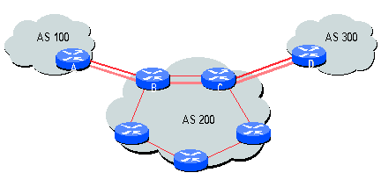
何时使用BGP？
Dual- or multi-homed
向下游的customer提供部分或全部Internet路由
当需要AS路径信息时

Slide 29
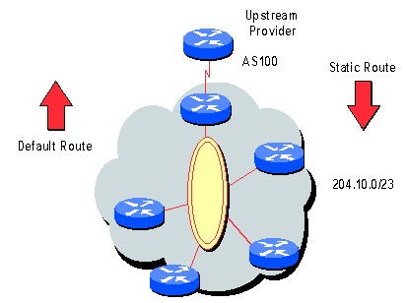
不需要BGP …
单宿主(singularly homed) …
不需要提供下游路由时…
采用缺省路由!

Slide 30
消息格式
最大消息长度4096字节, 最小消息长度19字节.
四类 BGP 消息
  Open : 建立会话.
  Keep Alive : 定期握手.
  Update : 宣布Announcing新路由或废除withdrawing以前宣布路由.
  Notification : 关闭会话.
announcement = prefix + attributes values

Slide 31
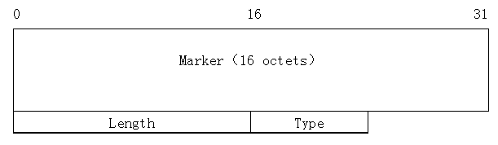
BGP消息头格式
消息头长度固定.
消息头后面可能有数据也可能没有.
如消息类型是OPEN, 或者OPEN消息不带认证信息Authentication Information, 那么Marker必须全为1. Otherwise, the value of the marker can be predicted by some a computation specified as part of the authentication mechanism used.

Slide 32
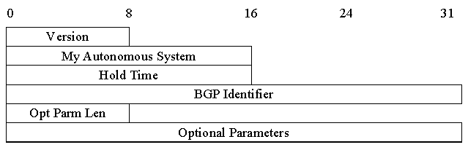
OPEN 消息格式
Hold Time指示成功收到KEEPALIVE 或UPDATE消息前的最大时间间隔 (seconds).
Hold Time在BGP speakers间协商, 必须是0或大于3 seconds.
BGP speaker设置 BGP Identifier为分配给自己的 IP address.
Optional Parameters包含一系列选项参数, 每个参数为一个三元组 <Parameter Type, Parameter Length, Parameter Value>.

Slide 33
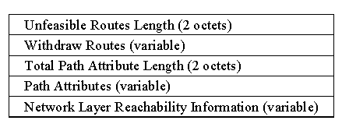
UPDATE 消息格式
Withdrawn Routes 包含一列将废除的路由二元组 <length, prefix>.
每个path attribute是一个变长三元组 <attribute type, attribute length, attribute value>.
NLRI field包含一列2-tuple <length, prefix>.

Slide 34
KEEPALIVE 消息格式
BGP不采用基于传输层的keep-alive机制去探测对端是否可达.
KEEPALIVE消息交换用于使Hold Timer不过期.
一个合理的最大KEEPALIVE消息时间间隔是Hold Time的三分之一.
KEEPALIVE消息不允许发送频率超过one per second.
如果协商的Hold Time为zero, 那么不允许发送KEEPALIVE 消息.
KEEPALIVE消息只有消息头，长度为 19 octets.

Slide 35
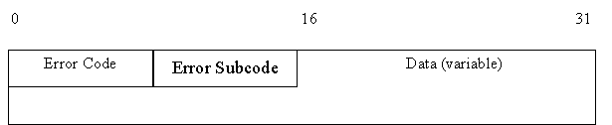
NOTIFICATION 消息格式
NOTIFICATION消息当检测到错误时发送. 并在发送后立即关闭BGP连接.
The Data field is used to diagnose the reason for the NOTIFICATION. The contents of the Data field depend upon the Error Code and Error Subcode.

Slide 36
BGP属性 Attributes
Value Code Reference
----- --------------------------------- ---------
1 ORIGIN [RFC1771]
2 AS_PATH [RFC1771]
3 NEXT_HOP [RFC1771]
4 MULTI_EXIT_DISC [RFC1771]
5 LOCAL_PREF [RFC1771]
6 ATOMIC_AGGREGATE [RFC1771]
7 AGGREGATOR [RFC1771]
8 COMMUNITY [RFC1997]
9 ORIGINATOR_ID [RFC2796]
10 CLUSTER_LIST [RFC2796]
11 DPA [Chen]
12 ADVERTISER [RFC1863]
13 RCID_PATH / CLUSTER_ID [RFC1863]
14 MP_REACH_NLRI [RFC2283]
15 MP_UNREACH_NLRI [RFC2283]
16 EXTENDED COMMUNITIES [Rosen]
...
255 reserved for development
This
tutorial
will cover
these
attributes
Not all attributes
need to be present in
every announcement
From IANA: http://www.iana.org/assignments/bgp-parameters

Slide 37
属性Attributes用于选择最佳路由
192.0.2.0/24
pick me!
192.0.2.0/24
pick me!
192.0.2.0/24
pick me!
Given multiple
routes to the same
prefix, a BGP speaker
must pick at most
one best route
(Note: it could reject
them all!)
192.0.2.0/24
pick me!

Slide 38
两类BGP邻居关系
External Neighbor (eBGP) in a different Autonomous Systems
Internal Neighbor (iBGP) in the same Autonomous System
AS1
eBGP
iBGP
AS2

Slide 39
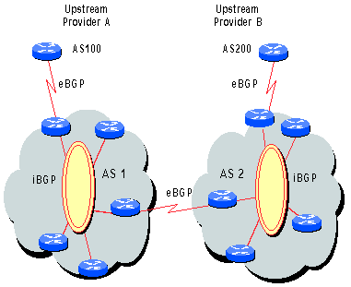
内部BGP (iBGP)
协议与eBGP相同, 不同应用
iBGP 用于避免在一个AS内的路由循环
iBGP should be used when AS_PATH information must remain intact between multiple eBGP peers
Injecting external routes into IGP does not scale and causes BGP policy information to be lost

Slide 40
iBGP 对必须是全连接的
All iBGP peers must be fully meshed, logically; an iBGP peer will not advertise a route learned by one iBGP peer to another iBGP peer (re_advertisement restriction to prevent looping)
BGP does not provide “shortest path” routing
Is iBGP an IGP? NO!
eBGP update
iBGP updates
iBGP neighbors do not announce
routes received via iBGP to other iBGP
neighbors.

Slide 41
BGP 的Next Hop 属性
12.125.133.90
12.127.0.121
AS 7018
AT&T
AS 6431
AS 12654
AT&T Research
RIPE NCC
RIS project
135.207.0.0/16
Next Hop = 12.125.133.90
135.207.0.0/16
Next Hop = 12.127.0.121
外部路由的Next hop在iBGP邻居间交互时不会改变.
每当路由信息穿过AS边界时，Next Hop属性转换为边界路由器的IP地址.

Slide 42
Join EGP with IGP For Connectivity
135.207.0.0/16
Next Hop = 192.0.2.1
135.207.0.0/16
10.10.10.10
AS 1
AS 2
192.0.2.1
192.0.2.0/30
Forwarding Table
destination
next hop
192.0.2.0/30
10.10.10.10
+
Forwarding Table
destination
next hop
EGP
135.207.0.0/16
10.10.10.10
destination
next hop
192.0.2.0/30
10.10.10.10
135.207.0.0/16
192.0.2.1

Slide 43
Next Hop Often Rewritten to Loopback
135.207.0.0/16
Next Hop = 127.22.33.44
135.207.0.0/16
Next Hop = 192.0.2.1
135.207.0.0/16
10.10.10.10
AS 1
AS 2
192.0.2.1
Forwarding Table
127.22.33.44
destination
next hop
127.22.33.44
10.10.10.10
+
Forwarding Table
destination
next hop
EGP
135.207.0.0/16
10.10.10.10
destination
next hop
127.22.33.44
10.10.10.10
135.207.0.0/16
127.22.33.44

Slide 44
实现Customer/Provider和Peer/Peer 关系
Two parts:
  Enforce transit relationships
    Outbound route filtering
  Enforce order of route preference
    provider < peer < customer

Slide 45
Import Routes
provider route
peer route
customer route
ISP route
From
provider
From
provider
From
peer
From
peer
From
customer
From
customer

Slide 46
Export Routes
provider route
peer route
customer route
ISP route
To
provider
From
provider
To
peer
To
peer
To
customer
To
customer
filters
block

Slide 47
如何分类路由?
BGP Communities!
A community value is 32 bits
Used for signally
within and between
ASes
By convention,
first 16 bits is
ASN indicating
who is giving it
an interpretation
community
number
Very powerful
BECAUSE it
has no (predefined) meaning
Community Attribute = a list of community values.
(So one route can belong to multiple communities)
Two reserved communities
  no_export = 0xFFFFFF01: don’t export out of AS
no_advertise 0xFFFFFF02: don’t pass to BGP neighbors

Slide 48
BGP Community 属性
RFC 1997, RFC 1998
是可选属性
Method to group destinations into communities and apply routing decisions (accept, prefer, redistribute, etc.) using route-maps

Slide 49
Communities 例子
1:100
  Customer routes
1:200
  Peer routes
1:300
  Provider Routes
To Customers
  1:100, 1:200, 1:300
To Peers
  1:100
To Providers
  1:100
Import
Export
AS 1

Slide 50
So Many Choices
peer
peer
provider
customer
AS 4
Frank’s
Internet Barn
AS 3
AS 2
AS 1
Which route should
Frank pick to 13.13.0.0./16?
13.13.0.0/16

Slide 51
BGP Route Processing
Open ended programming.
Constrained only by vendor configuration language
Receive
BGP
Updates
Apply Policy =
filter routes &
tweak attributes
Based on
Attribute
Values
Best
Routes
Apply Policy =
filter routes &
tweak attributes
Transmit
BGP
Updates
Apply Import
Policies
Best Route
Selection
Best Route
Table
Apply Export
Policies
Install forwarding
Entries for best
Routes.
IP Forwarding Table

Slide 52
Tweak Tweak Tweak
For inbound traffic
  Filter outbound routes
  Tweak attributes on outbound routes in the hope of influencing your neighbor’s best route selection
For outbound traffic
  Filter inbound routes
  Tweak attributes on inbound routes to influence best route selection
outbound
routes
inbound
traffic
outbound
traffic
inbound
routes
In general, an AS has more
control over outbound traffic

Slide 53
Route 选择
Highest Local Preference
Enforce relationships
Shortest ASPATH
Lowest MED
i-BGP < e-BGP
traffic engineering
Lowest IGP cost
to BGP egress
Lowest router ID
Throw up hands and
break ties

Slide 54
Local preference attribute
Local to AS
用来影响BGP path selection
选择最高local preference的路径

Slide 55
Back to Frank …
peer
peer
Local preference only used in iBGP
provider
customer
AS 4
local pref = 80
AS 3
local pref = 90
local pref = 100
AS 2
AS 1
Higher Local
preference values
are more preferred
13.13.0.0/16

Slide 56
用Local Preference实现Backup Links (Outbound Traffic)
AS 1
primary link
backup link
Set Local Pref = 100
for all routes from AS 1
Set Local Pref = 50
for all routes from AS 1
AS 65000
Forces outbound traffic to take primary link, unless link is down.
We’ll talk about inbound traffic soon …

Slide 57
多宿主网络Backups (Outbound Traffic)
AS 1
AS 3
provider
provider
primary link
backup link
Set Local Pref = 100
for all routes from AS 1
Set Local Pref = 50
for all routes from AS 3
AS 2
Forces outbound traffic to take primary link, unless link is down.

Slide 58
ASPATH Attribute
AS 1129
135.207.0.0/16
AS Path = 1755 1239 7018 6341
Global Access
AS 1755
135.207.0.0/16
AS Path = 1239 7018 6341
135.207.0.0/16
AS Path = 1129 1755 1239 7018 6341
Ebone
AS 12654
AS 1239
135.207.0.0/16
AS Path = 7018 6341
RIPE NCC
RIS project
Sprint
AS7018
135.207.0.0/16
AS Path = 3549 7018 6341
135.207.0.0/16
AS Path = 6341
AT&T
AS 6341
AS 3549
135.207.0.0/16
AS Path = 7018 6341
AT&T Research
Global Crossing
135.207.0.0/16
Prefix Originated

Slide 59
用ASPATH防止域间路由循环
AS 7018
BGP at AS YYY will never accept a route with ASPATH containing YYY.
Don’t Accept!
12.22.0.0/16
ASPATH = 1 333 7018 877
AS 1

Slide 60
网络流一般沿 ASPATH传送
135.207.0.0/16
ASPATH = 3 2 1
AS 1
AS 2
AS 3
AS 4
135.207.0.0/16
IP Packet Dest =
135.207.44.66

Slide 61
… 但也有例外
AS 2 filters all
subnets with masks
longer than /24
135.207.0.0/16
ASPATH = 1
135.207.0.0/16
ASPATH = 3 2 1
135.207.44.0/25
ASPATH = 5
AS 1
AS 2
AS 3
AS 4
135.207.0.0/16
IP Packet Dest =
135.207.44.66
From AS 4, it
may look like this
packet will take
path 3 2 1, but it
actually takes
path 3 2 5
AS 5
135.207.44.0/25

Slide 62
Shorter Doesn’t Always Mean Shorter
Mr. BGP says that
path 4 1 is better
than path 3 2 1
In fairness:
could you do
this “right” and
still scale?
Exporting internal
state would
dramatically
increase global
instability and
amount of routing
state
Duh!
AS 4
AS 3
AS 2
AS 1

Slide 63
用 ASPATH Padding建立备份链路(Inbound Traffic)
AS 1
provider
192.0.2.0/24
ASPATH = 2
192.0.2.0/24
ASPATH = 2 2 2
primary
backup
Padding will (usually)
force inbound
traffic from AS 1
to take primary link
customer
192.0.2.0/24
AS 2

Slide 64
Padding 不能阻止所有网络流
AS 1
AS 3
provider
provider
192.0.2.0/24
ASPATH = 2
192.0.2.0/24
ASPATH = 2 2 2 2 2 2 2 2 2 2 2 2 2 2
primary
backup
AS 3 will send
traffic on “backup”
link because it prefers
customer routes and local
preference is considered
before ASPATH length!
Padding in this way is often
used as a form of load
balancing
customer
192.0.2.0/24
AS 2

Slide 65
COMMUNITY Attribute to the Rescue!
AS 3: normal
customer local
pref is 100,
peer local pref is 90
AS 1
AS 3
provider
provider
192.0.2.0/24
ASPATH = 2
192.0.2.0/24
ASPATH = 2
COMMUNITY = 3:70
primary
backup
Customer import policy at AS 3:
If 3:90 in COMMUNITY then
set local preference to 90
If 3:80 in COMMUNITY then
set local preference to 80
If 3:70 in COMMUNITY then
set local preference to 70
customer
192.0.2.0/24
AS 2

Slide 66
Hot Potato Routing: Go for the Closest Egress Point
192.44.78.0/24
egress 1
egress 2
IGP distances
56
15
This Router has two BGP routes to 192.44.78.0/24.
Hot potato: get traffic off of your network as
Soon as possible. Go for egress 1!

Slide 67
Getting Burned by the Hot Potato
2865
Heavy
Content
Web Farm
High bandwidth
Provider backbone
17
SFF
NYC
Low bandwidth
customer backbone
56
15
San Diego
Many customers want
their provider to
carry the bits!
tiny http request
huge http reply

Slide 68
Cold Potato Routing with MEDs
(Multi-Exit Discriminator Attribute)
Prefer lower
MED values
2865
Heavy
Content
Web Farm
17
192.44.78.0/24
MED = 15
192.44.78.0/24
MED = 56
56
15
192.44.78.0/24
This means that MEDs must be considered BEFORE
IGP distance!

Slide 69
Multi-Exit Discriminator 属性
Used to convey the relative preference of entry points
影响最佳路由选择
如果路径是从同一个AS来时进行比较
IGP metric can be conveyed as MED
  MEDs need not be tied to IGP distance
Note : some providers will not listen to MEDs

Slide 70
Route 选择
Highest Local Preference
Enforce relationships
Shortest ASPATH
Lowest MED
i-BGP < e-BGP
traffic engineering
Lowest IGP cost
to BGP egress
Lowest router ID
Throw up hands and
break ties
This is somewhat simplified. Hey, what happened to ORIGIN??

Slide 71
Policies Can Interact Strangely
(“Route Pinning” Example)
customer
backup
1
2
Install backup link using community
3
Disaster strikes primary link
and the backup takes over
4
Primary link is restored but some
traffic remains pinned to backup

Slide 72
关于 BGP
BGP 不保证汇聚到稳定路由. 策略间的相互影响可能导致 “livelock” protocol 摆动.
推论: BGP 不保证从网络错误中恢复.

Slide 73
A Wee Bit of Theory
Underlying problem
Distributed means of
computing a solution.
Shortest Paths
RIP, OSPF, IS-IS
X?
BGP
What Problem is BGP solving?
X could
  在于设计策略分析算法和启发式算法
  在于分析和设计 BGP及其扩展
  help explain some BGP routing anomalies
  provide a fun way of thinking about the protocol

Slide 74
分隔动态和静态语义
static
semantics
dynamic
semantics
BGP Policies
BGP
Booo Hooo,
Many, many complications...
SPVP = Simple Path Vector Protocol = a distributed algorithm for solving SPP
Stable Paths
Problem (SPP)
SPVP
See [Griffin, Shepherd, Wilfong]

Slide 75
Stable Paths Problem (SPP)的例子
2 1 0
2 0
5
5 2 0
Node 0, called the origin
对每个非零节点，有一组到源点的允许路径. This set always contains the “null path”.
A ranking of permitted paths at each node. Null path is always least preferred. (Not shown in diagram)
2
2
4 2 0
4 3 0
4
0
1
3
3 0
1 3 0
1 0
1
most preferred
…
least preferred (not null)
When modeling BGP : nodes represent BGP speaking routers, and 0 represents a node originating some address block

Slide 76
A Solution to a Stable Paths Problem
2 1 0
2 0
5
5 2 0
A solution is an assignment of
permitted paths to each node
such that
2
4 2 0
4 3 0
node u’s assigned path is either the null path or is a path uwP, where wP is assigned to node w and {u,w} is an edge in the graph,
each node is assigned the highest ranked path among those consistent with the paths assigned to its neighbors.
4
0
1
3
3 0
1 3 0
1 0
A Solution need not represent
a shortest path tree, or
a spanning tree.

Slide 77
一个SPP 可能有多个解决方案
1 2 0
1 0
1 2 0
1 0
1 2 0
1 0
1
1
1
0
0
0
2
2
2
2 1 0
2 0
2 1 0
2 0
2 1 0
2 0
First solution
Second solution
DISAGREE

Slide 78
BAD GADGET : No Solution
2 1 0
2 0
2
0
3 2 0
3 0
1 3 0
1 0
1
3
3

Slide 79
SURPRISE : Beware of Backup Policies
2 1 0
2 0
Becomes a BAD GADGET if link
(4, 0) goes down.
2
4 0
4 2 0
4 3 0
BGP is not robust :
it is not guaranteed
to recover from
network failures.
4
0
1
3
3 4 2 0
3 0
1 3 0
1 0

Slide 80
不稳定性
Has a solution, but can get “trapped”
4
4 3 1 0
4 5 3 1 2 0
4 3 1 2 0
1 2 0
1 0
1
3 1 0
3 1 2 0
3
0
5
6
2
2 1 0
2 0
5 3 1 0
5 6 3 1 2 0
5 3 1 2 0
6 3 1 0
6 4 3 1 2 0
6 3 1 2 0
This part has a solution only
when node 1 is assigned the
direct path (1 0).
As with DISAGREE, this part
has two distinct solutions

Slide 81
造成BGP-4路由不收敛的主要原因
不同的自治系统分别由不同的机构管理，他们根据各自的需要设置了不同的路由策略。而且，出于安全性等方面的考虑，这些路由策略通常是不对外公开的。这使得各个自治系统都无法获得全部路由策略信息，不能判断策略冲突，最终导致路由不收敛。
即使各个自治系统将本地的路由策略全都公布出来，判断路由是否会在全局收敛仍然是一个NP-C问题或者NP-H问题。

Slide 82
Outline
The basics of interdomain routing and BGP
BGP in practice: Issues of Scale
  Scaling internal BGP
  BGP table growth
    Address aggregation vs. Multihoming
  Growth in number of autonomous systems
  Dynamics of BGP
    Route flapping
    BGP convergence
    Rates of BGP updates

Slide 83
Big and Getting Bigger
Scaling the iBGP mesh
  Confederations
  Route Reflectors
BGP Table Growth
  Address aggregation (CIDR)
  Address allocation
AS number allocation and use
Dynamics of BGP
  Inherent vs. accidental oscillation
  Rate limiting and route flap dampening
  Lots and lots of noise
  Slow convergence time
Scale
Scale
Scale
Scale
Scale
Scale
Scale
Scale
Scale
Scale
Scale
Scale
Scale

Slide 84
iBGP 全连接没有扩展性
eBGP update
N 个边界路由器意味着 N(N-1)/2 对会话
每个路由器必须有N-1 iBGP会话进行配置
增加单个 iBGP speaker 需要对其他所有iBGP speakers改变配置
iBGP routing table 大小可能N倍于最佳路由数 (remember alternate routes!)
每个路由器不得不接受从每个邻居来的更新noise
iBGP updates
Currently four solutions:
(0) Buy bigger routers!
Break AS into smaller ASes
BGP Route reflectors
BGP confederations

Slide 85
Route Reflectors
Method to reduce iBGP mesh
iBGP re-advertisement restrictions are relaxed
Route reflectors can pass on iBGP updates to clients
Clients must not peer with RR’s outside of cluster
Each RR passes along ONLY best routes
ORIGINATOR_ID and CLUSTER_LIST attributes are needed to avoid loops
RR
RR
RR

Slide 86
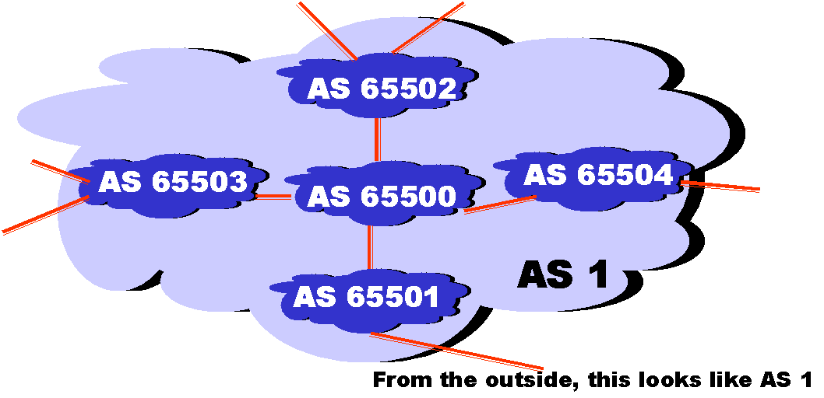
BGP Confederations
Method to subdivide a single AS into multiple, internal sub_ASes, yet still advertise a single AS to external peers
Reduce iBGP mesh
Confederation eBGP (between member ASes) preserves LOCAL_PREF, MED, and BGP NEXTHOP

Slide 87
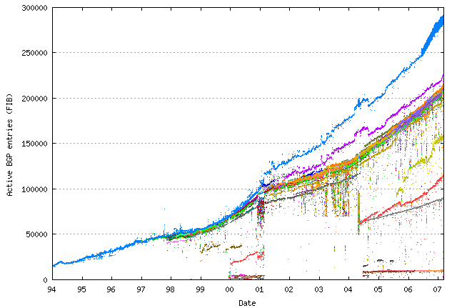
Growth of the BGP Table - 1994 to 2007
Thanks to Geoff Huston. http://www.telstra.net/ops/bgptable.html on Jan, 2007

Slide 88
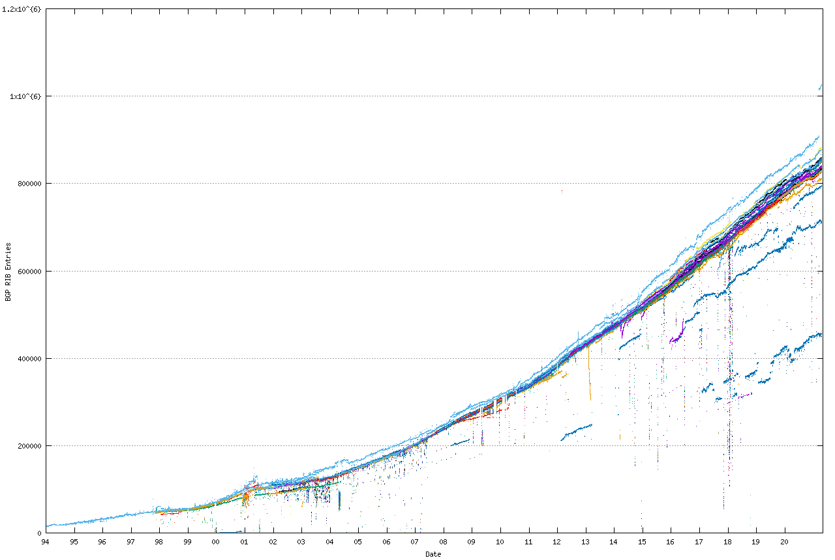
Growth of the BGP Table - 1994 to Present
plus 64-bits?
Thanks to https://bgp.potaroo.net/

Slide 89
Large BGP Tables Considered Harmful
Routing tables must store best routes and alternate routes
Burden can be large for routers with many alternate routes (route reflectors for example)
Increases CPU load, especially during session reset
Moore’s Law may save us in theory. But
in practice it means spending money to upgrade
equipment …

Slide 90
Deaggregation Due to Multihoming May be a Leading Cause
If AS 1 does
not announce the
more specific prefix,
then most traffic
to AS 2 will go
through AS 3
because it is a
longer match
12.2.0.0/16
12.0.0.0/8
12.2.0.0/16
AS 3
AS 1
provider
provider
AS 2
customer
12.2.0.0/16
AS 2 is
“punching a hole” in
The CIDR block of AS 1

Slide 91
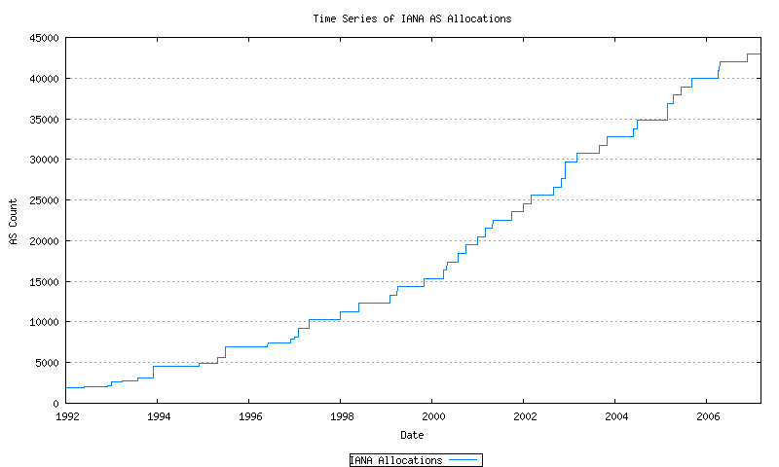
How Many ASNs Are There?
Thanks to Geoff Huston. http://www.telstra.net/ops on Mar., 2007

Slide 92
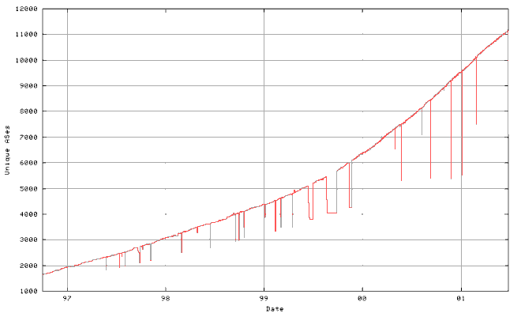
When Will We Run out of ASNs?
64,511
2008?
2010?

Slide 93
怎么办?
扩大ASNs的16 bits表示
  How about 32 bits?
  See Internet Draft: “BGP support for four-octet AS number space” (draft-ietf-idr-as4bytes-03.txt)
  Requires protocol change and wide deployment
改变 ASNs 的使用方式
  Allow multihomed, non-transit networks to use private ASNs
  Uses ASE (AS number Substitution on Egress )
  See Internet Draft: “Autonomous System Number Substitution on Egress” (draft-jhaas-ase-00.txt)
  Works at edge, requires protocol change (for loop prevention)
  Makes some kinds of debugging harder!

Slide 94
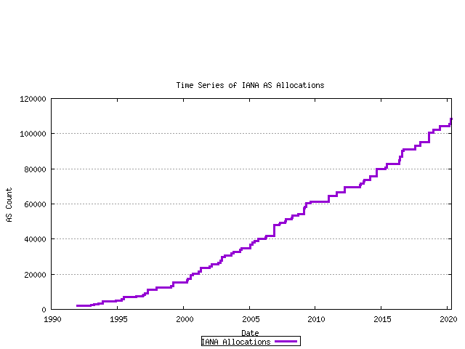
How Many ASNs Are There?
As of 1 December 2006 the AS Number Registry has expanded to a 32 bit number space.
Thanks to https://www.potaroo.net/tools/asn32/

Slide 95
BGP Routing Tables
show ip bgp
BGP table version is 111849680, local router ID is 203.62.248.4
Status codes: s suppressed, d damped, h history, * valid, > best, i - internal
Origin codes: i - IGP, e - EGP, ? - incomplete
Network Next Hop Metric LocPrf Weight Path
. . .
*>i192.35.25.0 134.159.0.1 50 0 16779 1 701 703 i
*>i192.35.29.0 166.49.251.25 50 0 5727 7018 14541 i
*>i192.35.35.0 134.159.0.1 50 0 16779 1 701 1744 i
*>i192.35.37.0 134.159.0.1 50 0 16779 1 3561 i
*>i192.35.39.0 134.159.0.3 50 0 16779 1 701 80 i
*>i192.35.44.0 166.49.251.25 50 0 5727 7018 1785 i
*>i192.35.48.0 203.62.248.34 55 0 16779 209 7843 225 225 225 225 225 i
*>i192.35.49.0 203.62.248.34 55 0 16779 209 7843 225 225 225 225 225 i
*>i192.35.50.0 203.62.248.34 55 0 16779 3549 714 714 714 i
*>i192.35.51.0/25 203.62.248.34 55 0 16779 3549 14744 14744 14744 14744 14744 14744 14744 14744 i
. . .

Slide 96
AS Graphs 不表示真实拓扑!
BGP was designed to
throw away information!
The AS graph
may look like this.
Reality may be closer to this…

Slide 97
BGP Dynamics
全Internet 有多少updates在进行?
多长时间路由会发生改变?
The goals of
(1) fast convergence
(2) minimal updates
(3) path redundancy
are at odds

Slide 98
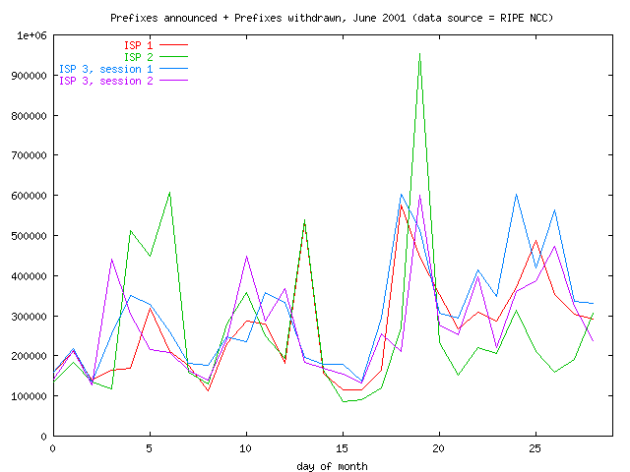
Daily Update Count

Slide 99
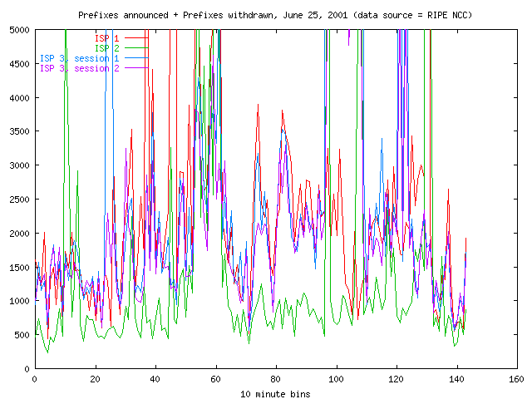
What is the Sound of One Route Flapping?

Slide 100
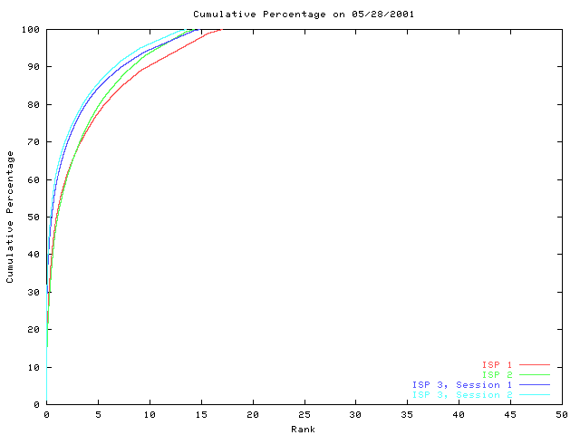
A Few Bad Apples …
Most prefixes are
stable most of the time.
On this day, about 83% of the prefixes were not updated.
Typically, 80% of
the updates are
for less than 5%
Of the prefixes.
Percent of BGP table prefixes
Thanks to Madanlal Musuvathi for this plot.
Data source: RIPE NCC

Slide 101
两个BGP机制来抑制 Updates
限制发送更新的频率Rate limiting
  Send batch of updates every Min Route Advertisement Interval seconds (+/- random fuzz)
  Default value is 30 seconds
  A router can change its mind about best routes many times within this interval without telling neighbors
Route Flap Dampening
  Punish routes for misbehaving
Effective in
dampening
oscillations
inherent in the
vectoring
approach
Must be turned on
with configuration

Slide 102
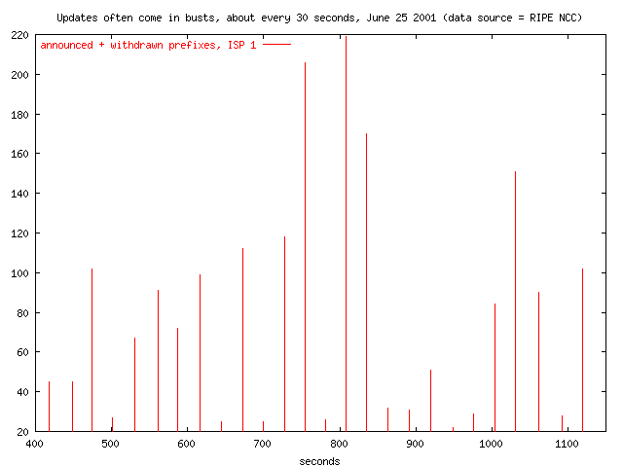
30 Second Bursts

Slide 103
不能尽快会聚的两个主要原因
Rate limiting使所有事情都慢下来了，包括路由会聚
BGP可能探测多个 alternate paths，在决定接受或放弃一条新路由前
  No global knowledge in vectoring protocols

Slide 104
Why is Rate Limiting Needed?
Updates
to convergence
Time
to convergence
0
0
MinRouteAdvertisementInterval
MinRouteAdvertisementInterval
Rate limiting dampens some of the
oscillation inherent in a vectoring protocol.
Current interval (30 seconds) was picked
“out of the blue sky”

Slide 105
Route Flap Dampening (RFC 2439)
Routes are given a penalty for changing.
If penalty exceeds suppress limit, the
route is dampened. When the route is not changing,
its penalty decays exponentially. If the penalty goes
below reuse limit, then it is announced again.
Can dramatically reduce the number of BGP updates
Requires additional router resources
Applied on eBGP inbound only

Slide 106
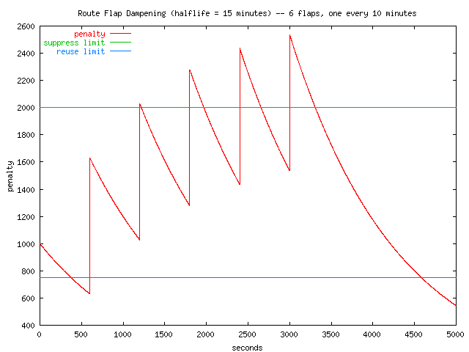
Route Flap Dampening Example
route dampened
for nearly 1 hour
penalty for each flap = 1000

Slide 107
Q: Why All the Updates?
Networks come, networks go
There’s always a router rebooting somewhere
Hardware failure, flaky interface cards, backhoes digging, …
This is “normal” --- exactly what
dynamic routing is designed for…

Slide 108
Q: Why All the Updates?
Misconfiguration
Route flap dampening not widely used
BGP exploring many alternate paths
Software bugs in implementation of routing protocols
BGP session resets due to congestion or lack of interoperability: BGP sessions are brittle. One malformed update is enough to reset session and flap 100K routes. (Consequence of incremental approach)
IGP instability exported by use of MEDs or IGP tie breaker
Sub-optimal vendor implementation choices
Secret source routing algorithms attempting fancy-dancy tricks
Weird policy interactions (MED oscillation, BAD GADGETS??)
Gnomes, sprites, and fairies
…
A: NO ONE REALLY KNOWS …

Slide 109
IGP Tie Breaking Can Export Internal Instability to the Whole Wide World
192.44.78.0/24
AS 1
AS 2
AS 3
10
FLAP
AS 4
15
56
FLAP
192.44.78.0/24
ASPATH = 4 2 1
FLAP FLAP
192.44.78.0/24
ASPATH = 4 3 1

Slide 110
MEDs 会将内部不稳定性扩散出去
2865
Heavy
Content
Web Farm
FLAP
17
FLAP
192.44.78.0/24
MED = 15
192.44.78.0/24
MED = 56 OR 10
10
FLAP
15
56
FLAP
FLAP
FLAP
192.44.78.0/24

Slide 111
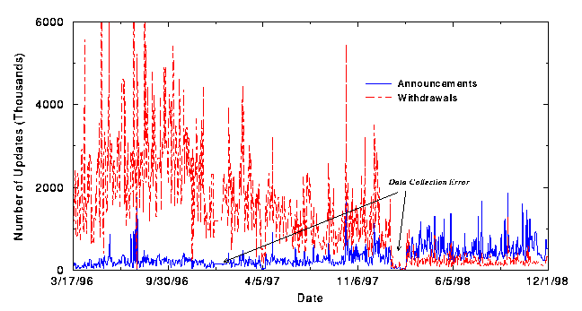
Implementation Does Matter!
stateless withdraws
widely deployed
stateful withdraws
widely deployed
Thanks to Abha Ahuja and Craig Labovitz for this plot.

Slide 112
Summary
BGP 是相当简单的协议 …
… 但难于配置
BGP 运行在超过 100K routers, 使其成为全世界最大和最明显的分布式系统
Global dynamics and scaling principles are still not well understood

Slide 113
Addressing and ASN RFCs
RFC 1380 IESG Deliberations on Routing and Addressing (1992)
RFC 1517Applicability Statement for the Implementation of Classless Inter-Domain Routing (CIDR) (1993)
RFC 1518 An Architecture for IP Address Allocation with CIDR (1993)
RFC 1519 Classless Inter-Domain Routing (CIDR) (1993)
RFC 1467 Status of CIDR Deployment in the Intrenet (1983)
RFC 1520 Exchanging Routing Information Across Provider Boundaries in the CIDR Environment (1993)
RFC 1817 CIDR and Classful routing (1995)
RFC 1918 Address Allocation for Private Internets (1996)
RFC 2008 Implications of Various Address Allocation Policies for Internet Routing (1996)
RFC 2050 Internet Registry IP Allocation Guidelines (1996)
RFC 2260 Scalable Support for Multi-homed Multi-provider Connectivity (1998)
RFC 2519 A Framework for Inter-Domain Route Aggregation (1999)
RFC 1930 Guidelines for creation, selection, and registration of an Autonomous System (AS)
RFC 2270 Using a Dedicated AS for Sites Homed to a Single Provider

Slide 114
Selected BGP RFCs
IDR : http://www.ietf.org/html.charters/idr-charter.html
RFC 1771 A Border Gateway Protocol 4 (BGP-4)
  Latest draft rewrite: draft-ietf-idr-bgp4-12.txt
RFC 1772 Application of the Border Gateway Protocol in the Internet
RFC 1773 Experience with the BGP-4 protocol
RFC 1774 BGP-4 Protocol Analysis
RFC 2796 BGP Route Reflection An alternative to full mesh IBGP
RFC 3065 Autonomous System Confederations for BGP
RFC 1997 BGP Communities Attribute
RFC 1998 An Application of the BGP Community Attribute in Multi-home Routing
RFC 2439 Route Flap Dampening

Slide 115
Titles of Some Recent Internet Drafts
Dynamic Capability for BGP-4
Application of Multiprotocol BGP-4 to IPv4 Multicast Routing
Graceful Restart mechanism for BGP
Cooperative Route Filtering Capability for BGP-4
Address Prefix Based Outbound Route Filter for BGP-4
Aspath Based Outbound Route Filter for BGP-4
Architectural Requirements for Inter-Domain Routing in the Internet
BGP support for four-octet AS number space
Autonomous System Number Substitution on Egress
BGP Extended Communities Attribute
Controlling the redistribution of BGP routes
BGP Persistent Route Oscillation Condition
Benchmarking Methodology for Basic BGP Convergence
Terminology for Benchmarking External Routing Convergence Measurements

Slide 116
Analysis of Inter domain Routing
Cooperative Association for Internet Data Analysis (CAIDA)
  http://www.caida.org/
  Tools and analyses promoting the engineering and maintenance of a robust, scalable global Internet infrastructure
Internet Performance Measurement and Analysis (IPMA)
  http://www.merit.edu/ipma/
  Studies the performance of networks and networking protocols in local and wide-area networks
National Laboratory for Applied Network Research (NLANR)
  http://www.nlanr.net/
  Analysis, tools, visualization.
IRTF Routing Research Group (IRTF-RR)
  http://puck.nether.net/irtf-rr/

Slide 117
阅读论文
An Analysis of BGP Convergence Properties. Timothy G. Griffin, Gordon Wilfong. SIGCOMM 1999
Internet Routing Instability. Craig Labovitz, G. Robert Malan and Farnam Jahanian. SIGCOMM 1997
Understanding BGP misconfiguration. Ratul Mahajan, David Wetherall, and Tom Anderson. SIGCOMM 2002
Jumpstarting BGP Security with Path-End Validation. Avichai Cohen, Yossi Gilad, Amir Herzberg, and Michael Schapira. SIGCOMM 2016

