Slide 1
第三章
路由算法与路由协议(2)
Open Shortest Path First Protocol (OSPF)
Jiang, Yong

Slide 2
Overview
Introduction
Motivation
OSPF Basics
OSPF Operation
Hierarchical Routing in OSPF
Summary

Slide 3
Overview
Introduction
Motivation
OSPF Basics
OSPF Operation
Hierarchical Routing in OSPF
Summary

Slide 4
Introduction
OSPF: Open Shortest First Path protocol
Preferred IGP
Evolved from IS-IS protocol
Link state protocol
Distribution of LSAs using reliable flooding, LSA flooding is bounded by area
Use IP as transport, IP protocol 89
Utilize IP multicast when sending/receiving the updates
  224.0.0.5, All OSPF Routers
  224.0.0.6, All DRs
Support for CIDR, Authentication and Multi-path
Employ Dijkstra’s Shortest Path First (SPF) algorithm to calculate the path tree

Slide 5
OSPF Development History
Development began in 1987
OSPF Working Group (part of IETF)
OSPFv2 first established in 1991
Many new features added since then (RFC 1247, RFC 1583, RFC2178)
Latest OSPFv2 specification is RFC 2328
OSPFv3 specification (for IPv6) in RFC 2740

Slide 6
OSPF Development History (Cont.)
CIDR
1987
1989
1991
1993
1995
1997
1999
OSPF Group formed
OSPFv2 published RFC 1247
Cryptographic authentication
OSPFv3 RFC 2740
Point-to-multipoint interfaces
OSPFv2 update RFC 2328
OSPFv1 published RFC 1131
MOSPF
OSPFv2 update RFC 2178
OSPFv2 update RFC 1583
Becomes recommended
2004年, OSPF RFC 2740被废弃，RFC 2740-->RFC 5340-->由 RFC 8362, RFC 6860, RFC 7503, RFC 6845对RFC 5340做进一步扩展

Slide 7
Overview
Introduction
Motivation
OSPF Basics
OSPF Operation
Hierarchical Routing in OSPF
Summary

Slide 8
Motivation
Original IGP used was RIP
Based on Bellman-Ford Algorithm
  Listen to neighboring routers
  Install routes in table, lowest distance wins
  Advertise all routes in table
  Very simple
  Very stupid
Worked well in small systems
  Hop count limit of 15

Slide 9
Motivation (Cont.)
Suffered from problems of Distance Vector Protocol
  Count to Infinity Problem
  Slow Convergence
  Large update packets
  Slow response to topological changes
Need for a Link State Protocol
A long list of functional requirements follows

Slide 10
Functional Requirements of OSPF
Faster Convergence and less consumption of network resources
A more descriptive routing metric
  Configurable
  Value ranges between 1 and 65,535
  No restriction on network diameters
Equal-cost multipath
  A way to do load balancing

Slide 11
Functional Requirements of OSPF (Cont.)
Routing Hierarchy
  Support large routing domains
Separate internal and external routes
Support of flexible subnetting schemes
Security
Type of Service Routing

Slide 12
Overview
Introduction
Motivation
OSPF Basics
OSPF Operation
Hierarchical Routing in OSPF
Summary

Slide 13
OSPF Basics
Distributed, replicated database model
  Each router builds a topology database
  Describes complete routing topology
Link state advertisements
  Carry local piece of routing topology
  Information about adjacencies sent to all routers
For most packets TTL = 1, except for hierarchical routing
Link state database
  Identical for all the routers
Destination IP address = Neighbors IP address or AllOSPFRouters (224.0.0.5) or AllDRouters (224.0.0.6)

Slide 14
OSPF Basics (Cont.)
A "shortest path" algorithm is used to find best route
  converge as quickly as databases can be updated
The protocol remains relatively quiet during steady-state conditions.
  Periodic refresh is 30 minutes
  MaxAge is 60 minutes
OSPF has 3 sub-protocols:
  Hello protocol
  Exchange protocol
  Flooding protocol

Slide 15
OSPF Metric
Cost applied on all router link paths
16-bit positive number 1–65,535, the lower the more desirable
Route decisions made on total cost of path
Derived from bandwidth (10⁸ ÷ bandwidth)
  56-kbps serial link = 1785
  Ethernet = 10
  64-kbps serial link = 1562
  T1 (1.544-Mbps serial link) = 64
  Fast Ethernet/FDDI = 1

Slide 16
OSPF Metric (Cont.)
Bandwidth dividend is user configurable:
Configured via:
  Interface subcommand: bandwidth
  Interface subcommand: ip ospf cost
  Router subcommand: ospf auto-cost reference bandwidth

Slide 17
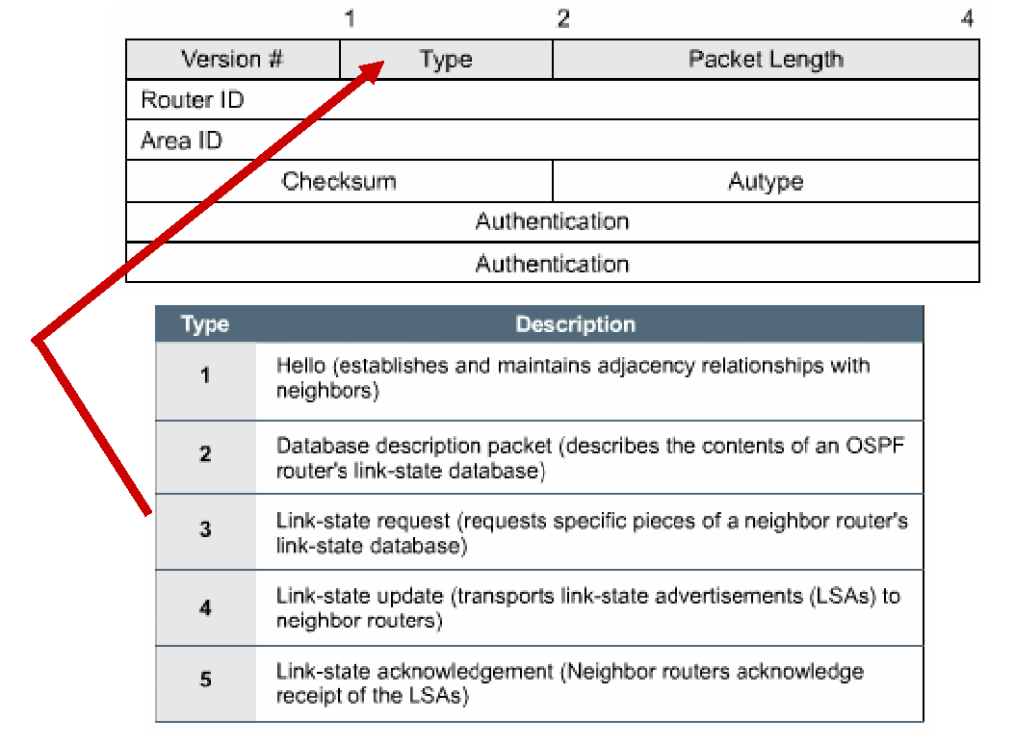
OSPF Packet Header
Every OSPF packet starts with a standard 24 bytes header

Slide 18
Router ID
Routers are identified by a unique 32-bit ID
RID: highest IP address of any active loopback interface
RID: if no loopback exists, highest IP address configured on any active physical interface
RID can be configured with
  router-id <ip address>

Slide 19
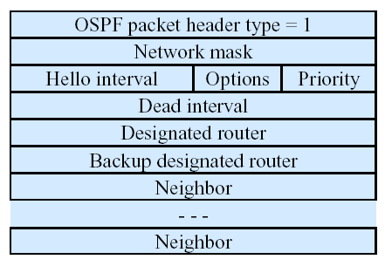
Hello Packet
Hello interval tells in seconds how often hello packets are sent
Priority tells about eligibility for the role of Designated Router
A hello packet must be sent and received before a link becomes operational
DR and Backup DR = 0 if not known
Neighbor – list of neighbors that have sent a hello packet during last dead interval seconds

Slide 20
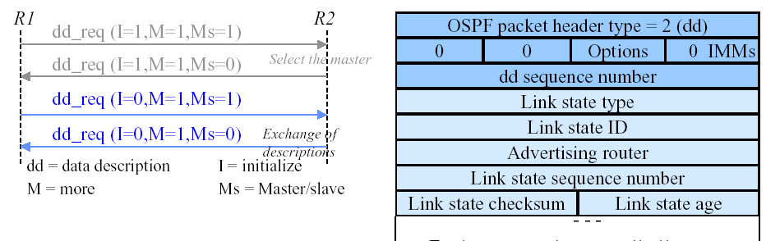
Database Description Packet
Master sends its Link DB description in sequence numbered packets
Slave acks by sending its corresponding description packets.
Exchange continues until all descriptions are sent and acknowledged. (M=0)
Differences are recorded on the list of “records-to-request”.

Slide 21
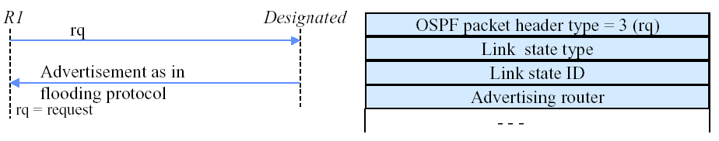
Link State Request Packet
After exchanging DD-packets with a neighboring router, a router may find that parts of its link-state database are out-of-date. The LSR packet is used to request the pieces of the neighbor's database that are more up-to-date.
“Records-to-request” may be split into many Requests
If something goes wrong, backup to role negotiation is the typical remedy.

Slide 22
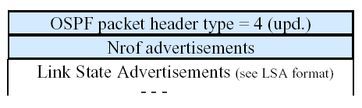
Link State Update Packet
Link State Update packets implement the flooding of LSAs.
Each Link State Update packet carries a collection of LSAs one hop further from their origin.
Several LSAs may be included in a single packet.

Slide 23
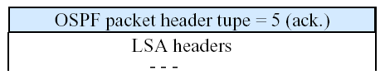
Link State Acknowledgment Packet
To make the flooding of LSAs reliable, flooded LSAs are explicitly acknowledged through sending and receiving of Link State Acknowledgment packets.
Multiple LSAs can be acknowledged in a single Link State Acknowledgment packet.

Slide 24
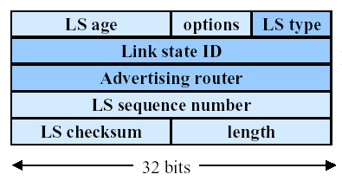
LSA Header

Slide 25
LSA Header (Cont.)
Identifying LSAs
  LS type field
    1. router LSA, 2. network LSA, 3. Summary link (IP network)
    4. Summary link (to a border router), 5. External link
    6. Multicast LSA, 7. NSSA record
    etc ...
  Link State ID field
    Mostly carries addressing information
    e.g. IP address of externally reachable network
  Advertising Router field
    Originating router’s OSPF router ID

Slide 26
LSA Header (Cont.)
Identifying LSA instances
  Needed to update self-originated LSAs
  LS Sequence Number field
    32 bit values
    Monotonically increasing until some max value
    600 years to roll over!
    LSA checksum and LS Age guard against potential problems

Slide 27
LSA Header (Cont.)
Verifying LSA contents
  LS Checksum field
    Computed by the originating router and left unchanged thereafter
    LS age field not included in checksum
Removing LSAs from databases
  LS Age field
    Ranges from 0 to 30 min.
    Max Age LSAs used to delete outdated LSAs

Slide 28
LSA Header (Cont.)
Other LSA Header fields
  Options field
    Sometimes used to give special treatment during flooding or routing calculations
  Length field
    Includes LSA header and contents
    Ranges from 20-65535 bytes

Slide 29
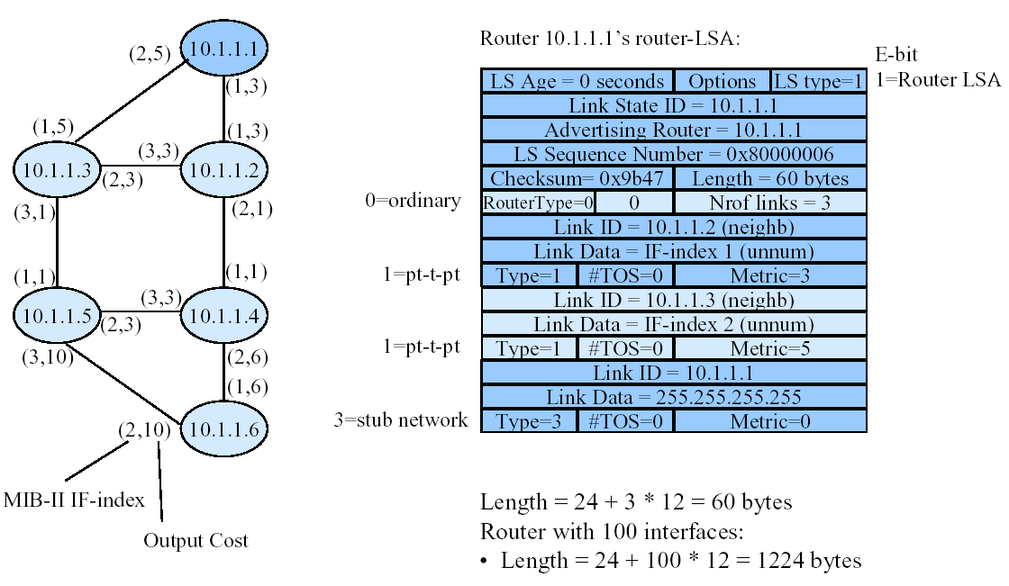
Sample Router LSA

Slide 30
Link State Database
Collection of all OSPF LSAs
Databases exchanged between neighbors
Synchronization thru reliable flooding
Gives the complete routing topology
Each OSPF router has identical link-state database
LS Type
Link State ID
Adv Router
LS Checksum
LS Seq No
LS Age
Router LSA
10.1.1.1
10.1.1.1
0x9b47
0x80000006
0
…..
…...
…..
…..
….
…...

Slide 31
Link State Advertisements (LSAs)
Once an adjacency is established, trade information with your neighbor
Topology information is packaged in a "link state announcement“
Announcements are sent ONCE, and only updated if there's a change (or every 30 mins...)

Slide 32
Overview
Introduction
Motivation
OSPF Basics
OSPF Operation
Hierarchical Routing in OSPF
Summary

Slide 33
OSPF Operation
Establishing router adjacencies
Electing DR and BDR
Discovering Routes
Choosing Routes
Maintaining Routing Information

Slide 34
OSPF Neighbor States
OSPF router interfaces can be in one of seven states:
  Down State
  Init State
  Two-way State
  ExStart State
  Exchange State
  Loading State
  Full Adjacency State

Slide 35
Steps to OSPF Operation with OSPF States
Establishing router adjacencies
  Down State
  Init State
  Two-way State
  (ExStart State unless DR/BDR election needed)
Electing DR and BDR
  ExStart State with DR and BDR
  Two-way State with all other routers

Slide 36
Steps to OSPF Operation with OSPF States (Cont.)
Discovering Routes
  ExStartState
  Exchange State
  Loading State
  Full State
Choosing Routes
Maintaining Routing Information

Slide 37
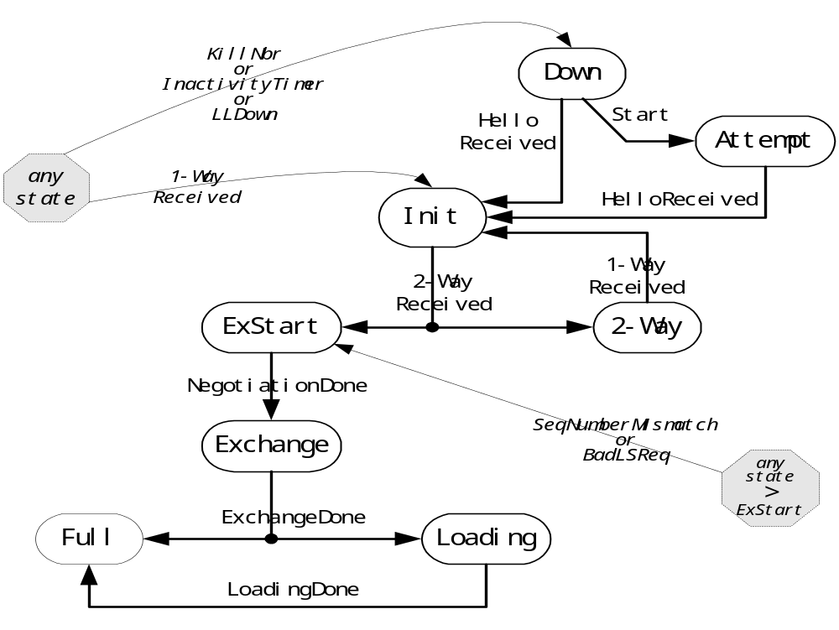
Neighbor State Machine
only valid for neighbors attached to NBMA networks

Slide 38
Neighbor Discovery and Maintenance
OSPF Hello Protocol
Multicast 224.0.0.5 on all router interfaces
Hello packets sent out periodically (10 sec. LAN, 30 sec. NBMA (non-broadcast multi-access))
Help to detect if neighbors are up or down
RouterDeadInterval (default 40 seconds)
Ensure that link is bidirectional
Neighboring routers agree on intervals
  Hello interval set so that a link is not accidentally brought down

Slide 39
Neighbor
Bi-directional OSPF communication
Result of OSPF hello packets
Need not exchange routing information

Slide 40
Adjacency
Between OSPF neighbors
Exchange routing information
Point-to-point or Broadcast media
  Point-to-point - neighbors are adjacent
  Broadcast media - not all neighbors are adjacent

Slide 41
Broadcast Media - problems
N neighbors - order of N square adjacency
Not optimal
Wasted bandwidth
Does not scale

Slide 42
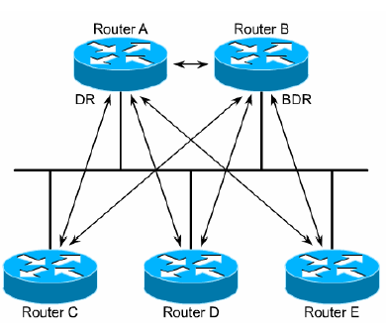
Broadcast Media - solution
Select a neighbor - Designated Router(DR)
All routers become adjacent to DR
Exchange routing information with the DR
DR updates all the neighbors
Scales
Backup Designated Router (BDR)

Slide 43
Electing a DR and BDR
Router with the highest interface priority
  Range 1–255, default 1
  0 for non-candidate
  Priority carried in Hello packet
  ip ospf priority <value>
Router with the highest router ID.
  Loopback address used first
  IP Address on active interface used second
BDR is the second highest

Slide 44
DR and BDR
All other routers, “DRother”, establish adjacencies with only the DR and BDR.
All routers continue to multicast Hello packets to 224.0.0.5 so they can track neighbors.
DRother routers multicast LSAs to only the DR and BDR
  224.0.0.6 - all DR routers
DR sends LSA to all adjacent neighbors
  224.0.0.5 - all OSPF routers

Slide 45
DR and BDR (Cont.)
Once a DR is established, a new router that enters the network with a higher priority or router id will NOT become the DR or BDR.
BDR
  Listens, but doesn’t act
  If LSA is sent, BDR sets a timer
  If timer expires before it sees the reply from the DR, it becomes the DR and takes over the update process
  The process for a new BDR begins

Slide 46
Establishing Adjacencies
Initially, an OSPF router interface is in the down state.
  In the down state, the OSPF process has not exchanged information with any neighbor.
  OSPF is waiting to enter the init state.
  An OSPF router tries to form an adjacency with at least one neighbor for each IP network it’s connected to.
  OSPF routers send Type 1 Hello packets at regular intervals to establish neighbors.
Init State
  When a router receives its first Hello packet, it enters the init state, meaning the router is ready to take the relationship to the next level.

Slide 47
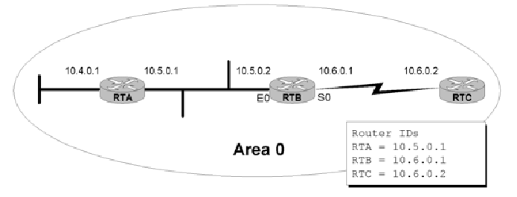
Establishing Adjacencies (Cont.)
From init state to the two-way state
  RTB receives Hello packets from RTA and RTC (its neighbors), and sees its own Router ID (10.6.0.1) in the Neighbor ID field.
  RTB declares takes the relationship to a new level, and declares a two-way state between itself and RTA, and itself and RTC.

Slide 48
Establishing Adjacencies (Cont.)
Two-way state to ExStart state
  RTB now decides who to establish a full adjacency with depending upon the type of network that the particular interfaces resides on.
  If the interface is on a point-to-point link, the routers becomes adjacent with its sole link partner, and take the relationship to the next level by entering the ExStart state.
  If the interface is on a multi-access link (Ethernet, Frame Relay, …) RTB must enter an election process to see who it will establish a full adjacency with, and remains in the two-way state. (Next!)

Slide 49
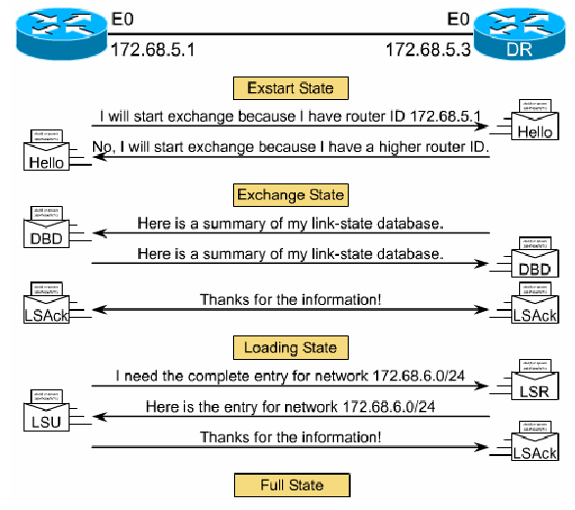
Discovering Routes and Reaching Full State
“adjacent”
OSPF Type-2 (DBD)
OSPF Type-2 (DBD)
OSPF Type-2 (DBD)
OSPF Type-2 (DBD)
OSPF Type-5 (LSAck)
OSPF Type-3 (LSR)
OSPF Type-4 (LSU)
OSPF Type-5 (LSAck)

Slide 50
Choosing Routes
Dijkstra - Shortest Path First (SPF) Algorithm
Link state database
  Created with Link State Packets (LSPs) from each router
TENT database
  Tentative triples (ID, path cost, direction)
PATH database
  Best path triples (ID, path cost, direction)
Forwarding database
  The Routing Table

Slide 51
SPF Holdtime
SPF algorithm is CPU intensive and takes some time depending upon the size of the area, the number of routers, the size of the link state database.
A flapping link can cause an OSPF router to keep on re-computing a new routing table, and never converge.
To minimize this problem:
  SPF calculations are delayed by 5 seconds after receiving an LSU (Link State Update)
  Delay between consecutive SPF calculations is 10 seconds
You can configure the delay time
  Router(config-router)#timers spf spf-delay spf-holdtime
  spf-delay: delay between topology change and start of shortest path first (SPF) calculation
  spf-holdtime: time between two consecutive SPF calculations

Slide 52
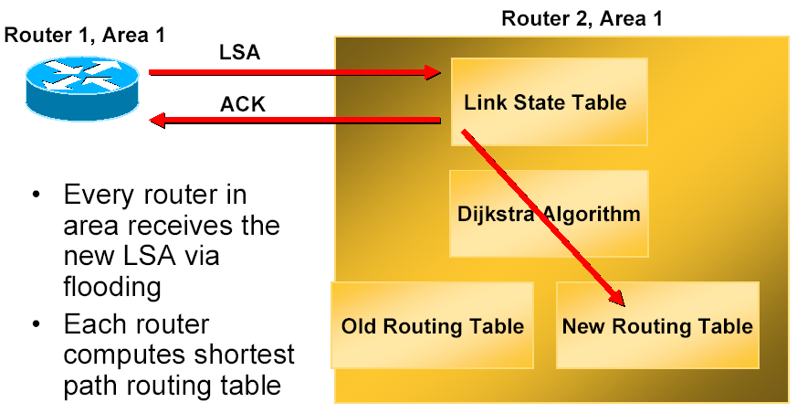
Maintaining routes
When a Link Changes State

Slide 53
Overview
Introduction
Motivation
OSPF Basics
OSPF Operation
Hierarchical Routing in OSPF
Summary

Slide 54
Hierarchical Routing
Technique used to build large networks
  Rule of thumb: no more than 150 routers/area
  Reality: no more than 500 routers/area
  Backbone "area" is an area, always ‘area 0’
Minimizes consumption of network resources such as
  Router memory
  Router computing resources
  Link bandwidth
With flat routing, linear increase in routing table size
With hierarchical routing, size increases logarithmically

Slide 55
An Example
10.3.3
10.3
10.0.0.0/8
10.3.1
10.3.2
10.1.3
10.1
10.2.3
10.2
10.1.1
10.1.2
10.2.1
10.2.2

Slide 56
An Example (Cont.)
Consider a router in 10.1.1
Assume 16 entries in each of the first level partitions
With flat routing, 9*16 = 144 entries/router
With 3 level hierarchy, the router has 16 entries within 10.1.1.0/24 + entries for 10.1.2.0/24, 10.1.3.0/24, 10.2/16, 10.3/16 for a total of 20 entries.
Marked reduction in routing table size
But might lead to suboptimal routing

Slide 57
OSPF Areas
Two-level hierarchical routing scheme through the use of areas
Areas identified by 32-bit id
  Can be defined using single decimal or IP address format value
  i.e. Area 0.0.0.0 or Area 0
Each area has its own link state database which is a collection of network-LSAs and router-LSAs

Slide 58
OSPF Areas (Cont.)
Interconnection of areas through area border routers (ABRs)
ABR leaks IP addressing information to other areas through summary LSAs
Area’s topology hidden from all other areas
All routers belonging to the same area should have identical databases
SPF calculation is performed independently for each area
LSA flooding is bounded by area

Slide 59
OSPF Areas (Cont.)
Reduction in link state databases of an area
Reduction in amount of flooding traffic needed for synchronization
Reduction in the cost of the shortest path calculations
Increased robustness
Routing protection
Hidden prefixes

Slide 60
Area Organization
All the areas are connected to area 0 also called the backbone area
Need not have a direct physical connection though
  Virtual links provide logical link to backbone
  Summary LSAs tunneled across non backbone areas
Exchange of routing information between areas using Distance Vector Protocol
  Absence of redundant paths between areas
  Not subject to convergence problems

Slide 61
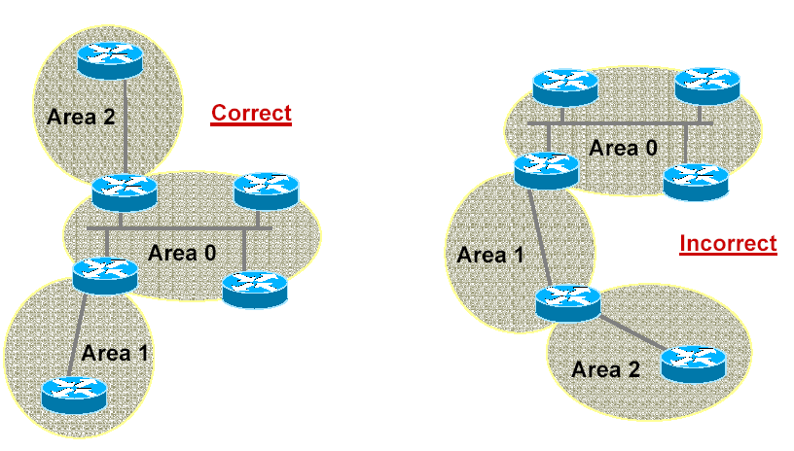
OSPF Areas - Example

Slide 62
Incorporating External Routing Information
Special routers called AS boundary routers at the edge of OSPF domain
ASBRs originate AS-External LSAs
Only routes for which the choice of an ASBR makes sense are imported
Otherwise default routes are used
AS external LSAs similar to Summary LSAs with 2 additional fields
  Forwarding address
  external route tag

Slide 63
OSPF Area Types
Restrict the amount of external routing information within an area
Used when resources especially router memory is very limited
Two types of restricted areas
  Stub Areas
  NSSAs or Not-So-Stubby-Areas

Slide 64
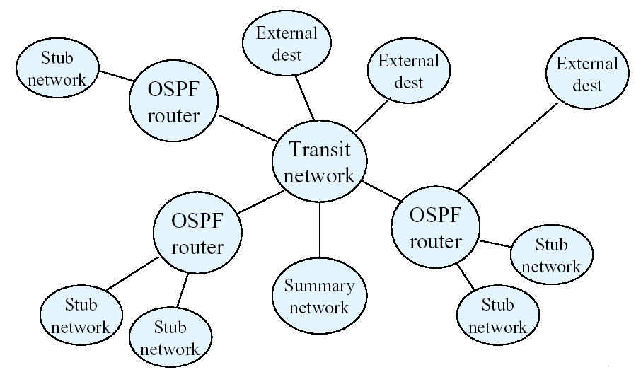
OSPF Area Types (Cont.)

Slide 65
OSPF Area Types (Cont.)
Stub Areas
  Don’t support ASBRs and hence no AS-External-LSAs
  Routing to external destinations based on default routes originated by the area’s border routers
  Summary LSAs also made optional
  Must lie on the edge of OSPF routing domain
  Inter-area routing may also be based on default routes
  Improved scaling
  But not preferred due to the possibility of suboptimal routes

Slide 66
OSPF Area Types (Cont.)
NSSAs
  Import small amount of routing information
  This information flooded to other areas by the NSSA Border router
  Use Type-7 LSAs to import external routing information
  Translated into AS-External-LSA at the NSSA Border
  One-way filter

Slide 67
Summary
Why OSPF is needed in the Internet?
The basics of the protocol
  OSPF packet format
The operation of the protocol
  Neighbor Discovery (Hello Protocol)
  The Link state Advertisements
  Database Synchronization and reliable flooding
Hierarchical Routing in OSPF
  OSPF Areas and Area Organization
  Interaction with External Routing Information
  OSPF Area Types viz. Stub Areas and NSSAs

Slide 68
Further Reading
John T. Moy, OSPF - An Anatomy of an Internet Routing Protocol
RFC 2328
Improving Convergence Speed and Scalability in OSPF: A Survey. M. Goyal et al. IEEE Communications Surveys & Tutorials 2012

