Slide 1
第二章
TCP拥塞控制
江 勇
jiangy@sz.tsinghua.edu.cn

Slide 2
Outline
Window Flow Control
Analysis of TCP Congestion Control
Tahoe, Reno, NewReno,Sack, Vegas
Beyond TCP Congestion Control

Slide 3
Outline
Window Flow Control
Analysis of TCP Congestion Control
Tahoe, Reno, NewReno, Sack, Vegas
Beyond TCP Congestion Control

Slide 4
Problem
Flow control
  make sure that the receiver can receive as fast as you send
Congestion control
  make sure that the network delivers the packets to the receiver

Slide 5
Window flow control
Lost packet detected by ACK
Approximately W packets transmitted per RTT
Higher window → higher throughput
Self-clocking
RTT
Source
1
2
W
1
2
W
time
Destination
1
2
W
time

Slide 6
Early TCP
Pre-1988
Go-back-N ARQ
  Detects loss from timeout
  Retransmits from lost packet onward
Flow control: self-clocking

Slide 7
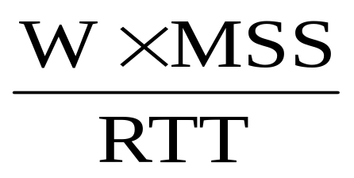
Source rate
Limit the number of packets in the network to window W
Source rate = bps
If W too small then rate « capacity
If W too big then rate > capacity
=> congestion

Slide 8
Why do You Care About Congestion Control?
Otherwise you get to congestion collapse
How might this happen?
  Assume network is congested (a router drops packets)
  You learn the receiver didn’t get the packet
    either by ACK, NACK, or Timeout
  What do you do? retransmit packet
  Still receiver didn’t get the packet
  Retransmit again
  …. and so on …
  And now assume that everyone is doing the same!

Slide 9
Why do You Care About Congestion Control?
Network will become more and more congested
  And this with duplicate packets rather than new packets!
October 1986, Internet had its first congestion collapse
  Link LBL to UC Berkeley
    400 yards, 3 hops, 32 Kbps
    throughput dropped to 40 bps
    factor of ~1000 drop!
1988, Van Jacobson proposed TCP flow control

Slide 10
Solutions?
Increase buffer size. Why not?
Slow down
  If you know that your packets are not delivered because network congestion, slow down
Questions:
  How do you detect network congestion?
  By how much do you slow down?

Slide 11
Outline
Window Flow Control
Analysis of TCP Congestion Control
Tahoe, Reno, NewReno, Sack, Vegas
Beyond TCP Congestion Control

Slide 12
What’s Really Happening?
packet
loss
knee
cliff
Knee – point after which
  Throughput increases very slow
  Delay increases fast
Cliff – point after which
  Throughput starts to decrease very fast to zero (congestion collapse)
  Delay approaches infinity
Note (in an M/M/1 queue)
  Delay = 1/(1 – utilization)
Throughput
congestion
collapse
Load
Delay
Load

Slide 13
Congestion Control vs. Congestion Avoidance
Congestion control goal
  Stay left of cliff
Congestion avoidance goal
  Stay left of knee
knee
cliff
Throughput
congestion
collapse
Load

Slide 14
Goals
Operate near the knee point
Remain in equilibrium
How to maintain equilibrium?
  Don’t put a packet into network until another packet leaves. How do you do it?
  Use ACK: send a new packet only after you receive an ACK. Why?
  Maintain number of packets in network “constant”

Slide 15
How Do You Do It?
Detect when network approaches/reaches knee point
Stay there
Questions
  How do you get there?
  What if you overshoot (i.e., go over knee point) ?
Possible solution:
  Increase window size until you notice congestion
  Decrease window size if network congested

Slide 16
Detecting Congestion
Explicit network signal
  Send packet back to source (e.g. ICMP Source Quench)
    Control traffic congestion collapse
  Set bit in header (e.g. DEC DNA/OSI Layer 4[CJ89], ECN)
    Can be subverted by selfish receiver [SEW01]
  Unless on every router, still need end-to-end signal
  Could be robust, if deployed

Slide 17
Detecting Congestion
Implicit network signal
  Loss (e.g. TCP Tahoe, Reno, New Reno, SACK)
    +relatively robust, -no avoidance
  Delay (e.g. TCP Vegas)
    +avoidance, -difficult to make robust
  Easily deployable
  Robust enough? Wireless?

Slide 18
Efficient Allocation
Too slow
  Fail to take advantage of available bandwidth → underload
Too fast
  Overshoot knee → overload, high delay, loss
Everyone’s doing it
  May all under/over shoot → large oscillations
Optimal:
  Σx_{i}=X_{goal}
Efficiency = 1 - distance from efficiency line
2 user example
overload
User 2: x₂
underload
Efficiency
line
User 1: x₁

Slide 19
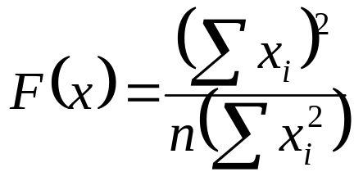
Fair Allocation
Maxmin fairness
  Flows which share the same bottleneck get the same amount of bandwidth
Assumes no knowledge of priorities
Fairness = 1 - distance from fairness line
2 user example
2 getting
too much
fairness
line
User 2: x₂
1 getting
too much
User 1: x₁

Slide 20
Control System Model [CJ89]
User 1
x₁
x₂
User 2

x_{i}>X_{goal}
x_{n}
User n
y
Simple, yet powerful model

Slide 21
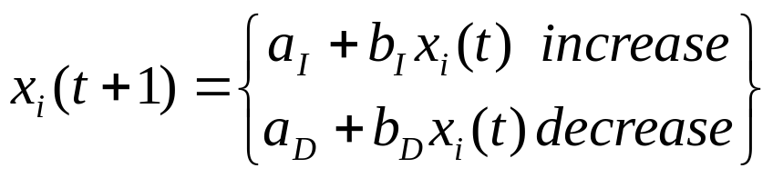
Possible Choices
Multiplicative increase, additive decrease
  a_{I}=0, b_{I}>1, a_{D}<0, b_{D}=1
Additive increase, additive decrease
  a_{I}>0, b_{I}=1, a_{D}<0, b_{D}=1
Multiplicative increase, multiplicative decrease
  a_{I}=0, b_{I}>1, a_{D}=0, 0<b_{D}<1
Additive increase, multiplicative decrease
  a_{I}>0, b_{I}=1, a_{D}=0, 0<b_{D}<1
Which one?

Slide 22
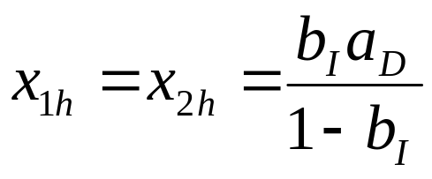
Multiplicative Increase, Additive Decrease
fairness
line
Does not converge to fairness
  Not stable at all
Does not converges to efficiency
  Stable iff
(b_{I}(x_{1h}+a_{D}), b_{I}(x_{2h}+a_{D}))
(x_{1h},x_{2h})
User 2: x₂
(x_{1h}+a_{D},x_{2h}+a_{D})
efficiency
line
User 1: x₁

Slide 23
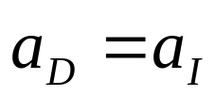
Additive Increase, Additive Decrease
(x_{1h}+a_{D}+a_{I}),
x_{2h}+a_{D}+a_{I}))
fairness
line
Does not converge to fairness
  Stable
Does not converge to efficiency
  Stable iff
(x_{1h},x_{2h})
User 2: x₂
(x_{1h}+a_{D},x_{2h}+a_{D})
efficiency
line
User 1: x₁

Slide 24
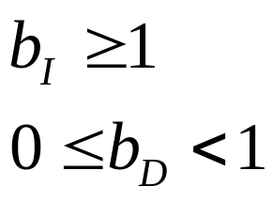
Multiplicative Increase,
Multiplicative Decrease
fairness
line
Does not converge to fairness
  Stable
Converges to efficiency iff
(x_{1h},x_{2h})
(b_{I}b_{D}x_{1h},
b_{I}b_{D}x_{2h})
User 2: x₂
(b_{d}x_{1h},b_{d}x_{2h})
efficiency
line
User 1: x₁

Slide 25
Additive Increase,
Multiplicative Decrease
fairness
line
Converges to fairness
Converges to efficiency
Increments smaller as fairness increases
(x_{1h},x_{2h})
(b_{D}x_{1h}+a_{I},
b_{D}x_{2h}+a_{I})
User 2: x₂
(b_{D}x_{1h},b_{D}x_{2h})
efficiency
line
User 1: x₁

Slide 26
Significance
Characteristics
  Converges to efficiency, fairness
  Easily deployable
  Fully distributed
  No need to know full state of system (e.g. number of users, bandwidth of links) (why good?)
Theory that enabled the Internet to grow beyond 1989
  Key milestone in Internet development
  Fully distributed network architecture requires fully distributed congestion control
  Basis for TCP

Slide 27
TCP Congestion Control
[CJ89] provides theoretical basis
  Still many issues to be resolved
How to start?
Implicit congestion signal
  Loss
  Need to send packets to detect congestion
  Must reconcile with AIMD
How to maintain equilibrium?
  Use ACK: send a new packet only after you receive an ACK. Why?
  Maintain number of packets in network “constant”

Slide 28
TCP Congestion Control
Maintains three variables:
  cwnd – congestion window
  flow_win – flow window; receiver advertised window
  ssthresh – threshold size (used to update cwnd)
For sending use: win = min(flow_win, cwnd)
Algorithms to calculate cwnd
  Tahoe, Reno, Vegas, RED, REM …

Slide 29
Outline
Window Flow Control
Analysis of TCP Congestion Control
Tahoe, Reno, NewReno, Sack, Vegas
Beyond TCP Congestion Control

Slide 30
TCP Congestion Controls
Tahoe (Jacobson 1988)
  Slow Start
  Congestion Avoidance
  Fast Retransmit
Reno (Jacobson 1990)
  Fast Recovery
Vegas (Brakmo & Peterson 1994)
  New Congestion Avoidance
RED (Floyd & Jacobson 1993)
  Probabilistic marking
REM (Athuraliya & Low 2000)
  Clear buffer, match rate

Slide 31
TCP Congestion Controls
DCTCP(2003)
  window-based
Cubic(2008)
  二分法找最佳拥塞窗口
QCN(2008)
  通过主动反向通知，降低网络中的丢包率和延时
BBR(2017)
  BBR: congestion-based congestion control
Remy(2013)\PCC(2015)\PCCV(2018)\Copa(2018)
  learning-based

Slide 32
TCP Tahoe (Jacobson 1988)
window
ss: slow start
ca: congestion avoidance
time
ss
ca
How to adjust window in each phase?
When to switch phase?

Slide 33
Slow Start
Goal: discover congestion quickly
How?
  Quickly increase cwnd until network congested → get a rough estimate of the optimal of cwnd
  Whenever starting traffic on a new connection, or whenever increasing traffic after congestion was experienced:
    Set cwnd =1
    Each time a segment is acknowledged increment cwnd by one (cwnd++).
Slow Start is not actually slow
  cwnd increases exponentially

Slide 34
Slow Start Example
The congestion window size grows very rapidly
TCP slows down the increase of cwnd when
cwnd >= ssthresh
cwnd = 1
segment 1
ACK 1
cwnd = 2
segment 2
segment 3
ACK 2
cwnd = 4
segment 4
segment 5
segment 6
segment 7
ACK3-4
cwnd = 8

Slide 35
Congestion Avoidance
Slow down “Slow Start”
If cwnd > ssthresh then
each time a segment is acknowledged
increment cwnd by 1/cwnd (cwnd += 1/cwnd).
So cwnd is increased by one only if all segments have been acknowlegded.
Congestion avoidance and slow start are independent algorithms with different objectives. In practice they are implemented together.

Slide 36
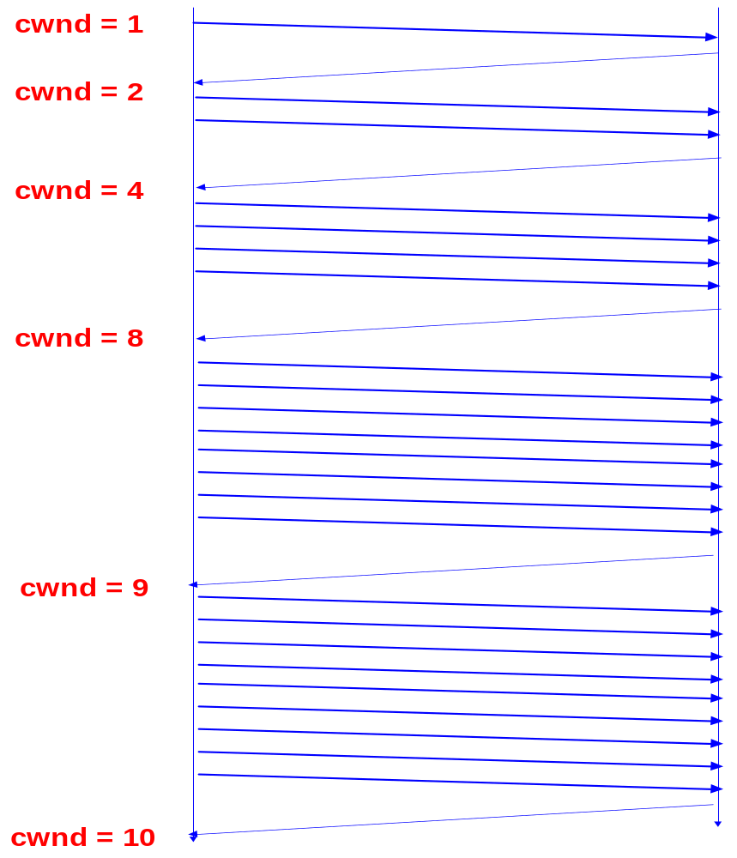
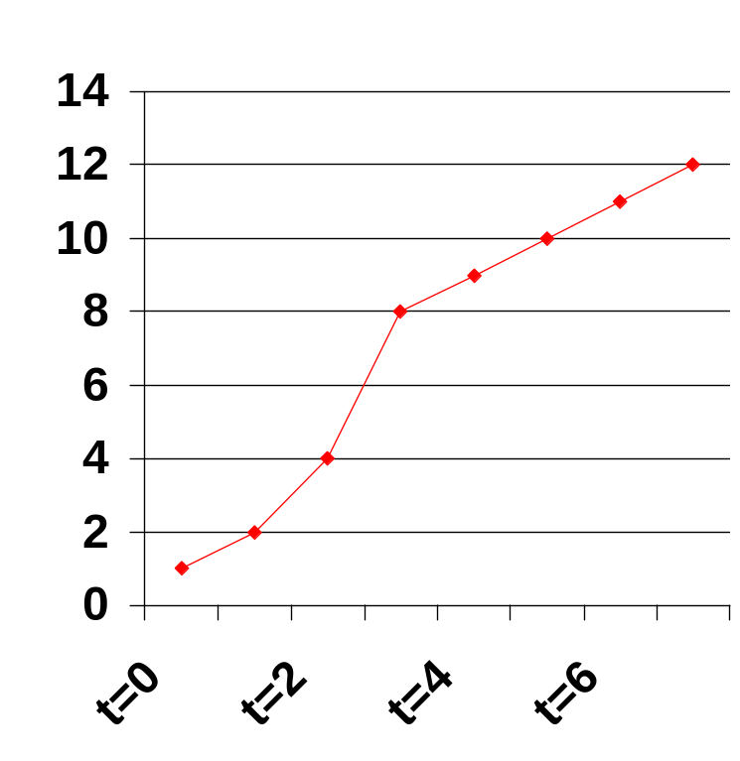
Slow Start/Congestion Avoidance Example
Assume that ssthresh = 8
ssthresh
Cwnd (in segments)
Roundtrip times

Slide 37
Putting Everything Together:
TCP Pseudocode
Initially:
cwnd = 1;
ssthresh = infinite;
New ack received:
if (cwnd < ssthresh)
/* Slow Start*/
cwnd = cwnd + 1;
else
/* Congestion Avoidance */
cwnd = cwnd + 1/cwnd;
Timeout:
/* Multiplicative decrease */
ssthresh = cwnd/2;
cwnd = 1;
while (next < unack + win)
transmit next packet;
where win = min(cwnd, flow_win);
seq #
unack
next
win

Slide 38
Packet Loss
Packet loss detected by
  Retransmission timeouts (RTO timer)
  Duplicate ACKs (at least 3)
Packets
1
2
3
4
5
6
7
Acknowledgements
1
2
3
3
3
3

Slide 39
Fast Retransmit
Immediately retransmits after 3 dupACKs without waiting for timeout (fast retransmit)
Adjusts ssthresh
  ssthresh ← max(flightsize/2, 2)
  flightsize: The amount of data that has been sent but not yet acknowledged.
Enter Slow Start (cwnd = 1)
Assumption: loss indicates congestion (buffer overflow)
The fast retransmit algorithm first appeared in the 4.3BSD Tahoe release, and it was followed by slow start.

Slide 40
Summary: Tahoe
Basic ideas
  Gently probe network for spare capacity
  Drastically reduce rate on congestion
  Windowing: self-clocking
  Other functions: round trip time estimation, error recovery
for every ack
{ if W < ssthresh then W ++ (ss)
else W += 1/W (ca) }
for every loss
{ ssthresh := W/2
W := 1 }

Slide 41
TCP Reno (Jacobson 1990)
window
ss: slow start
ca: congestion avoidance
time
ss
ca
Slow start, congestion avoidance, fast retransmit
Addition: fast recovery
Most widely used version of TCP today

Slide 42
Fast recovery
Motivation: prevent `pipe’ from emptying after fast retransmit
Idea: each dupACK represents a packet having left the pipe, that is, there is still data flowing between the two ends.
Enter FR/FR after 3 dupACKs
  Set ssthresh ← max(flightsize/2, 2)
  Retransmit lost packet
  Set cwnd ← ssthresh + 3*MSS (window inflation)
  Each time another duplicate ACK arrives, cwnd += MSS. Transmit a packet, if allowed by the new value of cwnd.
  On non-dup ACK (1 RTT later), set cwnd ← ssthresh (window deflation)
Enter CA

Slide 43
Example: FR/FR
RTT
S
1
2
3
4
5
6
7
8
1
9
0
1
time
Exit FR/FR
D
0
0
0
0
0
0
0
8
time
7
9
11
Fast retransmit
  Retransmit on 3 dupACKs
Fast recovery
  Inflate window while repairing loss to fill pipe
The fast recovery algorithm appeared in the 4.3BSD Reno release.

Slide 44
Summary: Reno
Basic ideas
  Fast recovery avoids slow start
  dupACKs: fast retransmit + fast recovery
  Timeout: fast retransmit + slow start
At steady state, cwnd oscillates around the optimal window size.
dupACKs
congestion avoidance
FR/FR
timeout
slow start
retransmit

Slide 45
Variant : NewReno (Fall & Floyd1996)
Motivation: multiple losses within a window
  Partial ACK acknowledges some but not all packets outstanding at start of FR
  Partial ACK takes Reno out of FR, deflates window
  Sender may have to wait for timeout before proceeding
Idea: partial ACK indicates lost packets
  Stays in FR/FR and retransmits immediately
  Retransmits 1 lost packet per RTT until all lost packets from that window are retransmitted
  Eliminates timeout

Slide 46
Example: NewReno
FR/FR
S
1
2
3
4
5
6
7
8
9
0
1
3
time
D
0
0
0
0
0
2
time
8
9
5
timeout
8 unack’d pkts
On 3 dupACKs, receiver has packets 2, 4, 6, 8, cwnd=8, retransmits pkt 1, enter FR/FR
Next dupACK increment cwnd to 9
After a RTT, ACK arrives for pkts 1 & 2, exit FR/FR, cwnd=5, 8 unack’ed pkts
No more ACK, sender must wait for timeout

Slide 47
Variant: SACK (Mathis, Mahdavi, Floyd, Romanow ‘96)
Motivation: Reno & NewReno retransmit at most 1 lost packet per RTT
  Pipe can be emptied during FR/FR with multiple losses
Idea: SACK provides better estimate of packets in pipe
  SACK TCP option describes received packets
  On 3 dupACKs: retransmits, halves window, enters FR
  Updates pipe = packets in pipe
    Increment when lost or new packets sent
    Decrement when dupACK received
  Transmits a (lost or new) packet when pipe < cwnd
  Exit FR when all packets outstanding when FR was entered are acknowledged

Slide 48
TCP Vegas (Brakmo & Peterson 1994)
window
time
ss
ca
Reno with a new congestion avoidance algorithm
Converges (provided buffer is large) !

Slide 49
Congestion avoidance
Each source estimates number of its own packets in pipe from RTT
Adjusts window to maintain estimate between αd and βd
for every RTT
{ if W/RTT_{min} – W/RTT < α RTT_{min} then W ++
if W/RTT_{min} – W/RTT > β RTT_{min} then W --
}
for every loss
W := W/2

Slide 50
Implications
Congestion measure = end-to-end queueing delay
At equilibrium
  Zero loss
  Stable window at full utilization
  Approximately weighted proportional fairness
  Nonzero queue, larger for more sources
Convergence to equilibrium
  Converges if sufficient network buffer
  Oscillates like Reno otherwise

Slide 51
Reflections on TCP
Assumes that all sources cooperate
Assumes that congestion occurs on time scales greater than 1 RTT
Only useful for reliable, in order delivery, non-real time applications
Vulnerable to non-congestion related loss (e.g. wireless)
Can be unfair to long RTT flows

Slide 52
Outline
Window Flow Control
Analysis of TCP Congestion Control
Tahoe, Reno, Vegas
Beyond TCP Congestion Control

Slide 53
TCP Problems
When TCP congestion control was originally designed in 1988:
  Maximum link bandwidth: 10Mb/s
  Users were mostly from academic and government organizations (i.e., well-behaved)
  Almost all links were wired (i.e., negligible error rate)
Thus, current problems with TCP:
  High bandwidth-delay product paths
  Selfish users
  Wireless (or any high error links)

Slide 54
High Bandwidth-Delay Product Paths
Motivation
  10Gb/s links now common in Internet core
    as a result of Wave Division Multiplexing (WDM), link bandwidth 2x/9 months
  Some users have access to and need for 10Gb/s end-to-end
    e.g., very large scientific, financial databases
  Satellite/Interplanetary links have a high delay
Problems
  slow start
  Additive increase, multiplicative decrease (AIMD)

Slide 55
Slow Start
TCP throughput controlled by congestion window (cwnd) size
In slow start, window increases exponentially, but may not be enough
example: 10Gb/s, 200ms RTT, 1460B payload, assume no loss
  Time to fill pipe: 18 round trips = 3.6 seconds
  Data transferred until then: 382MB
  Throughput at that time: 382MB / 3.6s = 850Mb/s
  8.5% utilization → not very good
Lose only one packet → drop out of slow start into AIMD (even worse)

Slide 56
AIMD
In AIMD, cwnd increases by 1 packet/ RTT
Available bandwidth could be large
  e.g., 2 flows share a 10Gb/s link, one flow finishes → available bandwidth is 5Gb/s
  e.g., suffer loss during slow start → drop into AIMD at probably much less than 10Gb/s
time to reach 100% utilization is proportional to available bandwidth
  e.g., 5Gb/s available, 200ms RTT, 1460B payload → 17,000s

Slide 57
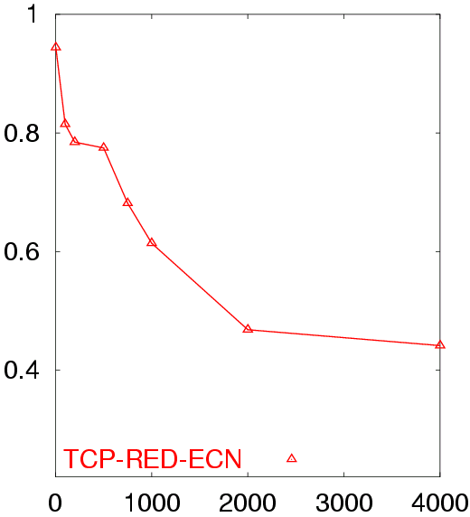
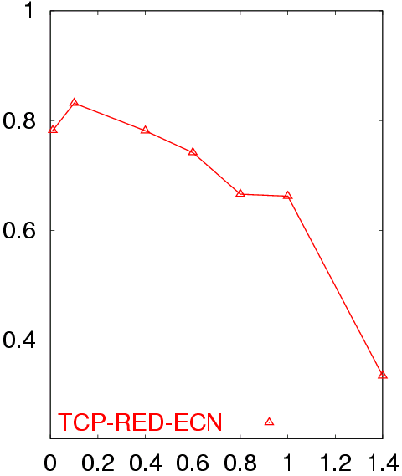
Simulation Results
Shown analytically in [Low01] and via simulations
Avg. TCP Utilization
50 flows in both directions
Buffer = BW x Delay
RTT = 80 ms
Avg. TCP Utilization
50 flows in both directions
Buffer = BW x Delay
BW = 155 Mb/s
Bottleneck Bandwidth (Mb/s)
Round Trip Delay (sec)

Slide 58
Proposed Solution:
Decouple Congestion Control from Fairness
Coupled because a single mechanism controls both
Example: In TCP, Additive-Increase Multiplicative-Decrease (AIMD) controls both
How does decoupling solve the problem?
To control congestion: use MIMD which shows fast response
To control fairness: use AIMD which converges to fairness

Slide 59
Characteristics of Solution
Improved Congestion Control (in high bandwidth-delay & conventional environments):
  Small queues
  Almost no drops
Improved Fairness
Scalable (no per-flow state)
Flexible bandwidth allocation: min-max fairness, proportional fairness, differential bandwidth allocation,…

Slide 60
XCP: An eXplicit Control Protocol
Congestion Controller
Fairness Controller

Slide 61
How does XCP Work?
Round Trip Time
Round Trip Time
Congestion Window
Congestion Window
Feedback
Feedback
Feedback = + 0.1 packet
Congestion Header

Slide 62
How does XCP Work?
Round Trip Time
Congestion Window
Feedback = + 0.1 packet
Feedback = - 0.3 packet

Slide 63
How does XCP Work?
Congestion Window = Congestion Window + Feedback
XCP extends ECN and CSFQ
Routers compute feedback without any per-flow state

Slide 64
How Does an XCP Router Compute the Feedback?
Congestion Controller
Fairness Controller
Goal: Matches input traffic to link capacity & drains the queue
Goal: Divides  between flows to converge to fairness
Looks at aggregate traffic & queue
Looks at a flow’s state in Congestion Header
MIMD
AIMD
Algorithm:
Aggregate traffic changes by 
 ~ Spare Bandwidth
~ - Queue Size
So,  =  d_{avg} Spare -  Queue
Algorithm:
If  > 0  Divide  equally between flows
If  < 0  Divide  between flows proportionally to their current rates

Slide 65
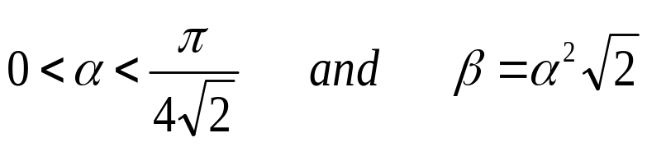
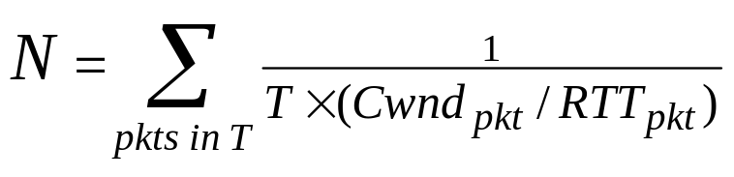
Details
Congestion Controller
Fairness Controller
 =  d_{avg} Spare -  Queue
Algorithm:
If  > 0  Divide  equally between flows
If  < 0  Divide  between flows proportionally to their current rates
Theorem: System converges to optimal utilization (i.e., stable) for any link bandwidth, delay, number of sources if:
Need to estimate number of flows N
No Per-Flow State
No Parameter Tuning
RTT_{pkt} : Round Trip Time in header
Cwnd_{pkt} : Congestion Window in header
T: Counting Interval
(Proof based on Nyquist Criterion)

Slide 66
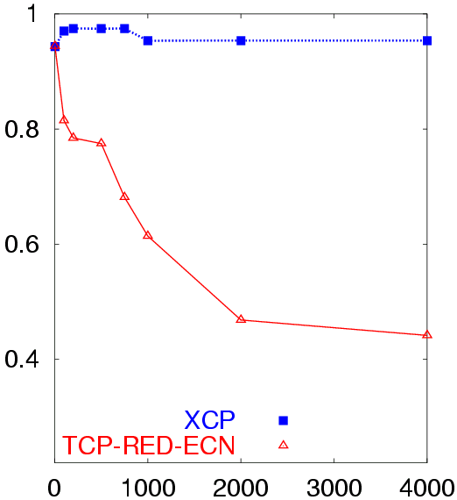
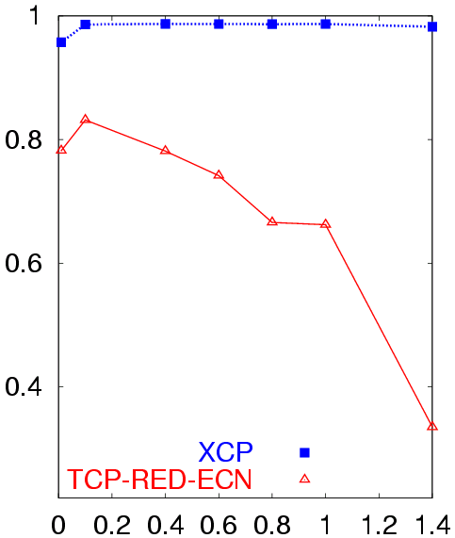
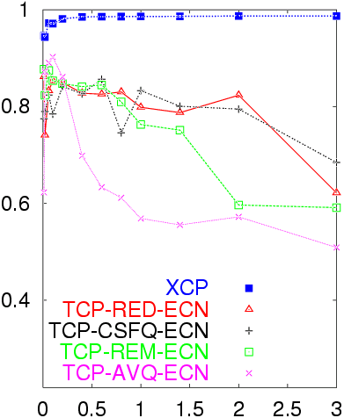
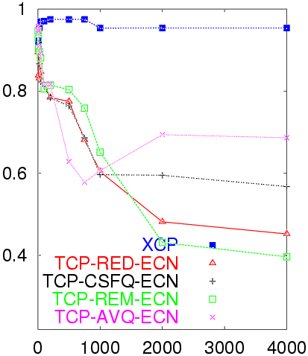
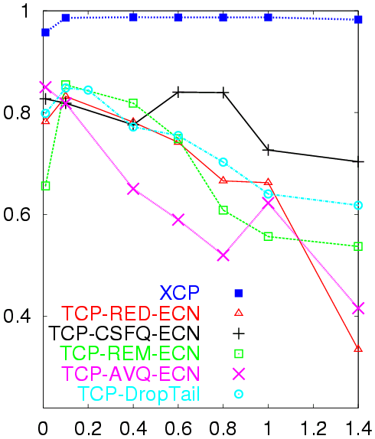
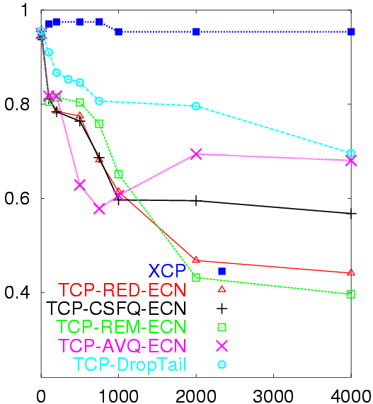
XCP Remains Efficient as Bandwidth or Delay Increases
Utilization as a function of Bandwidth
Utilization as a function of Delay
Avg. Utilization
Avg. Utilization
XCP increases proportionally to spare bandwidth
 and  chosen to make XCP robust to delay
Bottleneck Bandwidth (Mb/s)
Round Trip Delay (sec)

Slide 67
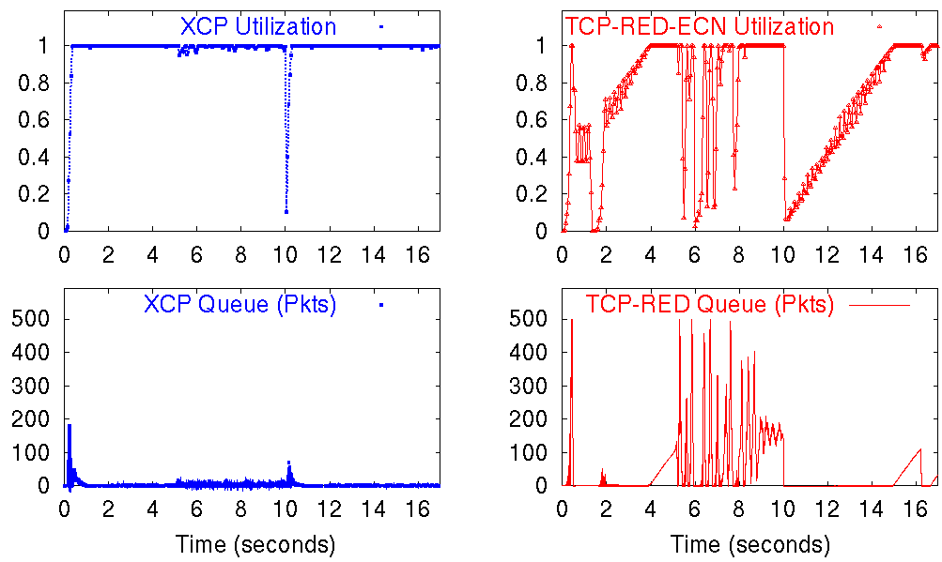
XCP Shows Faster Response than TCP
Start 40 Flows
Start 40 Flows
Stop the 40 Flows
Stop the 40 Flows
XCP shows fast response!

Slide 68
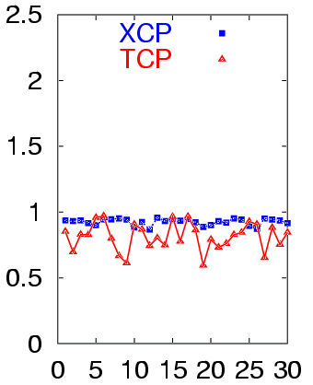
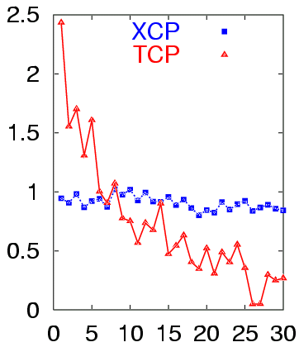
XCP is Fairer than TCP
Same RTT
Different RTT
Avg. Throughput
Avg. Throughput
Flow ID
Flow ID
(RTT is 40 ms 330 ms )

Slide 69
XCP Summary
XCP
  Outperforms TCP
  Efficient for any bandwidth
  Efficient for any delay
  Scalable (no per flow state)
Benefits of Decoupling
  Use MIMD for congestion control which can grab/release large bandwidth quickly
  Use AIMD for fairness which converges to fair bandwidth allocation

Slide 70
Selfish Users
Motivation
  Many users would sacrifice overall system efficiency for more performance
  Even more users would sacrifice fairness for more performance
  Users can modify their TCP stacks so that they can receive data from a normal server at an un-congestion controlled rate.
Problem
  How to prevent users from doing this?
  General problem: How to design protocols that deal with lack of trust?

Slide 71
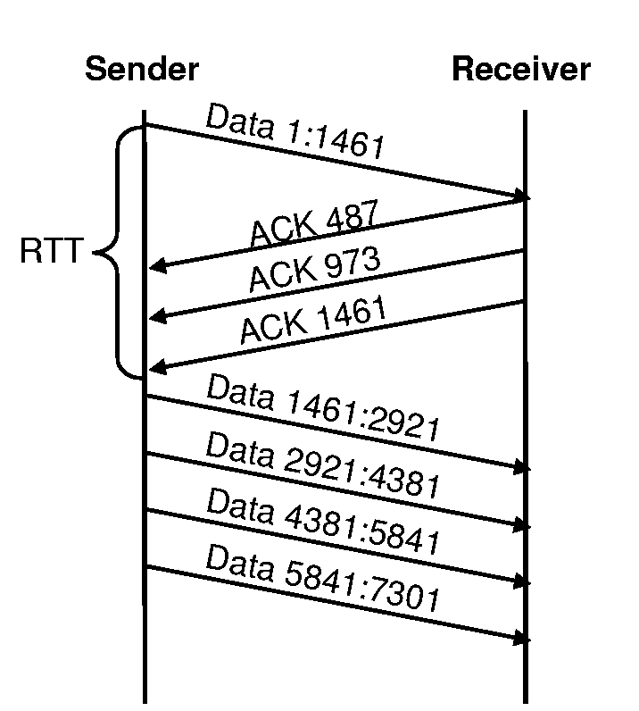
Ack Division
Receiver sends multiple, distinct acks for the same data
Max: one for each byte in payload
Smart sender can determine this is wrong

Slide 72
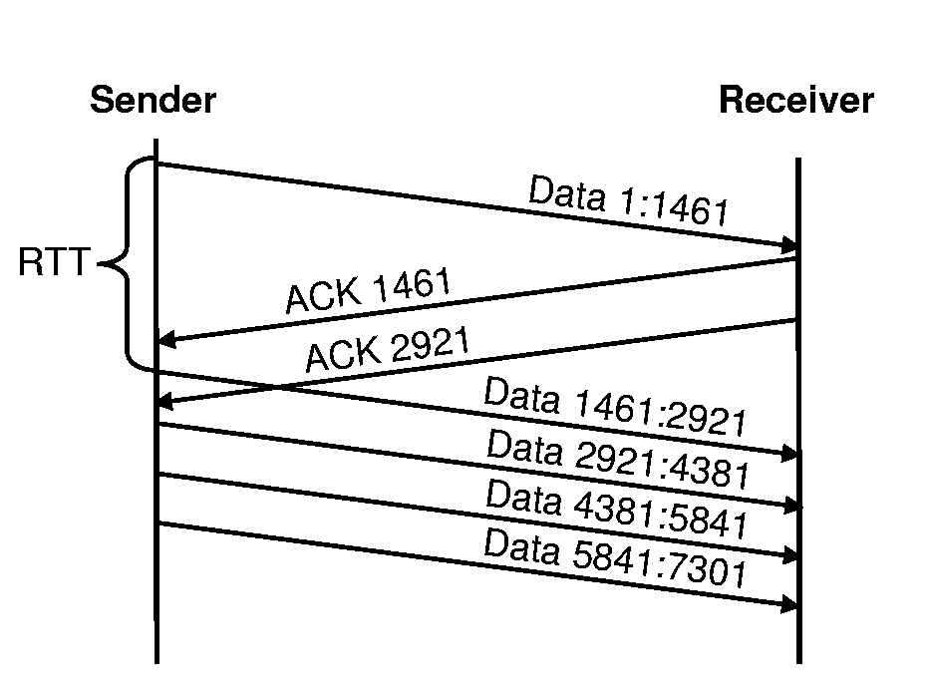
Optimistic Acking
Receiver acks data it hasn’t received yet
No robust way for sender to detect this on its own

Slide 73
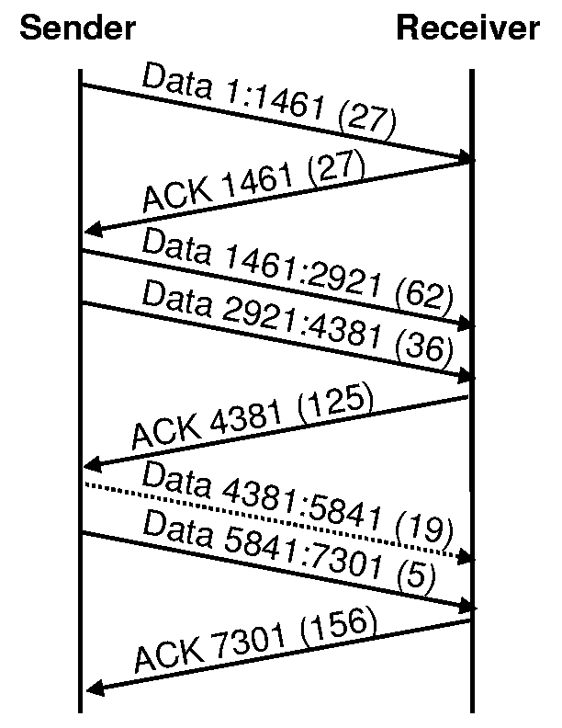
Solution: Cumulative Nonce
Sender sends random number (nonce) with each packet
Receiver sends cumulative sum of nonces
if receiver detects loss, it sends back the last nonce it received
Why cumulative?

Slide 74
ECN
Explicit Congestion Notification
  Router sets bit for congestion
  Receiver should copy bit from packet to ack
  Sender reduces cwnd when it receives ack
Problem: Receiver can clear ECN bit
  or increase XCP feedback
Solution: Multiple unmarked packet states
  Sender uses multiple unmarked packet states
  Router sets ECN mark, clearing original unmarked state
  Receiver returns packet state in ack
    receiver must guess original state to unmark packet

Slide 75
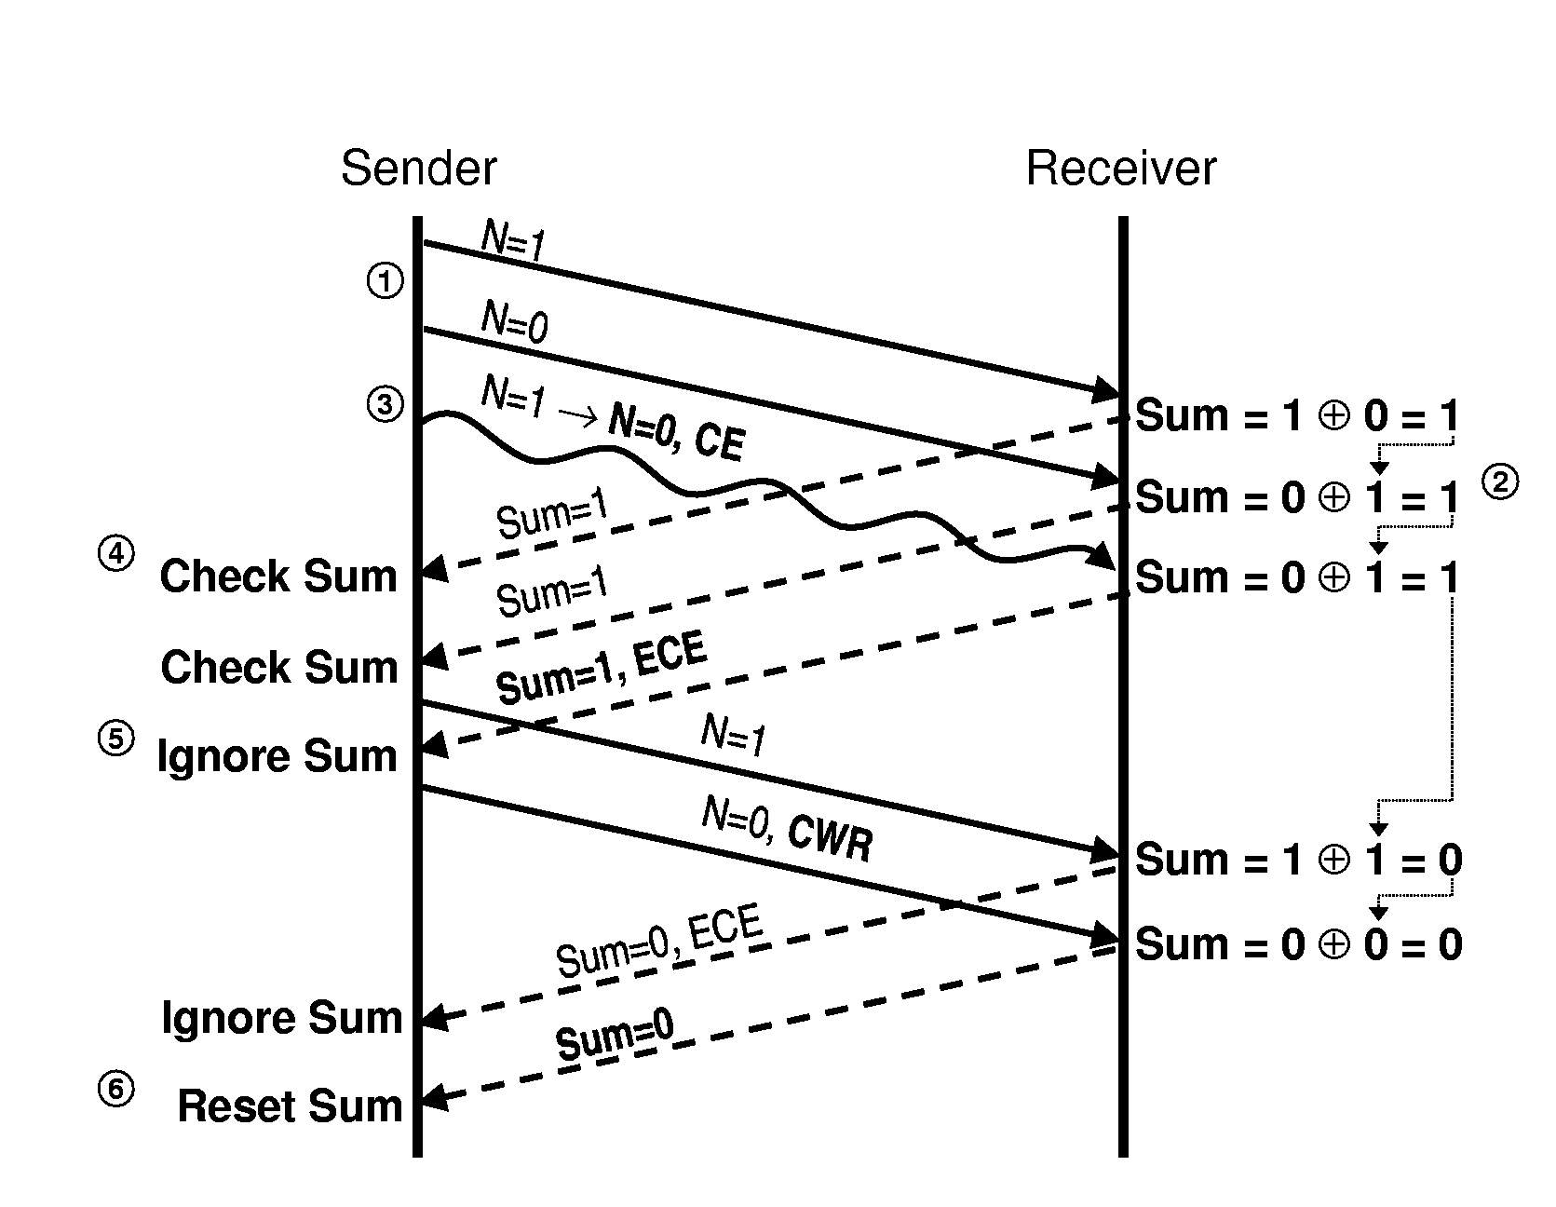
ECN
Receiver must either return ECN bit or guess nonce
More nonce bits → less likelihood of cheating
  1 bit is sufficient

Slide 76
Selfish Users Summary
TCP allows selfish users to subvert congestion control
Adding a nonce solves problem efficiently
  must modify sender and receiver
Many other protocols not designed with selfish users in mind, allow selfish users to lower overall system efficiency and/or fairness
  e.g., BGP

Slide 77
Wireless
Wireless connectivity proliferating
  Satellite, line-of-sight microwave, line-of-sight laser, cellular data (CDMA, GPRS, 3G), wireless LAN (802.11a/b), Bluetooth
  More cell phones than currently allocated IP addresses
Wireless → non-congestion related loss
  signal fading: distance, buildings, rain, lightning, microwave ovens, etc.
Non-congestion related loss →
  reduced efficiency for transport protocols that depend on loss as implicit congestion signal (e.g. TCP)

Slide 78
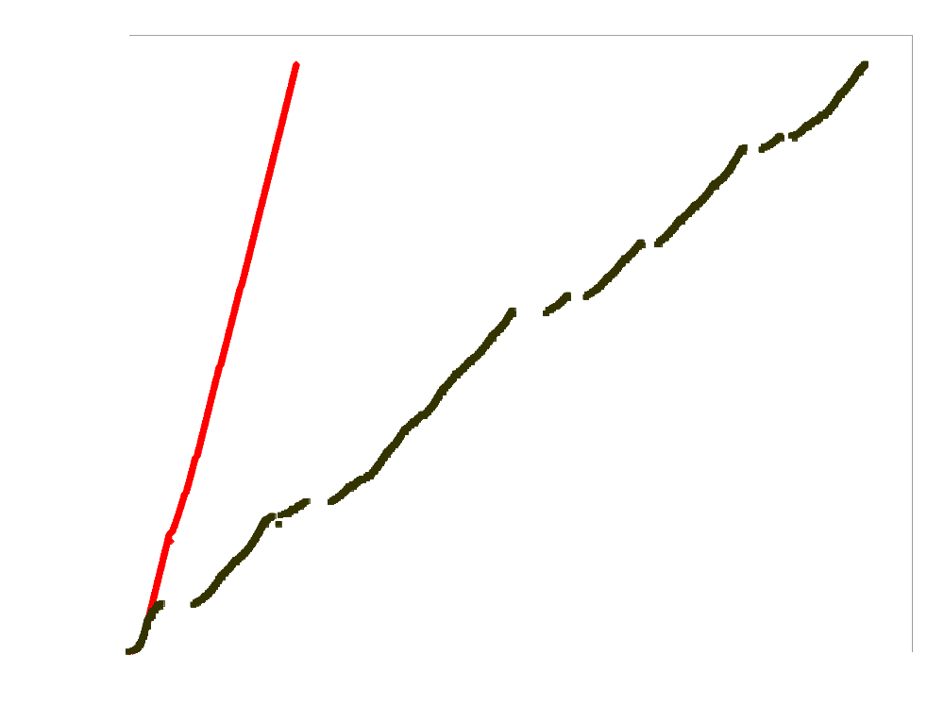
Problem
Best possible
TCP with no errors
(1.30 Mbps)
TCP Reno
(280 Kbps)
Sequence number (bytes)
Time (s)
2 MB wide-area TCP transfer over 2 Mbps Lucent WaveLAN
(from Hari Balakrishnan)

Slide 79
Solutions
Modify transport protocol
Modify link layer protocol
Hybrid

Slide 80
Modify Transport Protocol
Explicit Loss Signal
  Distinguish non-congestion losses
  Explicit Loss Notification (ELN) [BK98]
  If packet lost due to interference, set header bit
  Only needs to be deployed at wireless router
  Need to modify end hosts
  How to determine loss cause?
  What if ELN gets lost?

Slide 81
Modify Transport Protocol
TCP SACK
  TCP sends cumulative ack only→cannot distinguish multiple losses in a window
  Selective acknowledgement: indicate exactly which packets have not been received
  Allows filling multiple “holes” in window in one RTT
  Quick recovery from a burst of wireless losses
  Still causes TCP to reduce window

Slide 82
Modify Link Layer
Why not IP?
  not all protocols are willing to pay for reliability
Link layer retransmissions
  Wireless link adds seq. numbers and acks below the IP layer
  If packet lost, retransmit it
  May cause reordering
  Causes at least one additional link RTT delay
  Some applications need low delay more than reliability e.g. IP telephony
  easy to deploy

Slide 83
Modify Link Layer
Forward Error Correction (FEC) codes
  k data blocks, use code to generate n>k coded blocks
  can recover original k blocks from any k of the n blocks
  n-k blocks of overhead
  trade bandwidth for loss
  can recover from loss in time independent of link RTT
    useful for links that have long RTT (e.g. satellite)
  pay n-k overhead whether loss or not
    need to adapt n, k depending on current channel conditions

Slide 84
Hybrid
Indirect TCP [BB95]
  Split TCP connection into two parts
  regular TCP from fixed host (FH) to base station
  modified TCP from base station to mobile host (MH)
  base station fails?
  wired path faster than wireless path?

Slide 85
Hybrid
TCP Snoop [BSK95]
  Base station snoops TCP packets, infers flow
  cache data packets going to wireless side
  If dup acks from wireless side, suppress ack and retransmit from cache
  soft state
  what about non-TCP protocols?
  what if wireless not last hop?

Slide 86
Conclusion
Transport protocol modifications not deployed
  SACK was deployed because of general utility
Cellular, 802.11b
  link level retransmissions
  802.11b: acks necessary anyway in MAC for collision avoidance
  additional delay is only a few link RTTs (<5ms)
Satellite
  FEC because of long RTT issues
Link layer solutions give adequate, predictable performance, easily deployable

Slide 87
References
W. Stevens. TCP Slow Start, Congestion Avoidance, Fast Retransmit, and Fast Recovery Algorithms. RFC 2001, Jan. 1997.
S. Floyd and T. Henderson. The NewReno Modification to TCP's Fast Recovery Algorithm. RFC2582, April 1999.
M. Mathis, J. Mahdavi, S. Floyd, and A. Romanow. TCP Selective Acknowledgment Options. RFC 2018, October 1996.

Slide 88
Reading Papers
Dina Katabi, Mark Handley, and Charlie Rohrs. Congestion Control for High Bandwidth-Delay Product Networks, In: Proceedings on ACM Sigcomm 2002.
  http://ana.lcs.mit.edu/dina/XCP/
L. Brakmo, S. O'Malley, and L. Peterson. TCP Vegas: New techniques for congestion detection and avoidance. In Proceedings of ACM SIGCOMM 1994.

Slide 89
Reading Papers
CUBIC: a new TCP-friendly high-speed TCP variant. Sangtae Ha, Injong Rhee, and Lisong Xu. SIGOPS Oper. Syst. Rev. 2008
BBR: congestion-based congestion control. N. Cardwell, Y. Cheng, C. S. Gunn, S. H. Yeganeh, and V. Jacobson. Commun. ACM 2017

