Slide 1
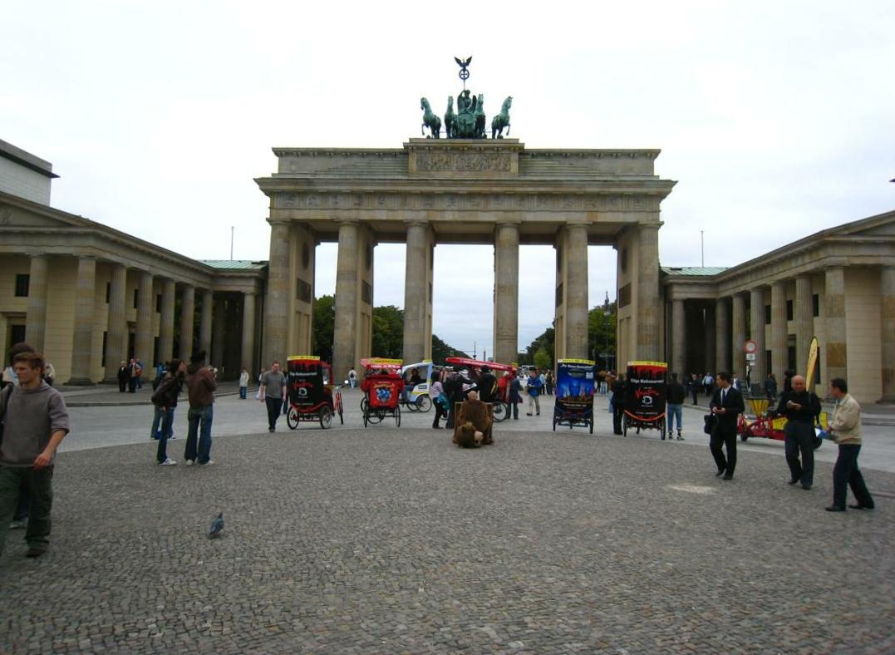
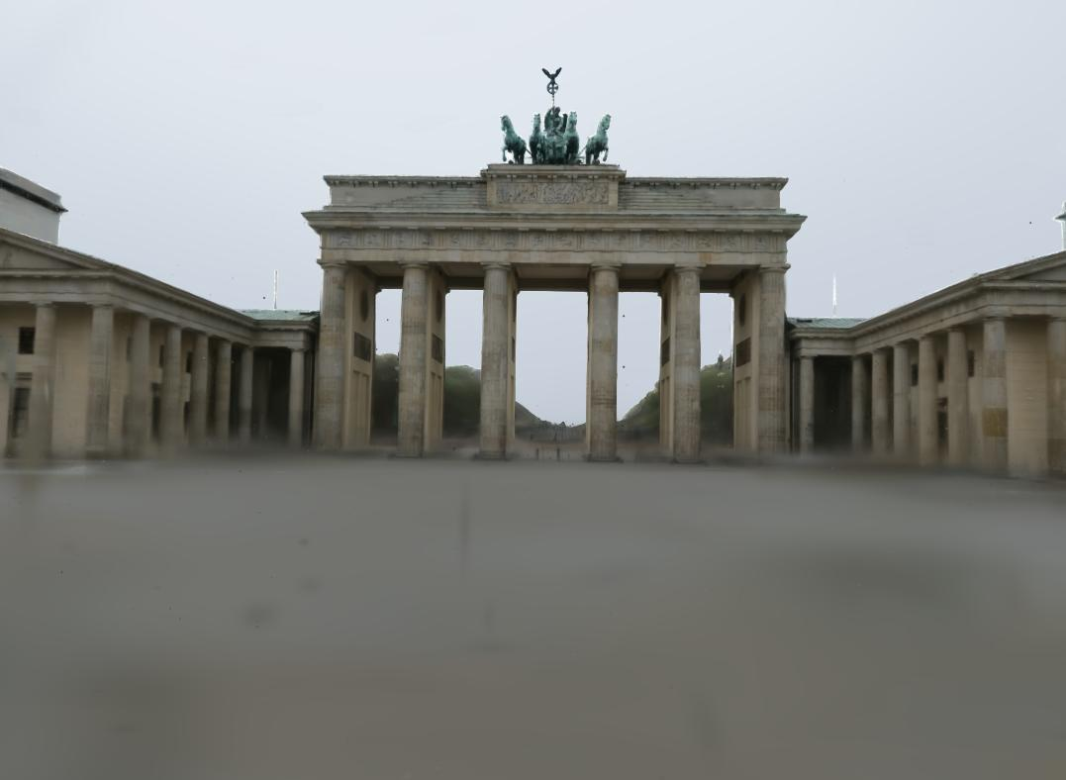

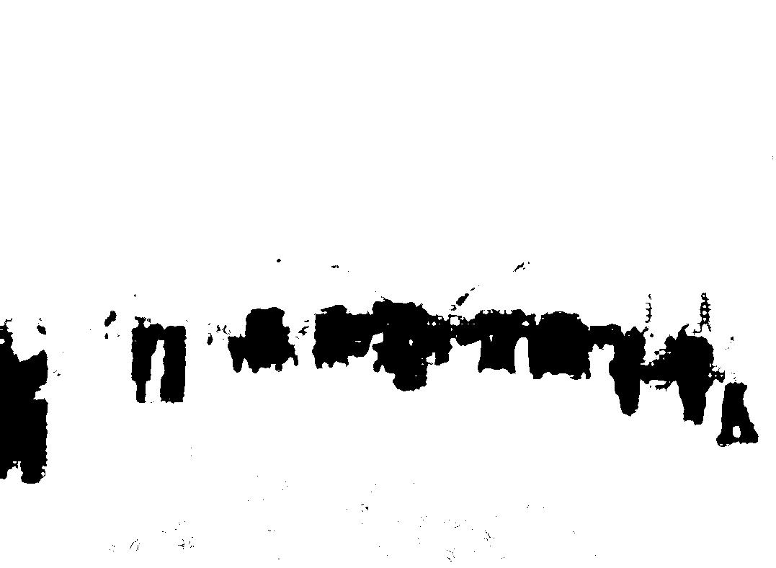














Reference Views
transient object
$$M_{sky}$$
Loss
3D Gaussian
Sky Handling
$$M_{vis}$$
$$\{xyz_{i},s_{i},r_{i},α_{i},c_{i}\}$$
Rasterization
Appearance Modeling
Output
Appearance Modeling
Sky Handling
Oneformer
$$M_{sky}$$
$$α_{i}$$
$$i=0,1,∙∙∙,N$$
Sky Mask
$$\frac{1}{N_{0}}$$
$$E_{a}$$
Lraspp+Mobilenet
pretrained
concat
$$c_{i}$$
Transient Objects
Encoder
$$\frac{1}{N_{1}}$$
2
0
0
4
Gaussian $×N$
$$M_{vis}$$
$$cov_{i}$$
MLP
3
6
Visibility Map
1
7
$$E_{h}$$
pretrained+train
anchor position
Hash encoding
Encoded feature

Slide 2




3D Gaussian
$$\{xyz_{i},s_{i},r_{i},α_{i},c_{i}\}$$
Rasterization with depth
$$\frac{1}{N_{0}}$$
$$\frac{1}{N_{1}}$$
2
0
0
4
3
6
1
7
$$p$$

Slide 3
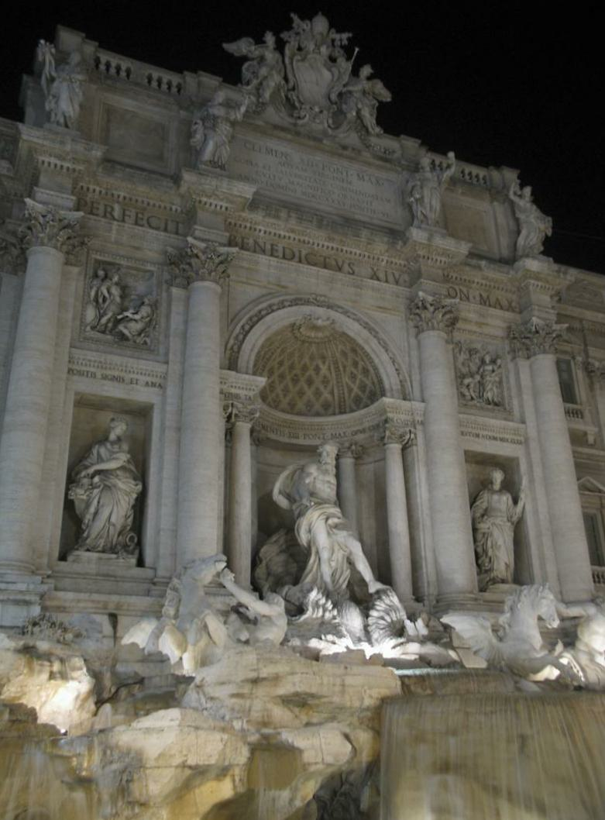
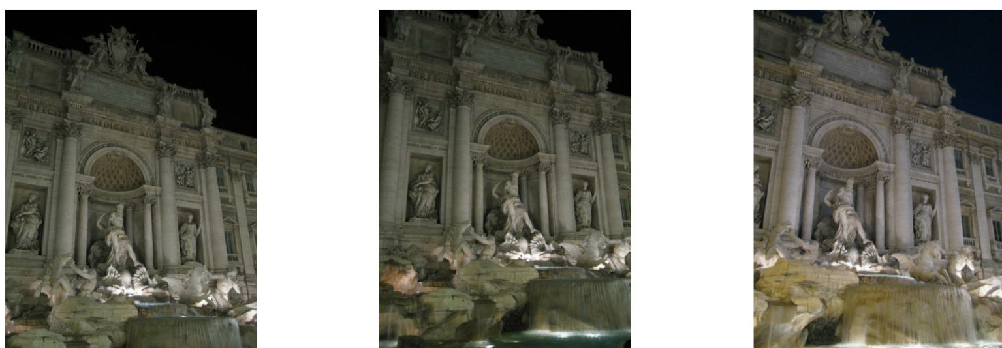
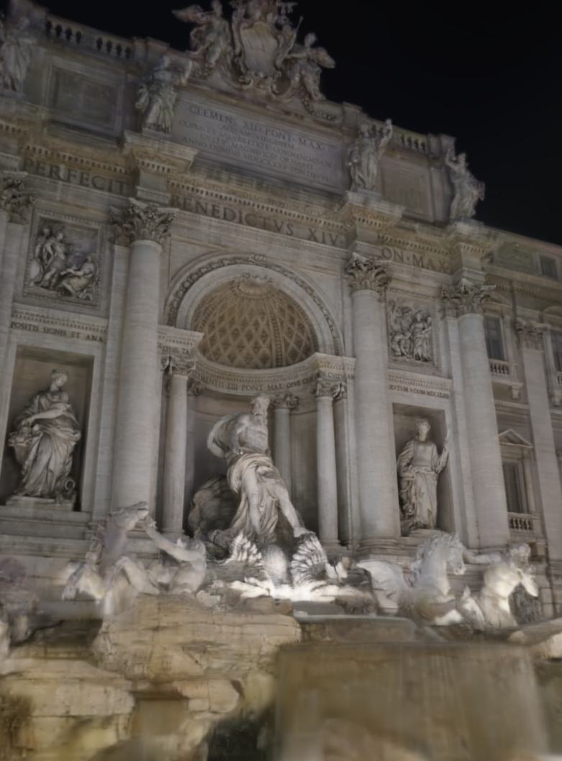
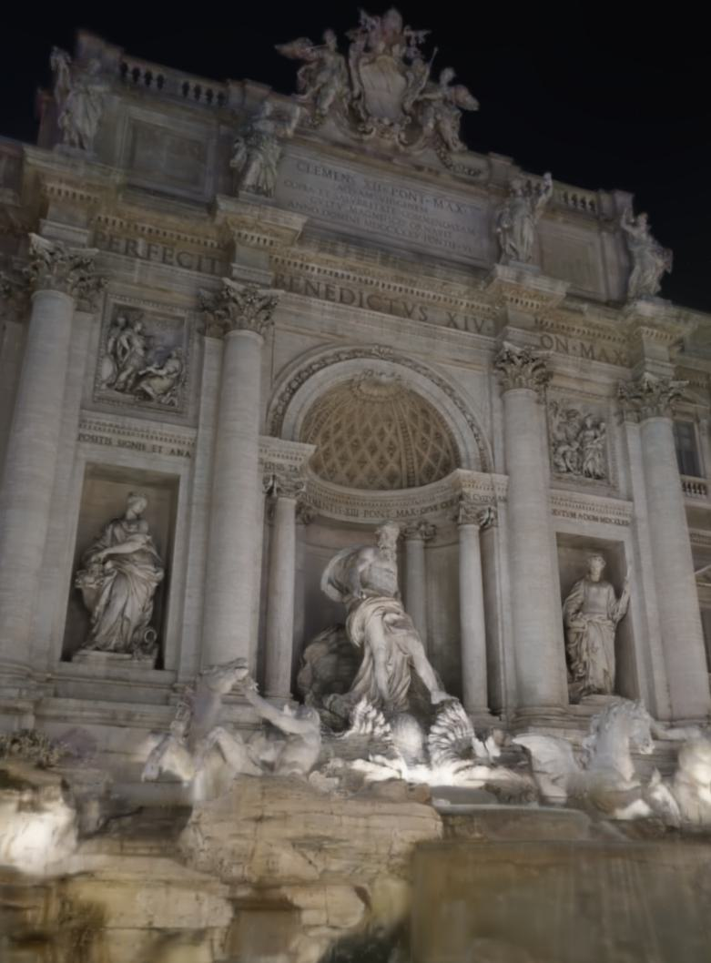
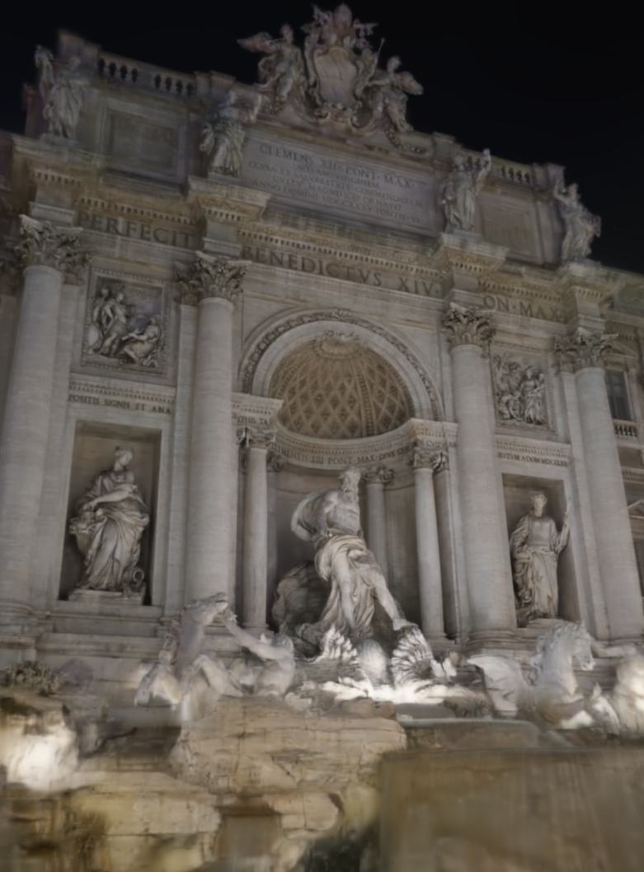
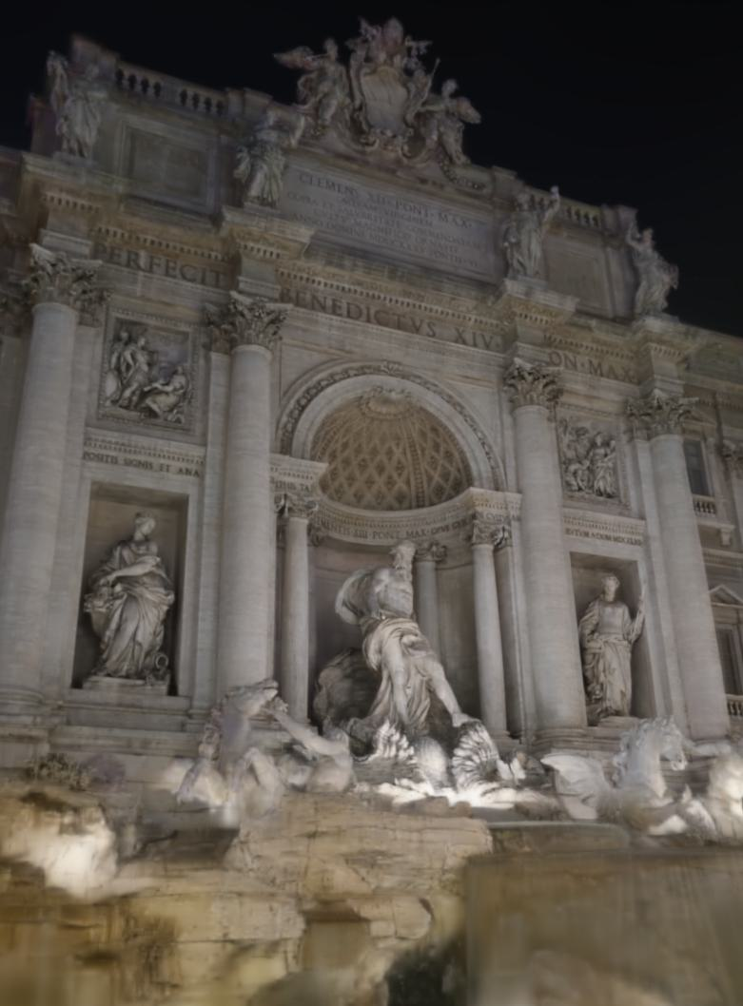
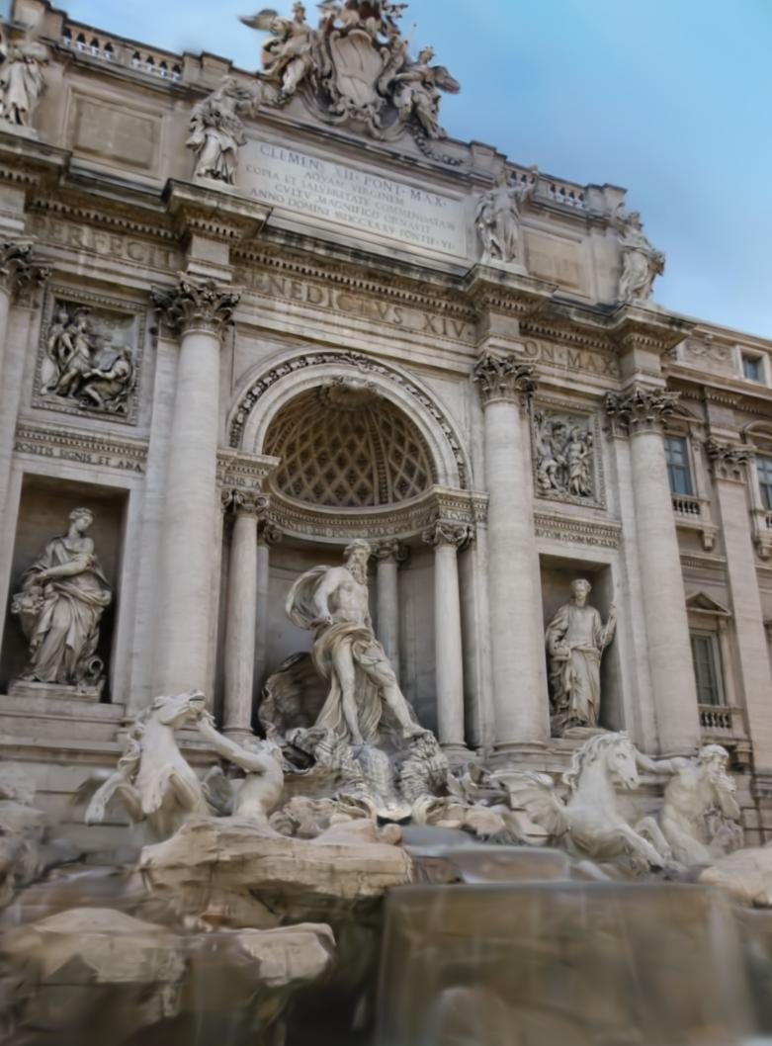
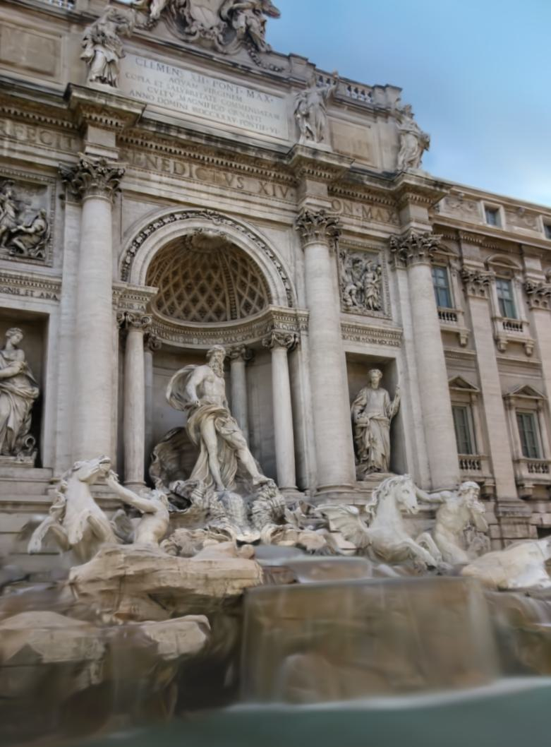





3D Gaussian
$$\{xyz_{i},s_{i},r_{i},α_{i},c_{i}\}$$
appearance
Appearance Modeling
Interpolation
$$knn$$
CosPlace
test image
$$r_{i}$$
R3GS (Ours)
0 step (init pose)
20 steps
50 steps
500 steps (end)
optimization steps
(without appearance)
3D Gaussian
$$\{xyz_{i},s_{i},r_{i},α_{i},c_{i}\}$$
3DGS

