Slide 1
Changing Linux Page Replacement Algorithm
Zihan Wang

Slide 2
Overview
Study of the Original Algorithm
Changing to a new LRU Algorithm
Changing to an LFU Algorithm

Slide 3
Study of the Original Algorithm

Slide 4
Basic Ideas
Reclaim ‘unused’ pages only.
Associate a counter storing the age of the page with each page in RAM.

Slide 5
State Diagram
PG_active = 0
PG_referenced = 0
PG_active = 1
PG_referenced = 0
PG_active = 0
PG_referenced = 1
PG_active = 1
PG_referenced = 1
activate_page
mark_page_accessed
shrink_active_list
page_check_references

Slide 6
Condition of Reclaiming
Low on memory: The kernel has difficulty allocating new pages.
Periodic: Kernel threads check periodically whether free pages are above a certain threshold.

Slide 7
LOW ON MEMORY RECLAIMING
PERIODIC RECLAIMING
try_to_free_pages
kswapd
shrink_zones
balance_pgdat
shrink_zone
shrink_mem_cgroup_zone
shrink_list
shrink_active_list
shrink_inactive_list
shrink_page_list
page_check_references
page_referenced

Slide 8
Memory-Related Structs
NUMA: The time required to access different memory locations is different.
Zone: Accounting for hardware constraints of the type of data stored in pages.
Memory
NUMA Node
Zone
Page Descriptor

Slide 9
Changing to a New LRU Algorithm

Slide 10
Scope of Work
The algorithm involved just select the candidates to be replaced.
We just need to change how the status of the pages are transitioned.

Slide 11
Comparison of Two Algorithms
Task | Original | New LRU
Renew page | If PG_referenced is 0, set it. Otherwise clear it and add to active list. | Right shift PG_referenced and add by an offset.
Age page | If PG_referenced is 0, clear it. Otherwise set it and add page to inactive list. | Right shift PG_referenced.
Condition | Original | New LRU
Add to active list | PG_referenced is 1 and the page is referenced recently. | PG_referenced is above some threshold.
Add to inactive list | PG_referenced is 0 and the page is not referenced recently. | PG_referenced is below some threshold.

Slide 12
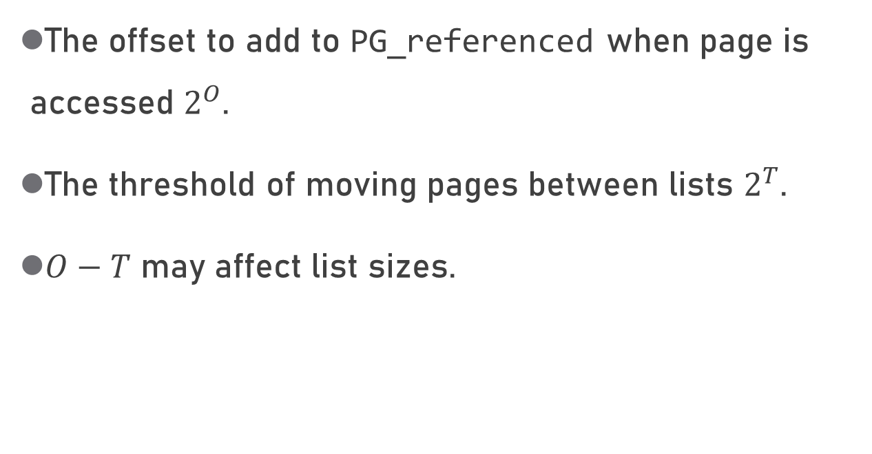
Parameters
The offset to add to PG_referenced when page is accessed $2^{O}$.
The threshold of moving pages between lists $2^{T}$.
$O−T$ may affect list sizes.

Slide 13
Test Results
New LRU Algorithm

Slide 14
Test the Algorithm
Write a program to occupy as much memory as possible.
Access /proc/meminfo periodically to get the sizes of active and inactive lists.

Slide 15
Notice
kswapd invokes lowmemkiller, which kills processes to reclaim memory space. The test process is then terminated.
List sizes change differently for mmap and malloc.

Slide 16
Trend

Slide 17
Trend
Time | Trend | Explanation
1-6s | Active list continues to grow. Inactive list remains. | Once a page is accessed, it is marked active.
6-10s | Active list grows more slowly. Inactive list begins to shrink. | Some pages are reused.
10-11s | Active list drops dramatically. | Some processes, including the test program, are killed.

Slide 18

The Impact of $O−T$

Slide 19
The Impact of $O−T$

Slide 20
Observation
Hard to find correlation between sizes of LRU lists and parameters.
The difference in list sizes is more of randomness than some inherent mechanism.

Slide 21
To an LFU Algorithm
With a few modifications to the LRU algorithm.

Slide 22
Differences from LRU
LRU: A page is immediately added to active list when it’s accessed.
LFU: A page is added to active list only when it’s accessed frequently enough.

Slide 23
Implementation Details
When a page is accessed, left shift PG_referenced and add by 1.
Maximal PG_referenced: necessary.

Slide 24
Test Results
LFU Algorithm

Slide 25
Trend

Slide 26
Trend
Time | Trend | Explanation
1-6s | Inactive list continues to grow. Active list remains. | Test program access every page only once.
7-9s | Inactive list grows more slowly. Active list begins to grow. | Some pages are reused.
9-11s | Inactive list grows, while active list shrinks. | Some pages are aged in the replacement algorithm.
11-12s | Inactive list drops dramatically. | Some processes, including the test program, are killed.

Slide 27
The Impact of Threshold

Slide 28
The Impact of Threshold

Slide 29
The Impact of Maximum

Slide 30
The Impact of Maximum

Slide 31
Observation
The smaller the threshold, the larger the active list.
The higher the maximum, the larger the active list.
The size of active list varies more greatly in the LFU algorithm, compared with the original.
The parameters seem to have little impact on the size of inactive list.

Slide 32
Choice of Parameters
Criterion | Threshold | Maximum
Similar to the original | 8 | 64
Smaller active list size | 16 or higher | Threshold × 2

Slide 33
Reference
Understanding the Linux Kernel. Daniel Bovet and Marco Cesati. O'Reilly Media.

Slide 34
The End
Thanks

