Slide 1
CAPSTONE — EXECUTIVE SUMMARY
Public-Data Analytics on the
InGen Robotics Portfolio
Market · Competition · BI · Forecasting · Operations
Thirteen weeks, five verticals, public data only — no internal access required.
Ziheng Wang · Data Analyst Intern · inGen Dynamics (Futurenauts)

Slide 2
Six findings that matter
If you read one slide, read this one.
1
Funding is not a moat
2
The biggest market isn't the loudest
Capital raised and defensible IP diverge. Margin structure predicts durability — not headline raises.
Sentinel (indoor security) has the clearest near-term economics. Humanoid gets the capital and the headlines.
3
Attention ≠ opportunity
4
Momentum is up; models beat naive
Demand ranking is the near-inverse of market attractiveness. Sentinel: strong asset, weak share of voice.
MASE < 1.0 in 4 of 5 verticals. No single model wins everywhere — keep a portfolio.
5
Sentinel's alerts: persistence, not threshold
6
Support is a parts problem
120-min persistence cuts alert load 33× (16.35 → 0.50/day) while recall rises to 88%.
Parts = 53% of cycle time, 100% waiting. Parts buffer −23% vs +1 engineer −8%.

Slide 3
How this was built
Four phases, thirteen self-contained modules, everything reproducible.
Phase 1
Phase 2
Phase 3
Phase 4
Wks 1–3
Wks 4–6
Wks 7–9
Wks 10–12
Foundation
Market analytics
BI platform
Advanced analytics
Products, 40+ competitors, 12-dataset pipeline, DuckDB warehouse
›
TAM/SAM/SOM, demand-signal index, peer financials
›
Star schema, 3 dashboards, exec scorecard
›
Forecasting, anomaly detection, process optimisation
Principles: sourced or not stated · ranges over false precision · synthetic data always labelled · fixed seeds + test suites · methods validated against ground truth where it exists

Slide 4
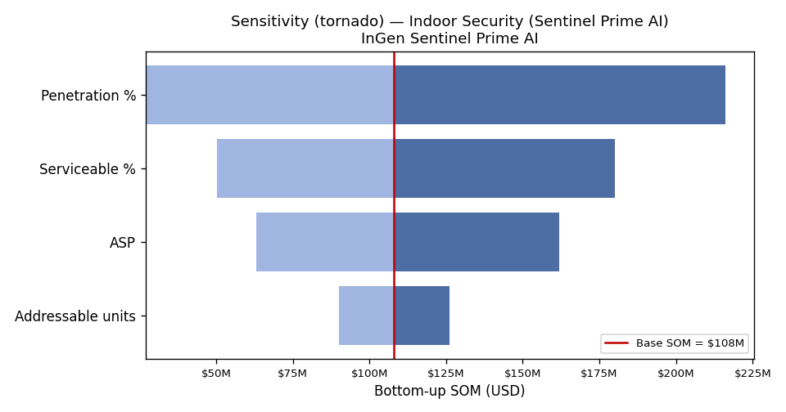
Market sizing — ranges, not points
Week 4
Published estimates disagree by an order of magnitude. That's the finding.
Sentinel Prime AI
Highest
Guard-replacement economics vs a costed alternative
indoor security
Fari
Medium-high
Large population; adoption-rate constrained
eldercare
Senpai
Medium
Steady; tied to budget cycles
education
Penetration rate dominates
Aido Rover
Scenario range
High potential, high uncertainty
outdoor patrol
In every vertical: penetration first, ASP second, unit count a distant third. Market size is mostly a go-to-market variable InGen partly controls — not a fixed external quantity.
Aido Humanoid
Scenario range
A bet on future deployment, not a current pool
humanoid
Humanoid quoted ~$290M–$4.89bn; security robotics ~$4.7bn–$19bn. Every figure is a sourced range.

Slide 5
Competition — funding is not a moat
Weeks 1–2
15 priority peers, real patents and headcounts, dated sources.
Capital raised and defensible IP diverge sharply.
The most heavily funded humanoid companies are not the most patent-dense. Several quieter competitors hold stronger, earlier, more specific grants. Funding is the metric the trade press reports and the one that shapes internal anxiety — and it is the wrong one.
$1bn + thin patents
$100M + dense position
Confirmed in Week 6
Buying time
Buying ground
From the other side
A war chest funds runway, not defensibility.
Specific grants around a mechanism are durable.
Durable peers have defensible margin structures — not the biggest raises.
Excluded on purpose: real-time hiring counts (no dated snapshot) and vendor deployment claims sourced only to marketing.

Slide 6
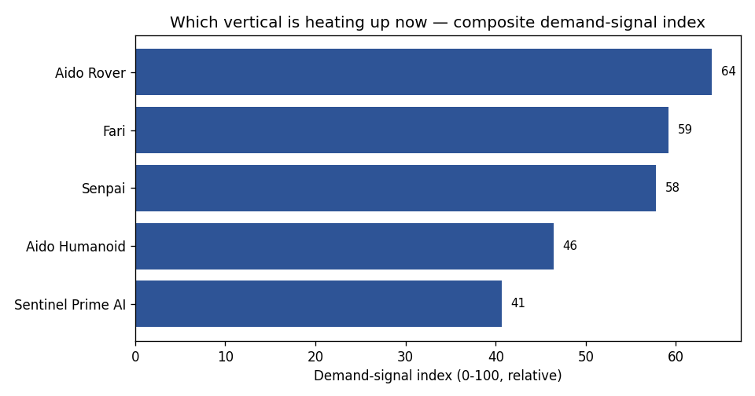
Attention ≠ opportunity
Week 5
The demand ranking is the near-inverse of market attractiveness.
The inversion
Aido Rover leads on attention (64). Sentinel Prime AI — the clearest near-term economics — comes last (41).
These aren't contradictory. Search and news measure attention. Sizing measures money. The gap is where the commercial opportunity hides.
Sentinel = strong asset, weak share of voice. A marketing problem — solvable.
Two pain-points recur in every vertical: navigation reliability in cluttered real spaces, and the gap between demo behaviour and sustained field behaviour. Both are credibility problems — both answered by published field-reliability data.

Slide 7
Financial benchmarks — margin structure is the moat
Week 6
Real FY2024 filings. The profitable peers aren't 'robotics companies' as the press means it.
Company | FY24 revenue | Gross margin | Op margin | What it tells us
Teradyne | $2,820M | 58.5% | +20.5% | Test & measurement — the profile robotics aspires to
Cognex | $915M | 68.0% | +7.0% | Machine vision — highest margin; a components business
Symbotic | $1,790M | 18.0% | −5.0% | Warehouse automation — scale, thin margin, integration economics
iRobot | $681.8M | 20.9% | −15.1% | Consumer robotics pure-play — losing money at scale
Figure AI's ~$1.68bn raise is ~2.5× iRobot's entire FY2024 revenue.
Capital is not the constraint in this industry — and it is not the moat either. What separates durable from fragile is whether you own something specific enough to charge for. For InGen: Sentinel-style deployments sold against a costed guard alternative have a defensible price story. Volume consumer hardware, on this evidence, does not.

Slide 8
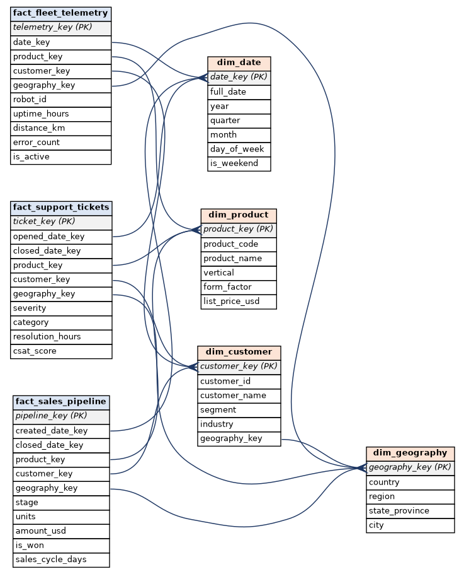
The BI platform
Weeks 7–9
A warehouse an analytics team could actually query, and dashboards on top.
Star schema
3 facts (telemetry, tickets, pipeline) + 4 dimensions. Surrogate keys, documented grain, zero orphan FKs on every load.
100k rows, fixed seed
Synthetic — no internal data was available. It fixes the shape, not the facts.
Portable by design
The schema mirrors what an InGen team would hold, so the 15-query library and every dashboard move to real data unchanged.
3 tools, 3 jobs
Tableau (external market view) · Looker (operations) · Power BI (exec scorecard, 10 DAX measures).
Dashboards are built and specified; publishing to the live services runs through personal accounts and was not completed. No live URLs are claimed.

Slide 9
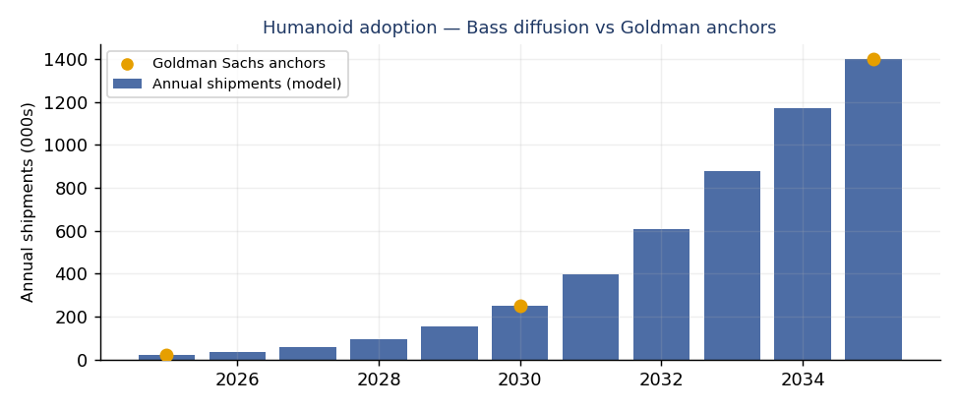
Forecasts — models beat naive in 4 of 5
Week 10
5 models per vertical, backtested on a held-out year. MASE < 1.0 beats seasonal-naive.
Vertical | Best model | MAPE | MASE
Senpai — education | Prophet | 3.1% | 0.54
Aido Humanoid | ETS | 2.6% | 0.59
Aido Rover — patrol | Prophet | 2.5% | 0.69
Sentinel — security | XGBoost | 5.7% | 0.96
Fari — eldercare | ETS | 4.1% | 1.00
Humanoid: shape, not level
No single model wins
Bass curve fits Goldman's anchors exactly (20k/2025 → 250k/2030 → 1.4M/2035). But Morgan Stanley projects ~13M in service by 2035 — ~3× apart. That spread is why humanoid is a scenario, not a forecast.
ETS twice, Prophet twice, XGBoost once. Keep a small portfolio and re-select per series rather than standardising on one algorithm. Fari sits at MASE 1.00 — no better than naive, and reported as such.
Target is search-interest momentum (0–100) — a relative demand read, not a unit forecast.

Slide 10
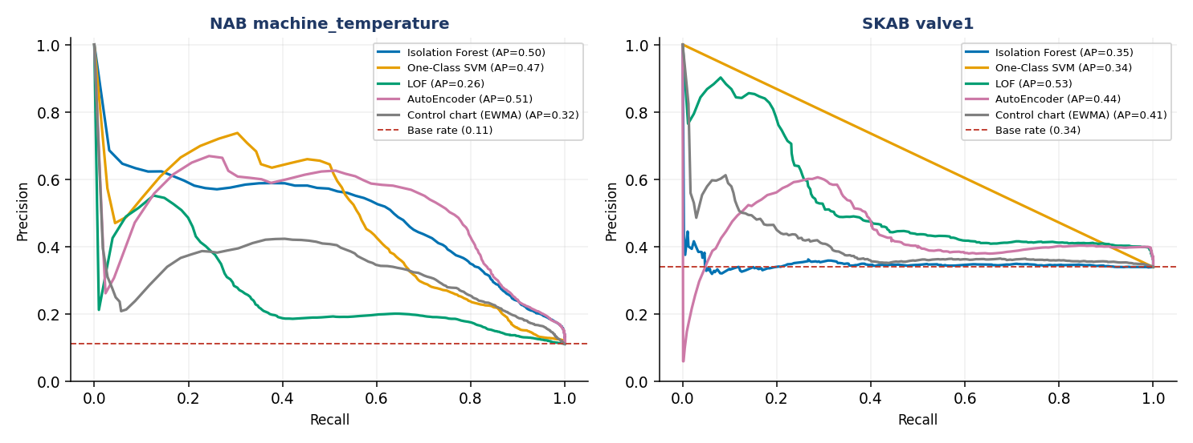
Sentinel: you can't threshold your way out of model quality
Week 11
Real public benchmarks (NAB — MIT; SKAB — GPL-3.0). No InGen data.
At 80% recall, the false-alarm rate bottoms out near 13% — whatever threshold we pick.
That ceiling is set by the model's discriminative power (AP ≈ 0.51), not by threshold policy. The stated 5% budget is unreachable at that recall — and we say so rather than quietly relaxing the bar.
5 detectors, identical splits
Isolation Forest · One-Class SVM · LOF · AutoEncoder (PyOD) — against an EWMA control chart, the thing a plant engineer would already do.
AutoEncoder leads NAB (F1 0.555), LOF leads SKAB (F1 0.545). Both clear the baseline — the bar that justifies the complexity.
Fitted unsupervised on a clean warm-up window — how a Sentinel unit would be baselined at commissioning.

Slide 11
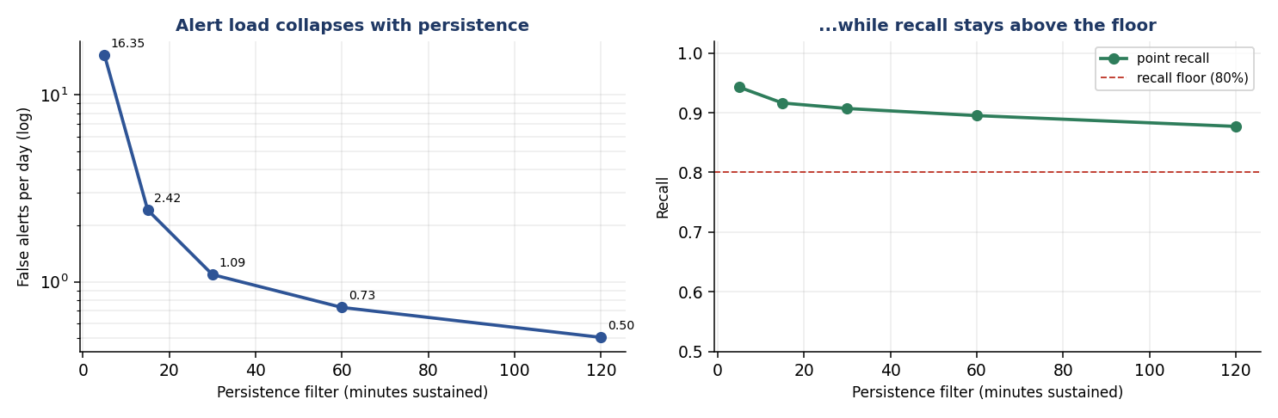
...but persistence cuts alert load 33×
Week 11
The point-level rate is the wrong metric. Operators experience alerts, not readings.
16.35
false alerts / day
no persistence filter
0.50
false alerts / day
120-min persistence
Adaptive thresholds lost — and the reason is the lesson
Recall RISES to 88%
Rolling quantile cut false alarms (13.4% → 3.3%) but collapsed recall (80% → 33%). NAB's failures run ~2 days, so a rolling baseline absorbs the anomaly and lifts the threshold exactly when it should hold. Survived a full parameter sweep; a baseline-freeze test confirmed the diagnosis. Verdict: fixed + persistence, re-baselined on a schedule.
All 4/4 real failures still caught. Real failures are sustained; false positives are isolated spikes.
Recommendation: two tiers — fast (intrusion) + sustained (degradation). Thresholds transfer as a method, not as constants.

Slide 12
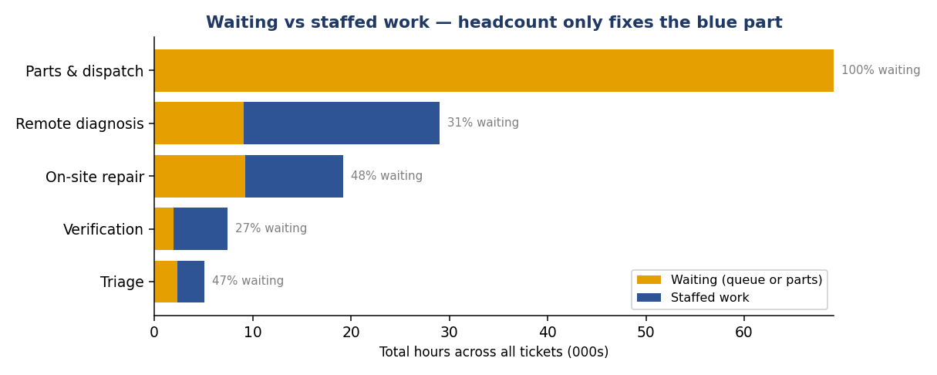
Support is a parts problem, not a people problem
Week 12
Where the fleet-support cycle time actually goes.
53%
of all process time is Parts & dispatch — and 100% of it is unstaffed waiting.
Nobody is working during it, so no amount of headcount shortens it. On-site repair, by contrast, is 48% queueing — which headcount can shorten. That distinction drives the whole recommendation.
The drivers you'd reach for explain 4% of the variance. One structural fact explains 72%.
Product, severity, geography, weekday, team workload → R² = 0.04. Add "did this ticket need a physical part?" → R² = 0.72, and a dispatched ticket takes +578% longer [+555%, +601%]. Severity and queue length are real but second-order.

Slide 13
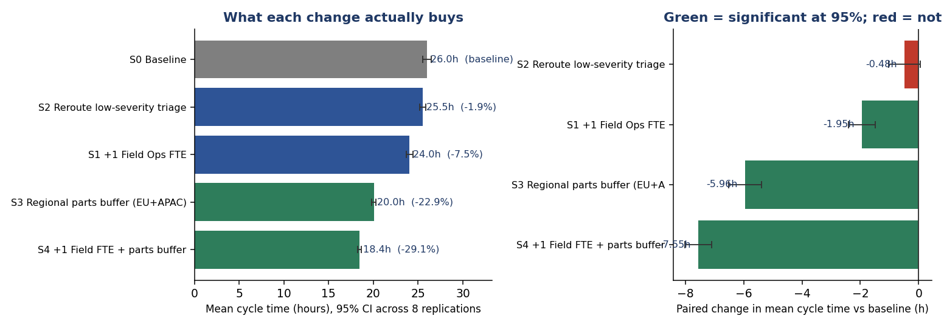
What each fix would actually buy
Week 12
8 replications per scenario, paired to identical seeds, 95% CIs.
−23%
−8%
−1.9%
Regional parts buffer
+1 Field Ops FTE
Reroute Tier-1 triage
P90 falls 64h → 47h. The tail is what customers complain about.
Nearly zeroes field-queue wait (4.9h → 0.4h) — but that stage is only ~15% of the process.
Not significant. Triage is 4% of process time. The obvious lever does nothing.
Amdahl's law in practice: perfect staffing of a 15% stage cannot buy more than 15%. Both changes together: −29%.

Slide 14
What public data could not answer
Stated plainly, because the caveats matter as much as the findings.
No internal InGen data — anywhere
The synthetic warehouse fixes shape, not fact
Every figure is public or clearly-labelled synthetic. Market bottom-ups use assumed penetration, not observed conversion. These analyses are directional, not decision-grade.
Weeks 7–9 and 12 rest on generated data. Nothing there measures InGen's actual fleet, support org or pipeline. Scorecard KPI targets are my assumptions.
Forecasts are momentum reads
Week 12's numbers are model properties
A 0–100 search index answers "is attention rising?" — not "how many units will we sell?"
The −23% is a simulation result, not a measurement. The method was validated (7/9 generating effects recovered); the number still needs real data.
Dashboards built, not published
Left out on purpose
Specs, extracts, prototypes and design log are complete. No live URLs exist, and none are claimed.
Competitor hiring counts (no dated snapshot), vendor deployment claims (marketing-sourced), frozen EV/Revenue multiples.
Week 11 is the exception that proves the point: real public benchmarks were reachable, and its results are measurements on real sensor data.

Slide 15
What I'd do next
1
Market Sentinel Prime AI harder
The one ask
First on market attractiveness, last on demand signal — the widest gap in the portfolio.
Read access to one small, anonymized slice of real InGen data.
2
Fund a regional parts buffer before hiring
−23% vs −8%. Parts is 53% of process time and 100% waiting.
The synthetic warehouse already matches the intended schema, so real data slots in with minimal rework — and it dissolves most of the limitations at once:
· the warehouse becomes real
· the dashboards become operational
· Week 12's diagnostic becomes a measurement
· the forecasts gain a calibration target
3
Ship two-tier alerting on Sentinel
Fast tier for intrusion; 120-min sustained tier at ~0.5 false alerts/day.
4
Treat humanoid as an option, not a plan
Credible analysts differ ~3× on 2035. Scenario-bound it.
Weeks 1–13 complete · 13 self-contained modules, each with README, plan, status and tests · HANDOFF.md documents how to pick up every workstream · thank you.

