Slide 1
CartoonGAN: Generative Adversarial Networks for Photo Cartoonization
Yang Chen ,Tsinghua University
Yu-Kun Lai, Cardiff University, UK
Yong-Jin Liu∗ ,Tsinghua University

Slide 2
CartoonGAN
Introduction
Related Work
Architecture
Experiments
Conclusion

Slide 3
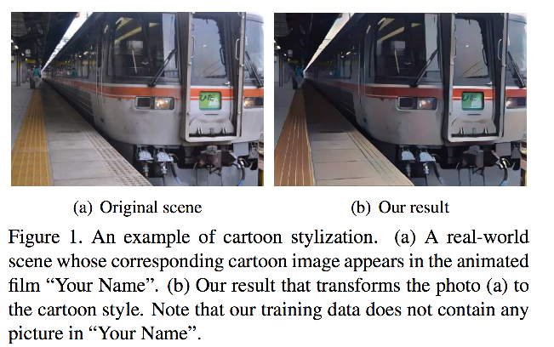
Introduction

Slide 4
Introduction
Motivation
Cartoon film <<Your Name>>
High level simplification and abstraction
Clear edges, smooth color shading and relatively simple textures

Slide 5
Introduction
Contribution
A dedicated CartoonGAN
Two simple effective loss functions
An initialization phase

Slide 6
Related Work
Non-photorealistic rendering (NPR)
Style transfer
GAN

Slide 7
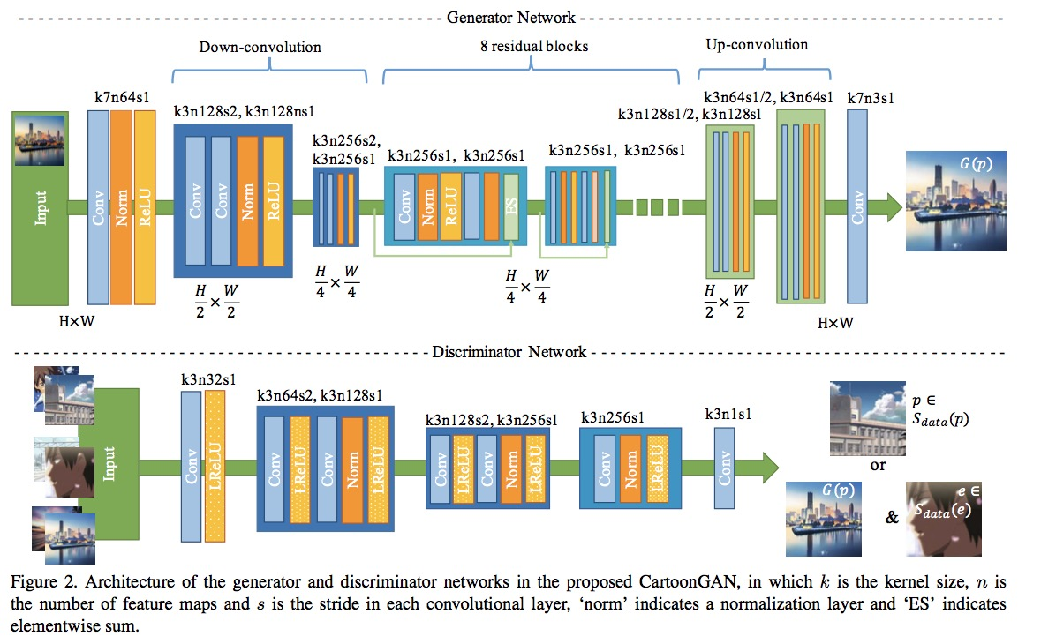
Architecture
无网络模型？？？

Slide 8
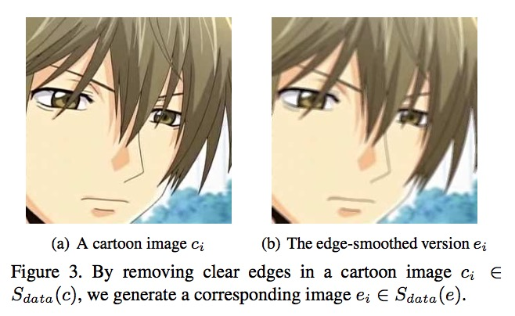
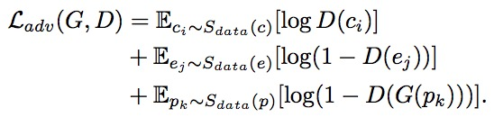

Architecture
Loss function
$L_{adv}(G,D)$

Slide 9


Architecture
Loss function
$L_{con}(G,D)$
Initialization phase

Slide 10
Experiments
Data
Photo
6153 images from Flickr
5402 images for training
Cartoon images
key frames of cartoon films
2000~4000 images for different style

Slide 11
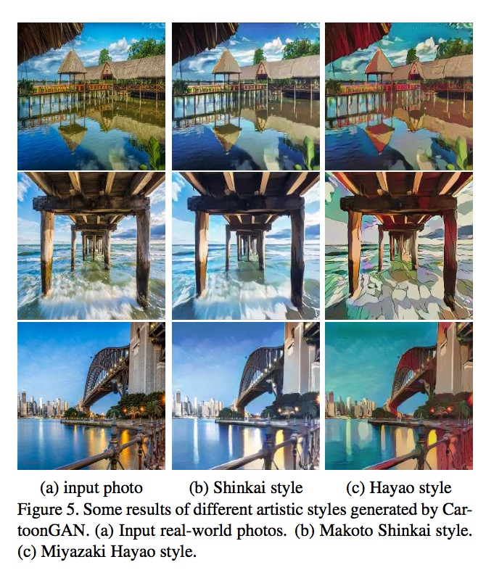
Experiments

Slide 12
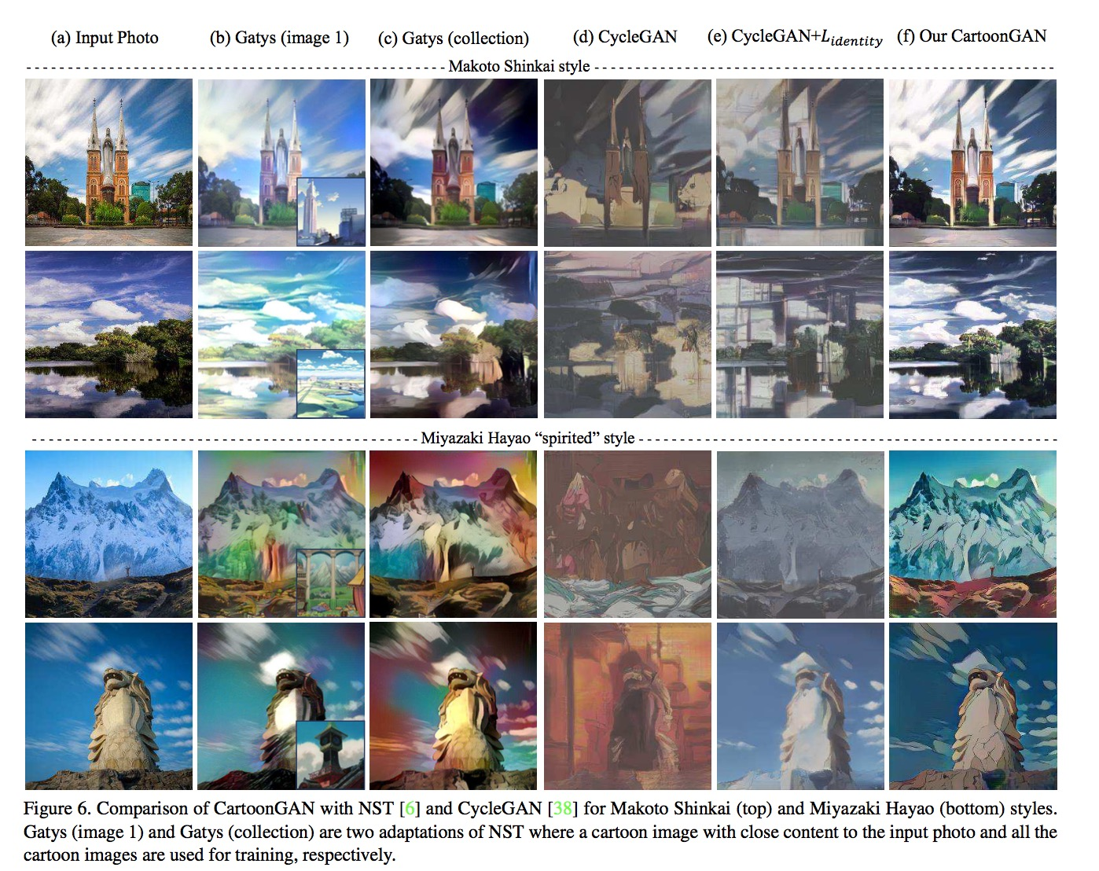
Experiments

Slide 13
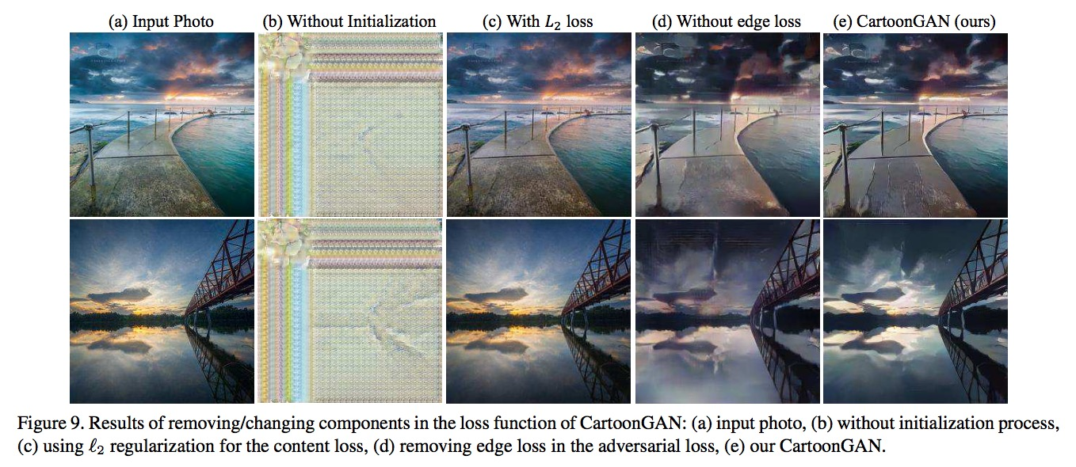
Experiment

Slide 14
Thanks

