Slide 1
Advanced Analytics Summer Intern Report
Wei Zhang

Slide 2
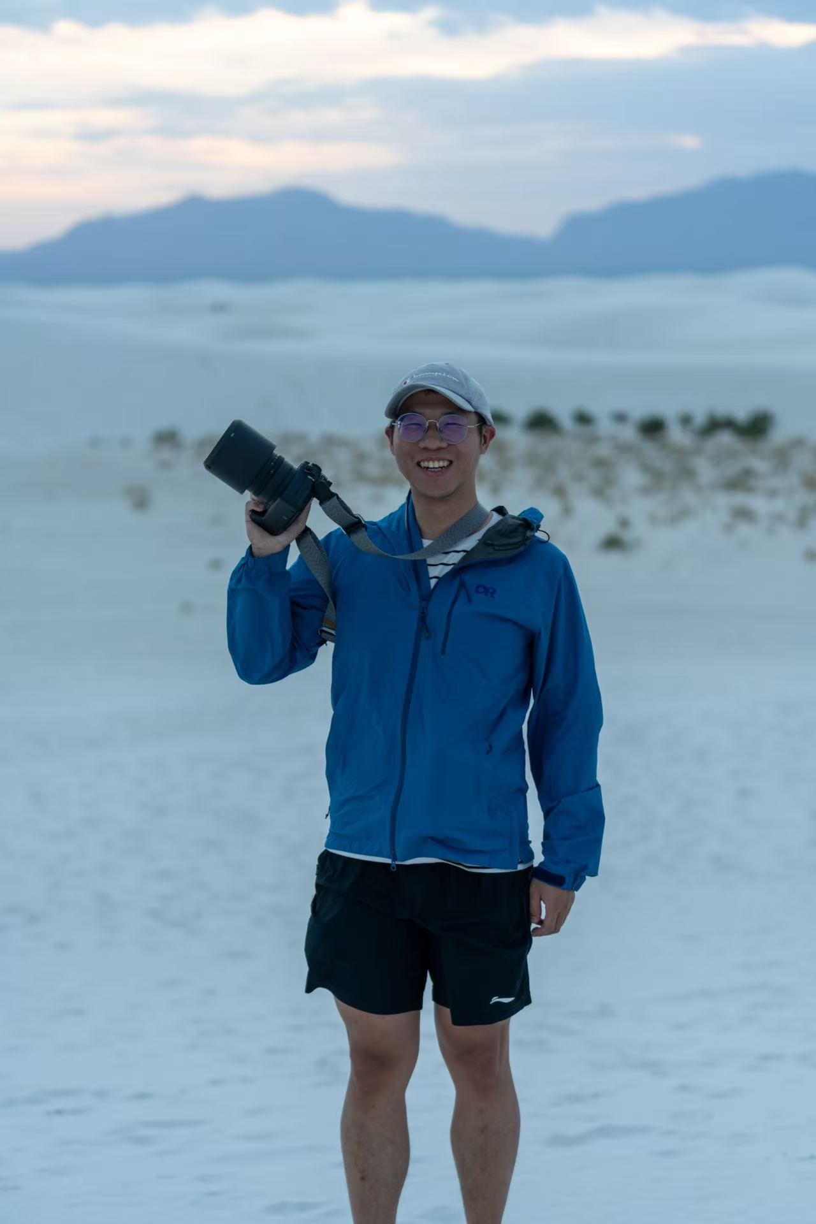

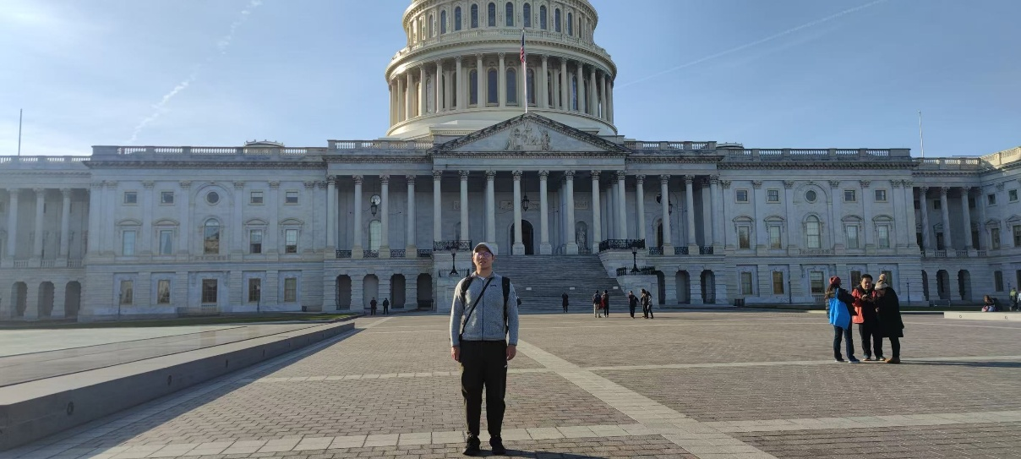
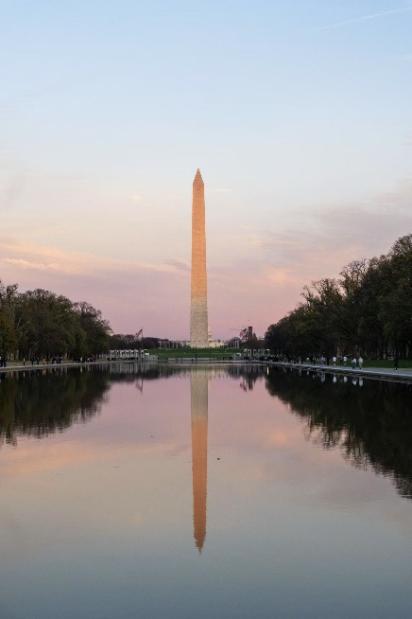
Wei Zhang
Wei Zhang
White Sand NP, 2023
Education
Bachelor in Geophysics and Computer Science, University of Science and Technology of China
Ph.D. candidate in Electrical and Computer Engineering, Boston University
Leisure
Badminton
Board games
Reading
Washington DC., 2024
Notes:
Intro to 3 projects

Slide 3
Outline
Summary for projects 1&2
Dive into the GPT project
  Background
  Objectives
  Results and Evaluation
  Conclusion and Future work
Notes:
Intro to 3 projects

Slide 4
Project 1, Objective: what changed from V4 to V5 in Cape data
the same 4.3 MM new images in April
V4 with features
: 3.9106 MM
V5 with features
: 3.9110 MM
166 features only in V4
71 common features
49 features
Only in V5
Features available both from V4 and V5 : ~3.9060 MM
120 features in V5.
237 features in V4
V4 and V5 data give different features. They look at the images differently.
Features with ‘hail’, ‘pool’, ‘zone’, ‘wildfire’, or ‘yard’ are not included in the current V5, but will be delivered in production.

Slide 5
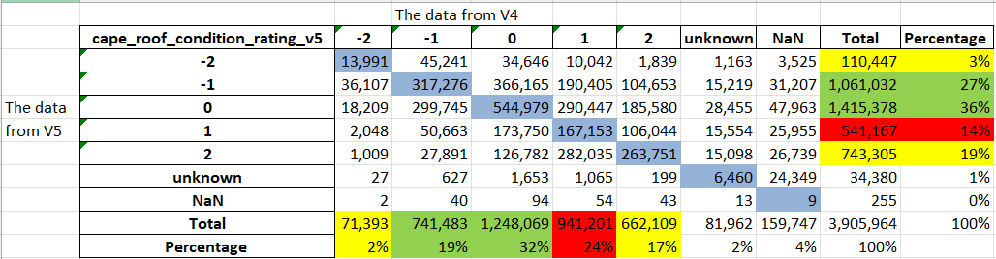
Results: cape_roof_condition_rating comparison for example
V5 compared with V4: reduced; steady; increased
Rating 1 has significant difference between V4 and V5, from 24% in V4 to 14 % in V5.
Other ratings show similar distributions. Rating 0 is the most common in both versions.
We are working on retro study with Cape to check which version is better.
Notes:
Greeen is more,
Red is less
Yellow similar
What features were lost do we care
-2 and -1 more accurate? Do we believe it.

Slide 6
Project 2, Objective: get driving distance and time to fire stations for 18 MM properties within a reasonable time.
Concurrent
route task
Concurrent table task
 | Route API (1x1, previously used) | Route with 3 threads | Table API (100x100) | Table with Asyncio | Table with 3 threads | Table with 3 processors
100 | 99.259 | 99.259 | 0.614 | - | - | -
1000 | 999.399 | 999.257 | 90.649 | Error, Too many request | 98.926 | 91.987
Time (s)
Sample (#)
Previous project suggests processing our 18 million properties would require ~ 2,500 hours (~3.5 months).
Table API submission and 4 concurrent pipeline jobs can reduce the running time to ~ 1 week.

Slide 7
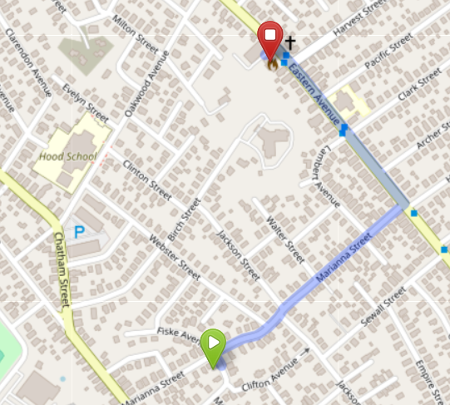
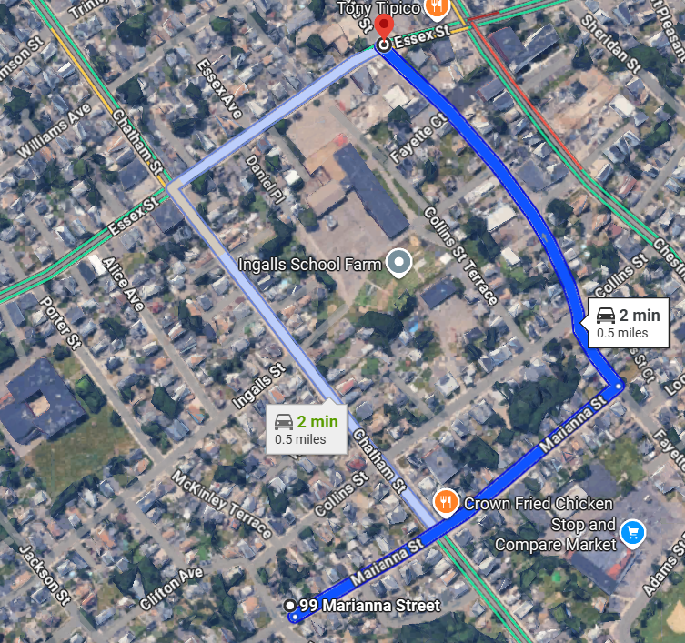
Results: example verification
Results of driving time and distance are in SharePoint, grouped by states:
  Home-DataScience - Documents - 2025InternSummer Driving distance for Prospect Table - All Documents
Codes are available on GitHub
  prac-home/HO_2025_SummerDriving-distance-for-Prospect-Table
  Ready for new data
Our logic Estimation:
Dist: 0.5 mile
Time: 1.2 min
Google Map driving time:
Dist: 0.5 mile
Time: 2 min
The estimated driving distances and times align with Google map results.

Slide 8
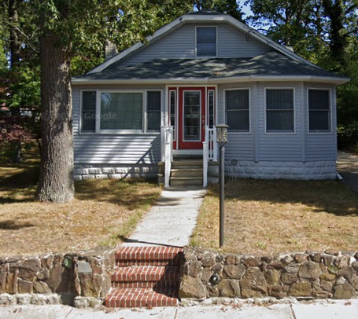
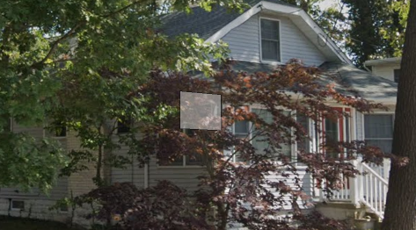
Project 3, Property Attributes Prediction Using AI
118 W Church St, Absecon, NJ 08201, Google Street View
Quantarium provides only ~27% residential property values (# of bedrooms and bathrooms) in New Jersey .
Our goal is to use the GPT to estimate the relative information.
Notes:
AI Property Attributes Prediction Using GPT)

Slide 9
Objective: estimate bedrooms and bathrooms using address only
We use a GPT model (gpt-4.1) to predict the number of bedrooms and bathrooms solely based on property address. We try to answer the following critical questions:
What prompts should be to used in GPT ?
Is GPT’s prediction accurate?
How robust is GPT’s prediction?
correct # of bedrooms?
format
distribution for different datasets
…
….
sentence
address
correct # of bathrooms?
consistent across multiple queries

Slide 10
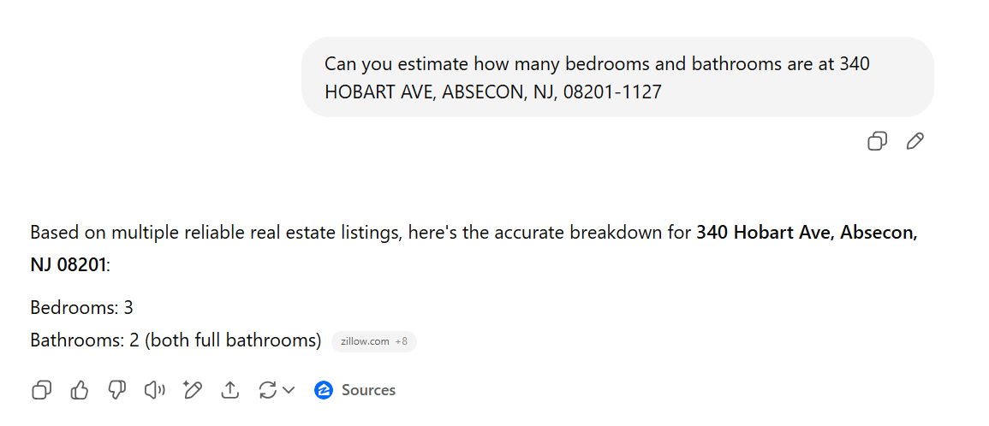
Questions prompts
Predicted bedrooms: 3 (Zillow gives 3)
Predicted bathrooms: 2 (Zillow gives 2)
Coding process:
  Use Python to submit the question to GPT and save the results as CSV file.

Slide 11
Results: bedrooms number difference from Quantarium
Total samples: 1000
Accuracy: 43.5%
84.0% prediction has difference <= 1.

Slide 12
Results: bathrooms number difference from Quantarium
Total samples: 1000
Accuracy: 31.8%
81.4% prediction has difference <= 1.

Slide 13
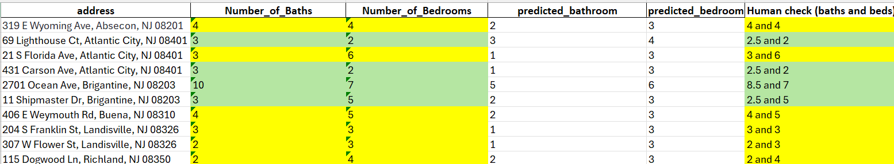
Evaluation: Quantarium has more accurate data
Quantarium
GPT
Manual verification
Quantarium correct;
Slight difference of Quantarium
GPT is less reliable compared with the Quantarium information.
Both Quantarium and GPT struggle to accurately handle the half bathroom.
Notes:
Green for less wrong and color code list

Slide 14
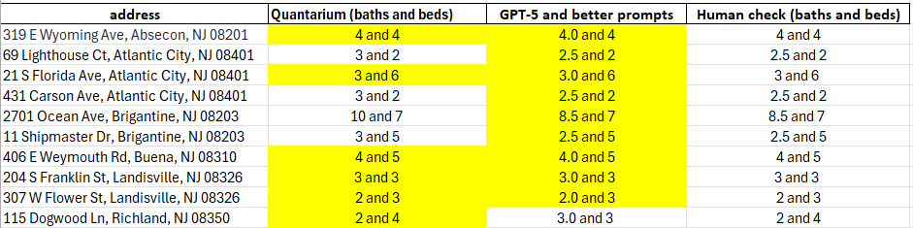
Evaluation: Better prompts and GPT-5 give correct prediction
Quantarium
GPT-5 and better prompts
Manual verification
correct
GPT reaches 9/10 accuracy with model gpt-5 and better prompts.
Notes:
Green for less wrong and color code list

Slide 15
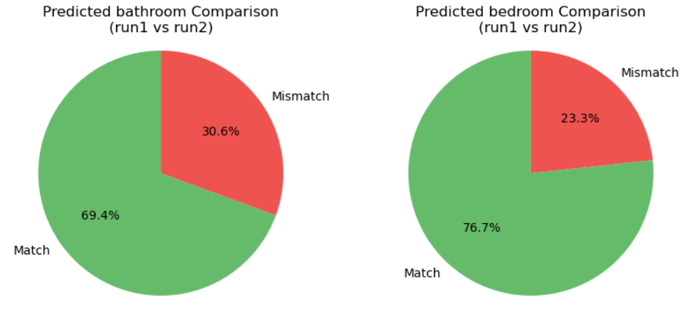
Evaluate: GPT gives relatively consistent results
96.2% predictions with errors within 1
98.3% predictions with errors within 1
We ran the queries (1000 samples) 5 times, with each time showing ~30% and ~23% difference in the number of bathrooms and bedrooms, respectively.
Over 95% of the predictions vary within ±1 across multiple queries.

Slide 16
Conclusion
More than 80% of GPT's predictions fall within a difference of 1 from the Quantarium data.
GPT (4.1) is less accurate than Quantarium but performs consistently across datasets and queries.
Future work
GPT takes ~110 tokens (¢ 0.1) and ~1.1 seconds per prompt, making it ~$2,000 for 2 MM properties in NJ.
Use GPT-5 and better prompts for predictions.

Slide 17
Thank you!
I’ve learned so much during my time here—both technical skills and business mindset. The company’s culture and environment are truly the best.
I’d like to sincerely thank everyone on the team and across the company, especially Shawn, Yi, Saurabh, and Scott, for their guidance and support.

Slide 18
Questions?

Slide 20
Results: V4 and V5 look at the same images differently
Whole common images:
~20.0 MM
the same 4.3 MM new images in April
V4 with features
: 3.9106 MM
V5 with features
: 3.9110 MM
V4 with features
: 16.1 MM
V5 with features: 16.6 MM
Features available both from V4 and V5 : ~3.9060 MM
Features available both from V4 and V5 : ~16.0 MM
Next we will compare some common features in this category
Notes:
0.6 M are both no features, 16.1 M are ok in V4, 16.5 M are ok in V5
V4 can produce features for 16.1 MM images
V5 can produce features for 16..6 MM images
The common part is 16 MM.
Both give the same numer with slightly different

Slide 21
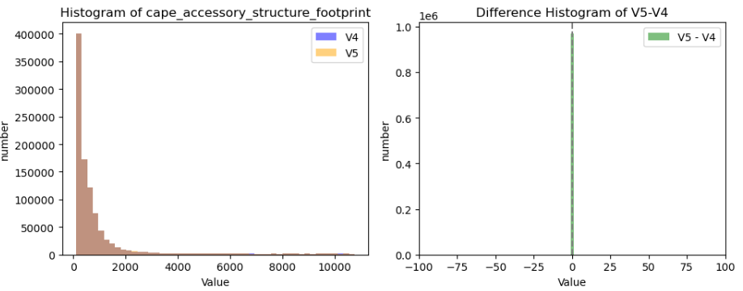
Results: cape_accessory_structure_footprint comparison
The continuous feature, cape_accessory_structure_footprint, displays the the same distribution.
0.1% data have value difference greater than 1.
Notes:
They are ['cape_accessory_structure_footprint_v4'] count 979967.000000 mean 992.120949 std 1750.109206 min 110.000000 25% 200.000000 50% 430.000000 75% 850.000000 max 10770.000000 Name: cape_accessory_structure_footprint_v4, dtype: float64

Slide 22
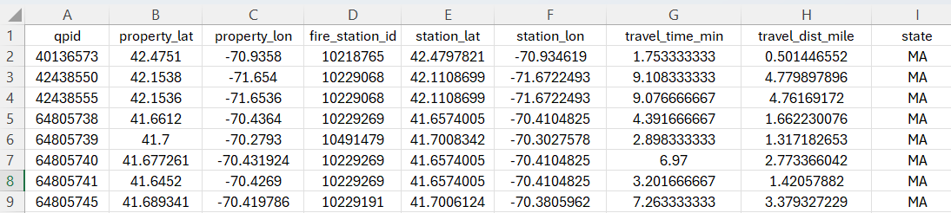
Results: properties to the nearest fire station
All 18 MM data are finished in 7 days.
From properties to the nearest fire stations in MA:
  Driving distance: 1.38 mile
  Driving time: 3.58 min

Slide 23
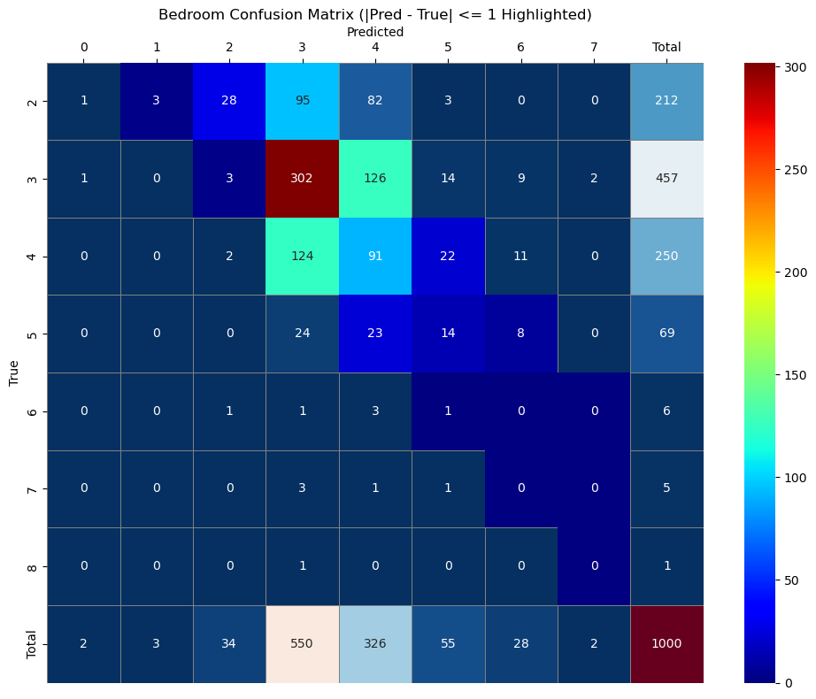
Predicted value
Results: bedrooms number confusion matrix
Total samples: 1000
|pred – true| <= 1 are highlighted
Quantarium value

Slide 24
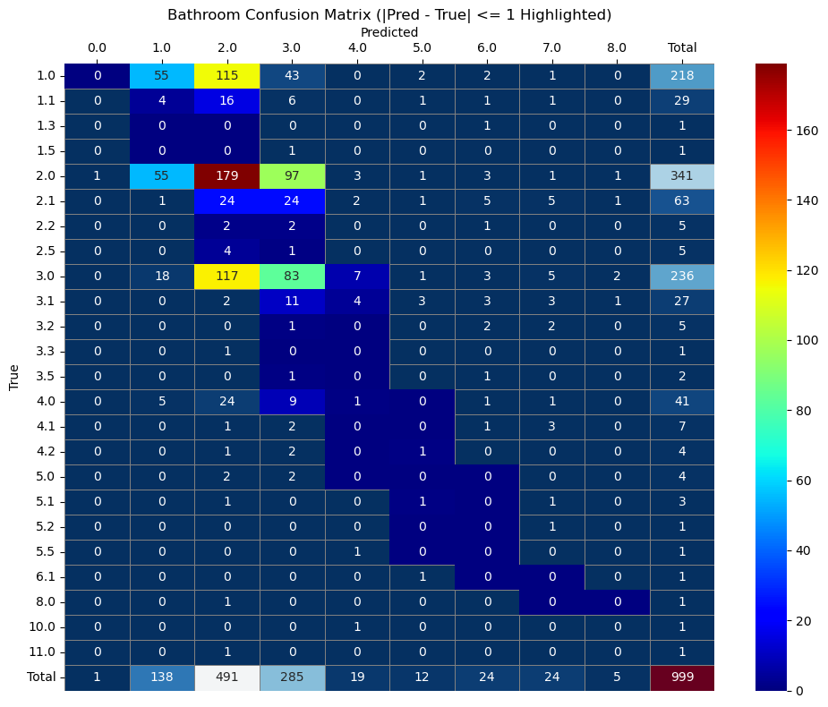
Results: bathrooms number confusion matrix
Total samples: 1000
Accuracy: 31.8%
81.4% prediction has erros <= 1.

Slide 25
Results: GPT gives similar distribution for different data
Dataset1
with Quantarium
Dataset2,
w/o Quantarium
For dataset with and without Quantarium information, GPT predicts similar results.

