Slide 1
Fall Intern: Cape V4V5 performance
Wei Zhang

Slide 2
Outline
Objectives
Model build
2. Results
3. Conclusion and Future work

Slide 3
Objective: V4 and V5 Cape data performance on model 1.40
Cape data has updated from Version 4 to Version 5 in 2025. We try to answer the following critical questions:
With selected features, how do V4 and V5 perform on Model 1.40 w/o cape prediction?
Gini score
….
Dual lift chart
How many matched samples between Cape and PRAC?
Size
Features
…
Do Cape V4 and V5 share the same features in May and July?
Common and unique features?
Distribution for the same features?
Lift chart

Slide 4
Cape V4 and V5 share similar features
Cape data show consistency both in May and July, except that May contains ‘effective_date’ while July contains ‘cape_run_dt’.
Features with ‘hail’, ‘pool’, ‘zone’, ‘wildfire’, or ‘yard’ are not included in Version 5, which Cape will deliver in production (not used).
Cape V5 gives some new roof features, such as ‘cape_roof_effluent_runoff’, ‘cape_roof_rusting’, ‘cape_roof_sealing’, etc.
33 features only in V4
70 common features
48 features
Only in V5
103 features in V4
118 features in V5.
Wei Zhang
Notes:
Property level variables , random foreset[ncat] , rule_rank performance[‘LR’]

Slide 5
PRAC loss samples are matched with Cape and baseline
Sample choices
Only HO3 and no highpoint.
Baseline (model score v1.40) samples are earlier than 2023-6.
Water fall of model samples selection
Wei Zhang
Notes:
Property level variables , random foreset[ncat] , rule_rank performance[‘LR’]

Slide 6
Cape V5 roof rating seems to have a better slope on PP
Exploratory Data Analysis (EDA) before modeling
Rating 1 has significant difference distribution between V4 and V5, from 26% in V4 to 18 % in V5.
Adj_PP is over $1,400 in V4 and $1,247 in V5.
Wei Zhang
Notes:
Property level variables , random foreset[ncat] , rule_rank performance[‘LR’]

Slide 7
Sample design follows DS standard procedure
Dataset | Total_Policies | Sum_EE | Overall PP_adj (NCAT_adj/EE) | Avg_EE_per_Policy (ee/#) | Overall Claim_Frequency_adj (ncat_cnt/ee) | Overall Avg_Severity_adj (ncat_adj/ncat_cnt) | Loss_Ratio_adj (NCAT_adj/EPRM)
Train (0.5) | 409,353 | 387,529 | $926.70 | 0.947 | 0.033 | $28,472.32 | 64.11%
Valid (0.2) | 175,438 | 166,166 | $1,015.06 | 0.947 | 0.033 | $30,852.16 | 70.10%
Test (0.3) | 248,953 | 235,599 | $882.60 | 0.946 | 0.033 | $26,600.99 | 60.99%
Year, state, legacy are stratified distributed.
The average severity and loss ratio of Test dataset is the least, which is still reasonable.
Wei Zhang

Slide 8
Selected features examples
We exclude id, address, time, source, url, and response relevant variables in our features (X).
Finally, there are 24 features used in V4, including 11 categorical ones. There are 33 features used in V5, including 16 categorical ones.
Some examples of V4 features:
Feature examples | Description
cape_roof_condition_rating | Cape roof rating, ranging from -2 to 2, with unknowns
cape_roof_condition_rating_confidence | Confidence of Cape_roof_condition_rating
cape_roof_material_degradation | Structural deterioration of the roofing material
Cape_roof_patching | W/ or w/o patching on roof
cape_roof_natural_discoloration | Amount of discoloration on the roof surface
Wei Zhang
Notes:
Property level variables , random foreset[ncat] , rule_rank performance[‘LR’]

Slide 9
Results: Cape V5 has higher Gini Score
Model | Train | Valid | Holdout
 | Gini Index |  | Gini Index | Gini Improvement
Baseline(Model 1.40) | 0.382 | 0.451 | 0.273 | /
Residual Xgboost with Cape V4 | 0.432 | 0.476 | 0.277 | +1.47%
Residual Xgboost with Cape V5 | 0.452 | 0.437 | 0.282 | +3.29%
Wei Zhang

Slide 10
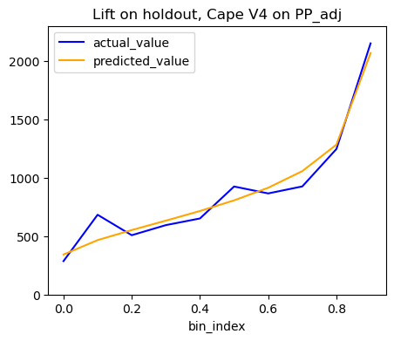
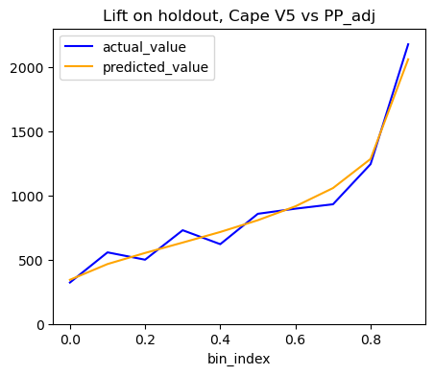
Results: Cape V5 has better performance on lift chart
Wei Zhang

Slide 11
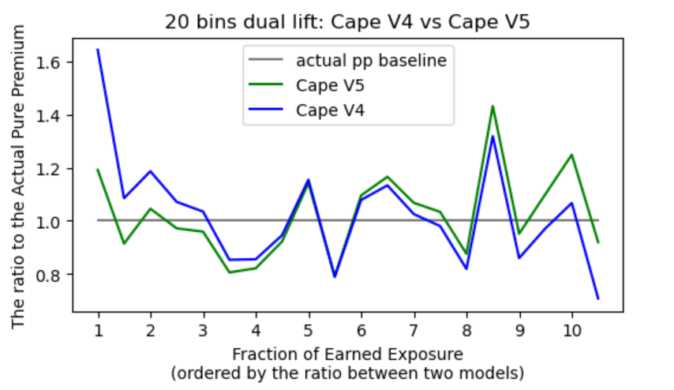
V5 has slightly better performance on standardized dual lift chart
Cape V5 has lower MAE (0.13) than V4 (0.15).
Wei Zhang

Slide 12
Conclusion
V4 and V5 images:
Similar data in May and July
Different features between V4 and V5 (deliver later)
Sanity check:
V5 has a better slope on roof_rating
Not use V4 only features for modeling
Modeling results:
V5 has a high score with 3.29% improvement.
V5 has a better lift chart and lower MAE.
Future work
More features from Cape
Incorporate into model 1.50
Model update

Slide 13
Thank you!
Finally, I’d like to thank everyone
in the team and in the company, especially Shawn and Yi for valuable suggestions.

Slide 14
Results: V4 model importance
Feature ImportancePct 0 cape_roof_ponding 10.57 1 cape_roof_material_degradation_reason 8.87 2 cape_accessory_structure_count 6.67 3 cape_roof_ponding_confidence 5.81 4 cape_accessory_structure_footprint 5.58 5 cape_accessory_structure_roof_condition_rating 5.46 6 cape_roof_patching_confidence 5.00 7 cape_primary_structure_longitude 4.66 8 cape_primary_structure_latitude 4.46 9 cape_roof_material_degradation_confidence 4.35 10 cape_roof_material_degradation_reason_confidence 4.22

Slide 15
Results: V5 model importance
Feature ImportancePct 0 cape_roof_ponding 5.25 1 cape_roof_ponding_confidence 4.56 2 cape_primary_structure_latitude 4.45 3 cape_roof_condition_rating_confidence 4.27 4 cape_accessory_structure_footprint 4.24 5 cape_roof_sealing_confidence 4.13 6 cape_accessory_structure_count 4.11 7 cape_primary_structure_longitude 4.09 8 cape_roof_streaking_confidence 3.97 9 cape_accessory_structure_roof_condition_rating 3.95 10 cape_roof_tarp_confidence 3.74

Slide 16
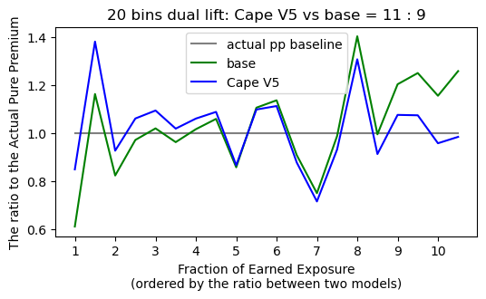
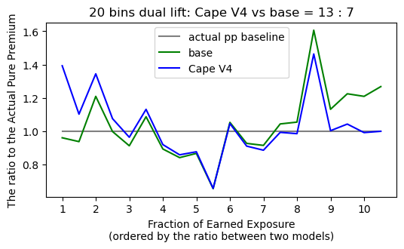
Results: dual lift chart vs base
--- Binned Calibration Metrics (from chart) --- base ('base’)
MAE (Avg. Miscalibration): 2.9064
Cape V5 ('pp_v5’)
MAE (Avg. Miscalibration): 2.3521
--- Binned Calibration Metrics (from chart) --- base ('base’)
MAE (Avg. Miscalibration): 2.9756
Cape V4 ('pp_v4’)
MAE (Avg. Miscalibration): 2.5560

Slide 17
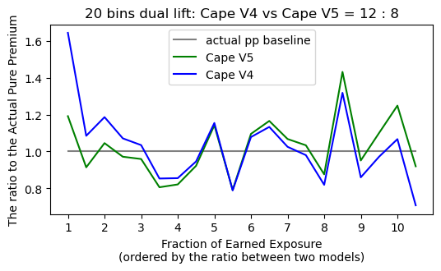

Slide 19
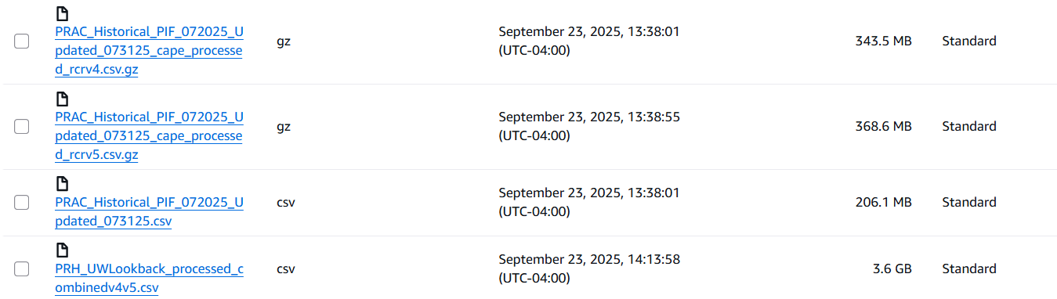
Objective: estimate bedrooms and bathrooms using address only
Check the following files and whether they are correct.
Cape sent back to us
Cape received from us

Slide 20
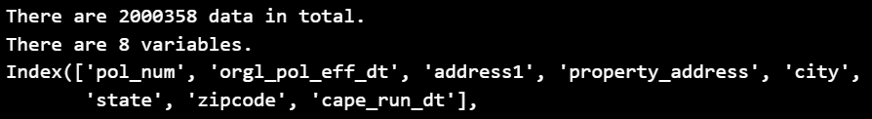
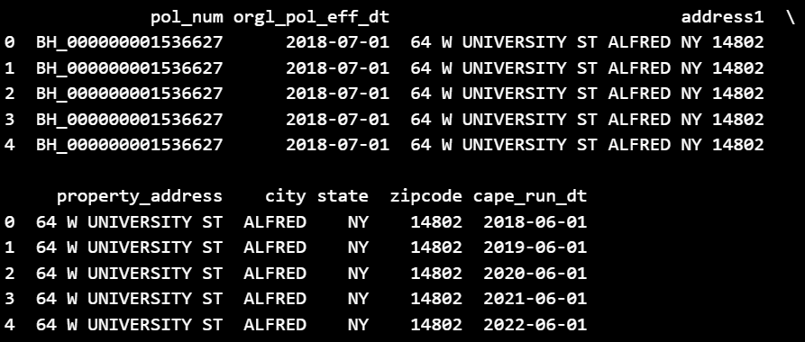

Cape received from us
Bo’s file
PRAC_Historical_PIF_072025_Updated_073125.csv
Number incorrect: should be 1 MM or 875K instead 2MM
Variables correct
First 5 samples correct

Slide 21
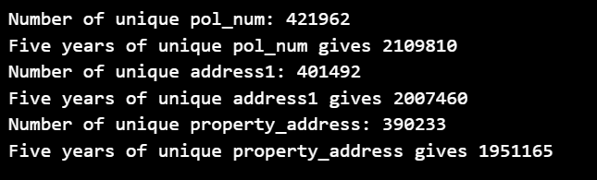
Check the unique variables
Bo’s file
Unique addresses are 400K, rather than 200K

Slide 22
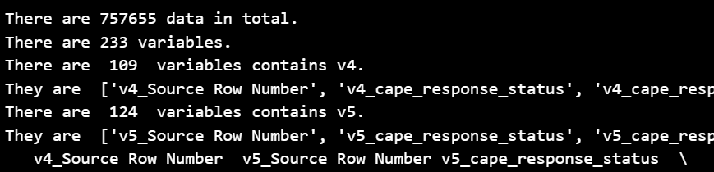
Cape received from us
Anh’s file (I was told) historical PIF data include “effective date”
PRH_UWLookback_processed_combinedv4v5.csv
Number incorrect: should be 2 MM
Variables incorrect: should not contain v4 or v5

Slide 23
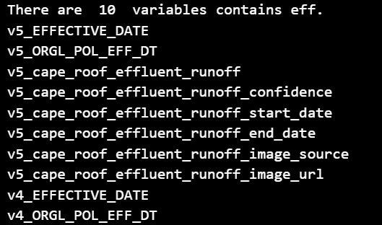







Check the keywords
Anh’s file: historical PIF data include “effective date”
This file may be Cape sent to us, and combined the V4 and V5 results.
But the number is only 750K and the total variables number not correct

Slide 24

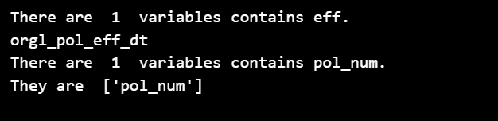


Cape send to us (V4 data)
PRAC_Historical_PIF_072025_Updated_073125_cape_processed_rcrv4.csv.gz
The number is the same as Bo’s file.
But Bo’s file should have been 1 MM or 875K.

Slide 25

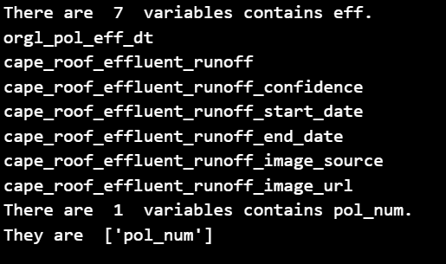

Cape send to us (V5 data)
PRAC_Historical_PIF_072025_Updated_073125_cape_processed_rcrv5.csv.gz

Slide 26
Creenshots for the 16 files in the directory
Locations of the files, why they are suspicious
( I can’t have accesss to Cape
( no keyword with run_date from Cape

