Slide 1
Summer Intern: Driving Distance for Prospect Table
Wei Zhang

Slide 2
Outline
1. Background
2. Objectives
3. Results and Evaluation
4. Conclusion and Future work

Slide 3
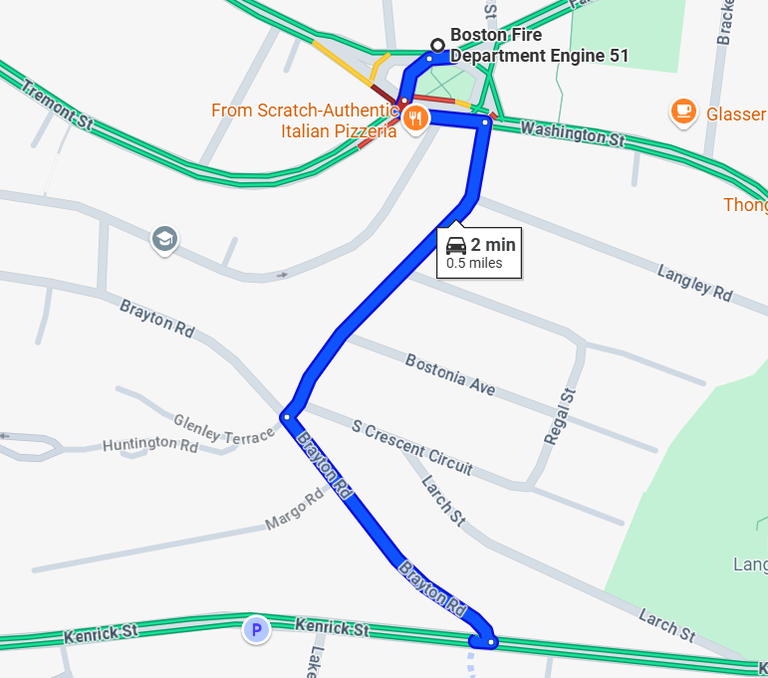
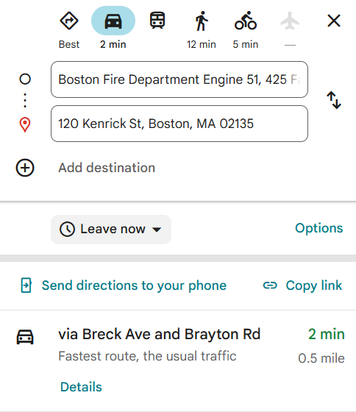
Business needs driving distance to fire station for PPC
Driving time and distance to the nearest fire station indicate how quickly a fire can be controlled, which is fundamental to insurance risk management.
Previous project suggests processing our 18 million properties would require ~ 2,500 hours.

Slide 4
Objective: get driving time and distance to fire stations for 18 MM properties within a reasonable time.
We use the OpenStreetMap Table API to estimate driving time and distance from 18 million properties to their nearest fire stations. Our analysis focuses on addressing the following key questions:
How can we speed up the previous codes?
How to handle 18 MM data within a week?
How robust is the algorithm?
Parallel computation?
Multi-processors?
Give the same answer?
…
….
Asyncio?
Pipeline?
Table API?
Multi-threads?
More workspaces?
Handle new data?

Slide 5
Four concurrent pipeline jobs can further reduce to ~1 week
Based on our observations, a single IP address can support up to 4 concurrent jobs. SageMaker pipelines won’t expire until the job finishes.
By running 4 concurrent pipelines, the actual wall-clock time is reduced by a factor of 22, and the total computational time by a factor of 10, compared to the previous project.
Prepare data for each job
Shortest route from properties to fire stations
Record results and merge chunks
Use KDTree to give 5 nearest fire stations to properties based on the address
Results follow the original property sequence.
….
Ask OpenStreetMap to obtain the best route.
Divide 18 million properties into chunks (300,000)
Each chunk requests using table API in 4 pipelines.
No NaN in results.

Slide 6
Project 2, Objective: get driving distance and time to fire stations for 18 MM properties within a reasonable time.
Concurrent
route task
Concurrent table task
 | Route API (1x1, previously used) | Route with 3 threads | Table API (100x100) | Table with Asyncio | Table with 3 threads | Table with 3 processors
100 | 99.259 | 99.259 | 0.614 | - | - | -
1000 | 999.399 | 999.257 | 90.649 | Error, Too many request | 98.926 | 91.987
Time (s)
Sample (#)
Previous project suggests processing our 18 million properties would require ~ 2,500 hours (~3.5 months).
Table API submission and 4 concurrent pipeline jobs can reduce the running time to ~ 1 week.

Slide 7
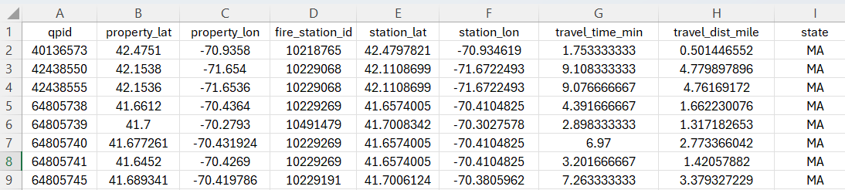
Results: properties to the nearest fire station
All 18 MM data are finished in 7 days.
From properties to the nearest fire stations in MA:
  Driving distance: 1.38 mile
  Driving time: 3.58 min

Slide 8
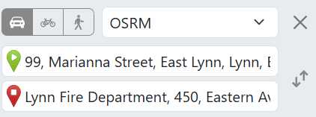
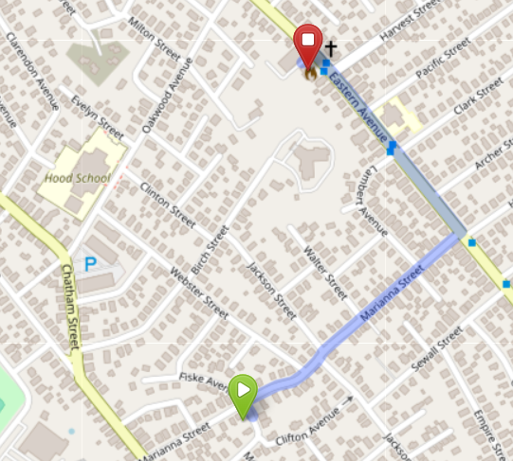
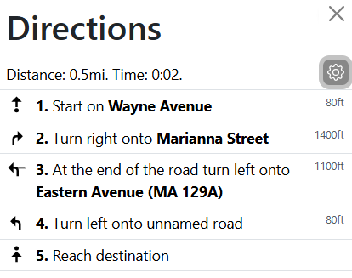
Results: estimation example from OpenStreetMap
 | Longitude (deg) | Latitude (deg)
Property | -70.9358 | 42.4751
Fire station | -70.934619 | 42.479782
Estimation: Dist: 0.5 mile, time: 0.02 hour (1.2 min)

Slide 9
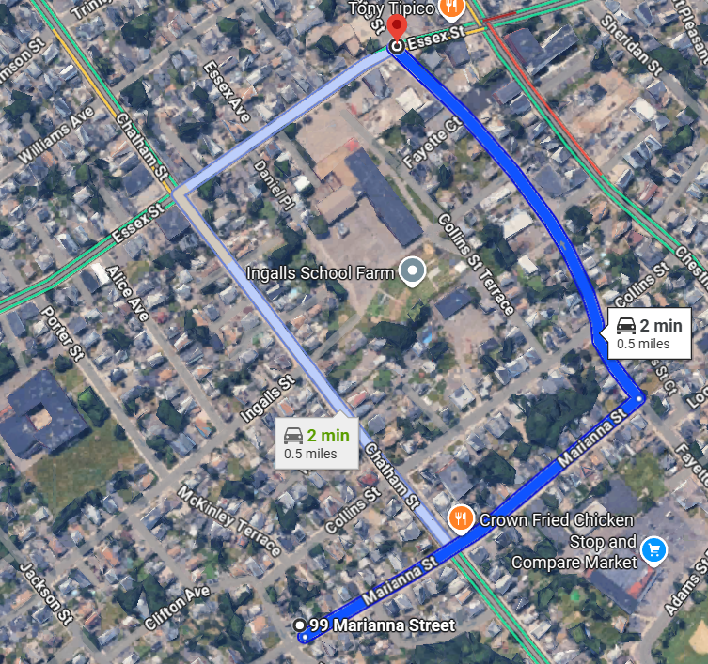
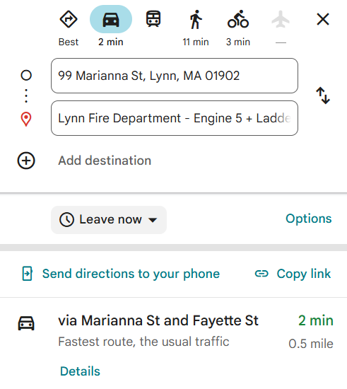
Results: verification against Google Map
OpenSteetMap Estimation:
Dist: 0.5 mile
Time: 1.2 min
Google Map driving time:
Dist: 0.5 mile
Time: 2 min

Slide 10
Results and code are ready!
Results of driving time and distance are in SharePoint, grouped by states:
Codes are available on GitHub
  prac-home/HO_2025_SummerDriving-distance-for-Prospect-Table
  Ready for new data
Home-DataScience - Documents - 2025InternSummer Driving distance for Prospect Table - All Documents

Slide 11
Conclusion
The actual wall-clock time is reduced by a factor of 22 (down to 7 days), and the total computational time by a factor of 10, compared to the previous project.
The estimated driving distances and times seem aligned with Google map results.
Future work
Multiple attempts have been made to deploy a local OpenStreetMap dataset, but the only feasible method requires installing Docker on the PC. This approach could bypass the IP blocking by the OpenStreetMap website.
Currently, properties and fire stations are grouped by state, meaning fire stations in neighboring states are not considered during distance estimation.

Slide 12
Thank you!
Finally, I’d like to thank everyone
in the team and in the company, especially Shawn and Yi.

Slide 13
Questions?

Slide 15
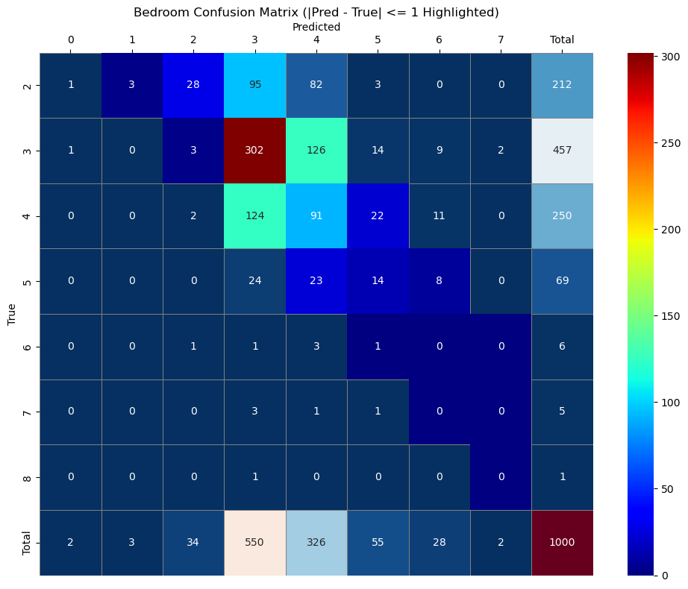
Predicted value
Results: bedrooms number confusion matrix
Total samples: 1000
|pred – true| <= 1 are highlighted
Quantarium value

Slide 16
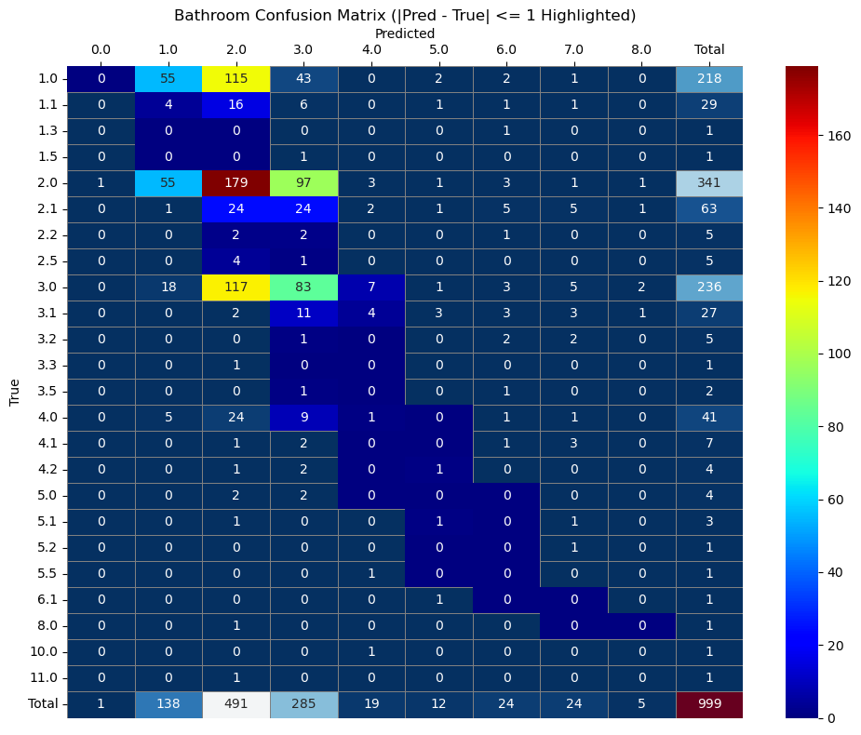
Results: bathrooms number confusion matrix
Total samples: 1000
Accuracy: 31.8%
81.4% prediction has erros <= 1.

